Slide 1
Potential Influence of Prior Experience in an Undergraduate-Graduate Level HPC Course
Chris Fietkiewicz, Ph.D.
Department of Electrical Engineering and Computer Science
Case Western Reserve University
Cleveland, Ohio

Slide 2
Outline
The class
Student performance
Conclusions

Slide 3
The class
EECS 438: High Performance Computing
Level | Number
PhD | 4
Master's | 6
Senior | 10
Junior | 2
Non-degree | 1
Total | 23

Slide 4
The class
EECS 438: High Performance Computing
Batch job processing
General optimization for sequential programming
Parallel programming using spawned (forked) processes
Parallel programming using OpenMP and multithreading
Parallel programming using OpenACC and GPUs
Parallel programming using message passing and MPI

Slide 5
Outline
The class
Student performance
Conclusions

Slide 6
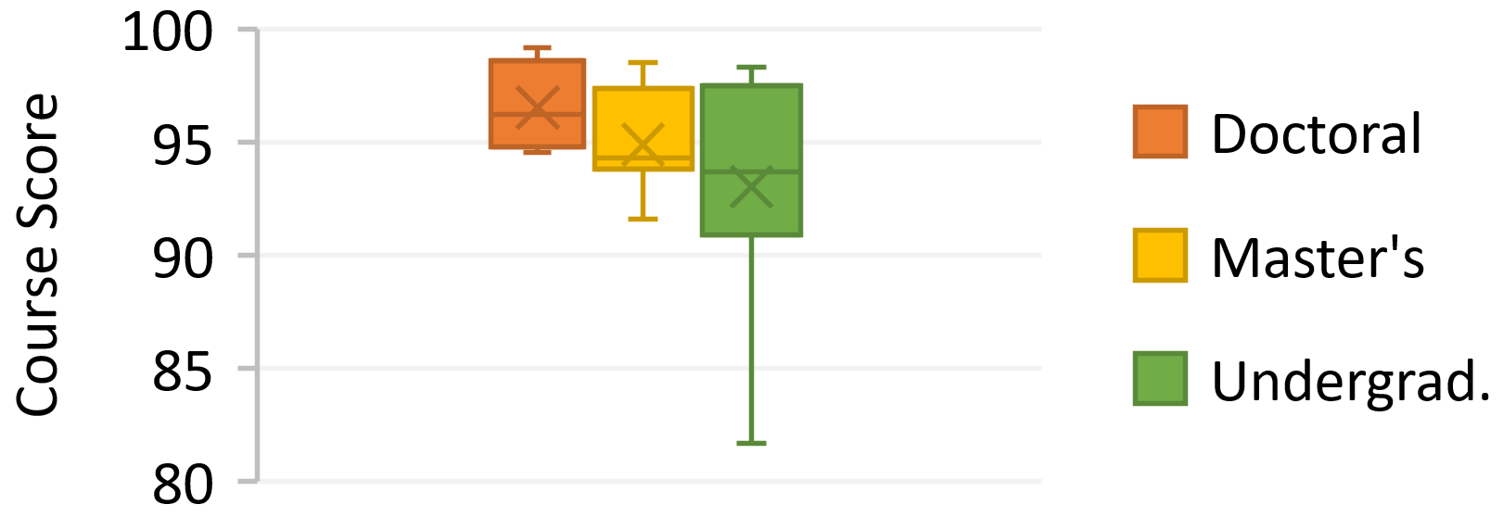
Student Performance
Course scores by academic experience. In this box-and-whisker plot, horizontal bars indicate quartiles, and the X indicates the mean.

Slide 7
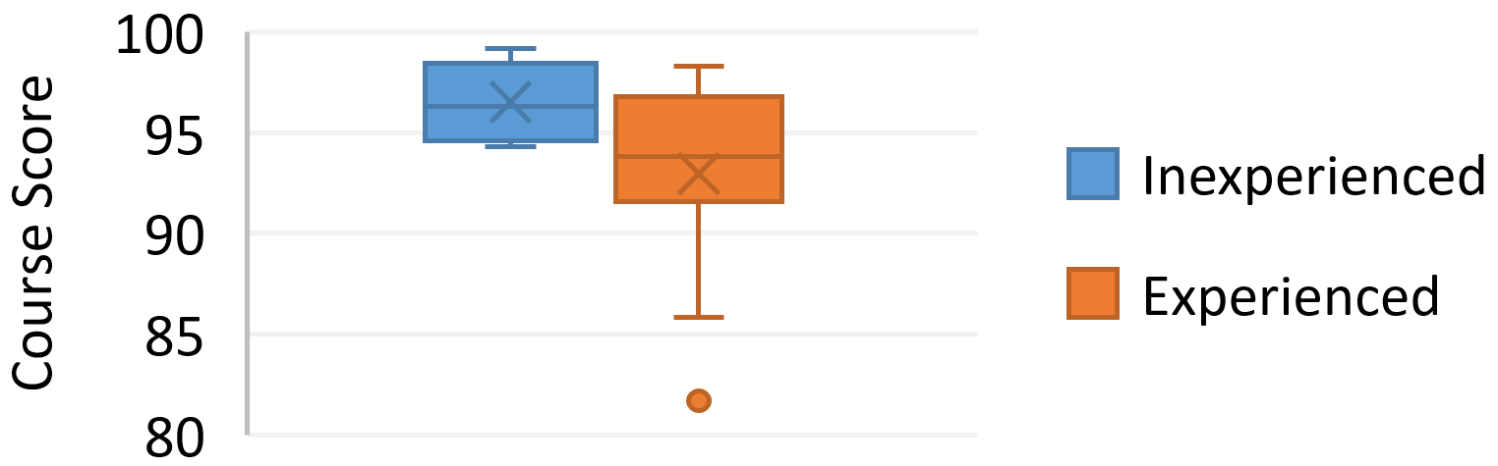
Student Performance
Course scores by technical experience. In this box-and-whisker plot, horizontal bars indicate quartiles, X indicates the mean, and the circle indicates an outlier.

Slide 8
Student Perceptions
Anonymous course evaluations
Overall rating of 4.09 on a scale of 1 – 5.
“The assignments he gave really helped me understand the content of this course and help me to understand how to implement it to any other algorithm out there. He also tells you what he expects to see in the report for each assignment.”

Slide 9
Outline
The class
Student performance
Conclusions

Slide 10
Conclusions
Performance correlated to academic experience
Performance not correlated to technical experience
Future: separate grad. student requirements, student surveys

Slide 11
Thank you!
High Performance Computing Resource in the Core Facility for Advanced Research Computing at CWRU
Organizers
Chris Fietkiewicz
email: chris.fietkiewicz@case.edu
website: tinyurl.com/chrisatcase

