Slide 1
Optimizing High Performance Distributed Memory Parallel Hash Tables for DNA k-mer Counting
Tony Pan, Srinivas Aluru
Institute for Data Engineering and Science
Georgia Institute of Technology
Sanchit Misra
Parallel Computing Laboratory
Intel Corporation

Slide 2
k-mer Counting
k-mer: a length k substring of a DNA/RNA sequence
  a.k.a. q-grams
k-mer counting computes the frequencies of occurrences of k-mers in a set of sequences
Useful in bioinformatics and computational linguistics
In bioinformatics
  Sequencing error detection and correction
  Repeat detection
  SNP detection
  and higher level tasks: genome assembly, comparative genomics, etc.
Typically computed via hash tables or sort-and-reduce
Notes:
Application -> data volume -> Kmerind implementation -> current performance

Slide 3
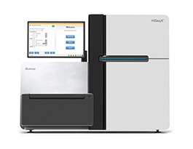
Next Generation Sequencing
Improvements in next generation sequencing has created a deluge of sequence data
Illumina’s HiSeq X Ten system
  Less than $1000 per human genome
  150 human genomes at 30x coverage per 3 day run
  Up to 18,000 human genomes per year
  Up to 1.8 tera-bases of sequence data every 3 days!
Illumina NovaSeq
  Up to 20 billion reads, 6 tera-bases per run
Distributed computation is necessary
for memory and computational scalability!

Slide 4
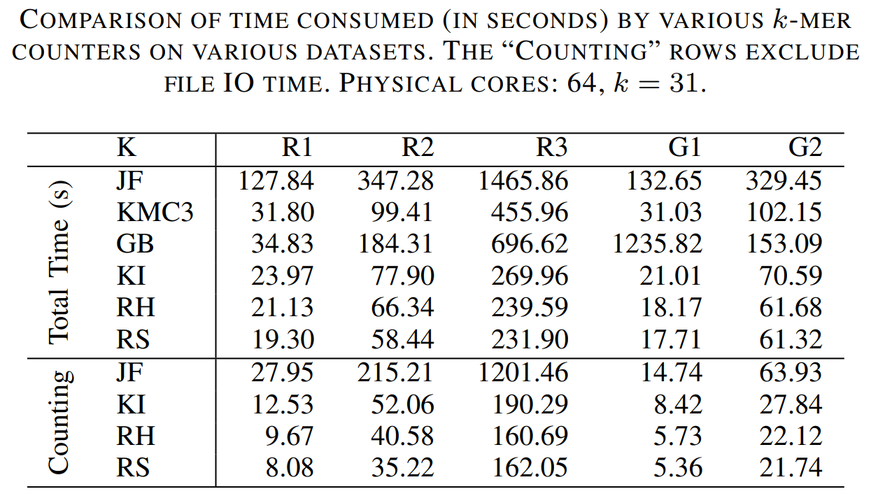
Kmerind
A distributed memory k-mer index library
Build on a 2 level distributed hash table
Bulk synchronous hash table operations: insert, query, erase, etc.
K-mer counting uses Google Dense Hashmap and Farm Hash
Significantly outperforms existing k-mer counters at 64 shared memory cores
Low core count performance not yet competitive
MPI_Alltoallv may affect scaling at high core count
Room for improvement!
Notes:
Other data sets (R1: strawberry 14.1gb, R2 chicken 116GB, R3, human 424.5GB)
Issues:
0.
1. scaling to 10^3 cores
2. Performance at low core count

Slide 5
Performance Factors
random access
collision
hash function
communication
Hash Function
Bucket Sort
All-to-all
K-mer
Map to process
via level 1 hash
Distribute
Insert in local hash map via level 2 hash
Hash Table Insertion: handle collision
Hash Table Insertion: access bucket
Hash Function
Hash Table Insertion
Compute
Random memory access: Latency
Memory Access + Compute
Communication
Cost
Notes:
Computation
Communication
Memory access holds up computation
Communication holds up computation

Slide 6
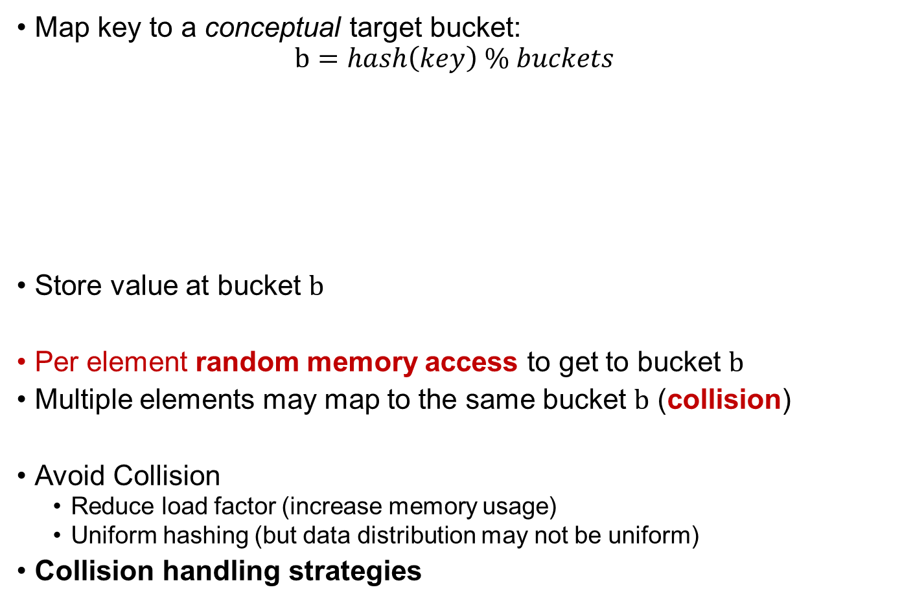
Hash Table Performance Factors
random access
collision
hash function
communication
Map key to a conceptual target bucket:
$$b=hash\left(key\right) \% buckets$$
Store value at bucket $b$
Per element random memory access to get to bucket $b$
Multiple elements may map to the same bucket $b$ (collision)
Avoid Collision
  Reduce load factor (increase memory usage)
  Uniform hashing (but data distribution may not be uniform)
Collision handling strategies
key
key
key
key
key
V
V
V
V
V
Notes:
TODO: consistently talk about insert/hash
TODO: consistently talk about collided elements/buckets

Slide 7
Random Memory Access
random access
collisions
hash function
communication
Bucket sort: insert into sorted array is random
Hash table: accessing conceptual bucket is random
Large table: unlikely a random bucket is in cache
Computation occurs only after memory load is complete
Haswell memory access latency: ~300 to 400 cycles
Solution: Batch Mode processing allows Software Prefetching
Pipelines and overlaps memory loads with computation
Prefetch between 8 to 16 elements is sufficient to hide latency
key
Key, V
Key, V
Key, V
V

Slide 8
Collision Handling Strategies
random access
collisions
hash function
communication
Collision: multiple keys map to the same conceptual bucket
Collision Handling determines
  Physical location to insert or search collided elements
  Traversal pattern
Chaining
  Linked lists
Open Addressing
  Linear reprobing
  Quadratic reprobing
  Double hashing
  Hopscotch
  …
key
key
key
key
key
V
V
V
V
V
reprobes = 0, 0 , 1, 2, 4
key
key
key
key
key
key
key
key
key
d=1
d=2
d=4
d=3
Notes:
Each memory load uses 64bytes
Each memory load that is not in cache takes 300 to 400 cycles
Hardware prefetching works with contiguous memory loads
Software prefetching
Illustrate memory access patterns
Linked list: Random memory accesses, cache line utilization low
Linear reprobe: Contiguous memory access, compares elements from other buckets
Quadratic reprobe: Not hardware-prefetchable, cache line utilization low
Double Hashing: Not hardware-prefetchable, cache line utilization low
HopScotch: Contiguous, fixed size memory access, compares elements from other buckets

Slide 9
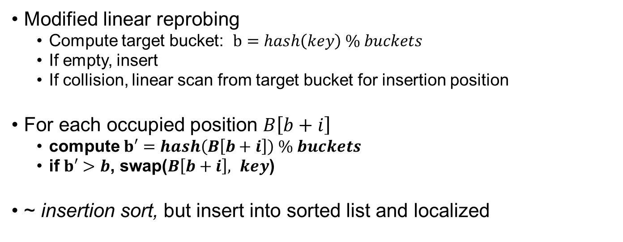
Collision Handling: Robin Hood (Celis 1986)
random access
collisions
hash function
communication
reprobes = 3, 0, 1, 2, 1
key
key
key
key
key
key
key
key
key
d=1
d=1
d=3
d=2
Modified linear reprobing
  Compute target bucket: $b=hash\left(key\right) \% buckets$
  If empty, insert
  If collision, linear scan from target bucket for insertion position
For each occupied position $B\left[b+i\right]$
  compute $b′=hash\left(B\left[b+i\right]\right) \% buckets$
  if $b′>b$, swap($B\left[b+i\right], key$)
~ insertion sort, but insert into sorted list and localized
Notes:
Let’s look at one algorithm that gets close.

Slide 10
Collision Handling: Robin Hood
random access
collisions
hash function
communication
Linear reprobes = 0, 0 , 1, 2, 4
reprobes = 3, 0, 1, 2, 1
key
key
key
key
key
key
key
key
Reprobe benefits vs linear reprobing
  Worst case reprobe distance is lower (4 -> 3)
  Reprobe distance variance is lower (2.8 -> 1.3)
  Expected query performance increases
Memory access benefits
  Bucket elements are grouped together, contiguously in memory
  Reduced number of memory loads
  Maximal cache line reuse
  possible hardware prefetching
But hashing per key compared to find bucket boundaries
And swap elements

Slide 11
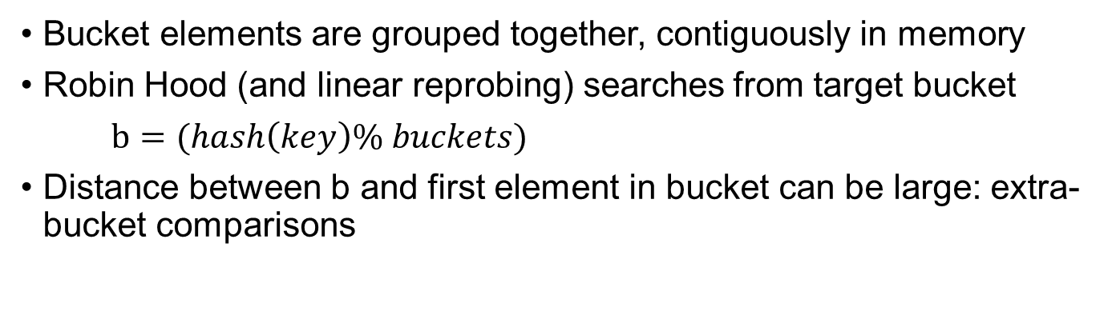
Improving Robin Hood
random access
collisions
hash function
communication
Bucket elements are grouped together, contiguously in memory
Robin Hood (and linear reprobing) searches from target bucket
$b=(hash\left(key\right)\% buckets)$
Distance between b and first element in bucket can be large: extra-bucket comparisons
key
key
key
0
1

Slide 12
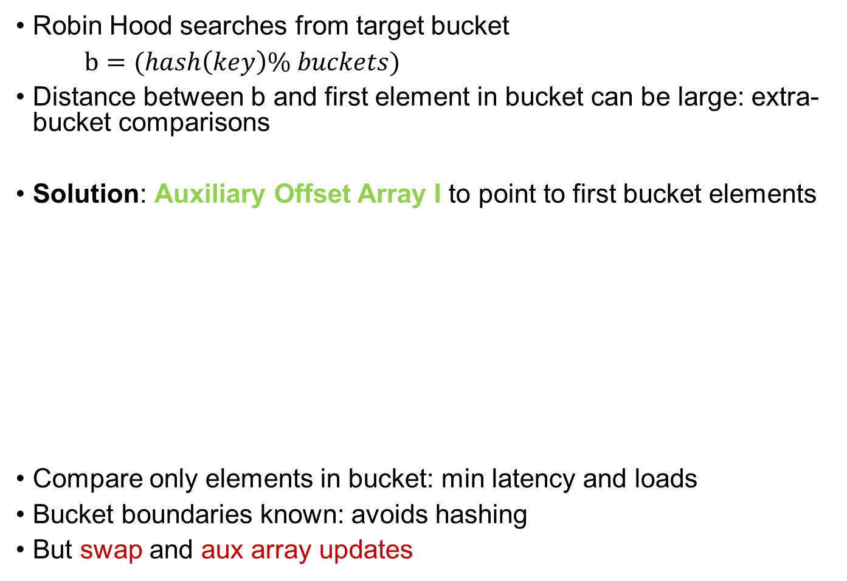
Improving Robin Hood
random access
collisions
hash function
communication
Robin Hood searches from target bucket
$b=(hash\left(key\right)\% buckets)$
Distance between b and first element in bucket can be large: extra-bucket comparisons
Solution: Auxiliary Offset Array I to point to first bucket elements
Compare only elements in bucket: min latency and loads
Bucket boundaries known: avoids hashing
But swap and aux array updates
key
key
key
0
6
Notes:
So far, we’ve
chosen a hashing scheme that minimizes latency and maximize cache line reuse
Further optimized it by reducing memory bandwidth needs and number of loads

Slide 13

Radix-sort Map
random access
collisions
hash function
communication
Inspired by Robin Hood hashing: ~ sorting by $(hash\left(key\right)\% buckets$)
Insertion: if $\left(hash\left(B\left[b+i\right]\right)\% buckets\right)>b$,
  swap($B\left[b+i\right], key$) and update auxiliary array
Lazy-sorting algorithm
  Hashing assigns keys to bins
  Append key-value tuples to bin
  If bin full, radix sort by bucket id, reduce by key (if still full, use overflow bins)
Finalize
  Radix sort and reduce for each bin
  Compute auxiliary array, offsets within bin
key
key
key
key
key
key
key
key
key
0
2
2
3
4
6
6
6
0
2
3

Slide 14
Radix-sort Map
random access
collisions
hash function
communication
Benefits
Maintains benefits of Improved Robin Hood hashing for query
  Min latency and loads, max cache line reuse, min bandwidth
Auxiliary array constructed at the end of insertions
Replaced swap (~ insertion sort) with a single write + lazy radix sort
Insertion at end of bin:
  1 cache line per bin, last cache line of all bins are likely in cache
Small bins
  Single radix sort iteration is enough
  Large portion of a bin in cache during radix sort

Slide 15
Hash Table Performance
random access
collisions
hash function
communication
Insert: RS vs Densehash: 1.56X to 3.17X
Find RH vs Densehash: 3.1X to 4.7X
Notes:
Insert batches of 4M, measure cumulative insertion time and memory usage
Query batches of 4M, measure query time for 4M batch
Why the high memory usage for RS?
count
Insert rate: 32+32 bit, 64 cores, MPI with overlap, unique elements 944M/s, 8 repeat 1337M/s
Query rate: 32+32, unique: 877M/s MPI with overlap, 8 repeat 1472M/s

Slide 16
Vectorized Hash Function
random access
collisions
hash function
communication
Focus on general purpose hash functions
String hashing designed for hashing individual long strings/byte sequences: Murmur, City, Farm, CLHash, etc.
K-mers are relatively short, fixed length, and numerous (batch mode)
MurmurHash: MUltiply, Rotate a 32-bit block of a string, mix with intermediate results, repeat for all 32-bit blocks
AVX2 vectorization
  Load and process 8 k-mers concurrently
  Multiply, rotate, and mix 8x32-bit vectors
ACGTATGCA
CGTATGCAA
GTATGCAAC

Slide 17
SIMD Murmur 3 Performance
random access
collisions
hash function
communication
Vs Sequential Murmur3
4 bytes
  6.6x for 32 bit, 6x for 128 bit
For DNA 31-mer, 8 bytes needed
  5x for 32 bit, 3.4x for 128 bit
Notes:
No change in complexity, but reduced constant factor
Extremely fast general purpose MURMUR 3 hash function implementation for short keys
6.5x at 2,
6.6x at 4 for 32 bit
5x at 8
128 bit:
2: 6.27
4: 6x
8: 3.4x

Slide 18
Shared Memory Improvements
random access
collisions
hash function
communication
64 cores shared memory system, DNA 31-mers, Bumble Bee (75 GB)
2.1X
1.8X
3.3X
3.4X
Notes:
Insert: RS: prefetch 58%, 18.7%, 8.5%: 2.1x
RH: 48.7%, 18%, 3.8% 1.8x
Find: RS: 96.4%, 40%, 15.3%, 3.2%: 3.3x
RH: 97%, 45.1%, 10.2%, 7.2%: 3.4x

Slide 19
Comparisons with k-mer counter
1.6X to 1.97X speed up vs KMC 3
Notes:
Other data sets (R1: strawberry 14.1gb, R2 chicken 116GB, R3, human 424.5GB)

Slide 20
Distributed Memory Strong Scaling
random access
collisions
hash function
communication
Notes:
512 core: 2.6x and 4.4x for insert and find using overlapped comm
4096: 2.15x and 2.6x for insert and find.
Large wait time at 4096: partitioning showed a 2.1% standard deviation, which causes compute and memory access imbalance that propagated to communication
Strong Scaling: message size decreases, so latency dominates at high core count. MT helps.

Slide 21
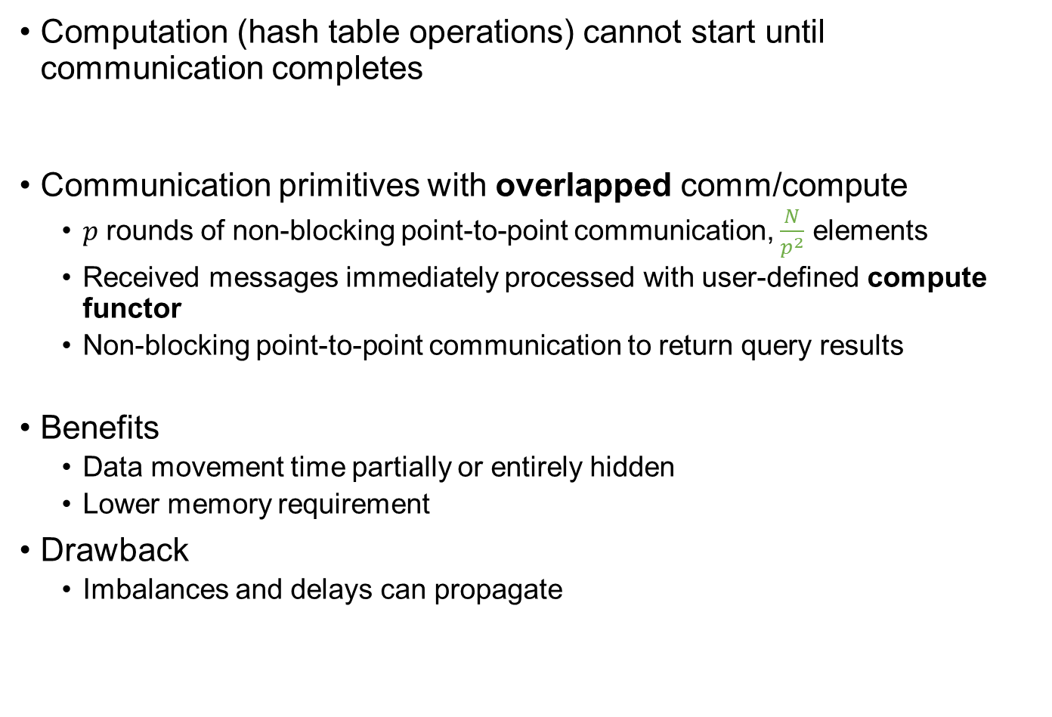
Communication Optimization
random access
collisions
hash function
communication
Computation (hash table operations) cannot start until communication completes
Reducing cost of $μ\frac{N}{p}$ in $O\left(τp+μ\frac{N}{p}\right)=O\left(τp+μ\left(\frac{N}{p^{2}}\right)p\right)$
Communication primitives with overlapped comm/compute
  $p$ rounds of non-blocking point-to-point communication, $\frac{N}{p^{2}}$ elements
  Received messages immediately processed with user-defined compute functor
  Non-blocking point-to-point communication to return query results
Benefits
  Data movement time partially or entirely hidden
  Lower memory requirement
Drawback
  Imbalances and delays can propagate
Notes:
Large messages -> long transit time -> idle processors
Benefits:
1. Reduce p to p’ for latency
2. law of large numbers – more balanced communication size
3. overlap comm with comp
4. per core memory access to a the thread local hash table, smaller so more cache coherent
MPI_Alltoallv for large messages: $p$ iterations, non-blocking point-to-point communication within each iteration
Apply functor to each received message for computation
Using xor to compute communicating pairs of processors in each iteration, if $p=2^{n}$
Advantages:
Generic interface for overlapping Alltoallv and computation
Lower memory requirement, receive buffer reused
Disadvantages:
Imbalance in computation time in an iteration propagates in time and to other processors
Advantage:
No fine-grain synchronization between cores
Minimal overhead for partitioning
No change in local hash table API and implementation
No change in distributed hash table API, minimal implementation changes

Slide 22
Distributed Memory Strong Scaling
random access
collisions
hash function
communication
Notes:
512 core: 2.6x and 4.4x for insert and find using overlapped comm
4096: 2.15x and 2.6x for insert and find.
Large wait time at 4096: partitioning showed a 2.1% standard deviation, which causes compute and memory access imbalance that propagated to communication
Strong Scaling: message size decreases, so latency dominates at high core count. MT helps.

Slide 23

MPI_Alltoallv Scalability
Imbalances do propagate – imbalanced point-to-point message sizes
Latency increases with $p$
duce $τp$ in $O\left(τp+μ\frac{N}{p}\right)$: $p′$ MPI processes, 1 per socket
Hybrid MPI OpenMP with thread-local hash tables
  1 MPI process per socket, 1 local hash table per core
  Partition data to $cp^{′}=p$ partitions, 1 per core
  Communicate $c$ partitions to each MPI process
  Perform local hash table operations, 1 partition per core
Benefits
  Communication latency scales with $p′$
  Per process message size is better balanced
  Thread-local hash table is better cached and does not require synchronization
Drawbacks
  Larger message size
random access
collisions
hash function
communication
Processor i
Core j
Notes:
Large core count -> high latency
Benefits:
1. Reduce p to p’ for latency
2. law of large numbers – more balanced communication size
3. overlap comm with comp
4. per core memory access to a the thread local hash table, smaller so more cache coherent
MPI_Alltoallv for large messages: $p$ iterations, non-blocking point-to-point communication within each iteration
Apply functor to each received message for computation
Using xor to compute communicating pairs of processors in each iteration, if $p=2^{n}$
Advantages:
Generic interface for overlapping Alltoallv and computation
Lower memory requirement, receive buffer reused
Disadvantages:
Imbalance in computation time in an iteration propagates in time and to other processors
Advantage:
No fine-grain synchronization between cores
Minimal overhead for partitioning
No change in local hash table API and implementation
No change in distributed hash table API, minimal implementation changes

Slide 24
Distributed Memory Strong Scaling
2.6X
2.2X
4.4X
2.6X
Notes:
512 core: 2.6x and 4.4x for insert and find using overlapped comm
4096: 2.15x and 2.6x for insert and find.
Large wait time at 4096: partitioning showed a 2.1% standard deviation, which causes compute and memory access imbalance that propagated to communication
Strong Scaling: message size decreases, so latency dominates at high core count. MT helps.

Slide 25
Distributed Memory Weak Scaling
2.9X
2.1X
4.1X
3.7X
Notes:
512 cores: speed up 2.9x and 4.1x for insert and find
4096 cores: speed up of 2.06x and 3.7x
Large message sizes - > MT is not good. OV is better.

Slide 26
Summary
Optimized distributed memory hash table for k-mer counting
  Sequential hash tables that minimize memory bandwidth and latency
  AVX2 vectorized Murmur3 hash functions
  Communication optimization
Between 2.1X and 2.9X speed up for insert, 2.6X and 4.4X for query on distributed memory system
General purpose, reusable components, not limited to k-mer counting
Support: NSF IIS-1416259, NSF CCF-1361053, and Intel Parallel Computing Center on Big Data in Biosciences and Public Health

Slide 27
Intel Legal Disclaimers
Intel, Xeon and Intel Xeon Phi are trademarks of Intel Corporation or its subsidiaries in the U.S. and/or other countries. Other names and brands may be claimed as the property of others. © Intel Corporation
Software and workloads used in performance tests may have been optimized for performance only on Intel microprocessors. Performance tests, such as SYSmark and MobileMark, are measured using specific computer systems, components, software, operations and functions. Any change to any of those factors may cause the results to vary. You should consult other information and performance tests to assist you in fully evaluating your contemplated purchases, including the performance of that product when combined with other products. For more information go to www.intel.com/benchmarks.
Benchmark results were obtained prior to implementation of recent software patches and firmware updates intended to address exploits referred to as "Spectre" and "Meltdown". Implementation of these updates may make these results inapplicable to your device or system.

Slide 28
Questions?

