Slide 1
Accelerating Quantum Chemistry with Batched and Vectorized Integrals
Hua Huang, Edmond Chow
Georgia Institute of Technology
November 14th, 2018

Slide 2
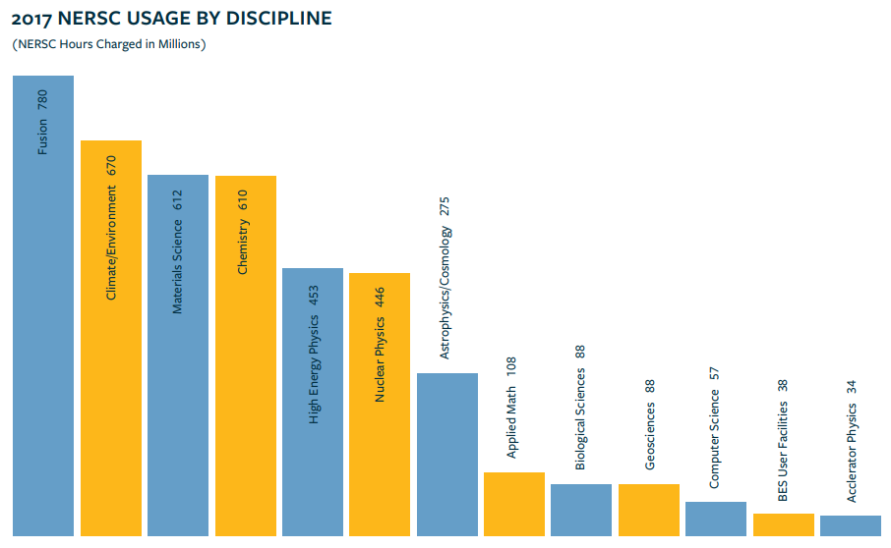
Quantum Chemistry Calculation: “Hotspot”
Material
Science
Chemistry
Source: NERSC 2017 annual report: https://www.nersc.gov/assets/Uploads/2017NERSC-AnnualReport.pdf

Slide 3
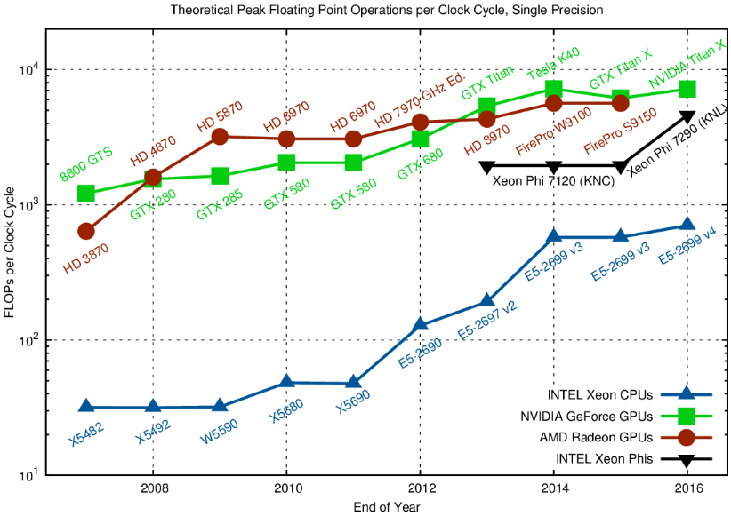
Vectorization
Software must exploit SIMD vectorization to obtain high performance
ISA | SIMD width | FP32 / Cycle
SSE 4 | 128 bits | 8 (no FMA)
AVX | 256 bits | 16 (no FMA)
AVX-2 | 256 bits | 32 (with FMA)
AVX-512 | 512 bits | 64 (with FMA)
+AVX2
+AVX
Source: https://www.karlrupp.net/2013/06/cpu-gpu-and-mic-hardware-characteristics-over-time/

Slide 4
Vectorization
Vectorizable loop:
One SIMD word
double *x, *y, alpha;
for (int i = 0; i < 1024; i++)
x[i] += alpha * y[i];
x:
……
i=0
i=1023
“Horizontal vectorization”
double *x0, *x1, *x2, *x3;
double *y0, *y1, *y2, *y3;
for (int i = 0; i < 1024; i++) {
x0[i] += alpha * y0[i];
x1[i] += alpha * y1[i];
x2[i] += alpha * y2[i];
x3[i] += alpha * y3[i];
}
One SIMD word
x0:
……
x1:
……
x2:
……
x3:
……
i=0
i=1023

Slide 5

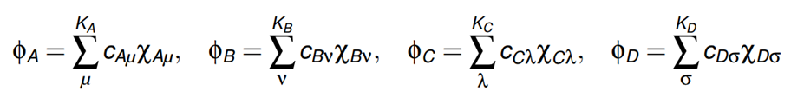
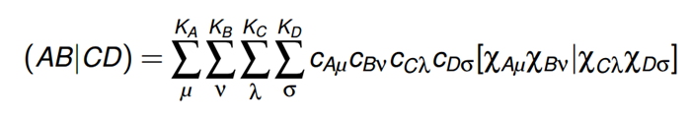
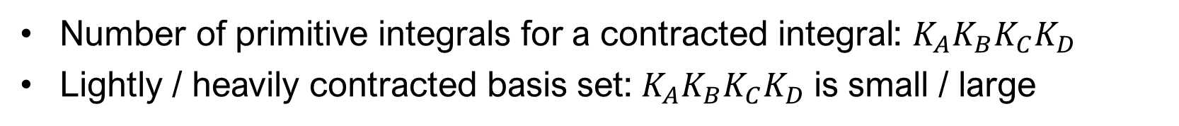
Electron Repulsive Integral (ERI)
ERI calculation: one of the main kernels in quantum chemistry
ERI :
basis functions
(known)
primitive functions
(known)
contracted integral
primitive integrals
8-way symmetries: $\left(AB | CD\right)=\left(BA | CD\right)=\left(AB | DC\right)=\left(CD | AB\right)$
Number of primitive integrals for a contracted integral: $K_{A}K_{B}K_{C}K_{D}$
Lightly / heavily contracted basis set: $K_{A}K_{B}K_{C}K_{D}$ is small / large

Slide 6
Electron Repulsive Integral (ERI)
Angular momentum (AM) number:
Shell: a group of basis functions with same AM & center coordinate
  AM = 0, 1, 2, 3, … → s, p, d, f, … shell
Shell quartet (MN|PQ): a set of integrals defined by four shells M, N, P, Q

Slide 7
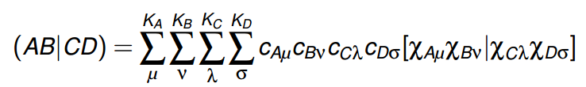
Vectorizing ERI Calculation
Huge amount (${10}^{7}\sim {10}^{10}$) of ERIs → need vectorization
Previous attempts to improve the vectorization of an existing ERI code:
Shan, Austin, De Jong, et al., 2013 improved TEXAS
Chow, Liu, Misra, et al., 2015 optimized ERD → OptERD
vectorization target
Resulted in better cache performance but SIMD performance was still poor!

Slide 8
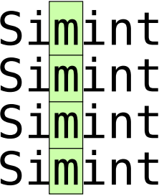
Vectorizing ERI Calculation
Simint:
Based on the Obara-Saika (OS) recurrence relations
Large SIMD vectorization speedup
Integrating into Psi4, NWChem & GAMESS
Simint vectorized the computation of multiple primitive integrals
Simint vectorization target
(horizontal vectorization)

Slide 9

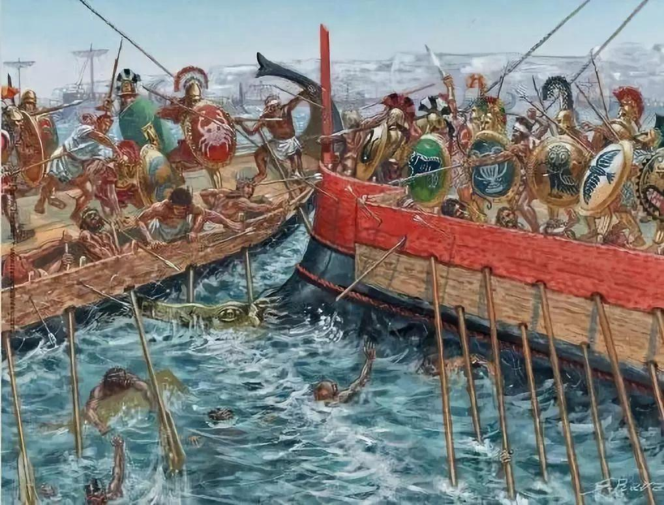
Batching ERIs in Quantum Chemistry Codes
Challenge: construct lists of shell quartets that:
Are unique under the 8-way symmetry property
Will not be screened (the absolute ERI values are large enough)
Are not a precomputed list of all shell quartets with the same AM class
Maximize the number of shell quartets that can be batched together
“micro-benchmarks”
“real-world applications”

Slide 10
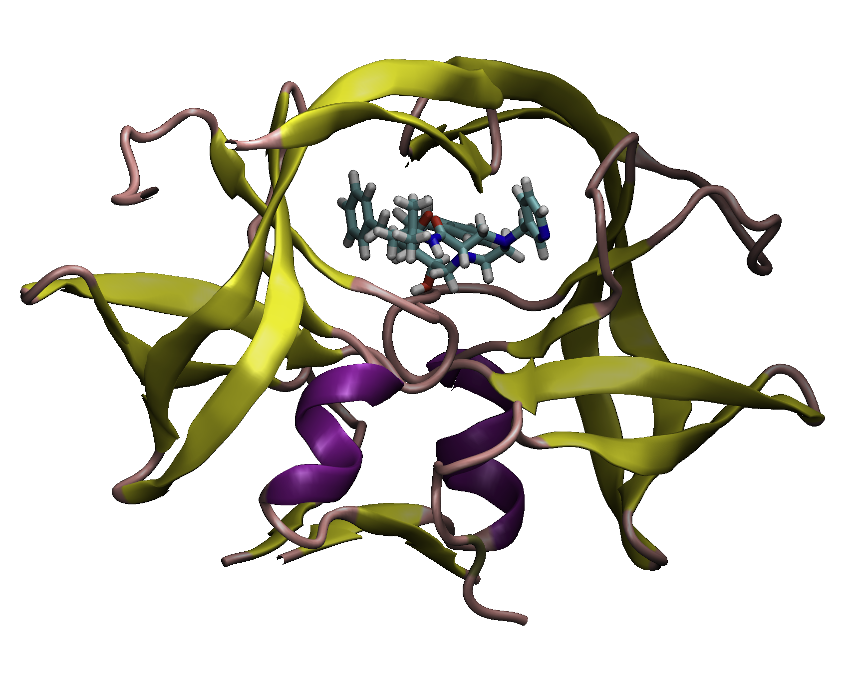
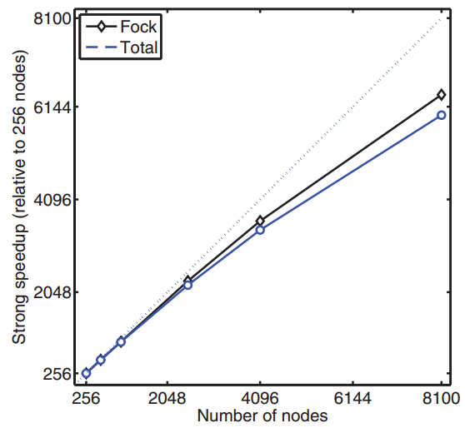
Batching ERIs in Quantum Chemistry Codes
GTFock and Simint:
GTFock: library for distributed memory parallel Fock matrix computation with a demo HF-SCF program
GTFock previous used OptERD, now uses Simint for ERI calculation
Protein-ligand system simulated using GTFock
GTFock strong scaling on Tianhe-2

Slide 11


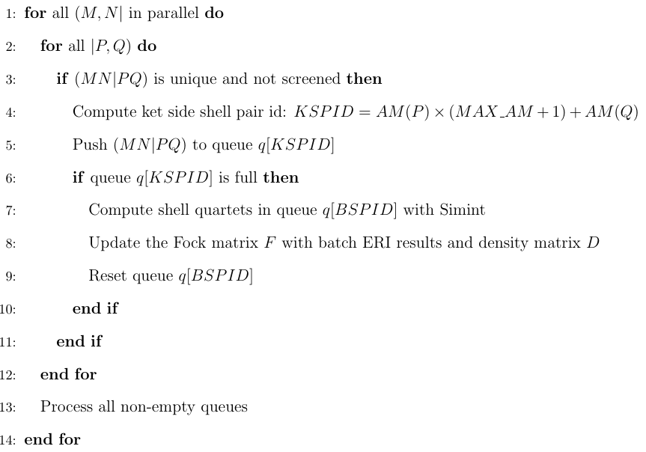
Batching ERIs in Quantum Chemistry Codes
A compute task in GTFock:

Slide 12
Performance Test Setting
Test platform: NERSC Cori supercomputer
Intel Xeon Phi 7250
  68C / 272T @ 1.4GHz, fixed to quadrant clustering mode
  16GB MCDRAM, fixed to cache mode
Intel C/C++/Fortran compiler 2017v4
Cray Aries interconnect, Cray MPI 7.6.2 and Cray LibSci (math library)

Slide 13
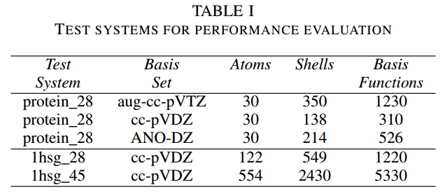
Performance Test Setting
Test molecules: from a protein-ligand complex consisting of a HIV drug molecule bound to HIV II protease
Basis sets:
aug-cc-pVTZ: A lightly contracted basis set
cc-pVDZ: A moderately contracted basis set, has few high AM shells
ANO-DZ: A heavily contracted basis set

Slide 14
Batching ERIs in Quantum Chemistry Codes
Why batching ERIs is important for vectorization:
Table: Average Number of Primitive Integrals of Simint Call
Basis Set | w/o Batching | w/ Batching | Ratio
aug-cc-pVTZ | 2.7 | 40.0 | 14.81
cc-pVDZ | 7.4 | 71.5 | 9.66
ANO-DZ | 79.3 | 1184.8 | 14.94
Test molecule: protein_28
ERI batching: greatly increases the SIMD loop length

Slide 15
Batching ERIs in Quantum Chemistry Codes
ERI calculations speedup via ERI batching:
Table: Average ERI calculation times (in second) per SCF iteration
Basis Set | OptERD | Scalar Simint w/o Batching | Vectorized Simint w/o Batching | Vectorized Simint w/ Batching
aug-cc-pVTZ | 251 | 128 | 143 | 39.4
cc-pVDZ | 2.03 | 0.75 | 0.67 | 0.33
ANO-DZ | 3511 | 1677 | 393 | 406
Test molecule: protein_28
Vectorized Simint with ERI batching:
6~8x faster compared to OptERD
2~3x faster compared to no ERI batching

Slide 16


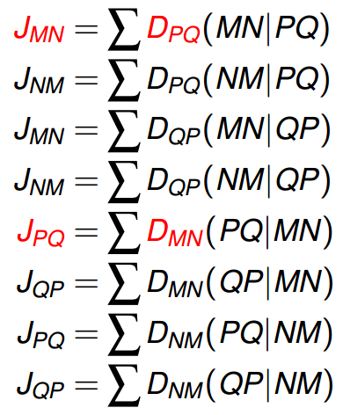
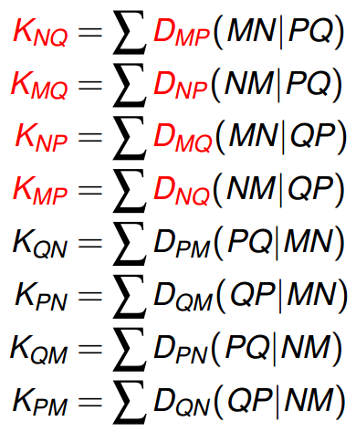
Efficient Parallel Fock Matrix Accumulation
Suppose a shell quartet (MN|PQ) is computed, then:

Slide 17
Efficient Parallel Fock Matrix Accumulation
After speeding up ERI calculations, the Fock matrix accumulation becomes the new performance bottleneck:
Test molecule: protein_28

Slide 18
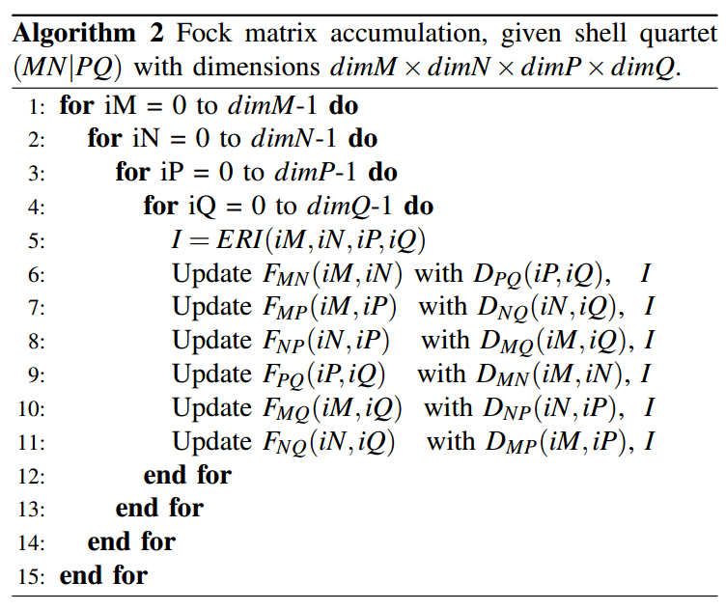
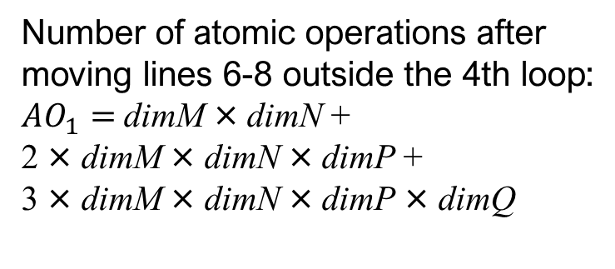
Efficient Parallel Fock Matrix Accumulation
Suppose we have computed the shell quartet (MN|PQ), then
Number of atomic operations after moving lines 6-8 outside the 4th loop:
${AO}_{1}=$dimM × dimN +
2 × dimM × dimN × dimP +
3 × dimM × dimN × dimP × dimQ

Slide 19
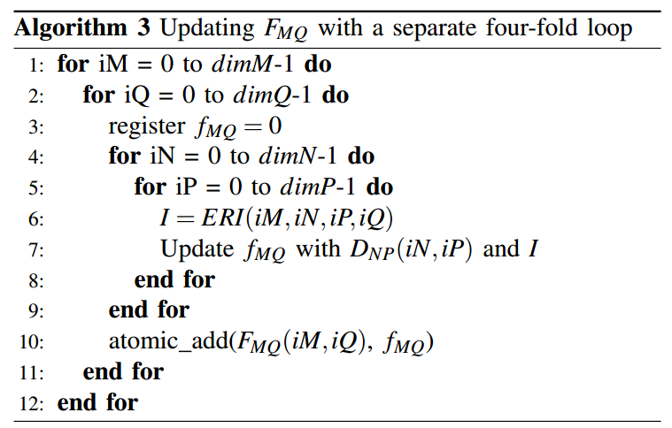
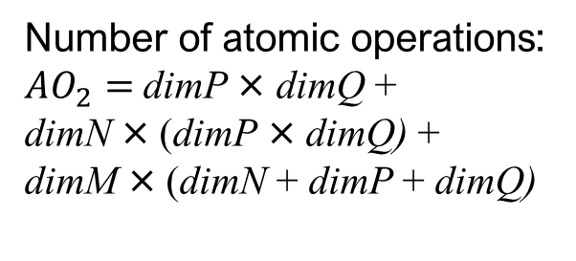
Efficient Parallel Fock Matrix Accumulation
Approach 1: split Algorithm 2 into six four-fold loops s.t. each four-fold loop only update one block of the Fock matrix.
Number of atomic operations:
${AO}_{2}=$dimP × dimQ +
dimN × (dimP × dimQ) +
dimM × (dimN + dimP + dimQ)
Problem: the ERI array is read six times and has discontinuous memory access

Slide 20
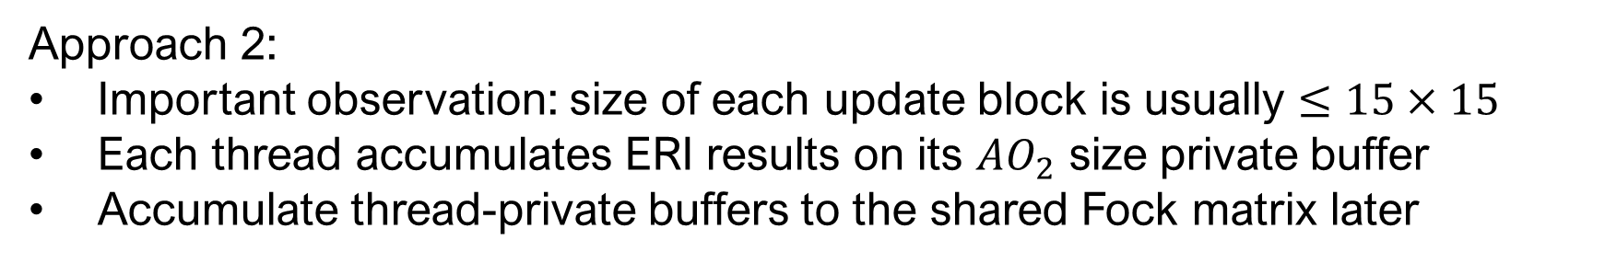
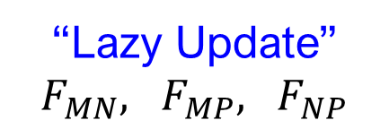
Efficient Parallel Fock Matrix Accumulation
Approach 2:
Important observation: size of each update block is usually $≤15×15$
Each thread accumulates ERI results on its ${AO}_{2}$ size private buffer
Accumulate thread-private buffers to the shared Fock matrix later
Further optimization enabled via ERI batching:
$\left(MN | PQ_{1}\right): F_{MN}, F_{MP}, F_{NP}, F_{MQ_{1}},$ $F_{NQ_{1}},$ $F_{PQ_{1}}$
$\left(MN | PQ_{2}\right): F_{MN}, F_{MP}, F_{NP}, F_{MQ_{2}},$ $F_{NQ_{2}},$ $F_{PQ_{2}}$
$\left(MN | PQ_{3}\right): F_{MN}, F_{MP}, F_{NP}, F_{MQ_{3}},$ $F_{NQ_{3}},$ $F_{PQ_{3}}$
“Lazy Update” $F_{MN}, F_{MP}, F_{NP}$
… …
… …
… …
$\left(MN | PQ_{k−1}\right): F_{MN}, F_{MP}, F_{NP}, F_{MQ_{k−1}},$ $F_{NQ_{k−1}},$ $F_{PQ_{k−1}}$
$\left(MN | PQ_{k}\right): F_{MN}, F_{MP}, F_{NP}, F_{MQ_{k}},$ $F_{NQ_{k}},$ $F_{PQ_{k}}$

Slide 21
Efficient Parallel Fock Matrix Accumulation
Table: Fock Matrix Accumulation Timings (in seconds) and Speedup After Optimization
Basis Set | Batched & Vectorized ERI | Fock Accum. w/o Optimization | Fock Accum. w/ Optimization | Fock Accum. Speedup
aug-cc-pVTZ | 39.4 | 136.3 | 36.5 | 3.73
cc-pVDZ | 0.336 | 0.432 | 0.197 | 2.19
ANO-DZ | 405.5 | 13.3 | 6.15 | 2.16
Test molecule: protein_28
Optimized Fock matrix accumulation: 2~3x speedup

Slide 22
Overall Results
Table: Fock Build Timings (in seconds)
Basis Set | OptERD | Scalar Simint w/o Batching | Vectorized Simint w/o Batching | Vectorized Simint w/ Batching
aug-cc-pVTZ | 345 | 221 | 250 | 92.5
cc-pVDZ | 2.98 | 1.66 | 1.56 | 0.68
ANO-DZ | 3578 | 1722 | 427 | 436
Test molecule: protein_28
Fock build using vectorized Simint with ERI batching:
4~8x faster compared to OptERD
2.3~2.7x faster compared to no ERI batching

Slide 23
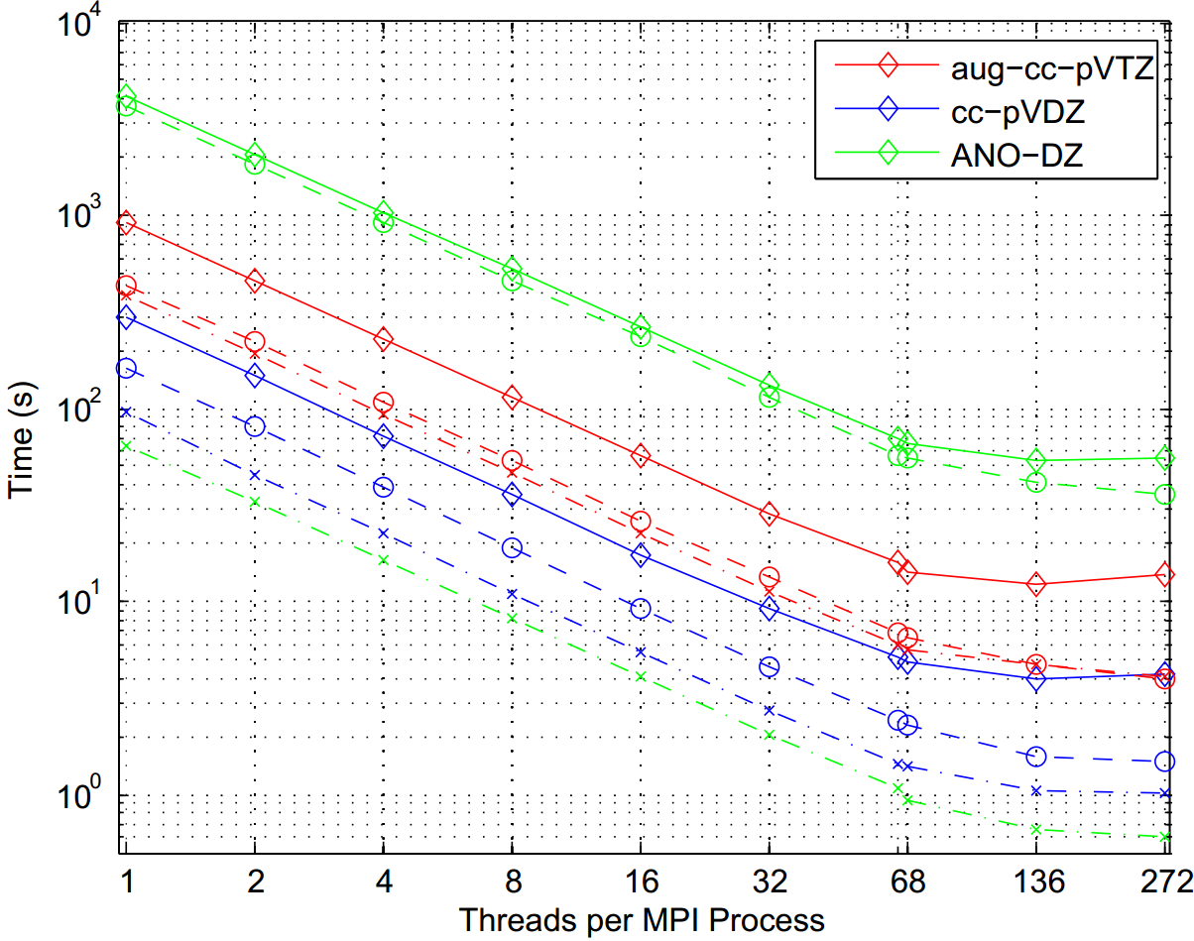
Overall Results
Multi-thread efficiency (9 KNL nodes, 1hsg_28 molecule):
Circle: ERI calculation
Cross: Fock accumulation
Diamond: Fock build

Slide 24
Software Availability
Simint: https://github.com/simint-chem
GTFock: https://github.com/gtfock-chem
IPCC at Georgia Tech: https://www.cc.gatech.edu/~echow/ipcc

Slide 25
Thank You!

