Slide 1
Cooperative Rendezvous Protocols for Improved Performance and Overlap
Sourav Chakraborty, Mohammadreza Bayatpour,
Jahanzeb Hashmi, Hari Subramoni, and Dhabaleswar K Panda
Network Based Computing Laboratory
Department of Computer Science and Engineering
The Ohio State University

Slide 2
Overview
Introduction
Motivation
Vision and Contribution
Detailed Designs
Experimental Evaluations
Conclusion and Future Work

Slide 3
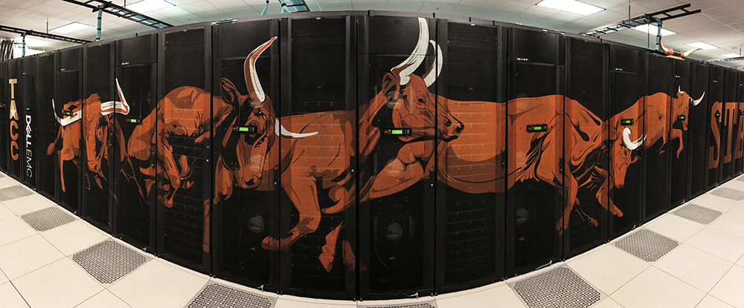


Current Trends in HPC
Supercomputing systems scaling rapidly
  Multi-/Many-core architectures (Xeon, OpenPOWER)
  High-performance interconnects (InfiniBand, OmniPath)
Core density (per node) is increasing
  Improvements in manufacturing tech
  More performance per watt
Message Passing Interface (MPI) used by vast majority of HPC applications
  Blocking/Non-blocking point-to-point operations
  Collectives based on point-to-point communication
Stampede2 @ TACC
Sunway TaihuLight
Sierra @ LLNL

Slide 4
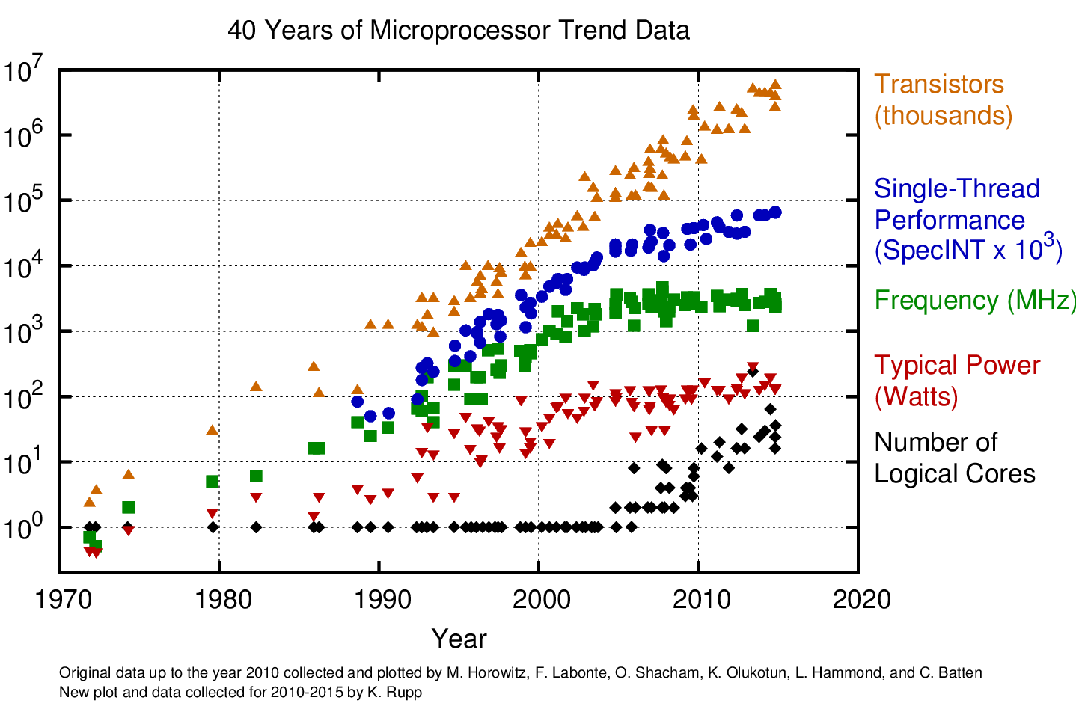
CPU Scaling Trends over Past Decades
Single thread performance increasing slowly
Frequency increase has slowed down
Number of transistors continue to grow
Number of cores rapidly increasing
More compute power in small number of nodes
Need to improve both intra-node and inter-node communication!
https://www.karlrupp.net/2015/06/40-years-of-microprocessor-trend-data/

Slide 5
Intra-Node communication in MPI
Send Buffer
Recv Buffer
Send Buffer
Recv Buffer
MPI Sender
MPI Receiver
MPI Sender
MPI Receiver
Shared Memory
Kernel
Kernel
Eager Protocol
Requires two copies
Better for Small Messages
Rendezvous Protocol
Requires single copy
Better for Large Messages

Slide 6
Existing Rendezvous Protocols in MPI
Sender
Receiver
Sender
Receiver
Control messages (RTS, CTS, FIN) used to exchange PID, address, length etc.
Read/Write done through kernel modules (CMA, KNEM, LiMiC) or kernel-assisted page mapping (XPMEM)
Statically selected (same protocol used for all communication)
RTS
RTS
CTS
Write Data
Read Data
FIN
FIN
Write-Based (RPUT)
Read-Based (RGET)

Slide 7
Research Questions
Are existing rendezvous protocols using all the available resources?
Can rendezvous protocols take advantage of different communication channels for better performance and overlap?
How does the communication pattern affect performance of different rendezvous protocols?
Are existing protocols ensuring effective overlap of intra-node and inter-node communication?
Do we need to rethink the design of MPI rendezvous protocols to deliver the best performance to applications?

Slide 8
Overview
Introduction
Motivation
Vision and Contribution
Detailed Designs
Experimental Evaluations
Conclusion and Future Work

Slide 9
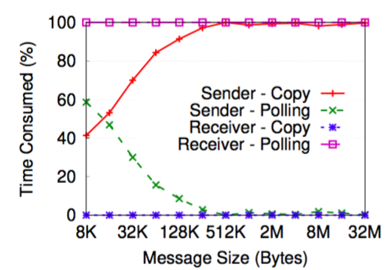
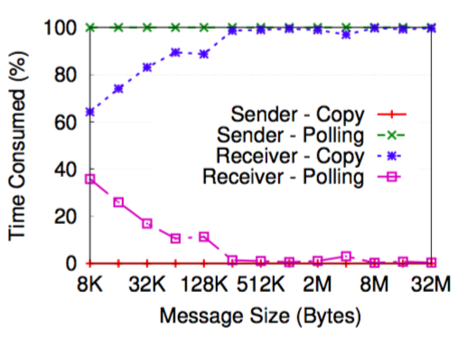
Limitations of Existing Rendezvous Protocols - Resource Utilization
Write-Based (RPUT)
Read-Based (RGET)
Write-based protocols (RPUT) are driven by the sender CPU while the receiver CPU idles (opposite for RGET)
Can the sender and the receiver cooperate to improve the performance or overlap of point-to-point communication?

Slide 10
Impact of Communication Pattern on Performance
P0
P0
P1
P3
P1
P3
P2
P2
One-to-All: RGET > RPUT
All-to-one: RPUT > RGET
Different communication patterns require different rendezvous protocols
How can MPI processes “discover” the overall communication pattern?
How can MPI libraries dynamically select the appropriate rendezvous protocol for these different patterns?

Slide 11
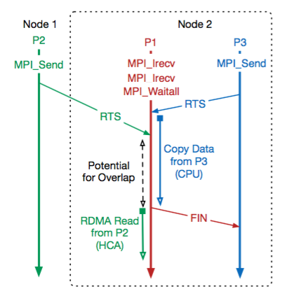
Progress and Overlap of Multiple Concurrent Communications
Intra-node communication is driven by the CPU itself
Blocking nature of copying data prevents the CPU from processing control messages and issuing RDMA read/writes
Limits the concurrency of intra-node communication
Reduces overlap of intra-node and inter-node communication
Can new rendezvous protocols be designed to allow better progress?

Slide 12
Overview
Introduction
Motivation
Vision and Contribution
Detailed Designs
Experimental Evaluations
Conclusion and Future Work

Slide 13
Broad Vision and Contribution
Rethink MPI rendezvous protocols with the goal of improved performance and overlap
Design efficient and dynamic “Cooperative” rendezvous protocols
Multiple levels of “cooperation”:
  Cooperation between the sender and the receiver for improved resource utilization
  Cooperation among processes one the same node to intelligently adapt to the application’s communication pattern
  Cooperation among processes across nodes for improved overlap of intra-node and inter-node communication

Slide 14
Overview
Introduction
Motivation
Vision and Contribution
Detailed Designs
Experimental Evaluations
Conclusion and Future Work

Slide 15
Cooperation between the Sender and the Receiver
Sender
Receiver
Combines both RGET and RPUT protocols
Control messages (RTS, CTS) used to exchange buffer addresses and lengths
Sender writes half of the data directly to receiver’s memory
Receiver reads rest of the data from the sender’s memory
Reads and writes happen concurrently
Utilizes both the sender and the receiver’s CPU to extract more parallelism and reduce the latency
RTS
CTS
Write Data
Read Data
FIN
FIN
Proposed COOP-p2p protocol

Slide 16
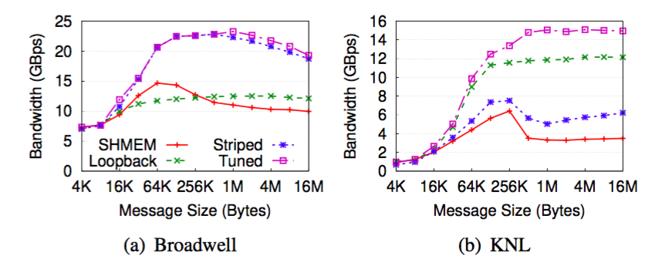
Offloading Point-to-point Communication for Overlap (COOP-hca)
CPU performs the copy operation and progresses the communication
Unavailable for application computation (low overlap)
Can be offloaded to DMA engines of HCA to improve CPU availability
Use multiple channels (both CPU and HCA) to further reduce latency
Intelligent striping required to get the best performance

Slide 17
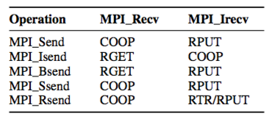
Cooperation Based on Communication Primitive (COOP-coll)
Determine the need of overlap at the sender or the receiver
  Isend/Irecv => overlap wanted
  Send/Recv => No overlap wanted
  Works for collectives built using point-to-point primitives
Enhance the control messages (RTS/CTS) to convey protocol information to the peer process
Ensure both sender and receiver decides to use the same protocol
Decision tree for COOP-coll protocol

Slide 18
Dynamic Load Balancing among Processes (COOP-load)
MPI collectives are often imbalanced (one-to-many or many-to-one communication patterns)
Point-to-point operations like Stencil has both intra-node and inter-node components
Can lead to load-imbalance on the driving CPUs
Use number of pending rendezvous copies as heuristic for CPU load
Incremented when RTS/CTS is received and before the copy is performed
Decremented when FIN is received or copy operation has finished
Share “load” information through shared memory regions
Dynamically select the protocol based on load

Slide 19
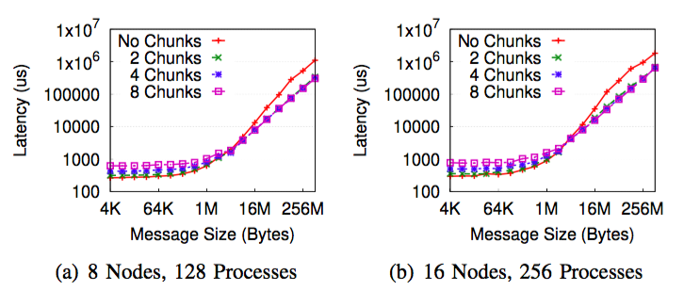
Cooperation among Processes Across Nodes (COOP-chunked)
Intra-node copies for large messages are time-consuming and blocks the CPU
Can’t process control messages and issue RDMA operations to the HCA
Lack of overlap of intra-node and inter-node messages
Use a chunking based design to progress the intra-node communication
Improves CPU availability for progressing inter-node communication

Slide 20
Hybrid Cooperative Protocol
Combines aspects of different Rendezvous protocols discussed
Applies the protocol best suitable for the scenario
COOP-p2p is used for blocking Send/Recv operations
COOP-coll is used for collectives and Send/Irecv or Isend/Recv communication patterns
COOP-load is used for Isend/Irecv communication
COOP-chunked is used for messages larger than a system-specific threshold value
COOP-hca is used if system is undersubscribed
Used for application level evaluations (coming up!)

Slide 21
Overview
Introduction
Motivation
Vision and Contribution
Detailed Designs
Experimental Evaluations
Conclusion and Future Work

Slide 22
Experimental Setup
Specification | Xeon Phi | Xeon | OpenPower
Processor Family | Knights Landing | Broadwell | IBM POWER-8
Processor Model | KNL 7250 | E5 v2680 | PPC64LE
Clock Speed | 1.4 GHz | 2.4 GHz | 3.4 GHz
No. of Sockets | 1 | 2 | 2
Cores per Socket | 68 | 14 | 10
Threads per Core | 4 | 1 | 8
Memory Config | Cache | NUMA | NUMA
RAM (DDR) | 96 GB | 128 GB | 256 GB
HBM (MCDRAM) | 16 GB | - | -
Interconnect | Omni-Path (100 Gbps) | InfiniBand EDR (100 Gbps) | InfiniBand EDR (100 Gbps)
MPI Library | MVAPICH2X-2.3rc1 OpenMPI v3.1.0 | MVAPICH2X-2.3rc1 OpenMPI v3.1.0 | MVAPICH2X-2.3rc1 OpenMPI v3.1.0

Slide 23

Overview of the MVAPICH2 Project
High Performance open-source MPI Library for InfiniBand, Omni-Path, Ethernet/iWARP, and RDMA over Converged Ethernet (RoCE)
  MVAPICH (MPI-1), MVAPICH2 (MPI-2.2 and MPI-3.1), Started in 2001, First version available in 2002
  MVAPICH2-X (MPI + PGAS), Available since 2011
  Support for GPGPUs (MVAPICH2-GDR) and MIC (MVAPICH2-MIC), Available since 2014
  Support for Virtualization (MVAPICH2-Virt), Available since 2015
  Support for Energy-Awareness (MVAPICH2-EA), Available since 2015
  Support for InfiniBand Network Analysis and Monitoring (OSU INAM) since 2015
  Used by more than 2,950 organizations in 86 countries
  More than 500,000 (> 0.5 million) downloads from the OSU site directly
  Empowering many TOP500 clusters (June ‘18 ranking)
    2nd, 10,649,600-core (Sunway TaihuLight) at National Supercomputing Center in Wuxi, China
    12th, 556,104 cores (Oakforest-PACS) in Japan
    15th, 367,024 cores (Stampede2) at TACC
    24th, 241,108-core (Pleiades) at NASA
    62nd, 76,032-core (Tsubame 2.5) at Tokyo Institute of Technology
  Available with software stacks of many vendors and Linux Distros (RedHat and SuSE)
  http://mvapich.cse.ohio-state.edu
Empowering Top500 systems for over a decade
  System-X from Virginia Tech (3rd in Nov 2003, 2,200 processors, 12.25 TFlops) ->
  Stampede at TACC (12th in Jun’16, 462,462 cores, 5.168 Plops)

Slide 24
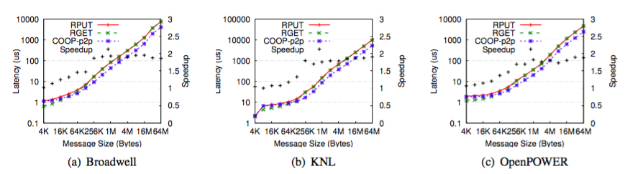
Performance of Point-to-point Operations
Intra-node communication latency of large messages improved by up to 2X on Broadwell and OpenPower
Up to 1.75x improvement on KNL (L2 cache sharing and lack of L3 cache)
Similar improvement for unidirectional bandwidth

Slide 25
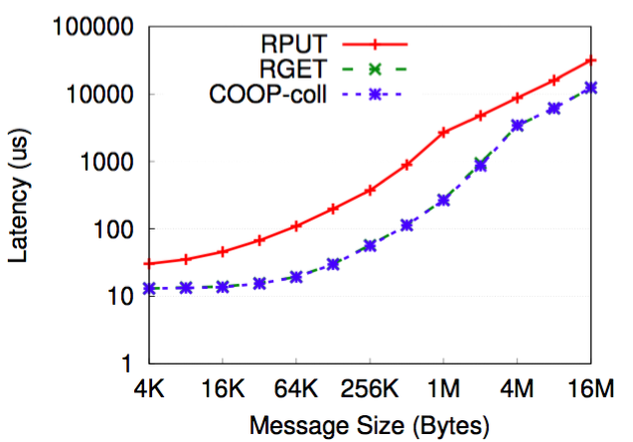
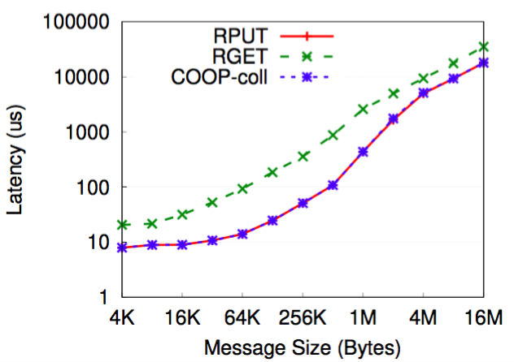
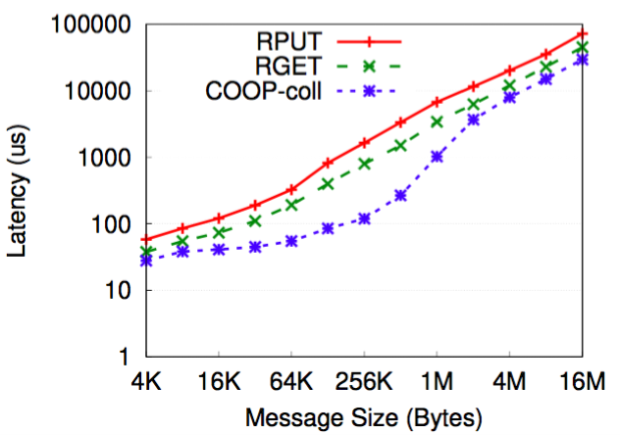
Impact on Performance of Collectives
One-to-all
All-to-one
Reduce-Scatter+Gather
RGET performs better for one-to-all communication
RPUT performs better for all-to-one communication
Neither provides the best performance for mixed communication patterns
COOP-coll performs equal or better than existing protocols for all communication patterns

Slide 26
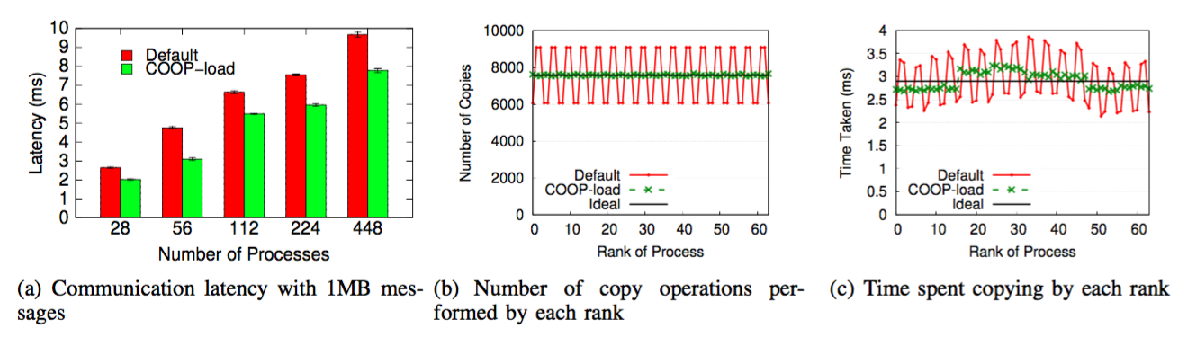
Impact on Performance of 3DStencil
COOP-load outperforms existing design by up to 10%
Equalizes number of copy operations across ranks
Reduces variance in time spent in copying across processes

Slide 27
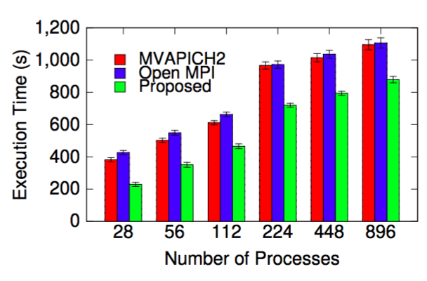
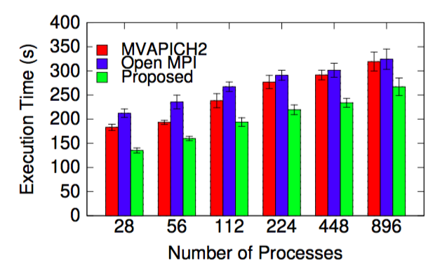
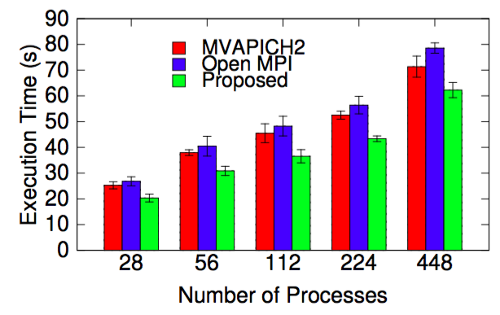
Impact on Application Performance
Graph500
CoMD
MiniGhost
Graph Processing: up to 19% improvement for Graph500 @ 896 processes
Molecular Dynamics: up to 16% improvement for CoMD @ 896 processes
Halo Exchange: up to 10% improvement for MiniGhost @ 448 processes

Slide 28
Overview
Introduction
Motivation
Vision and Contribution
Detailed Designs
Experimental Evaluations
Conclusion and Future Work

Slide 29
Conclusion and Future Work
Existing MPI rendezvous protocols are suboptimal for emerging architectures
  Lack of cooperation among participant processes
  Loss of performance, overlap, and adaptivity to diverse communication patterns
Designed novel rendezvous protocols based on cooperation among processes
  Take advantage of available resources
  Dynamically adapt to the application communication pattern
  Improve overlap of intra-node and inter-node communication
Up to 20% reduction in application runtime of Graph500, CoMD, and MiniGhost
Proposed designs available in MVAPICH2X-2.3rc2
  Deployed in TACC Stampede2 (17th in TOP500)
  Larger scale run planned in the future
  Download from http://mvapich.cse.ohio-state.edu/downloads/

Slide 30


Thank You!
{ chakraborty.52, bayatpour.1, hashmi.29, subramoni.1, panda.2 }@ohio-state.edu
Network Based Computing
Laboratory
Network-Based Computing Laboratory
http://nowlab.cse.ohio-state.edu/
The MVAPICH2 Project
http://mvapich.cse.ohio-state.edu/

