Slide 1

ADAPT: algorithmic differentiation APPLIED TO FLOATING-POINT PRECISION TUNING
Harshitha Menon, Michael O. Lam, Daniel Ossei-Kuffuor, Markus Schordan, Scott Lloyd, Kathryn Mohror, Jeffrey Hittinger
Center for Applied Scientific Computing
Lawrence Livermore National Laboratory
SC 2018

Slide 2
motivation
ADAPT
Evaluation
Notes:
First I will be motivating the talk by discussing the impact of floating-point precision errors, and what is there to be gained in terms of performance.
Then, I will go into the details of our proposed work ADAPT
Followed by evaluation and future work.
First I will be motivating the talk by discussing some of the existing challenges with floating-point precision HPC applications.

Slide 3
MOTIVATION
Notes:
Comments:
Show using AMR why dynamic lb is required with pictures
In a parallel application run, slight imbalance in the load can result in decrease in the utilization of processors and significant wastage of resources. Load imbalance is a critical factor that can reduce the performance of parallel application significantly. As we move towards exascale era ie given a million processors (or larger systems), the chance that one of them has a load significantly larger than the average is very high.
For some applications it is easy to predict the load and therefore we can perform a static distribution of tasks.
But in many applications the computational load varies over time and it is hard to predict. Few example of such application includes weather simulation, molecular dynamics AMR. for such applications, high performance can only be obtained if work load is distributed among processors in a dynamic fashion.

Slide 4
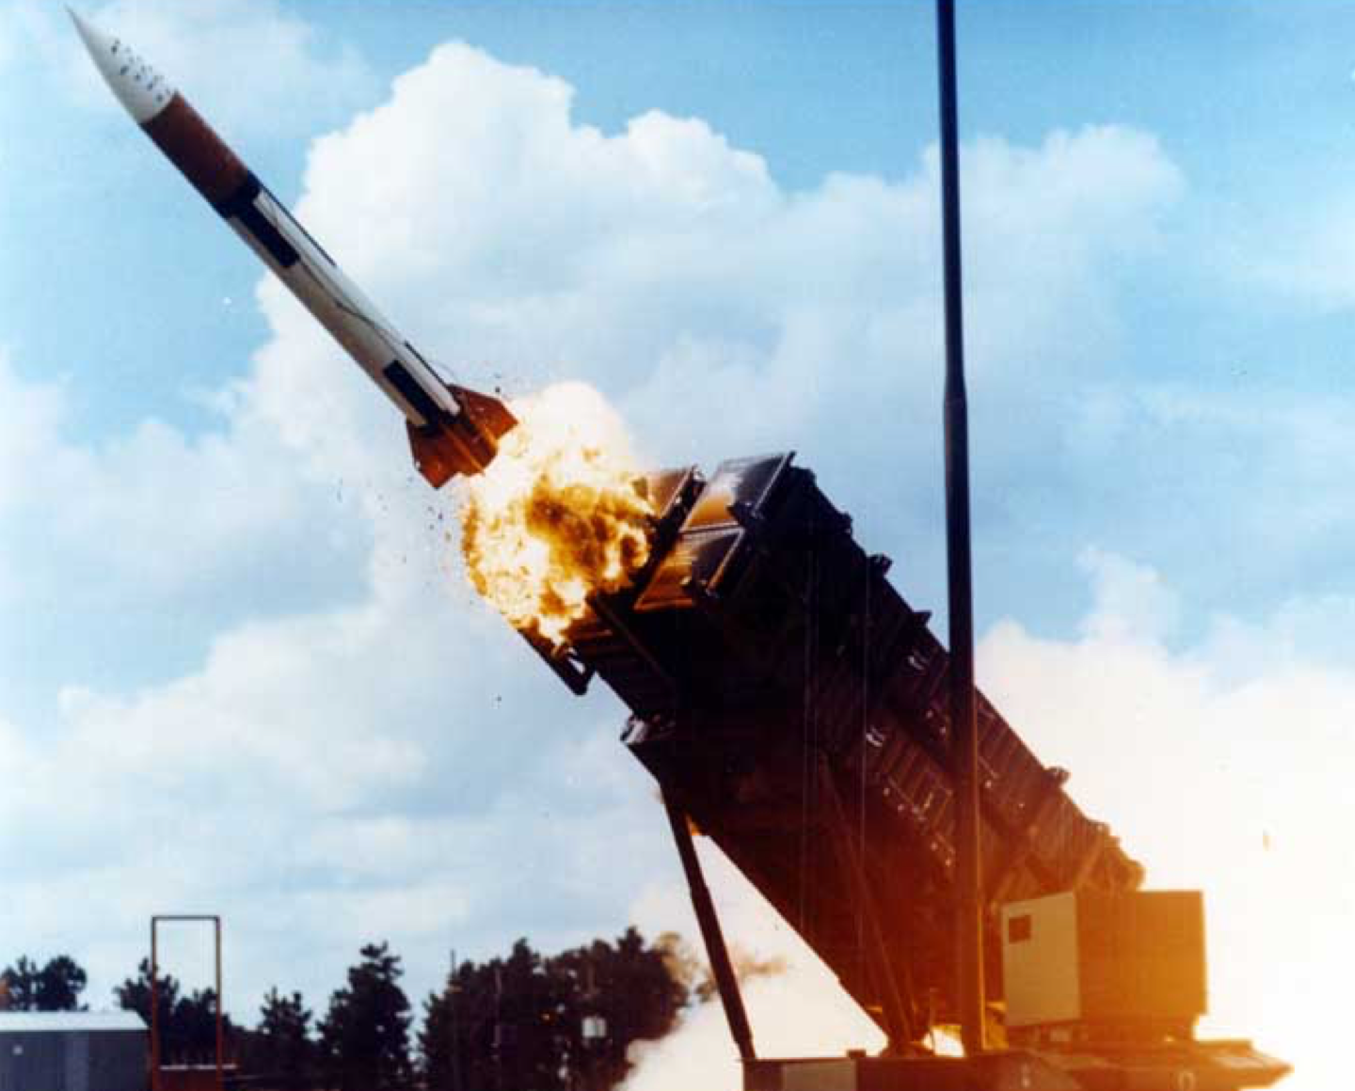

0.0001100110011001100110011001100….
0.00011001100110011001100
Error : 0.000000095
Time Error: 0.34 seconds

Slide 5

Notes:
We may think that that the probability of encountering an error in a single run is not very high. But for applications that run on thousands if not millions of cores, these

Slide 6
GOAL
Understand the impact of rounding errors so that we can help develop code that executes faster with better integrity and correctness of result.

Slide 7
Floating-point precision
HPC applications extensively use floating point arithmetic operations
Computer architectures support multiple levels of precision
      Higher precision - improve accuracy
      Lower precision - reduces running time, memory pressure, energy consumption
Notes:
HPC applications extensively use floating point arithmetic operations.
Computer architectures support multiple levels of precision for floating-point data and arithmetic operations. The standard IEEE floating-point precision choices single, double, quad, half. The choice of floating-point precision determines the magnitude of rounding errors in the computation.
Although a higher precision may improve the accuracy of the program output, it usually results in an increase of application run time, energy consumption, memory pressure, and interconnect usage.
Often, programmers resort to the safer option of uniformly applying higher precision throughout the program to ensure accuracy of the simulation output at the expense of performance.
However, not all applications require higher precision.
Ideally, applications should use the lowest precision necessary to achieve the required accuracy in order to take advantage of the performance and energy benefits of using the lower precision.

Slide 8
Mixed-precision arithmetic
Using multiple levels of precision in a single program
        Without affecting correctness
        Improving performance
Manually optimizing for mixed precision is challenging
Notes:
One promising approach is the use of mixed-precision arithmetic,
i.e., using multiple levels of precision in a single program,
gaining the benefits of high-precision arithmetic where necessary to maintain accuracy but
using lower-precision arithmetic where possible to improve perfor- mance [3] and reduce energy usage [4].
Unfortunately, it is not always easy to develop mixed-precision versions of large code bases manually, as
this not only requires extensive knowledge of the numerical behavior of the algorithm
but also requires understanding of the subtle details of floating-point rounding errors.
This process becomes increasingly infeasible for larger- scale HPC programs with multiple modules.

Slide 9
Develop an automated analysis technique to
Identify the variables that require higher precision to ensure correctness.
Use mixed-precision to achieve a desired output accuracy to improve performance.
Notes:
In this paper, we develop

Slide 10
Related work
Automatically discovering unstable floating-point operations and applying transformations
    Herbie [Panchekha’14 et al.], Darulova’18 et al.
Search based methods
  CRAFT [Lam’13 et al.], Precimonious/HiFPTuner [Rubio’13 et al.]
Rigorous error analysis methods
  FPTuner [Chiang’17 et al.], Rosa/Daisy [Darulova’14 et al.]
Notes:
There have been many efforts to automate this process in various ways.
One is automatically discovering unstable floating-point execution and accuracy-improving transformations based on a database of rewrite rules
Dynamic automated search based approaches
These techniques evaluates and Executes different mixed-precision configurations of the program to identify the best configuration that satisfies the error threshold.
The main drawback of these approaches is that the state space to explore is exponential in the number of variables; exploring even a subset is very time-intensive.
Then there are various rigorous static analysis approaches use interval and affine arithmetic or Taylor series approximations to analyze stability and to provide rigorous bounds on rounding errors.
However, they do not scale very well and therefore have not been applied to HPC workloads.

Slide 11
ADAPT : FLOATING-POINT PRECISION ANALYSIS
Notes:
We propose a scalable approach to estimate the effect of rounding errors due to lowering the precision, and use that to develop a mixed-precision version of the code to improve performance.

Slide 12
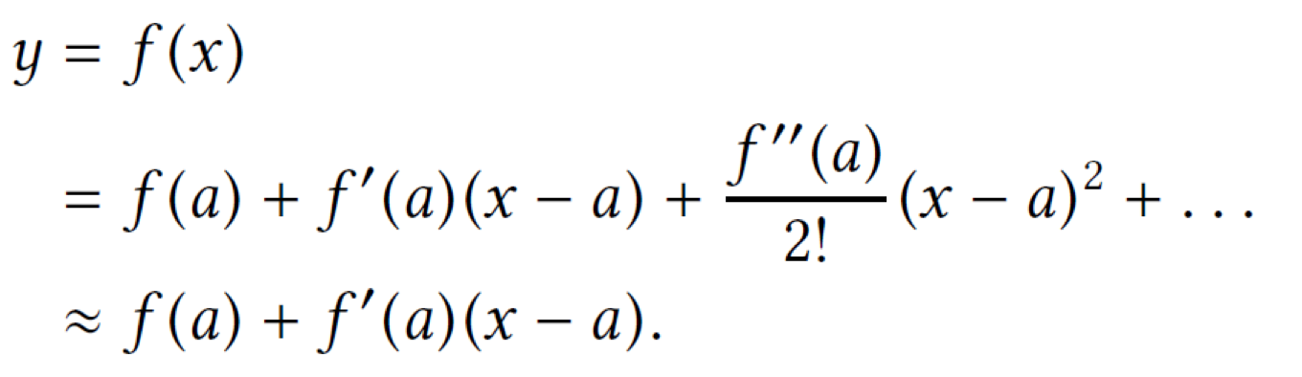
How does the output change with respect to its inputs?
For a given y = f(x)
First order Taylor series approximation at x=a
∆y = f’(a) ∆x
Generalizing it for y = f(x1, x2, …,xn) at xi=ai
∆y = fx1’(a) ∆x1 +…+ fxn’(a) ∆xn
Obtain f’(a) using Algorithmic Differentiation (AD)
Notes:
We are interested in knowing how the output changes with respect to the errors in the variables.
We view a program as a function of inputs and intermediate variables to compute some output.
In our error prediction model, we use first order taylor series approximation of the program around the input to compute error estimates.
Here let x be any input or intermediate variable in the program and y be the output variable. Then the error in y is f’(a) times error in x.
This can be extended to consider the output y as a function of multiple inputs and generalizing it.
The total differential delta y is the sum of partial differentials.
The key point is that we use algorithmic differentiation to obtain f’(a).

Slide 13
Algorithmic Differentiation (AD)
Compute the derivative of the output of a function with respect to its inputs
  A program is a sequence of operations
  Apply the chain rule of differentiation at each operation
  AD has been used in sensitivity analysis in various domains
  AD Tools: CoDiPack, Tapenade
Alternatives to AD: Symbolic differentiation, Finite difference
Notes:
Algorithmic differentiation, also known as automatic differentiation, is used to compute the derivative of a computer program. AD treats computer program as a function with a sequence of elementary arithmetic operations. Then it uses chain rule of differentiation on those operations to compute the numerical derivative of the computer program.
There are two modes of AD, forward and reverse. We use the reverse mode of AD, which I will describe in the next slide.
AD has been used in uncertainty quantification.
There are numerous AD tools available and for this project we have been using Tapanade. This tool transforms the program to compute the derivatives.
Alternatives:
Symbolic differentiation requires the computer program to be represented as a single expression, which is difficult or impossible for reasonable-sized pro- grams
finite differences suffers from numerical instability due to rounding errors in discretization process.

Slide 14
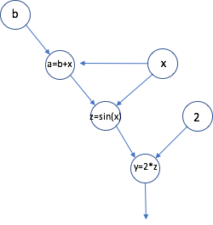







Reverse mode of algorithmic differentiation
Y
Notes:
Here is an example of reverse mode of AD. Here is our small program a=b+x… Each operation is shown in the circles and the edges represent the flow of information. Y is the final output.
In the reverses mode of AD first a trace of the forward execution of the program is collected.
Then in the reverse pass partial derivatives are multiplied with the derivatives of the output and sent up the chain.
At the end we can see that it computes the partial derivative of the output y with respect to all the inputs along the computation path.
The main reason for choosing the reverse mode is that, In the reverse mode, computation of the derivatives can be done at a small constant multiple of the original computation irrespective of the number of inputs.
Reverse mode of AD is used to compute the partial derivatives of all the variables with respect to the output in a single execution.

Slide 15
Output error estimation
Obtain fxi’(a) using algorithmic differentiation (AD)
Reverse mode of AD is used to compute the partial derivatives of all the variables with respect to the output in a single execution.

Slide 16
MIXED-PREcision allocation
Estimate the error due to lowering the precision of every dynamic instance of a variable
Aggregate the error over all dynamic instance of the variable
Greedy approach
        Sort variables based on error contribution
        Variables switched to lower precision - estimated error contribution within threshold
Notes:
To identify a set of variables that can be changed to lower precision without violating a given error threshold,
we begin by evaluating the output error due to lowering the precision at every dynamic instance of each variable. We then aggregate the output error estimates at the assignment statement level as well as at the source variable and function level.
We use this as the basis of our mixed-precision allocation and describe a greedy approach used to create mixed-precision configuration
Next, the variables are sorted in increasing order of their contribution to the final output given by Equation 8. Finally, variables are assigned to lower precision if converting them does not violate the error threshold.
There are two other variations of this algorithm described in the paper.
Full algorithm and the proof is in the paper.

Slide 17
EVALUATION

Slide 18
evaluation
Benchmarks and Mini-Apps:
        6 benchmarks including the ones from previous work
        HPCCG, LULESH
System:
        Quartz (Intel Xeon E5-2695 processors with 2.1 GHz cores and 128 GB of memory per node)
        Blue Waters (XK7 nodes with NVIDIA Kepler GPU)
Comparison with existing tools
        Precimonious, CRAFT : search based
        FPTuner : real-valued expression

Slide 19
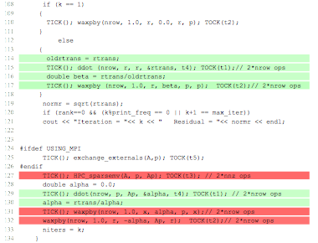
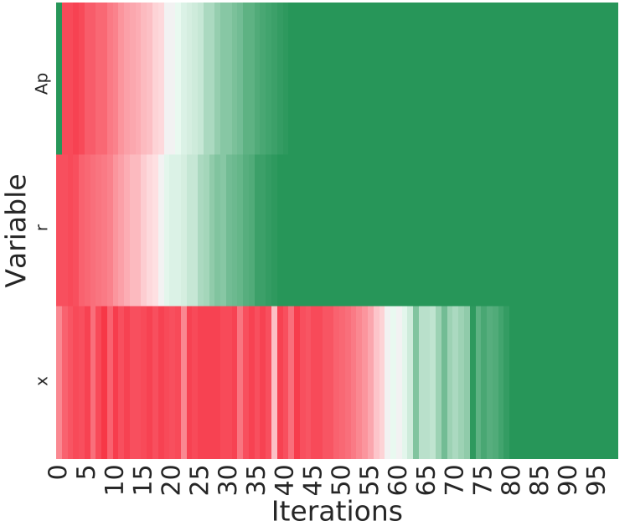
Evaluation on HPCCG
        HPCCG from Mantevo benchmark suite
        ADAPT is able to identify critical sections that need to be in higher precision
        Mixed precision analysis version achieves 1.1x speedup.
Notes:
We evaluate our approach on HPCCG, a mini-application from the Mantevo benchmark suite. It is a conjugate gradient benchmark code with a problem size of 20 × 30 × 160.
Here we show the code highlight produced by ADAPT. It shows the critical sections of the algorithm that need to be evaluated in higher precision as determined by ADAPT .
Further analyses of the results reveal that initial iterates are critical for accuracy. Figure shows a plot of the critical variables across different iterations. The results indicate that after the first 20 iterations, the error in r is below the 1.0e-10.
These results are interesting as they suggest the feasibility of performing lower precision arithmetic in the later iterations for efficiency.

Slide 20
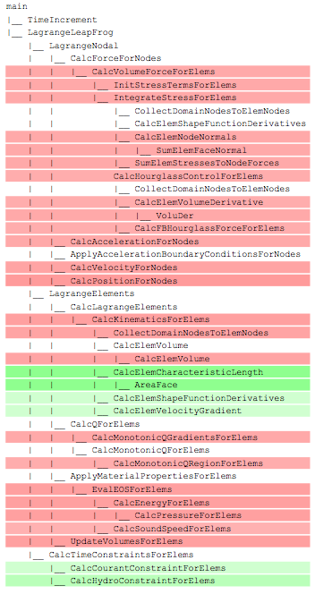
Evaluation on lulesH
        Used ADAPT on LULESH to create mixed precision sensitivity profile
        Used the profile as a guide to develop a mixed precision version for a CUDA implementation of LULESH
        Achieved speedup of 1.2x within error threshold of 1e-11 on GPU
Notes:
We use ADAPT on LULESH 2.0 to create a precision sensitivity profile of the program. LULESH is a shock hydrodynamics program developed at LLNL.
Figure shows the call graph at the function level highlighting functions that need to be in higher precision.
According to our analysis, the function, which pertains to calculation of the time step constraints, can be performed in lower precision. The time step variable is merely used to advance the simulation and therefore needs to be accurate only to a few significant digits.
We used the profile as a guide to develop a mixed precision version for a CUDA implementation of LULESH. The mixed-precision version was within the error threshold specified in, which resulted in a speedup of 1.2x.
The routine CalcElemCharacteristicLength computes the characteristic length of the element, which is later used in CalcTimeConstraintsForElems to update the next time step.

Slide 21
Evaluation
Program | Error Threshold | Output Error | Speedup
arclength | 1E-12 | 1.7E-13 | 1.11
simpsons | 1E-12 | 4.5E-14 | 1.13
jetEngine | 1E-13 | 2.5E-13 | 1.40
carbonGas | 1E-10 | 1.0E-11 | 1.57
HPCCG | 1E-10 | 2.8E-15 | 1.10
LULESH | 1E-08 | 1.8E-11 | 1.20
Notes:
Here is a table giving an overall picture of the output accuracy and the speedup.
The paper has more details about the benchmarks and experiments.
What I want to highlight in this slide is that, for a given error threshold, ADAPT was able to identify a mixed-precision configuration that satisfies that threshold and at the same time giving atleast 1.1x speedup.

Slide 22
Evaluation
Program | Threshold | Estimated | Actual | Speedup
HPCCG | 1E-10 |  | 2.8E-15 | 1.10
arclength | 1E-12 | 1.7E-13 | 1.7E-13 | 1.11
simpsons | 1E-12 | 3.7E-14 | 4.5E-14 | 1.13
jetEngine | 1E-13 | 8.4E-14 | 2.5E-13 | 1.40
carbonGas | 1E-10 | 2.8E-11 | 1.0E-11 | 1.57
LULESH | 1E-08 |  | 1.8E-11 | 1.20

Slide 23
Comparison with existing tools
        CRAFT
              Search based approach
              Analyzes instructions
        Precimonious
              Search based approach
              Explores hundreds of configurations for tiny benchmarks
        FPTuner
              Rigorous approach
              Supports only real-valued expression language
Notes:
We compare ADAPT with Precimonious and FPTuner. We also compared it with CRAFT, which is a search based approach. It not directly comparable with ADAPT because ADAPT analyzes variables while CRAFT analyze instructions.
Precimonious is another search based approach, but it supports only C and doesn’t support changing the types of dynamic memory. The main drawback of these search based approaches is that they have to explore and execute a large number of mixed-precision configuration, which takes significant amount of time.
FPTuner is a rigorous approach which gives tight bounds for rounding errors for a given interval range, but it is applicable to benchmarks written in real-valued expression language. There is no real-valued expression language version of LULESH and HPCCG and it is not trivial to convert them to that form. So, we convert some of the real-valued expression benchmarks to C and evaluate ADAPT on it.

Slide 24
ANALYSIS TIME
        Analysis time wrt to the application time. ADAPT has the lowest analysis time
Notes:
This plot shows the analysis time taken by the tools with respect to the application time. X axis is the benchmark and y axis is the analysis time / application time. This is in log scale and lower is better.
Precimonious explored 800 configurations for HPCCG, around 100 configurations for arclength, simpsons, and jetEngine, and 60 for carbonGas.
The analysis time of Precimonious and FPTuner was orders of magnitude more than that of ADAPT.
ADAPT is not only able to identify mixed-precision configurations within the specified error threshold giving speedup, it does it in the least amount of analysis time.
In the case of jetEngine and carbonGas, high analysis time of Precimonious is attributed to high overhead of executing LLVM pass to transform the LLVM bitcode based on the search configuration.

Slide 25
Limitations
Analysis limited to inputs used
          Use representative datasets
Control-flow divergence:
          Consider control-flow variables as one of the dependent variables
Memory requirements
          Periodic checkpointing
Overhead of type cast operations
Notes:
There are a few limitations of this approach
The analysis we provide is limited to the inputs we run. But typically there is a representative set of input datasets that will capture various characteristics of different possible inputs. We can use them in combination to give an overall mixed-precision configuration for the program.
Our assumption is that changing the precision doesn’t affect the control flow or doesn’t cause control flow divergence. One way to mitigate this would be to consider control-flow variables explicitly as dependent variables and ensure that we don’t lower the precision such that control flow divergence happens.
The reverse mode of AD has the advantage that it can compute the adjoints in a constant multiple of the original computation for any number of inputs. To do this, it has to store the relevant intermediate computations (often referred to as a “tape”). Depending on the algorithm and the size of the input problem, storing the tape can be very expensive. Periodic checkpointing could help to mitigate this cost.
Mixed precision assignment may result in implicit and explicit cast operations potentially leading to degradation of performance. while creating the mixed-precision version of the program we use a simple cost model to predict the performance. Ideally we want to consider them while making the decision to lower the precision

Slide 26
Current And
FUTURE WORK
Automate source-level conversion [Poster #219]
Better performance model to assign precision
Extend the framework to analyze other types of errors such lossy compression
Notes:
We are working on improving our tool and method.

Slide 27
CONCLUSION
Method using Algorithmic Differentiation (AD)
    Obtains close estimate of the output error
    Scaling better than previous methods
    Applied to HPC benchmarks
Mixed precision version achieves 1.2x speedup for LULESH on GPU
Notes:
The primary goal of our work was to provide a scalable approach for mixed-precision analysis on HPC workloads while providing more rigorous guarantees about the chosen mixed-precision configuration.
We used algorithmic differentiation (AD) to estimate the error in the final output due to lowering the precision of variables.
This provided a scalable approach in comparison with the existing work and provided good estimate for the final output error.
The precision sensitivity profile, which highlights regions of the code that can potentially be converted to lower precision, was used as a guide to study the stability of the algorithm and to develop mixed precision configurations of the program.
Most importantly, ADAPT is able to provide insights about the floating-point sensitivity of codes in a scalable fashion, making it feasible to apply it to LULESH, an HPC proxy application, to achieve 1.2x speedup.

Slide 28
thank you!
Questions?
This work was performed under the auspices of the U.S. Department of Energy by Lawrence Livermore National Laboratory under Contract DE-AC52-07NA27344, via LDRD project 17- SI-004.

Slide 29
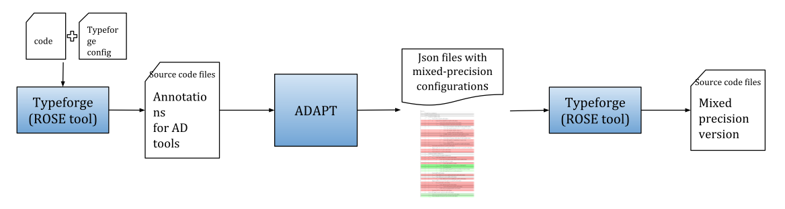
automatic Floating-point precision analysis
Notes:
Since

