Slide 1



PruneJuice: Pruning Trillion-edge Graphs to a Precise Pattern-Matching Solution
Tahsin Reza Matei Ripeanu Nicolas Tripoul
Geoffrey Sanders Roger Pearce

Slide 2
An Application of Pattern Matching in a Large Social Network Graph
E
P
Going to
Going to
Likes
P
Likes
U
Friend
U
Going to
E
Likes
Friend
Friend
Friend
Going to
U
U
U
Friend
Friend
Friend
U
User
Going to
Likes
Likes
Likes
E
Event
E
P
U
U
P
P
Page
Likes
[Ching 2015]
Social Network

Slide 3
An Application of Pattern Matching in a Large Social Network Graph
Link Recommendation
E
P
Going to
Going to
Likes
P
Likes
U
Friend
U
Going to
E
U
Likes
Friend
Friend
Friend
Going to
U
U
U
U
P
E
Friend
Friend
Friend
U
User
Going to
Likes
Likes
U
Likes
E
Event
E
P
U
U
P
P
Page
Social Network
[Ching 2015]
Template

Slide 4
An Application of Pattern Matching in a Large Social Network Graph
E
P
U
Going to
Going to
Likes
U
P
Likes
U
Friend
U
Going to
E
P
E
U
Likes
Friend
Friend
Friend
Going to
Template
U
U
U
Friend
Friend
Friend
U
User
Going to
Likes
Likes
Likes
E
Event
E
P
U
U
P
P
Page
Likes
[Ching 2015]
Social Network

Slide 5
An Application of Pattern Matching in a Large Social Network Graph
E
P
U
Going to
Going to
Likes
U
P
Likes
U
Friend
U
Going to
E
P
E
U
Likes
Friend
Friend
Friend
Going to
Template
U
U
U
Friend
Friend
Friend
U
User
Going to
Likes
Likes
Likes
E
Event
E
P
U
U
P
P
Page
Likes
[Ching 2015]
Social Network

Slide 6
Highlights
An Algorithmic Pipeline based on Graph Pruning
Enables robust and efficient pattern matching in large graphs
4.4T edges on 1024 nodes / 36,864 cores in < 1 minutes
Exact pattern matching
No assumptions about the background graph and template
System designed to curb combinatorial explosion

Slide 7
The Challenge
< 1 min. to prune a 128B webgraph¹ by 10⁵
  |V*| = 81,913, 2|E*| = 255,022
40+ hours to enumerate the pruned graph
1.49+ billion matches
biz
org
mil
gov
edu
ac
net
info
¹Web Data Commons Hyperlink graph

Slide 8
The Challenge
biz
org
mil
gov
edu
ac
net
info
Tree-search
Message growth for walks starting from 5 vertices
[Ullman1976]

Slide 9
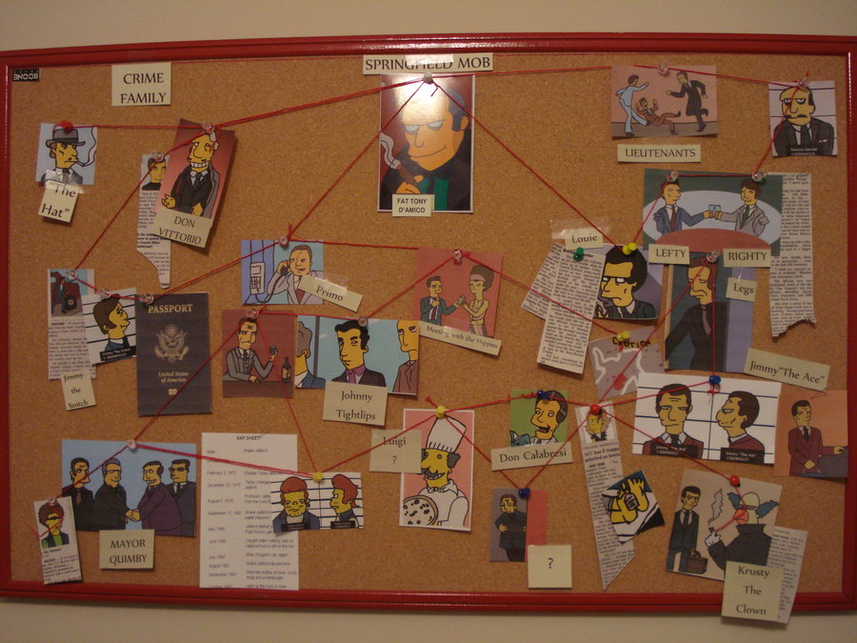
http://calto.info/topics/simpsons-the-springfield-mafia.html

Slide 10

http://calto.info/topics/simpsons-the-springfield-mafia.html

Slide 11

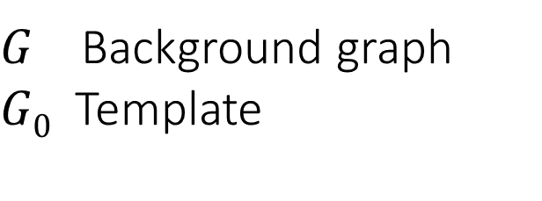

The Big Picture
Do not scale
Match Counting
Existing Techniques
$$G, G0$$
Enumeration
Top-k Query
Centrality-based Ranking
Set of Matching Vertices and Edges
$G$ Background graph
$G0$ Template
Match Exists?

Slide 12
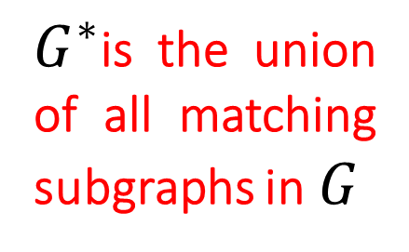


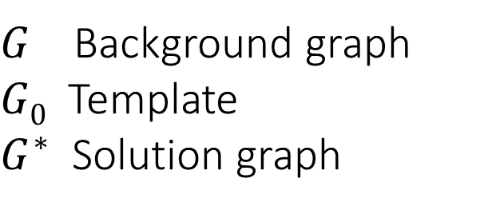
The Big Picture
Do not scale
Match Counting
Existing Techniques
$$G, G0$$
Enumeration
Top-k Query
$G^{∗}$is the union of all matching subgraphs in $G$
Centrality-based Ranking
Our Approach Graph pruning
Set of Matching Vertices and Edges
$$G^{∗}$$
$G$ Background graph
$G0$ Template
$G^{∗}$ Solution graph
$$G^{∗}≪G$$
Match Exists?

Slide 13
The Big Picture
Do not scale
Match Counting
Existing Techniques
$$G, G0$$
Enumeration
Top-k Query
$G^{∗}$is the union of all matching subgraphs in $G$
Centrality-based Ranking
Our Approach Graph pruning
Set of Matching Vertices and Edges
$$G^{∗}$$
$G$ Background graph
$G0$ Template
$G^{∗}$ Solution graph
Match Exists?

Slide 14

The Big Picture
Enumeration
Match Counting
$$G, G0$$
Operating on $G^{∗}$
Top-k Query
Centrality-based Ranking
Our Approach Graph pruning
Set of Matching Vertices and Edges
$$G^{∗}$$
$G$ Background graph
$G0$ Template
$G^{∗}$ Solution graph
Match Exists?

Slide 15

The Big Picture
Enumeration
Match Counting
Existing Techniques
Enumeration
Top-k Query
$$G, G0$$
Operating on $G^{∗}$
Match Counting
$$G, G0$$
Design Objectives
Graph Pruning for Pattern Matching
Evaluation Methodology
Experiment Results
Centrality-based Ranking
Our Approach Graph pruning
Our Approach Graph pruning
Match Exists?
Operating on $G^{∗}$
Set of Matching Vertices and Edges
$$G^{∗}$$
$G$ Background graph
$G0$ Template
$G^{∗}$ Solution graph
Match Exists?

Slide 16
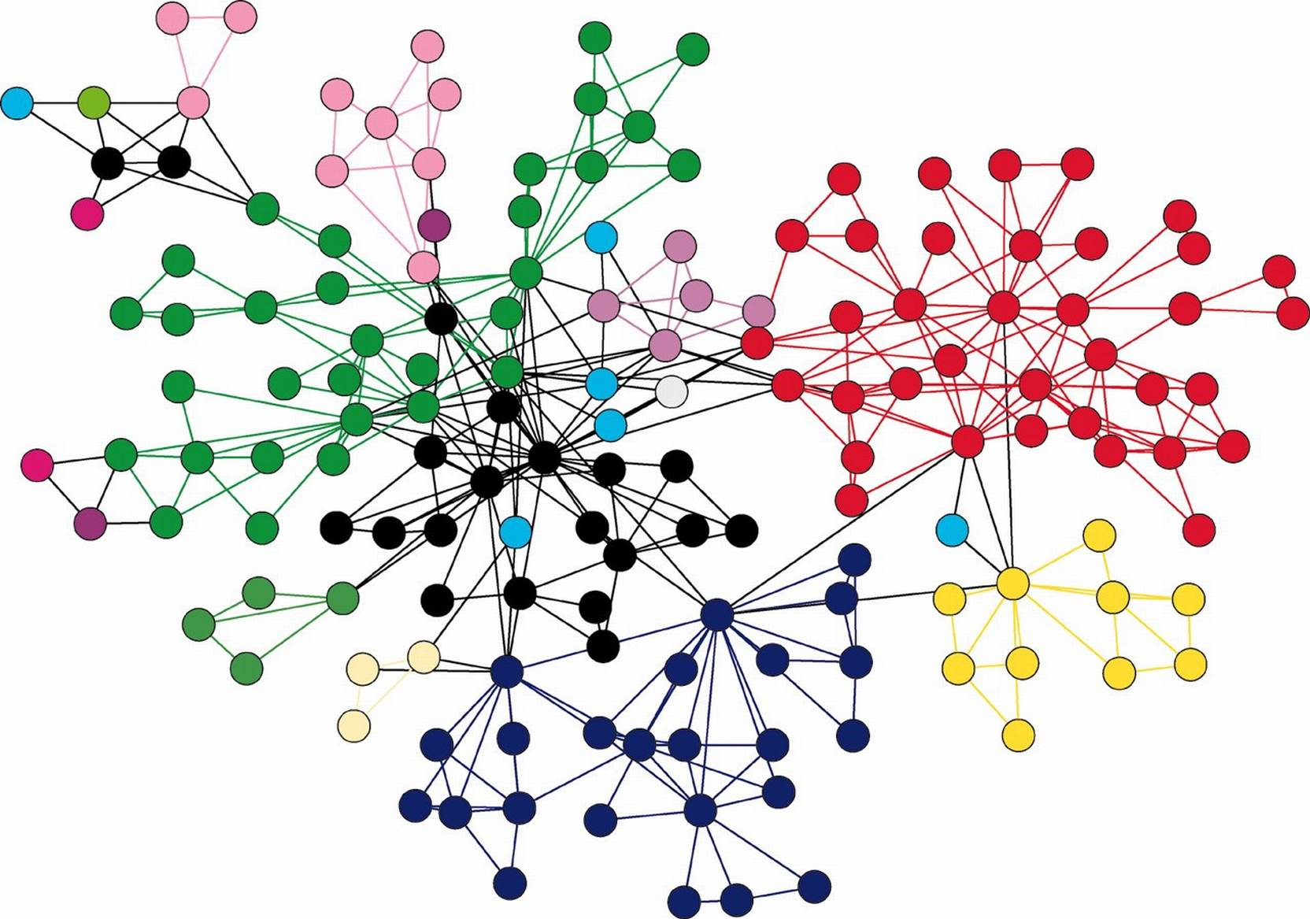
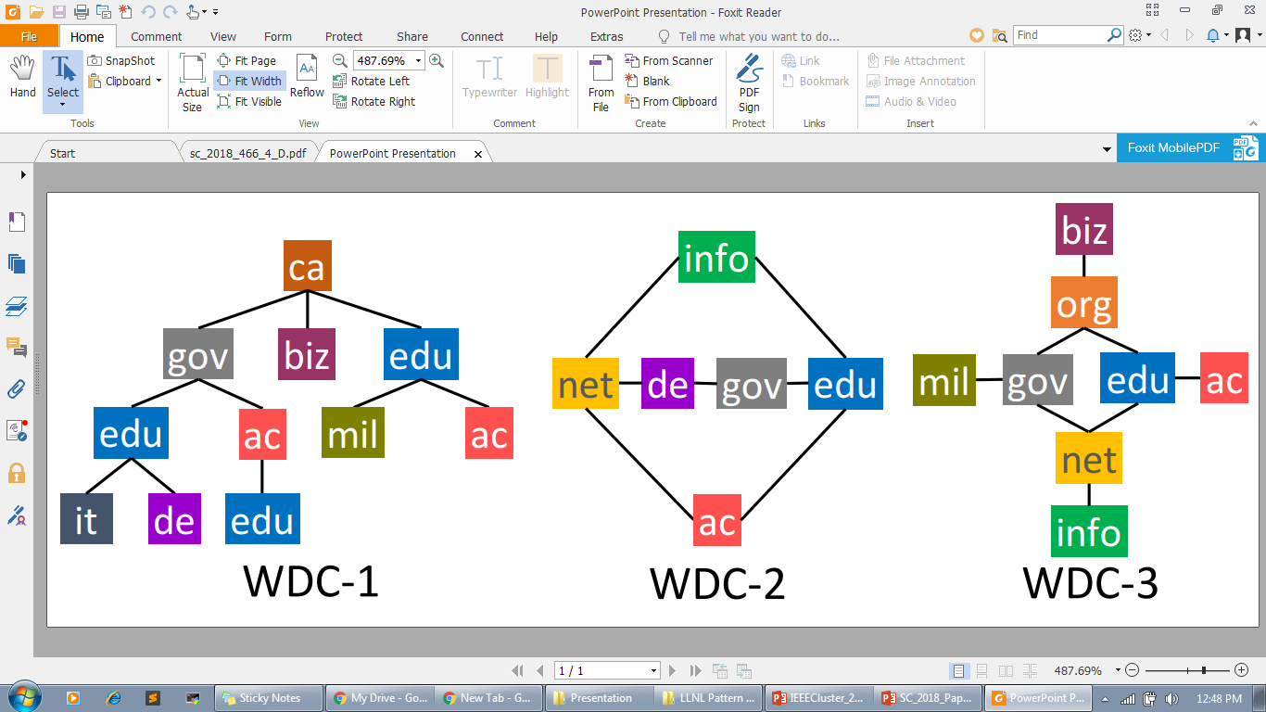
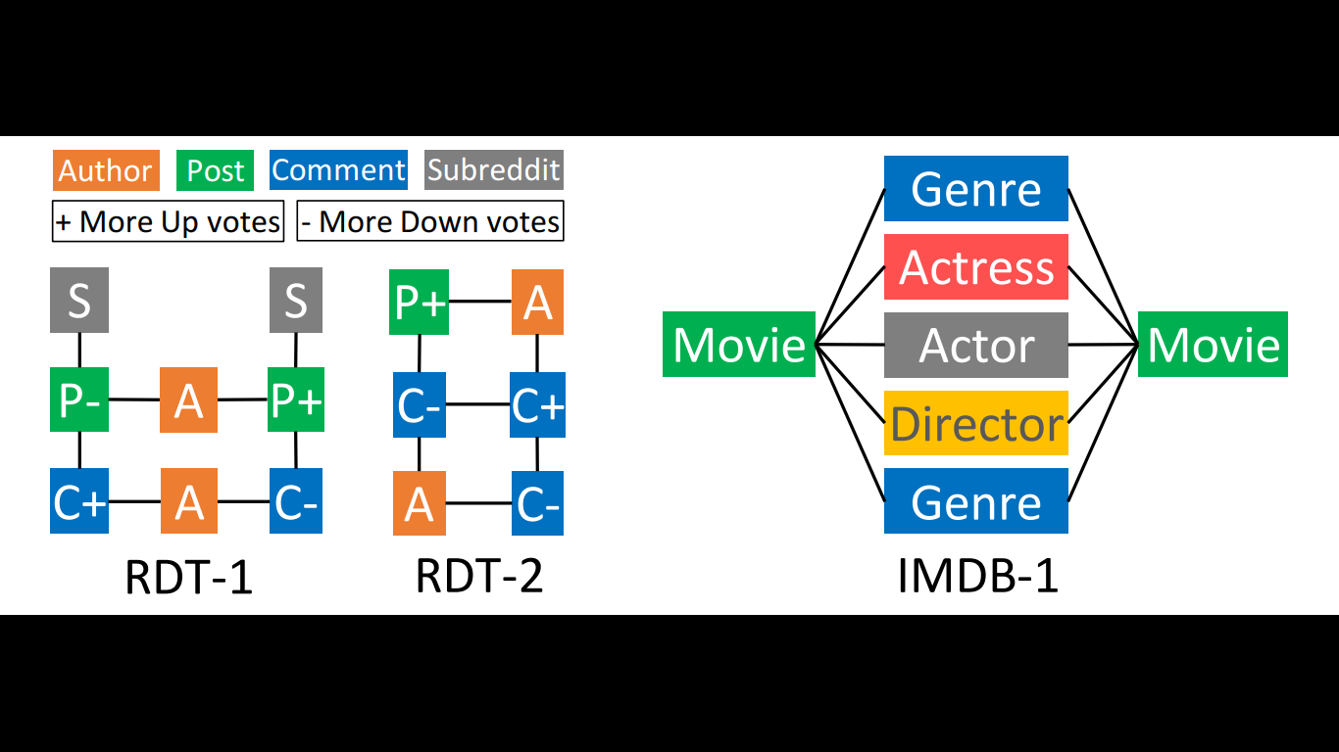


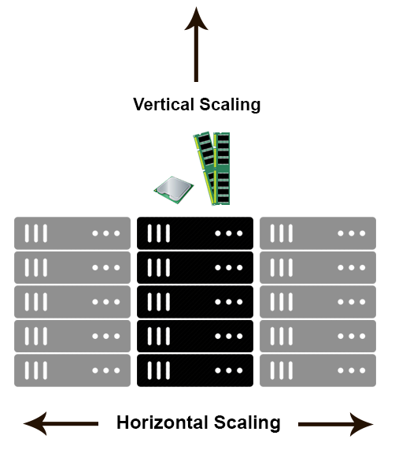



Design Objectives
Design Objectives
Graph Pruning for Pattern Matching
Evaluation Methodology
Experiment Results
Arbitrary Patterns
Large Graphs
10⁹ – 10¹² edges
Fast Time-to-Solution
Horizontal Scalability, 10⁴ Cores
Vertex-Centric
100% Precision and Recall
HavoqGT

Slide 17



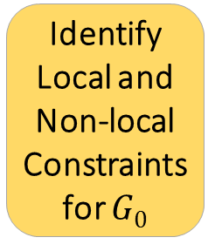
Overview of the Graph Pruning Pipeline
Design Objectives
Graph Pruning for Pattern Matching
Evaluation Methodology
Experiment Results
Identify Local and Non-local Constraints for $G0$
Local Constraint Checking
For each non-local constraint
$$G, G0$$
Non-local Constraint Checking
Local Constraint Checking
$$G^{∗}$$
$G$ Background graph
$G0$ Template
$G^{∗}$ Solution graph, union of all matching subgraphs

Slide 18

Constraint Generation
Design Objectives
Graph Pruning for Pattern Matching
Evaluation Methodology
Experiment Results
Identify Local and Non-local Constraints for $G0$
Local Constraint Checking
For each non-local constraint
$$G, G0$$
Non-local Constraint Checking
Local Constraint Checking
$$G^{∗}$$
$G$ Background graph
$G0$ Template
$G^{∗}$ Solution graph, union of all matching subgraphs

Slide 19

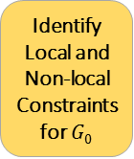

Local constraints of $G0$
Design Objectives
Graph Pruning for Pattern Matching
Evaluation Methodology
Experiment Results
U
U
P
E
U
Template
Identify Local and Non-local Constraints for $G0$
Local Constraint Checking
For each non-local constraint
$$G, G0$$
Non-local Constraint Checking
Local Constraint Checking
$$G^{∗}$$

Slide 20
Non-local constraints of $G0$
Design Objectives
Graph Pruning for Pattern Matching
Evaluation Methodology
Experiment Results
U
U
P
E
U
Template
Identify Local and Non-local Constraints for $G0$
Local Constraint Checking
For each non-local constraint
$$G, G0$$
Non-local Constraint Checking
Local Constraint Checking
$$G^{∗}$$

Slide 21
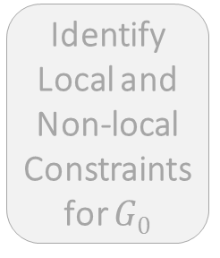
Local Constraint Checking – Eliminates vertices and edges
Design Objectives
Graph Pruning for Pattern Matching
Evaluation Methodology
Experiment Results
Identify Local and Non-local Constraints for $G0$
Local Constraint Checking
For each non-local constraint
$$G, G0$$
Non-local Constraint Checking
Local Constraint Checking
$$G^{∗}$$
$G$ Background graph
$G0$ Template
$G^{∗}$ Solution graph, union of all matching subgraphs

Slide 22
Local Constraint Checking – Eliminates vertices and edges
Design Objectives
Graph Pruning for Pattern Matching
Evaluation Methodology
Experiment Results
E
P
P
U
U
E
U
U
P
E
U
U
U
U
Template
E
P
U
U
P
Identify Local and Non-local Constraints for $G0$
Local Constraint Checking
For each non-local constraint
$$G, G0$$
Non-local Constraint Checking
Local Constraint Checking
$$G^{∗}$$

Slide 23
Local Constraint Checking – Eliminates vertices and edges
Design Objectives
Graph Pruning for Pattern Matching
Evaluation Methodology
Experiment Results
E
P
P
U
U
E
U
U
P
E
U
U
U
U
Template
E
P
U
U
P
Identify Local and Non-local Constraints for $G0$
Local Constraint Checking
For each non-local constraint
$$G, G0$$
Non-local Constraint Checking
Local Constraint Checking
$$G^{∗}$$

Slide 24

Non-local Constraint Checking – Eliminates vertices
Design Objectives
Graph Pruning for Pattern Matching
Evaluation Methodology
Experiment Results
Identify Local and Non-local Constraints for $G0$
Local Constraint Checking
For each non-local constraint
$$G, G0$$
Non-local Constraint Checking
Local Constraint Checking
$$G^{∗}$$
$G$ Background graph
$G0$ Template
$G^{∗}$ Solution graph, union of all matching subgraphs

Slide 25
Non-local constraints of $G0$
Design Objectives
Graph Pruning for Pattern Matching
Evaluation Methodology
Experiment Results
U
U
U
P
E
U
U
U
P
E
U
U
U
Template
P
E
P
E
U
U
Identify Local and Non-local Constraints for $G0$
Local Constraint Checking
For each non-local constraint
$$G, G0$$
Non-local Constraint Checking
Local Constraint Checking
$$G^{∗}$$

Slide 26
Non-local Constraint Checking – Eliminates vertices
Design Objectives
Graph Pruning for Pattern Matching
Evaluation Methodology
Experiment Results
U
E
P
T
P
U
P
U
U
E
U
T
U
U
E
P
E
T
U
U
U
U
U
U
Template
P
E
T
E
P
U
U
P
U
U
Identify Local and Non-local Constraints for $G0$
Local Constraint Checking
For each non-local constraint
P
E
$$G, G0$$
Non-local Constraint Checking
Local Constraint Checking
$$G^{∗}$$
U

Slide 27
Non-local Constraint Checking – Eliminates vertices
Design Objectives
Graph Pruning for Pattern Matching
Evaluation Methodology
Experiment Results
U
E
P
T
P
U
P
U
U
E
U
T
U
U
E
P
E
T
U
U
U
U
U
U
Template
P
E
E
T
P
U
U
P
U
U
Identify Local and Non-local Constraints for $G0$
Local Constraint Checking
For each non-local constraint
P
E
$$G, G0$$
Non-local Constraint Checking
Local Constraint Checking
$$G^{∗}$$
U

Slide 28
Non-local Constraint Checking – Eliminates vertices
Design Objectives
Graph Pruning for Pattern Matching
Evaluation Methodology
Experiment Results
U
E
P
P
U
P
U
U
E
U
U
U
E
P
E
U
U
U
U
U
U
Template
P
E
E
P
U
U
P
U
U
Identify Local and Non-local Constraints for $G0$
Local Constraint Checking
For each non-local constraint
P
E
$$G, G0$$
Non-local Constraint Checking
Local Constraint Checking
$$G^{∗}$$
U

Slide 29
Design Objectives
Graph Pruning for Pattern Matching
Evaluation Methodology
Experiment Results
Solution Graph $G^{∗}$, union of all matching subgraphs
Identify Local and Non-local Constraints for $G0$
Local Constraint Checking
For each non-local constraint
$$G, G0$$
Non-local Constraint Checking
Local Constraint Checking
$$G^{∗}$$
$G$ Background graph
$G0$ Template
$G^{∗}$ Solution graph, union of all matching subgraphs

Slide 30

Solution Graph $G^{∗}$, union of all matching subgraphs
Design Objectives
Graph Pruning for Pattern Matching
Evaluation Methodology
Experiment Results
E
P
P
U
U
E
U
U
P
E
U
U
U
U
Template
E
P
U
U
P
Identify Local and Non-local Constraints for $G0$
Local Constraint Checking
For each non-local constraint
$$G, G0$$
Non-local Constraint Checking
Local Constraint Checking
$$G^{∗}$$

Slide 31


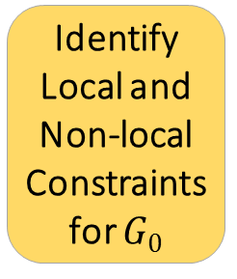
Full Match Enumeration on the Solution Graph $G^{∗}$
Design Objectives
Graph Pruning for Pattern Matching
Evaluation Methodology
Experiment Results
Identify Local and Non-local Constraints for $G0$
Local Constraint Checking
For each non-local constraint
Non-local Constraint Checking
Local Constraint Checking
Full Match Enumeration
$$G, G0$$
$$G^{∗}$$
Non-local constraint ordering influences performance
Constraint selection and ordering can be optimized
  Exploratory work at IA^3 (2018)

Slide 32
Distributed System Implementation on top of HavoqGT
Design Objectives
Graph Pruning for Pattern Matching
Evaluation Methodology
Experiment Results
Metadata Store
LCC
NLCC
Enumeration
Control Logic
HavoqGT Vertex-Centric API
HavoqGT Asynchronous Visitor Queue MPI Runtime
HavoqGT Delegate Partitioned Graph
Checkpointing and Load Balancing
[Pearce 2014]

Slide 33
Evaluation
Design Objectives
Graph Pruning for Pattern Matching
Evaluation Methodology
Experiment Results
Strong and weak scaling exp. for pruning
Performance metrics
  Search time for a single template
  Pruning factor
Full match enumeration on the pruned graph
Comparison with related work
Insights into performance

Slide 34
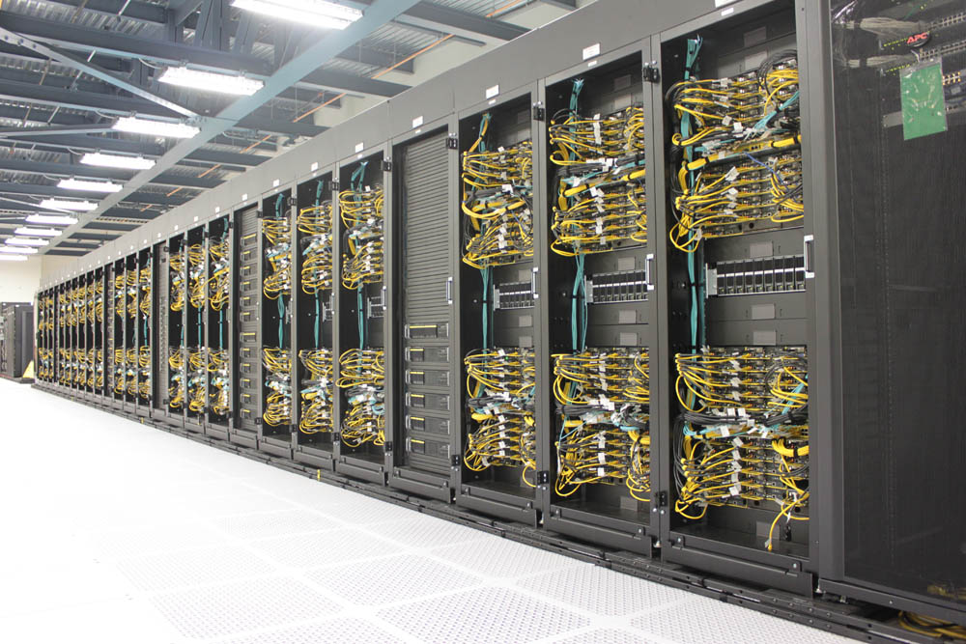
Testbed – Quartz at
Design Objectives
Graph Pruning for Pattern Matching
Evaluation Methodology
Experiment Results
Quartz System Details
CPU Arch. | Intel Xeon E5-2695 (2.1GHz)
Cores/Node | 36 (2x CPU Sockets)
Memory/Node | 128GB
Total Nodes | 2,634
Peak Perf. | 2.6PFlop
Interconnect | Intel Omni-Path
63rd in TOP500 List – June 2018
TOSS3 kernel version 3.10 | OpenMPI 2.0 | GCC 4.9

Slide 35



Workloads
Design Objectives
Graph Pruning for Pattern Matching
Evaluation Methodology
Experiment Results
Graphs | Type | |V| | 2|E| | d_{max} | d_{avg} | d_{stdev} | Size
Web Data Commons | Real | 3.5B | 257B | 95M | 72.25 | 3.6K | 2.7TB
Reddit | Real | 3.9B | 14B | 19M | 3.74 | 483.25 | 460GB
IMDb | Real | 5M | 29M | 552K | 5.83 | 342.64 | < 2GB
Patent | Real | 2.7M | 28M | 789 | 10.17 | 10.80 | < 2GB
Youtube | Real | 4.6M | 88M | 2.5K | 19.16 | 21.67 | < 2GB
R-MAT up to Scale 37 | Synthetic | 137B | 4.4T | 612M | 32 | 4.9K | 45TB

Slide 36
Workloads
Design Objectives
Graph Pruning for Pattern Matching
Evaluation Methodology
Experiment Results
Graphs | Type | |V| | 2|E| | d_{max} | d_{avg} | d_{stdev} | Size
Web Data Commons | Real | 3.5B | 257B | 95M | 72.25 | 3.6K | 2.7TB
Reddit | Real | 3.9B | 14B | 19M | 3.74 | 483.25 | 460GB
IMDb | Real | 5M | 29M | 552K | 5.83 | 342.64 | < 2GB
Patent | Real | 2.7M | 28M | 789 | 10.17 | 10.80 | < 2GB
Youtube | Real | 4.6M | 88M | 2.5K | 19.16 | 21.67 | < 2GB
R-MAT up to Scale 37 | Synthetic | 137B | 4.4T | 612M | 32 | 4.9K | 45TB

Slide 37
Strong Scaling – Web Data Commons (WDC) Hyperlink Graph
Design Objectives
Graph Pruning for Pattern Matching
Evaluation Methodology
Experiment Results
3.5 billion vertices and 128 billion directed edges (2.7TB)
Vertex labels – top-level domain names, e.g., gov, ca, and edu, 2903 labels
These are the among the most frequent domains, covering ∼22% of the vertices in the WDC graph. org covers 220M vertices, the 2nd most frequent after com.
http://webdatacommons.org/hyperlinkgraph/index.html

Slide 38
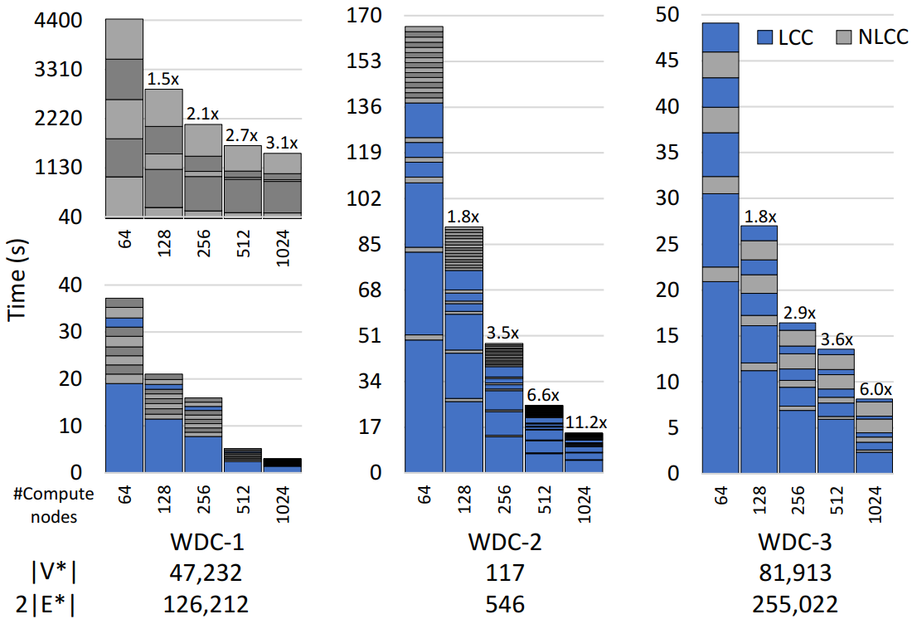
Strong Scaling Experiments
Design Objectives
Graph Pruning for Pattern Matching
Evaluation Methodology
Experiment Results
# Compute nodes
Template

Slide 39
Strong Scaling Experiments
Design Objectives
Graph Pruning for Pattern Matching
Evaluation Methodology
Experiment Results
# Compute nodes
Template

Slide 40
Strong Scaling Experiments
Design Objectives
Graph Pruning for Pattern Matching
Evaluation Methodology
Experiment Results
# Compute nodes
Template

Slide 41
Strong Scaling Experiments
Design Objectives
Graph Pruning for Pattern Matching
Evaluation Methodology
Experiment Results
Good strong scaling for cyclic and acyclic templates, up to 90% efficient
LCC shows near perfect strong scaling
NLCC is the bottleneck – topology, match distribution, load imbalance
# Compute nodes
Template

Slide 42
Match Enumeration on the Pruned Graph
Design Objectives
Graph Pruning for Pattern Matching
Evaluation Methodology
Experiment Results
Count | 668M | 2,444 | 1.49B
Time | 4min | 1.84s | 40h

Slide 43
Match Enumeration on the Pruned Graph
Design Objectives
Graph Pruning for Pattern Matching
Evaluation Methodology
Experiment Results
< 1 min. to prune the 128B webgraph¹ by 10⁵
  |V*| = 81,913, 2|E*| = 255,022
40+ hours to enumerate the pruned graph
1.49+ billion matches
‘To Enumerate, or Not to Enumerate’
¹Web Data Commons Hyperlink graph

Slide 44
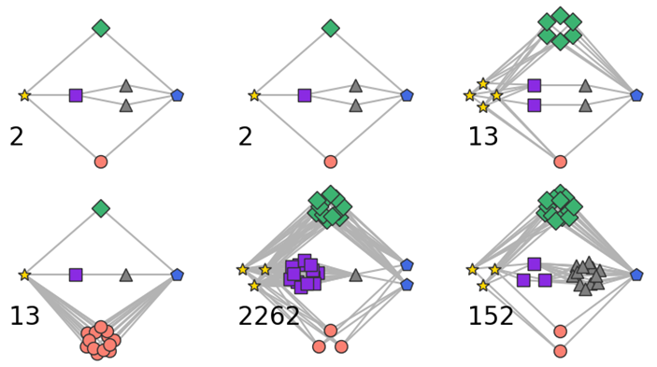

‘To Enumerate, or Not to Enumerate’
Design Objectives
Graph Pruning for Pattern Matching
Evaluation Methodology
Experiment Results
2,444
Output produced from the pruned subgraph using matplotlib

Slide 45
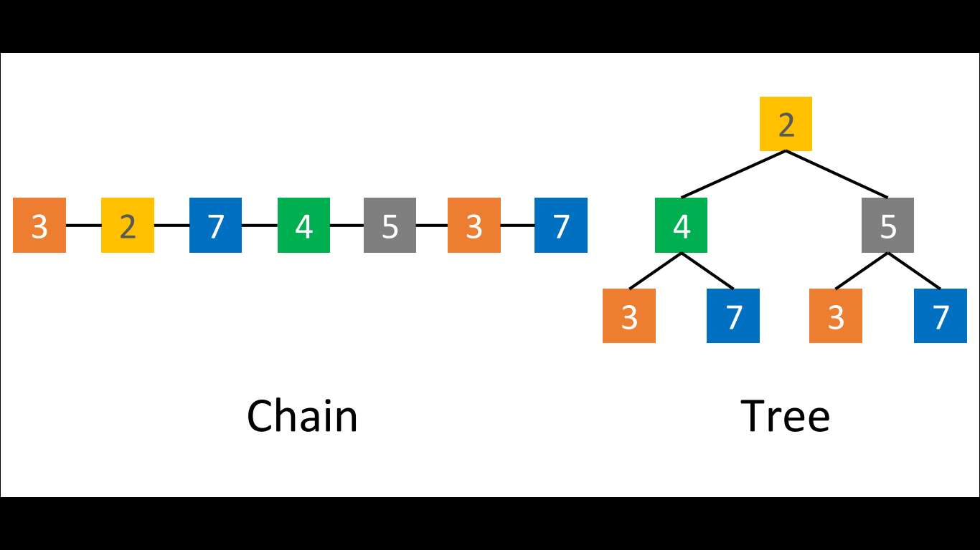
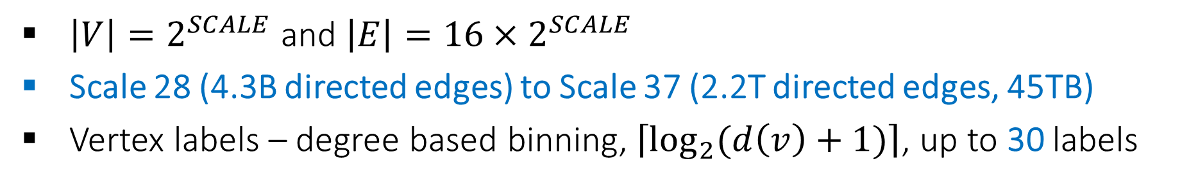
Weak Scaling – Recursive Matrix (R-MAT), Graph500 Synthetic Graphs
Design Objectives
Graph Pruning for Pattern Matching
Evaluation Methodology
Experiment Results
$\left|V\right|=2^{SCALE}$ and $\left|E\right|={16×2}^{SCALE}$
Scale 28 (4.3B directed edges) to Scale 37 (2.2T directed edges, 45TB)
Vertex labels – degree based binning, $\left\lceil \log_{2}{(d\left(v\right)+1)}\right\rceil$, up to 30 labels
These labels cover ∼30% of the vertices, with 2 being the most frequent label (14B instances in the Scale 37 graph)

Slide 46
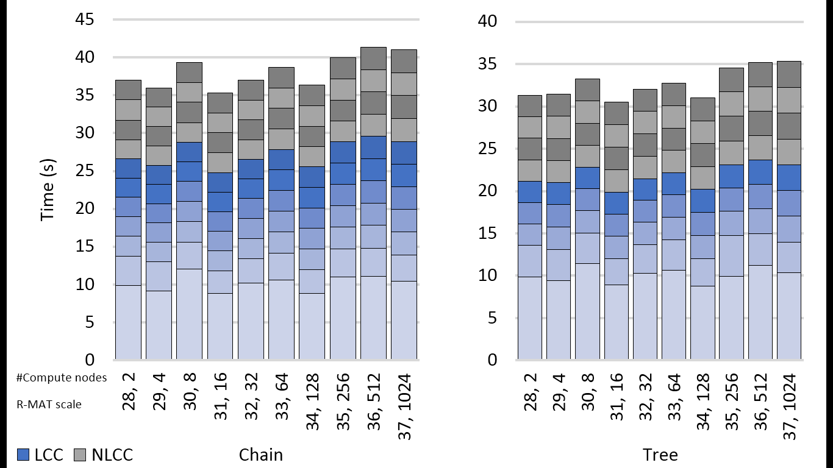
Weak Scaling Experiments
Design Objectives
Graph Pruning for Pattern Matching
Evaluation Methodology
Experiment Results
Steady weak scaling
Prunes trillion edge graphs by 10⁷ in < 1 min.
Number of iterations depends on the topology, diameter of the template

Slide 47
Comparison with Arabesque/QFrag [SOSP’15, SoCC’17]
Design Objectives
Graph Pruning for Pattern Matching
Evaluation Methodology
Experiment Results
Patent | 9x | 6.4x | 10x | 10x
Youtube | 4.4x | 3.9x | 6.6x | 4.3x
a
a
a
a
b
c
b
c
b
b
c
d
e
d
c
d
d
e
f
Speedup over QFrag on 60 cores, single node
Runtime for pruning + enumeration
Multithreaded shared memory – up to 100x speedup

Slide 48
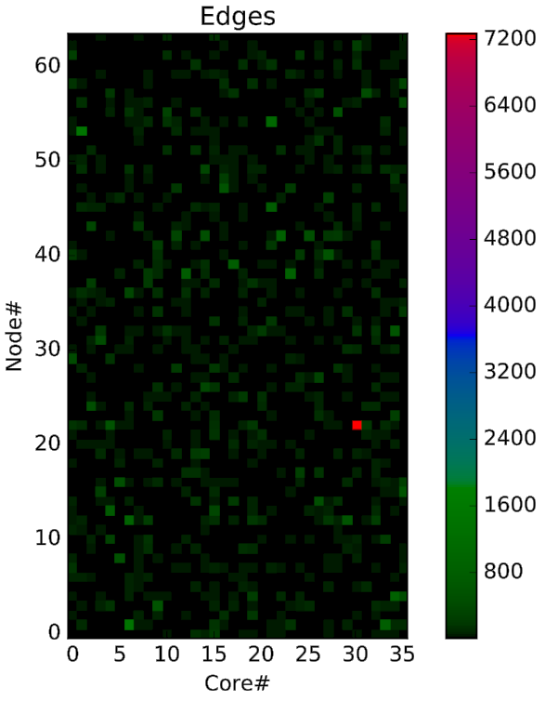
Explaining Performance …
Design Objectives
Graph Pruning for Pattern Matching
Evaluation Methodology
Experiment Results
Graph mutation
Nonuniform distribution of matches in the bkg. graph
Load imbalance
Loss of parallelism
668M

Slide 49


Takeaways
What makes a pruning-based approach promising?
U
U
U
U
U
U
No false positives or negatives
P
E
P
E
P
E
P
E
U
U
U
U
U
Template
Smaller algorithm state – can prevent combinatorial explosion
Search space reduction – enumeration is now less expensive
Tahsin Reza treza@ece.ubc.ca
netsyslab.ece.ubc.ca
computation.llnl.gov/casc

