Slide 1
Framework for scalable intra-node collective operations using shared memory
Presenter: Surabhi Jain
Contributors: Surabhi Jain, Rashid Kaleem, Marc Gamell Balmana, Akhil Langer, Dmitry Durnov, Alexander Sannikov, and Maria Garzaran
Supercomputing 2018, Dallas, USA

Slide 2
Legal Notices & Disclaimers
Acknowledgment: This material is based upon work supported by the U.S. Department of Energy and Argonne National Laboratory and its Leadership Computing Facility under Award Number(s) DE-AC02-06CH11357 and Award Number 8F-30005. This work was generated with financial support from the U.S. Government through said Contract and Award Number(s), and as such the U.S. Government retains a paid-up, nonexclusive, irrevocable, world-wide license to reproduce, prepare derivative works, distribute copies to the public, and display publicly, by or on behalf of the Government, this work in whole or in part, or otherwise use the work for Federal purposes.
Disclaimer: This report/presentation was prepared as an account of work sponsored by an agency and/or National Laboratory of the United States Government. Neither the United States Government nor any agency or National Laboratory thereof, nor any of their employees, makes any warranty, express or implied, or assumes any legal liability or responsibility for the accuracy, completeness, or usefulness of any information, apparatus, product, or process disclosed, or represents that its use would not infringe privately owned rights. Reference herein to any specific commercial product, process, or service by trade name, trademark, manufacturer, or otherwise does not necessarily constitute or imply its endorsement, recommendation, or favoring by the United States Government or any agency or National Laboratory thereof. The views and opinions of authors expressed herein do not necessarily state or reflect those of the United States Government or any agency or National Laboratory thereof.
Access to this document is with the understanding that Intel is not engaged in rendering advice or other professional services. Information in this document may be changed or updated without notice by Intel.
This document contains copyright information, the terms of which must be observed and followed.
Reference herein to any specific commercial product, process or service does not constitute or imply endorsement, recommendation, or favoring by Intel or the US Government.
Intel makes no representations whatsoever about this document or the information contained herein. IN NO EVENT SHALL INTEL BE LIABLE TO ANY PARTY FOR ANY DIRECT, INDIRECT, SPECIAL OR OTHER CONSEQUENTIAL DAMAGES FOR ANY USE OF THIS DOCUMENT, INCLUDING, WITHOUT LIMITATION, ANY LOST PROFITS, BUSINESS INTERRUPTION, OR OTHERWISE, EVEN IF INTEL IS EXPRESSLY ADVISED OF THE POSSIBILITY OF SUCH DAMAGES.
2

Slide 3
Legal Notices & Disclaimers (cont.)
INFORMATION IN THIS DOCUMENT IS PROVIDED “AS IS”. NO LICENSE, EXPRESS OR IMPLIED, BY ESTOPPEL OR OTHERWISE, TO ANY INTELLECTUAL PROPERTY RIGHTS IS GRANTED BY THIS DOCUMENT. INTEL ASSUMES NO LIABILITY WHATSOEVER AND INTEL DISCLAIMS ANY EXPRESS OR IMPLIED WARRANTY, RELATING TO THIS INFORMATION INCLUDING LIABILITY OR WARRANTIES RELATING TO FITNESS FOR A PARTICULAR PURPOSE, MERCHANTABILITY, OR INFRINGEMENT OF ANY PATENT, COPYRIGHT OR OTHER INTELLECTUAL PROPERTY RIGHT.
Software and workloads used in performance tests may have been optimized for performance only on Intel microprocessors. Performance tests, such as SYSmark and MobileMark, are measured using specific computer systems, components, software, operations and functions. Any change to any of those factors may cause the results to vary. You should consult other information and performance tests to assist you in fully evaluating your contemplated purchases, including the performance of that product when combined with other products. For more information go to www.intel.com/benchmarks.
Performance results are based on testing as of July 31, 2018 and may not reflect all publicly available security updates. See configuration disclosure for details. No component or product can be absolutely secure.
Intel®, Pentium®, Intel® Xeon®, Intel® Xeon PhiTM, Intel® CoreTM, Intel® VTuneTM, Intel® CilkTM, and the Intel logo are trademarks of Intel Corporation in the U.S. and other countries. *Other names and brands may be claimed as the property of others.
Optimization Notice
Intel’s compilers may or may not optimize to the same degree for non-Intel microprocessors for optimizations that are not unique to Intel microprocessors. These optimizations include SSE2, SSE3, and SSSE3 instruction sets and other optimizations. Intel does not guarantee the availability, functionality, or effectiveness of any optimization on microprocessors not manufactured by Intel. Microprocessor-dependent optimizations in this product are intended for use with Intel microprocessors. Certain optimizations not specific to Intel microarchitecture are reserved for Intel microprocessors. Please refer to the applicable product User and Reference Guides for more information regarding the specific instruction sets covered by this notice. Notice revision #20110804
3

Slide 4
Motivation
MPI collectives represent common communication patterns, computations, or synchronization
Why should we optimize intra-node collectives?
  They are on the critical path for many collectives (Reduce, Allreduce, Barrier,…)
      First, perform intra-node portion
      Then, perform inter-node portion
  Important for large multicore nodes and/or small clusters

Slide 5
Contributions
Propose a framework to optimize intra-node collectives
  Based on release/gather building blocks
  Dedicated shared memory layer
  Topology aware intra-node trees
  Implement 3 collectives: MPI_Bcast(), MPI_Reduce(), and MPI_Allreduce()
  Significant speedups with respect to MPICH, MVAPICH, and Open MPI
    E.g., for MPI_Allreduce, average speedups of
  3.9x faster than Open MPI
  1.2x faster than MVAPICH
  2.1x faster than MPICH/ch3, 2.9x faster than MPICH/ch4

Slide 6
Outline
Background
Design and Implementation
  Shared memory layout
  Release and gather steps
  Implement collectives using release and gather
Optimizations
Performance Evaluation
Conclusion

Slide 7
Background – MPI_Allreduce
Current MPI Implementations optimize collectives for multiple ranks per node
  Intra-node reduce
    MPICH and Open MPI use point to point, MVAPICH uses dedicated shared memory
Intra-node reduce
Node 0
Node 1
Node 2
Node 3
Rank 0
Rank 1
Rank 2
Rank 3
Rank 4
Rank 5
Rank 6
Rank 7
Rank 8
Rank 9
Rank 10
Rank 11
MPI_AllReduce ( …,0,... )

Slide 8
Background – MPI_Allreduce
Current MPI Implementations optimize collectives for multiple ranks per node
  Intra-node reduce
    MPICH and Open MPI use point to point, MVAPICH uses dedicated shared memory
  Inter-node allreduce
Inter-node allreduce
Node 0
Node 1
Node 2
Node 3
Rank 0
Rank 1
Rank 2
Rank 3
Rank 4
Rank 5
Rank 6
Rank 7
Rank 8
Rank 9
Rank 10
Rank 11
MPI_AllReduce ( …,0,... )

Slide 9
Background – MPI_Allreduce
Current MPI Implementations optimize collectives for multiple ranks per node
  Intra-node reduce
    MPICH and Open MPI use point to point, MVAPICH uses dedicated shared memory
  Inter-node allreduce
  Intra-node bcast
Intra-node bcast
Node 0
Node 1
Node 2
Node 3
Rank 0
Rank 1
Rank 2
Rank 3
Rank 4
Rank 5
Rank 6
Rank 7
Rank 8
Rank 9
Rank 10
Rank 11
MPI_AllReduce ( …,0,... )

Slide 10
Intra-node Broadcast
4 steps:
    Root copies to shared memory buffer
    Root sets a flag to let the ranks know that data is ready
    Other ranks copy the data out
    Other ranks update a flag to indicate the root that they have copied the data
Copy-out
Non-root 1
Root
User
buffer
MPI_Bcast (...)
User
buffer
Shared
buffer
MPI_Bcast (...)
Copy-in
Copy-out
User
buffer
Non-root 2
MPI_Bcast (…)

Slide 11
Intra-node Reduce
4 steps:
    Each non-root copies to shared memory
    Each non-root updates a flag to tell the root that data is ready
    Root copies the data out of each non-root
    Root updates a flag to tell non-roots that it has copied the data out
Non-root 1
Copy-in
MPI_Reduce (...)
User
buffer
Shared
buffer
Copy-out
Root
User
buffer
Copy-in
Shared
buffer
MPI_Reduce (...)
Non-root 2
User
buffer
Copy-out
MPI_Reduce (...)

Slide 12
Design and implementation

Slide 13
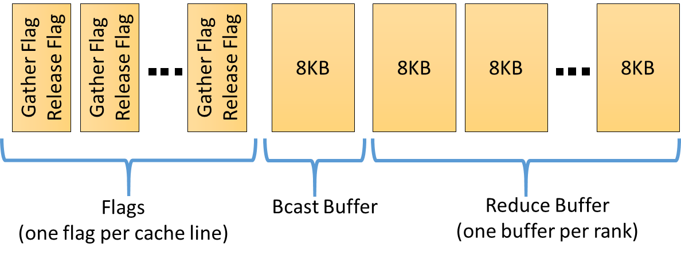
Shared Memory Layout
Bcast Buffer: Root copies the data in. Other ranks copy data out
Reduce Buffer: Each rank copy its data in. Root copies the data out and reduces
Flags: To notify the ranks after copying the data in/out of shared memory

Slide 14
Release and Gather steps
Release Step
0
Set-up-
  Arrange the ranks in a tree with rank 0 as the root
Release: A rank releases its children
  Top-down step
  Copy the data (if bcast)
  Inform the children using release flags
Gather: A rank gathers from all its children
  Bottom-up step
  Copy the data (if reduce)
  Inform the parent using gather flags
1
2
3
4
5
6
7
Gather Step
0
1
2
3
4
5
6
7

Slide 15
Bcast and Reduce using Release and Gather steps
0
0
1
2
1
2
3
4
5
6
3
4
5
6
7
7
Collective | Release step | Gather step
MPI_Bcast | Data movement Root copy data in shm buffer Inform children Children copy data out | Acknowledgment Inform parent buffer ready for next bcast
MPI_Reduce | Acknowledgement Inform children buffer ready for next reduce | Data movement All copy data in shm buffer Inform parent Parent reduce data

Slide 16
Optimizations
Intra-node topology aware trees
Data pipelining
Read from parent flag on the release step
Data copy optimization in reduce

Slide 17
Intra-node Topology aware trees
Socket 0
Socket 1
Socket 2
Socket 3
Socket 4
0
1
2
3
4
5
6
7
8
9
10
11
12
13
14
15
16
17
18
19
Subtree 0
Subtree 4
Subtree 8
Subtree 12
Subtree 16
0
0
4
8
12
16
S0
1
2
3
5
6
7
9
10
11
0
13
14
15
17
18
19
0
Socket-leader-first
0
Socket-leader-last
Better for release step
S0
4
8
4
8
S0
Better for gather step
12
16
12
16
S4
S8
S4
S8
S12
S16
S12
S16

Slide 18
Other variants for trees
Right skewed v/s left skewed
K-ary v/s k-nomial trees
Topology-unaware trees
0
0
1
2
2
1
3
4
5
6
6
5
4
3
7
7
Left skewed tree Right skewed tree

Slide 19
Data Pipelining
Split the large message into multiple
Bcast-
  Root copy the next chunk of data in next cell
  Non-roots copy out from previous cells
Reduce-
  Non-roots copy in the next cells
  Root reduce the data from previous cells
Also useful for back to back collectives
Cell 0
Non-root 1
Non-root 3
Cell 1
Root
Cell 2
Non-root 2
Bcast buffer split into 3

Slide 20
Other Optimizations
Read from parent flag on the release step
  Parent updates its own flag
  Not write flag for each child
Data copy optimization in Reduce
  Root reduce the data directly in its user-buffer
  Not reduce in shm buf and copy to user-buffer
0
1
2
3
4
5
6
7

Slide 21
performance evaluation

Slide 22
Experimental Setup
System Configuration
  Skylake (SKL): Intel® Xeon Gold 6138F CPU (2.0 GHz, 2 sockets, 20 cores/socket, 2 threads/core). 32KB L1 data and instruction cache, 1MB L2 cache, 27.5MB L3 cache
  OmniPath-1 Fabric Interconnect
Software Configuration
  Gcc compiler version 8.1.0
  SUSE Linux Enterprise Server 12 SP3 running linux version 4.4.132-94.33-default
  Libfabric (commit id 91669aa), opa-psm2 (commit id 0f9213e)
  MPICH (commit id d815dd4) used as the baseline for our implementation, MPICH/ch3, MPICH/ch4
  Open MPI (version 3.0.0) and MVAPICH (version 2-2.3rc1)
Benchmark
  Intel MPI Benchmarks (IMB) (version 2018 Update 1). Reported T-max used for comparison

Slide 23
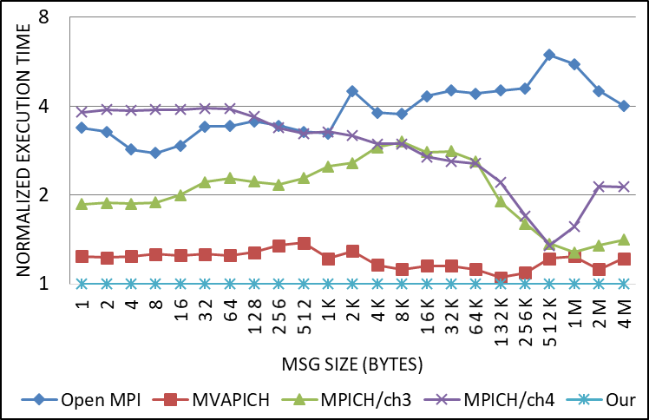
MPI_Bcast: Single node, 40 MPI ranks (1 rank per core)
Lower the better
32KB buffer split in 4 cells
Flat tree used to propagate flags
Tuned Open MPI, MVAPICH, MPICH/ch3, and MPICH/ch4
Average Speedups:
  3.9x faster than Open MPI
  1.2x faster than MVAPICH
  2.1x faster than MPICH/ch3
  2.9x faster than MPICH/ch4
Intel Xeon Gold 6138F CPU , 40 cores, 2 threads/core, 2.0 Ghz Frequency, 32KB of L1, 1MB of L2, 27.5 MB of L3 cache. gcc compiler version 8.1.0 SUSE Linux Enterprise Server 12 SP3. IMB Benchmarks “-iter 5000 -msglog 22 -sync 1 –imb_barrier 1 –root_shift 0”, Tmax

Slide 24
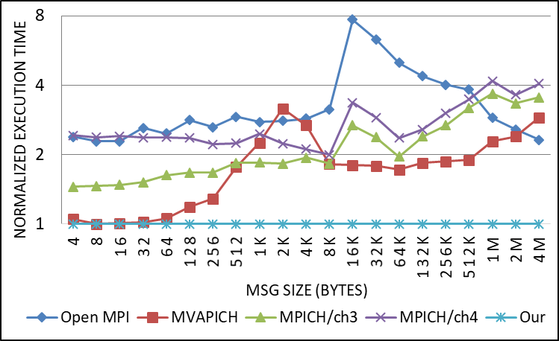
MPI_Allreduce: Single node, 40 MPI ranks (1 rank per core)
Lower the better
32KB buffers split in 4 cells
Tree configuration
  Reduce:
    Socket-leaders-last and right-skewed
    Msg size < 512B topology-unaware, k-nomial tree, K=4
    512B <= msg_size < 8KB topology aware, k-ary tree, K=3
    Msg size >= 8KB topology aware, k-ary tree, K=2
  Bcast: Flat tree
Intel Xeon Gold 6138F CPU , 40 cores, 2 threads/core, 2.0 Ghz Frequency, 32KB of L1, 1MB of L2, 27.5 MB of L3 cache. gcc compiler version 8.1.0 SUSE Linux Enterprise Server 12 SP3. IMB Benchmarks “-iter 5000 -msglog 22 -sync 1 –imb_barrier 1 –root_shift 0”, Tmax

Slide 25
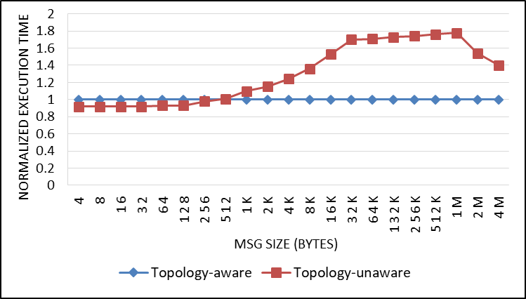
Impact of Topology aware trees
Lower the better
MPI_Reduce, 40 MPI ranks, 1 rank per core
Topology-aware tree
  Socket-leaders-last and right-skewed
  Msg size <= 4KB, k-ary tree, K=3
  Msg size > 4KB, k-ary tree, K=2
Topology-unaware trees
  Msg size <= 16KB, k-nomial tree, K=8
  Msg size > 16KB, k-nomial tree, K=2
Intel Xeon Gold 6138F CPU , 40 cores, 2 threads/core, 2.0 Ghz Frequency, 32KB of L1, 1MB of L2, 27.5 MB of L3 cache. gcc compiler version 8.1.0 SUSE Linux Enterprise Server 12 SP3. IMB Benchmarks “-iter 5000 -msglog 22 -sync 1 –imb_barrier 1 –root_shift 0”, Tmax

Slide 26
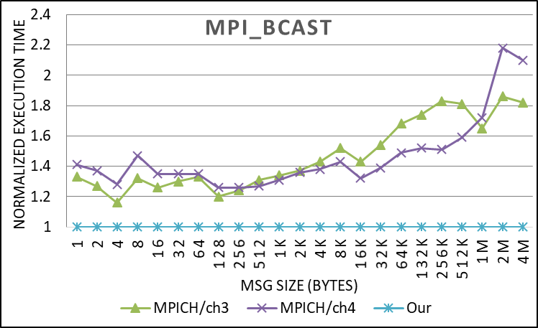
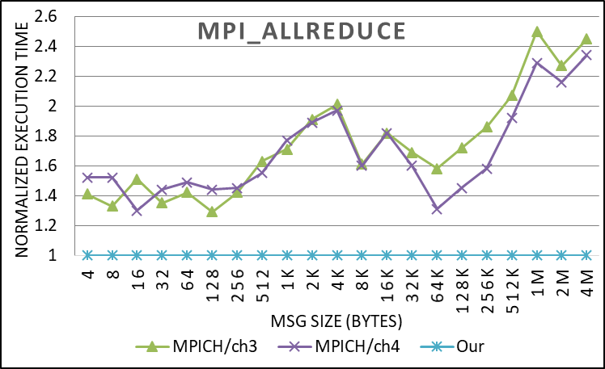
Multiple node runs (32 nodes, 40 ranks per node)
We only compare to MPICH/ch3 and MPICH/ch4 to keep the inter-node collectives implementation same
Lower the better
Intel Xeon Gold 6138F CPU , 40 cores, 2 threads/core, 2.0 Ghz Frequency, 32KB of L1, 1MB of L2, 27.5 MB of L3 cache. gcc compiler version 8.1.0 SUSE Linux Enterprise Server 12 SP3. IMB Benchmarks “-iter 5000 -msglog 22 -sync 1 –imb_barrier 1 –root_shift 0”, Tmax

Slide 27

Why are we better?
 | Network topology aware | Dedicated shared memory | Node topology aware
Open MPI
MVAPICH
MPICH (ch3, ch4)
Our framework

Slide 28
Conclusions
Implement MPI_Bcast, MPI_Reduce, and MPI_Allreduce using release and gather building blocks
Significantly outperform MVAPICH, Open MPI, and MPICH
Careful design of trees to propagate data and flags provide improvement upto 1.8x over naïve trees
Compared to MPICH, speedups upto 2.18x for MPI_Allreduce and upto 2.5x for MPI_Bcast on a 32 node cluster

Slide 29
Questions?
surabhi.jain@intel.com
Check out MPICH BoF today! @C145, 5:15pm

