Slide 1

Exploring Flexible Communications for Streamlining DNN Ensemble Training Pipelines
Randall Pittman, Hui Guan, Xipeng Shen
North Carolina State University
Seung-Hwan Lim, Robert Patton

Slide 2
Outline
DNN Ensembles
Efficiency challenges
New pipeline designs and implementations
Metrics and results

Slide 3
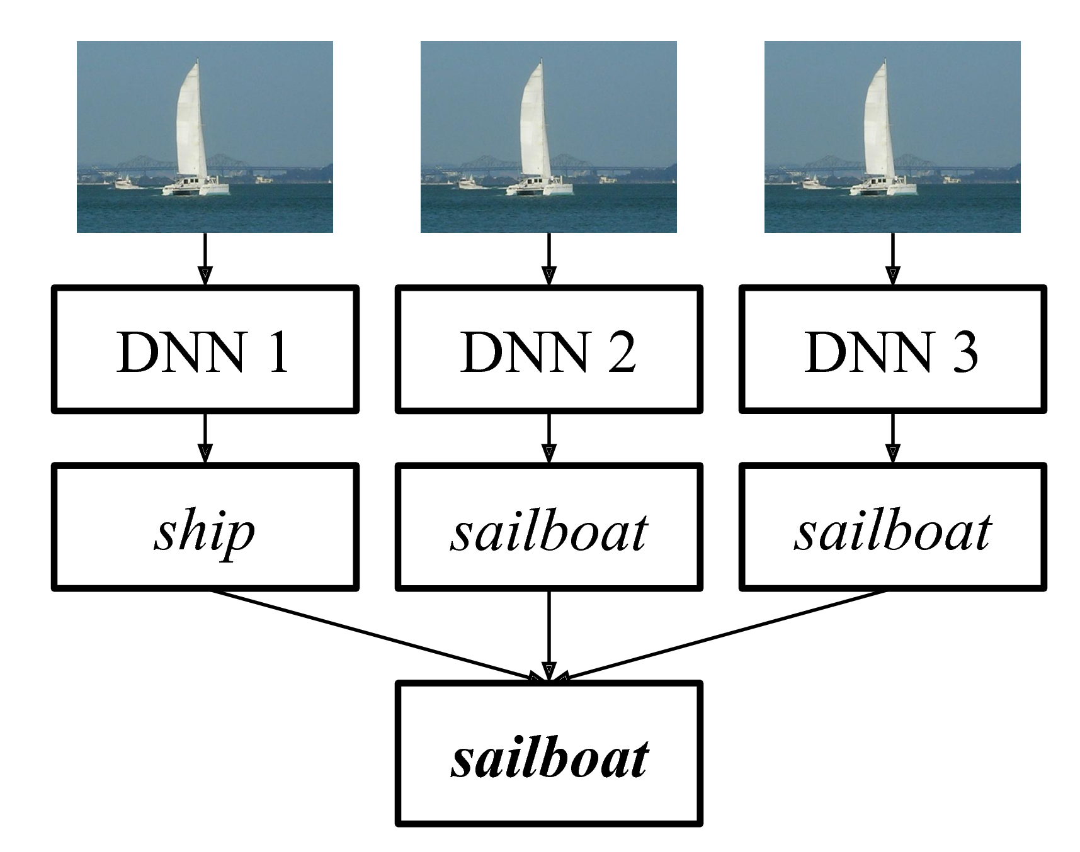
Ensemble Training
A DNN ensemble is a group of DNNs training simultaneously on a distributed system.
Use cases
Parameter tuning: Finding the best DNN structure or hyper-parameters.
Multiple predictors: Creating multiple good predictors, whose combined prediction gives better accuracies.

Slide 4
Open Questions for Ensembles
Training DNN ensembles poses interesting questions
What parts of the training pipeline can be optimized?
How can we minimize training time for large ensembles?
Will pipeline bottlenecks shift due to differences in cluster hardware?

Slide 5

Prior work on distributed training
Most only training one (large) DNN in parallel.
[ICDM ‘13] MLI: An API for Distributed Machine Learning
[OSDI ’16] Tensorflow: A System for Large Scale Machine Learning
[CoRR ‘17] User-Transparent Distributed Tensorflow
[arXiv ‘18] Horovod: Fast and Easy Distributed Deep Learning in Tensorflow
Not about creating flexible systems for efficient ensemble training for many DNNs.

Slide 6
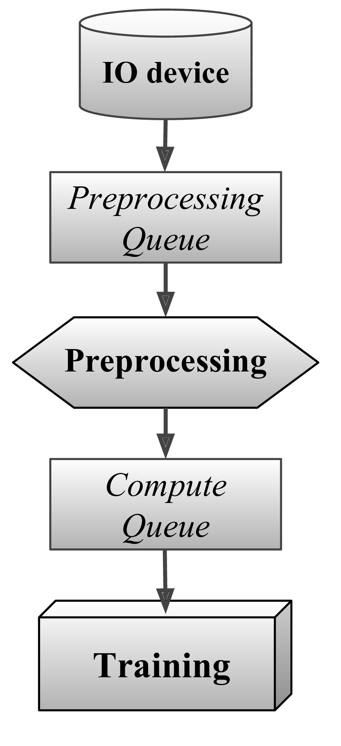
DNN Training Pipelines
Read data from IO device
Preprocess the data
Train DNN on preprocessed data
Multi-core CPU
GPU, TPU, or other accelerator

Slide 7
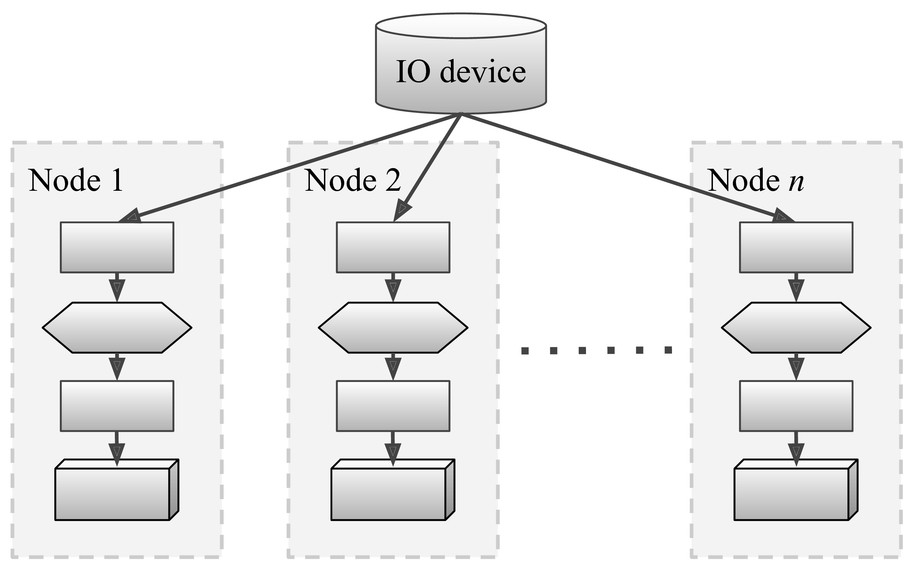
Ensemble Pipelines
A simple ensemble duplicates the standard training pipeline onto each cluster node.

Slide 8

Overview
DNN Ensembles
Efficiency Challenges
New pipeline designs and implementations
Metrics and results

Slide 9
IO Bottleneck?
Can redundant data reads cause an IO bottleneck?
No such problem observed on supercomputer Titan, likely due to caching and high storage system bandwidth.

Slide 10
Preprocessing
Preprocessing – A set of transformations that prepare raw data for the input layer of the neural network.
For images, this typically involves
Random bounding boxes
Resizing
Cropping
Normalization
Shifting
Random distortions
Preprocessing increases generalizability, and mitigates overfitting.
Preprocessing should be performed repeatedly after every epoch to increase this effect
Notes:
TODO: Distinguish between image decoding and preprocessing

Slide 11
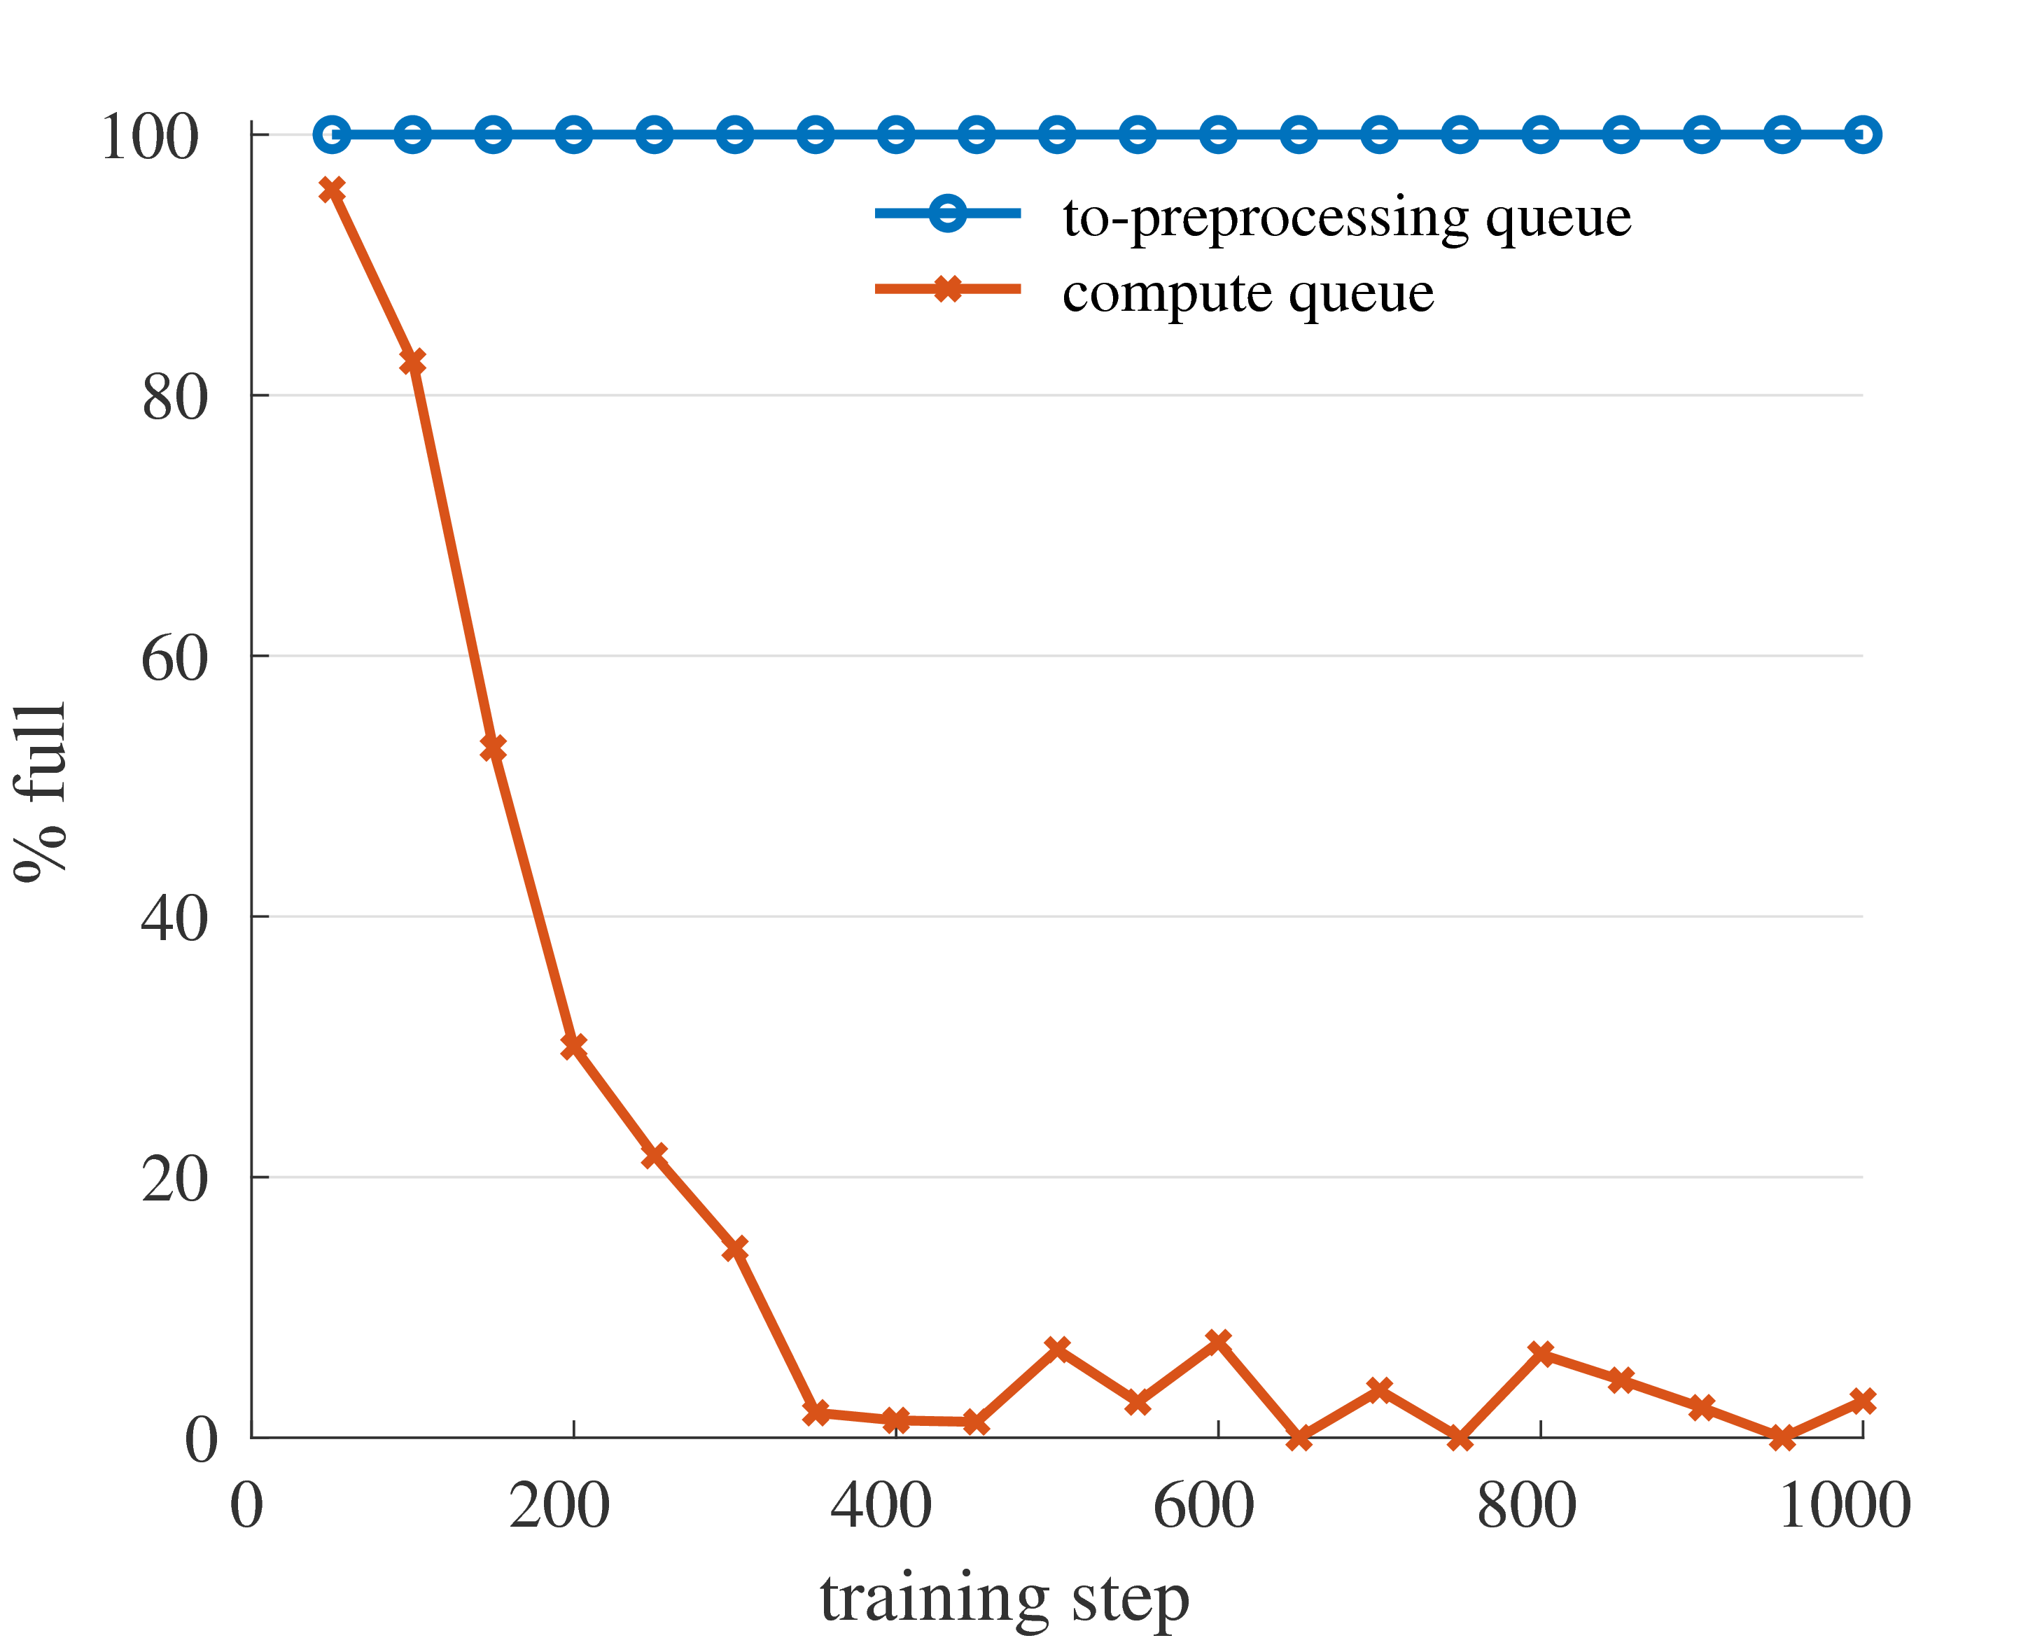
Preprocessing Is Expensive
Preprocessing can take up an entire 16-core CPU when training Alexnet, averaging 96% usage in our tests.
Queue occupancy (%)
Training step

Slide 12
Ensemble Redundancy
Preprocessing is an expensive redundant operation for DNN ensembles.
Basic Idea:
Sharing preprocessing
among DNNs.

Slide 13
Potential Benefits
(1) Lower overall CPU usage.
CPU power savings
Or allowing cores to be used by other jobs
(2) Acceleration through co-operative preprocessing among nodes.

Slide 14
Challenges
Combining MPI with DNN frameworks (TensorFlow)
  Existing addons do not provide sufficient flexibility to perform the combination efficiently.
Designing new pipelines to best facilitate data-sharing
  Tradeoffs among communication traffic, core usage, and needed coordination.

Slide 15

Horovod
A Tensorflow addon by Uber that enables better scalability in distributed DNN training.
Interface for some collective MPI operations.
Collectives must include all group members.
Our extension: Horovod Groups allows collectives to run on a subset of available MPI ranks.
This provided the flexibility to develop alternative pipelines.

Slide 16
Overview
DNN Ensembles
Efficiency Challenges
New pipeline designs and implementations
Metrics and results

Slide 17
Designs of Cooperative Pipelines
All-Shared (AS)
Single-Broadcast (SB)
Multi-Broadcast (MB)

Slide 18
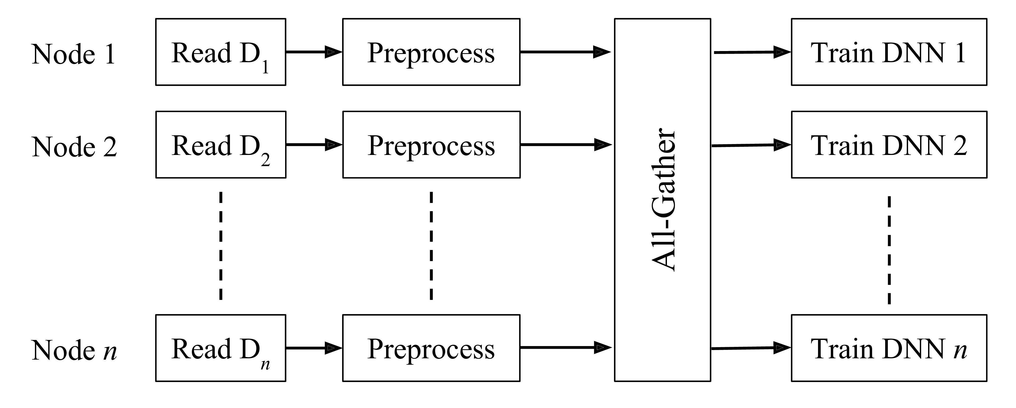
All-Shared (AS)
Perform an all-gather operation on preprocessed data to share with other nodes.
AS Pipeline
Simple
No tunable parameters

Slide 19
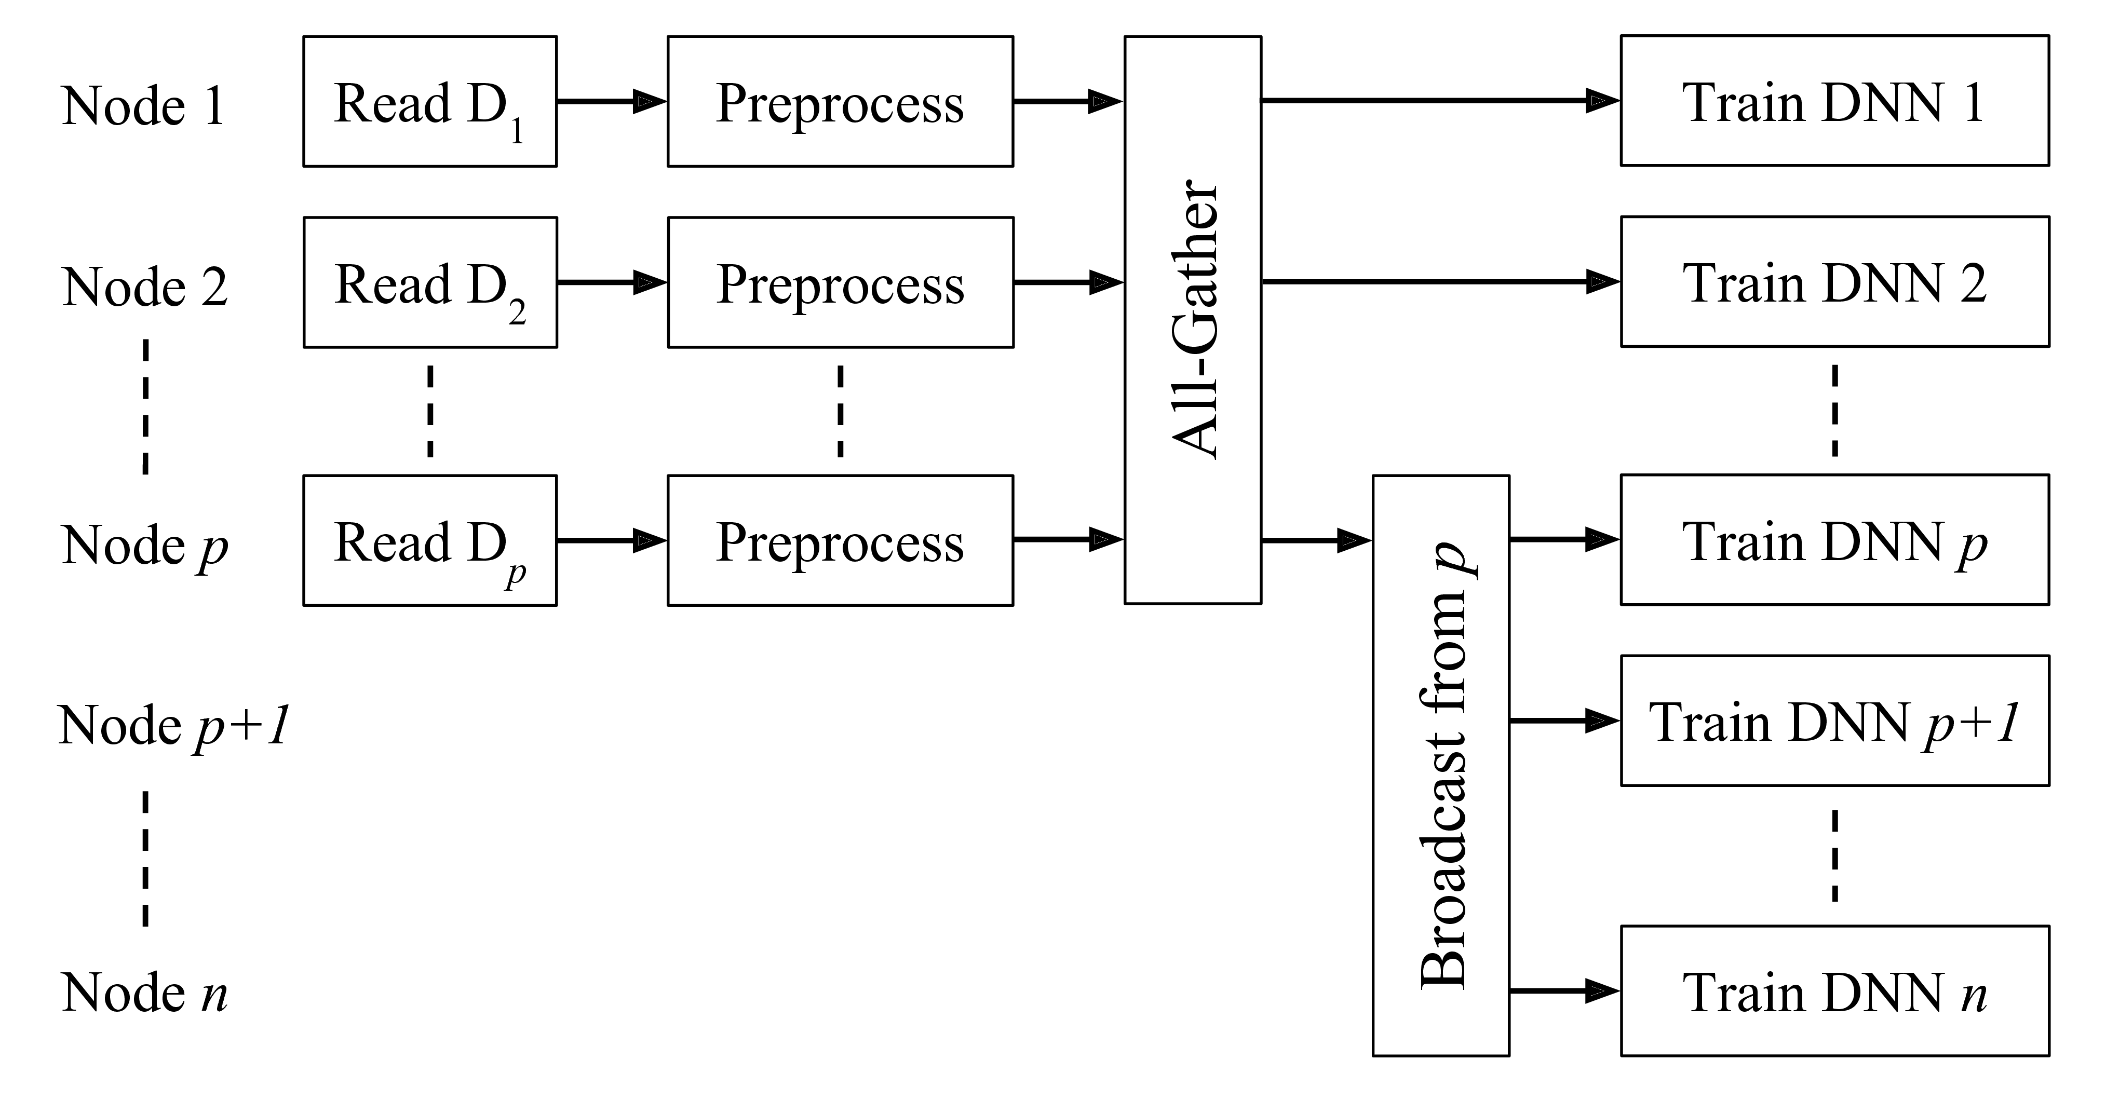
Single-Broadcast (SB)
Broadcasts data from a particular preprocessor node.
Can change # preprocessors
Potential bottleneck on rank p

Slide 20
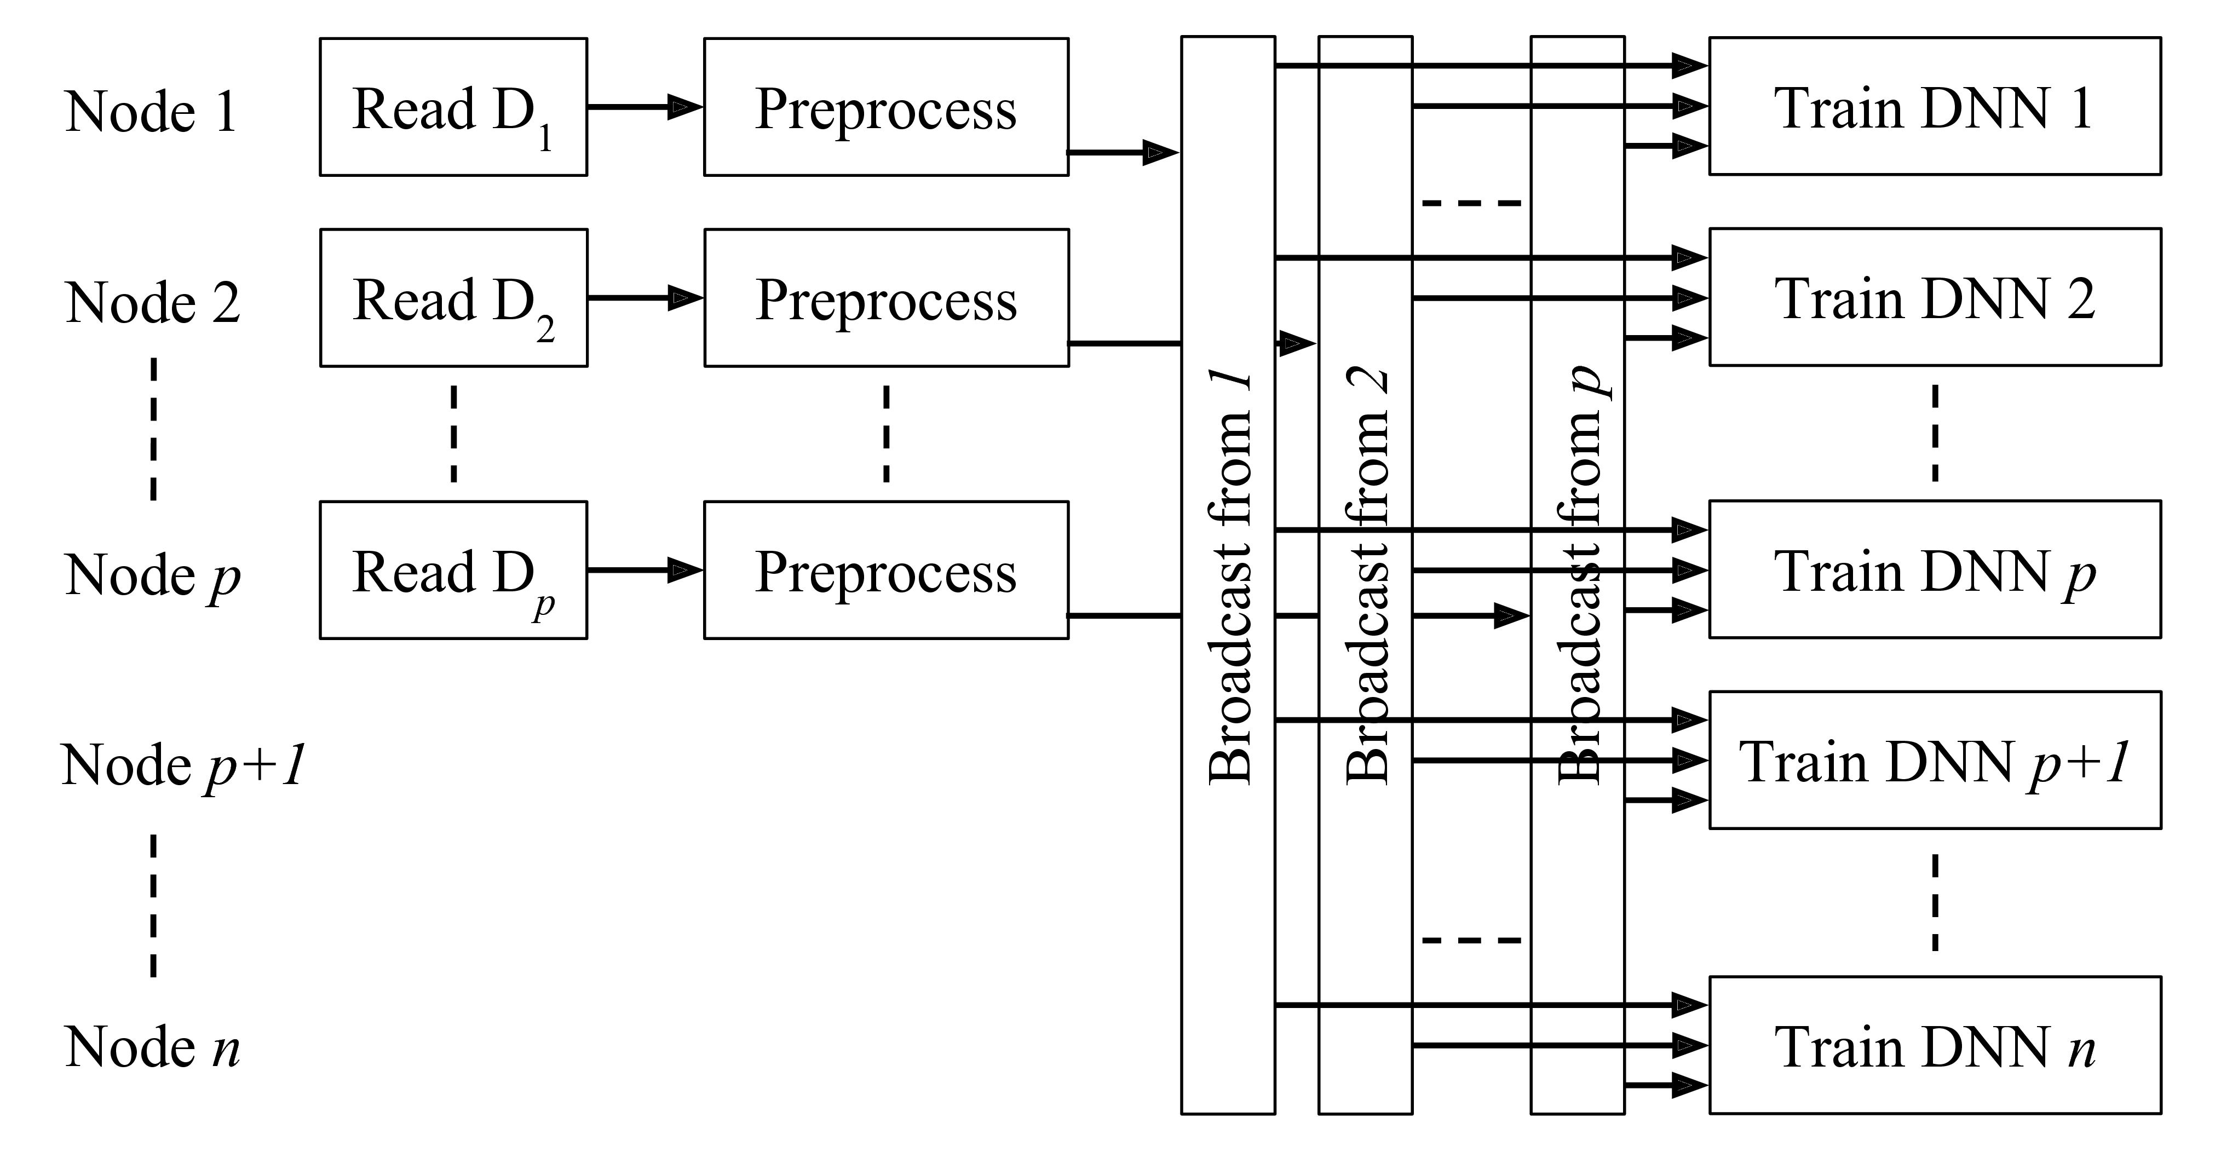
Multi-Broadcast (MB)
All preprocessors perform asynchronous broadcasts.
Can change # preprocessors
Many broadcasts could be expensive

Slide 21
Overview
DNN Ensembles
Efficiency Challenges
Data pipeline designs
Metrics and results

Slide 22

CPU Usage Reduction
Monitor the busy time of the CPUs on all ensemble nodes through a Titan utility.
Dividing the baseline by the optimized usage yields CPU Reduction:
$$CPU Reduction= \frac{baseline CPU time}{optimized CPU time}$$

Slide 23
Testing DNNs
DNN | # Layers Deep | # Parameters | Compute Rate (images/sec)
Alexnet | 8 | 60M | 306
Inception | 22 | 6.8M | 69
VGG | 11 | 133M | 31

Slide 24
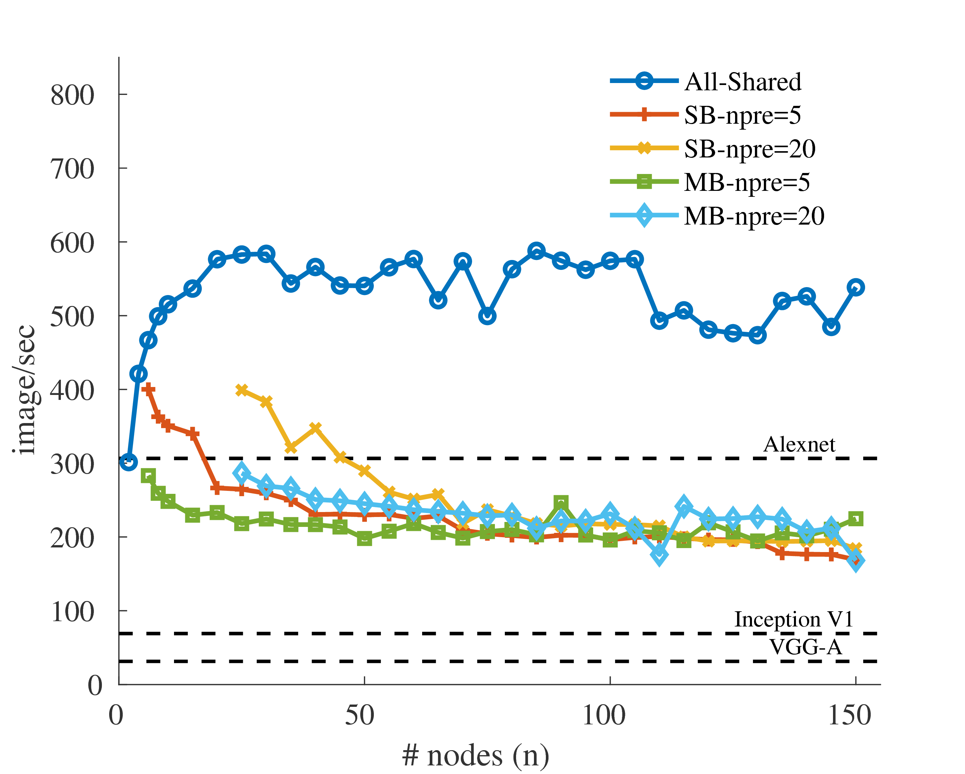
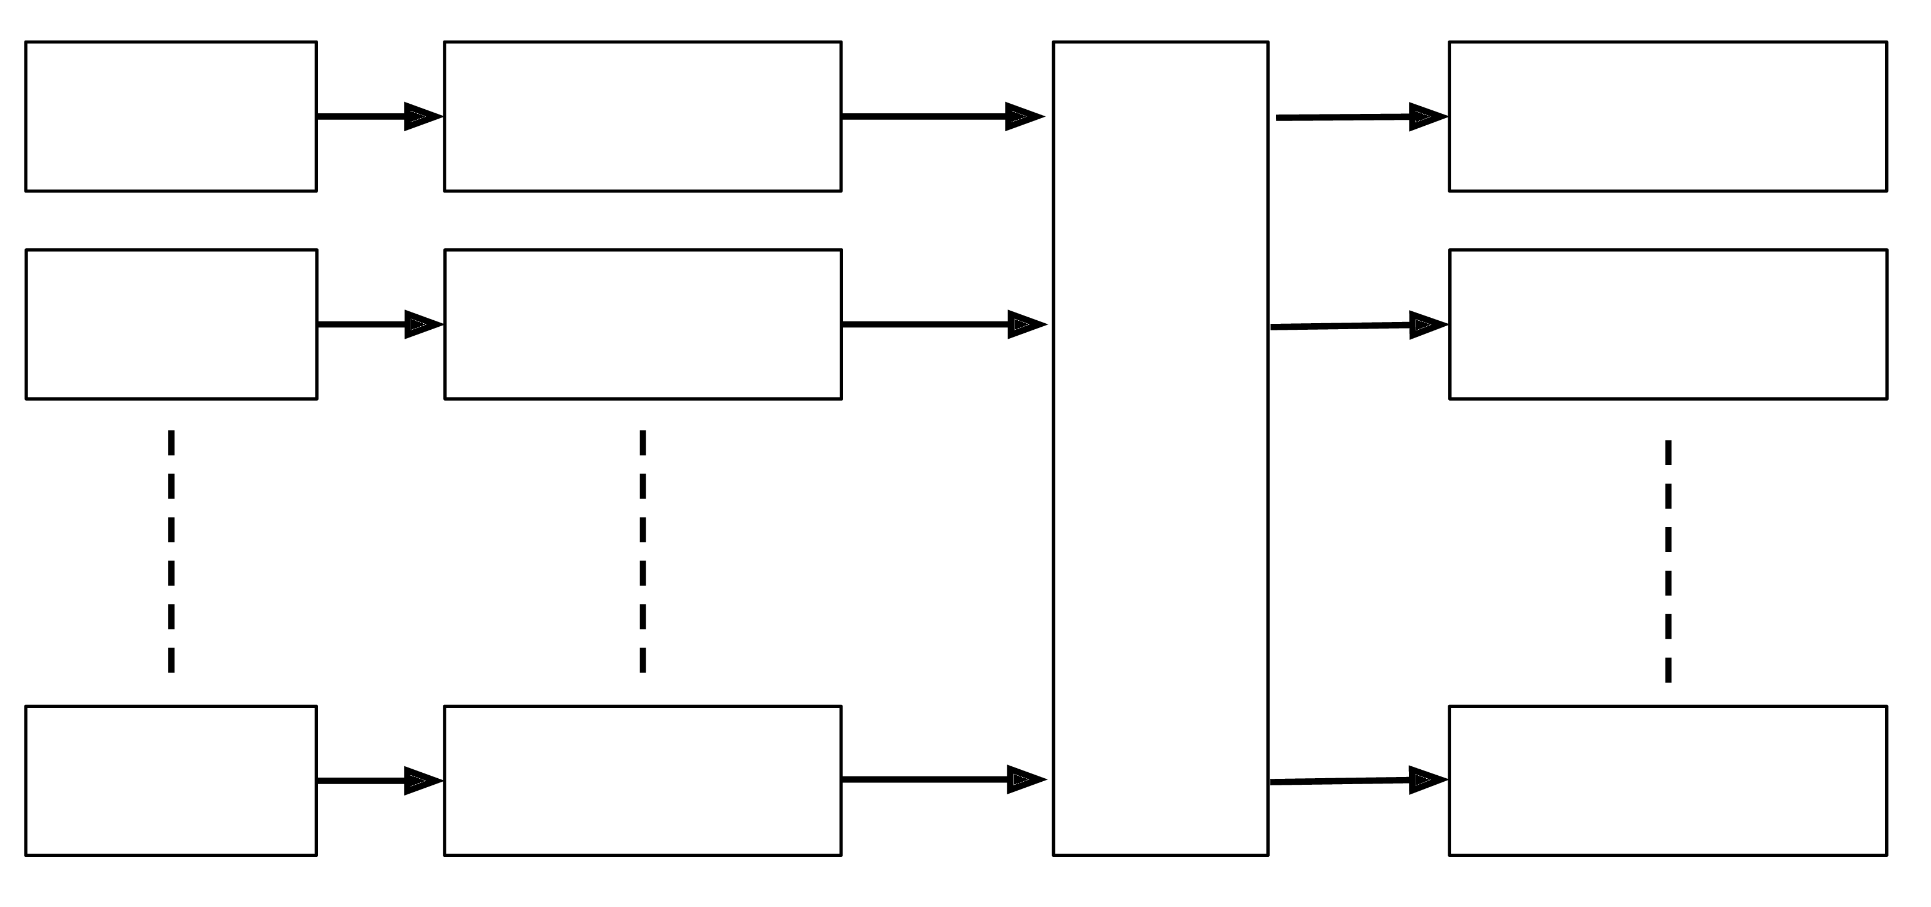
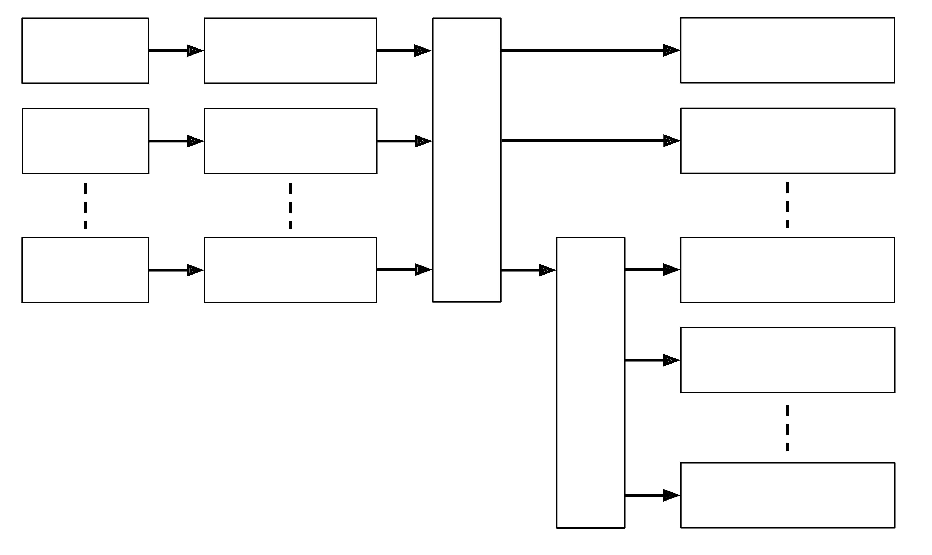
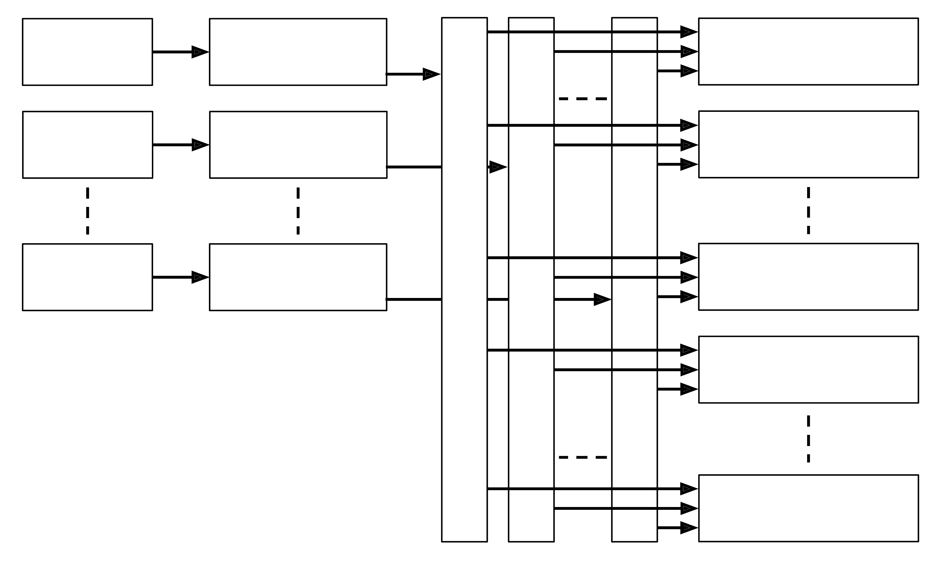
Preprocessing Throughput
Using all 16 cores
All-Shared
Single-Broadcast
images/sec
Multi-Broadcast
Alexnet
Inception
VGG-A
Total # ensemble nodes
Notes:
Audience will forget which pipeline is which, re-explain them one at a time so things are clear.

Slide 25
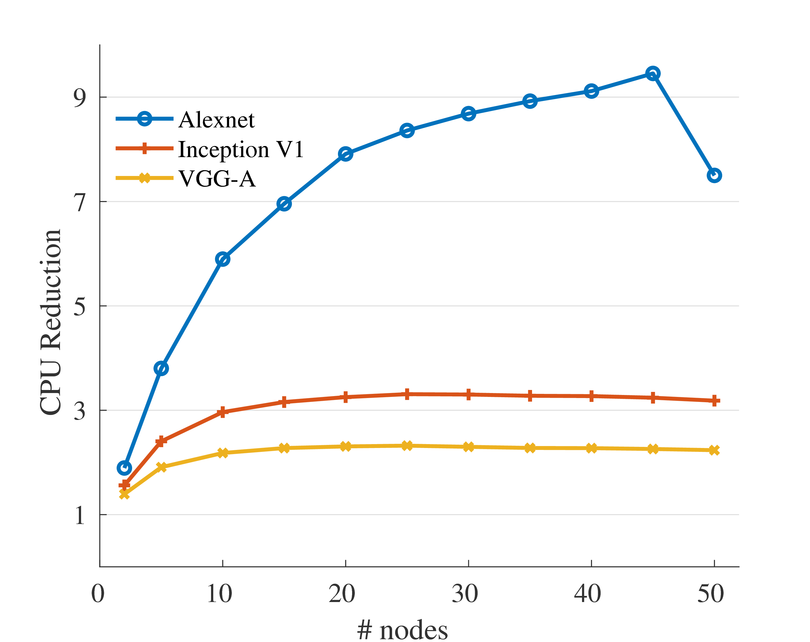

CPU Usage Reduction (AS)
CPU Reduction
$$CPU Reduction= \frac{baseline CPU time}{optimized CPU time}$$
Total # ensemble nodes

Slide 26
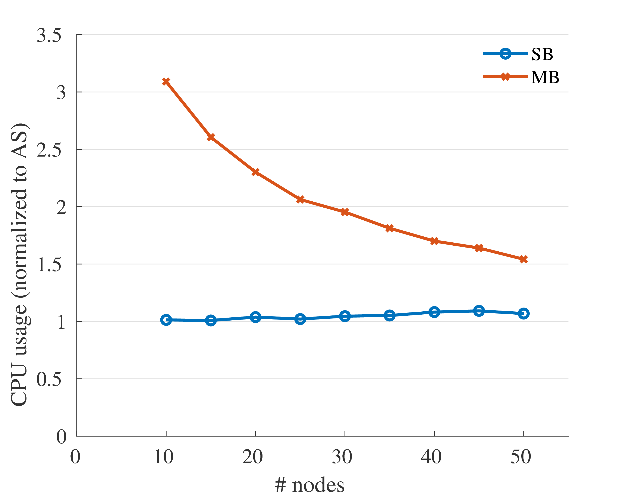
SB and MB Use More CPU Than AS
SB
MB
CPU Usage Normalized to AS
Using 5 preprocessing nodes
Total # ensemble nodes

Slide 27
16 to 1-core Slowdown
What happens to training rate (in images/sec) when 1 CPU core is used instead of all 16?
Pipeline | DNN | 1-core slowdown
 | Alexnet | 9.61X
Baseline | Inception | 3.49X
 | VGG | 1.83X
 | Alexnet | 1.54X
All-Shared | Inception | 1.06X
 | VGG | 1.02X

Slide 28
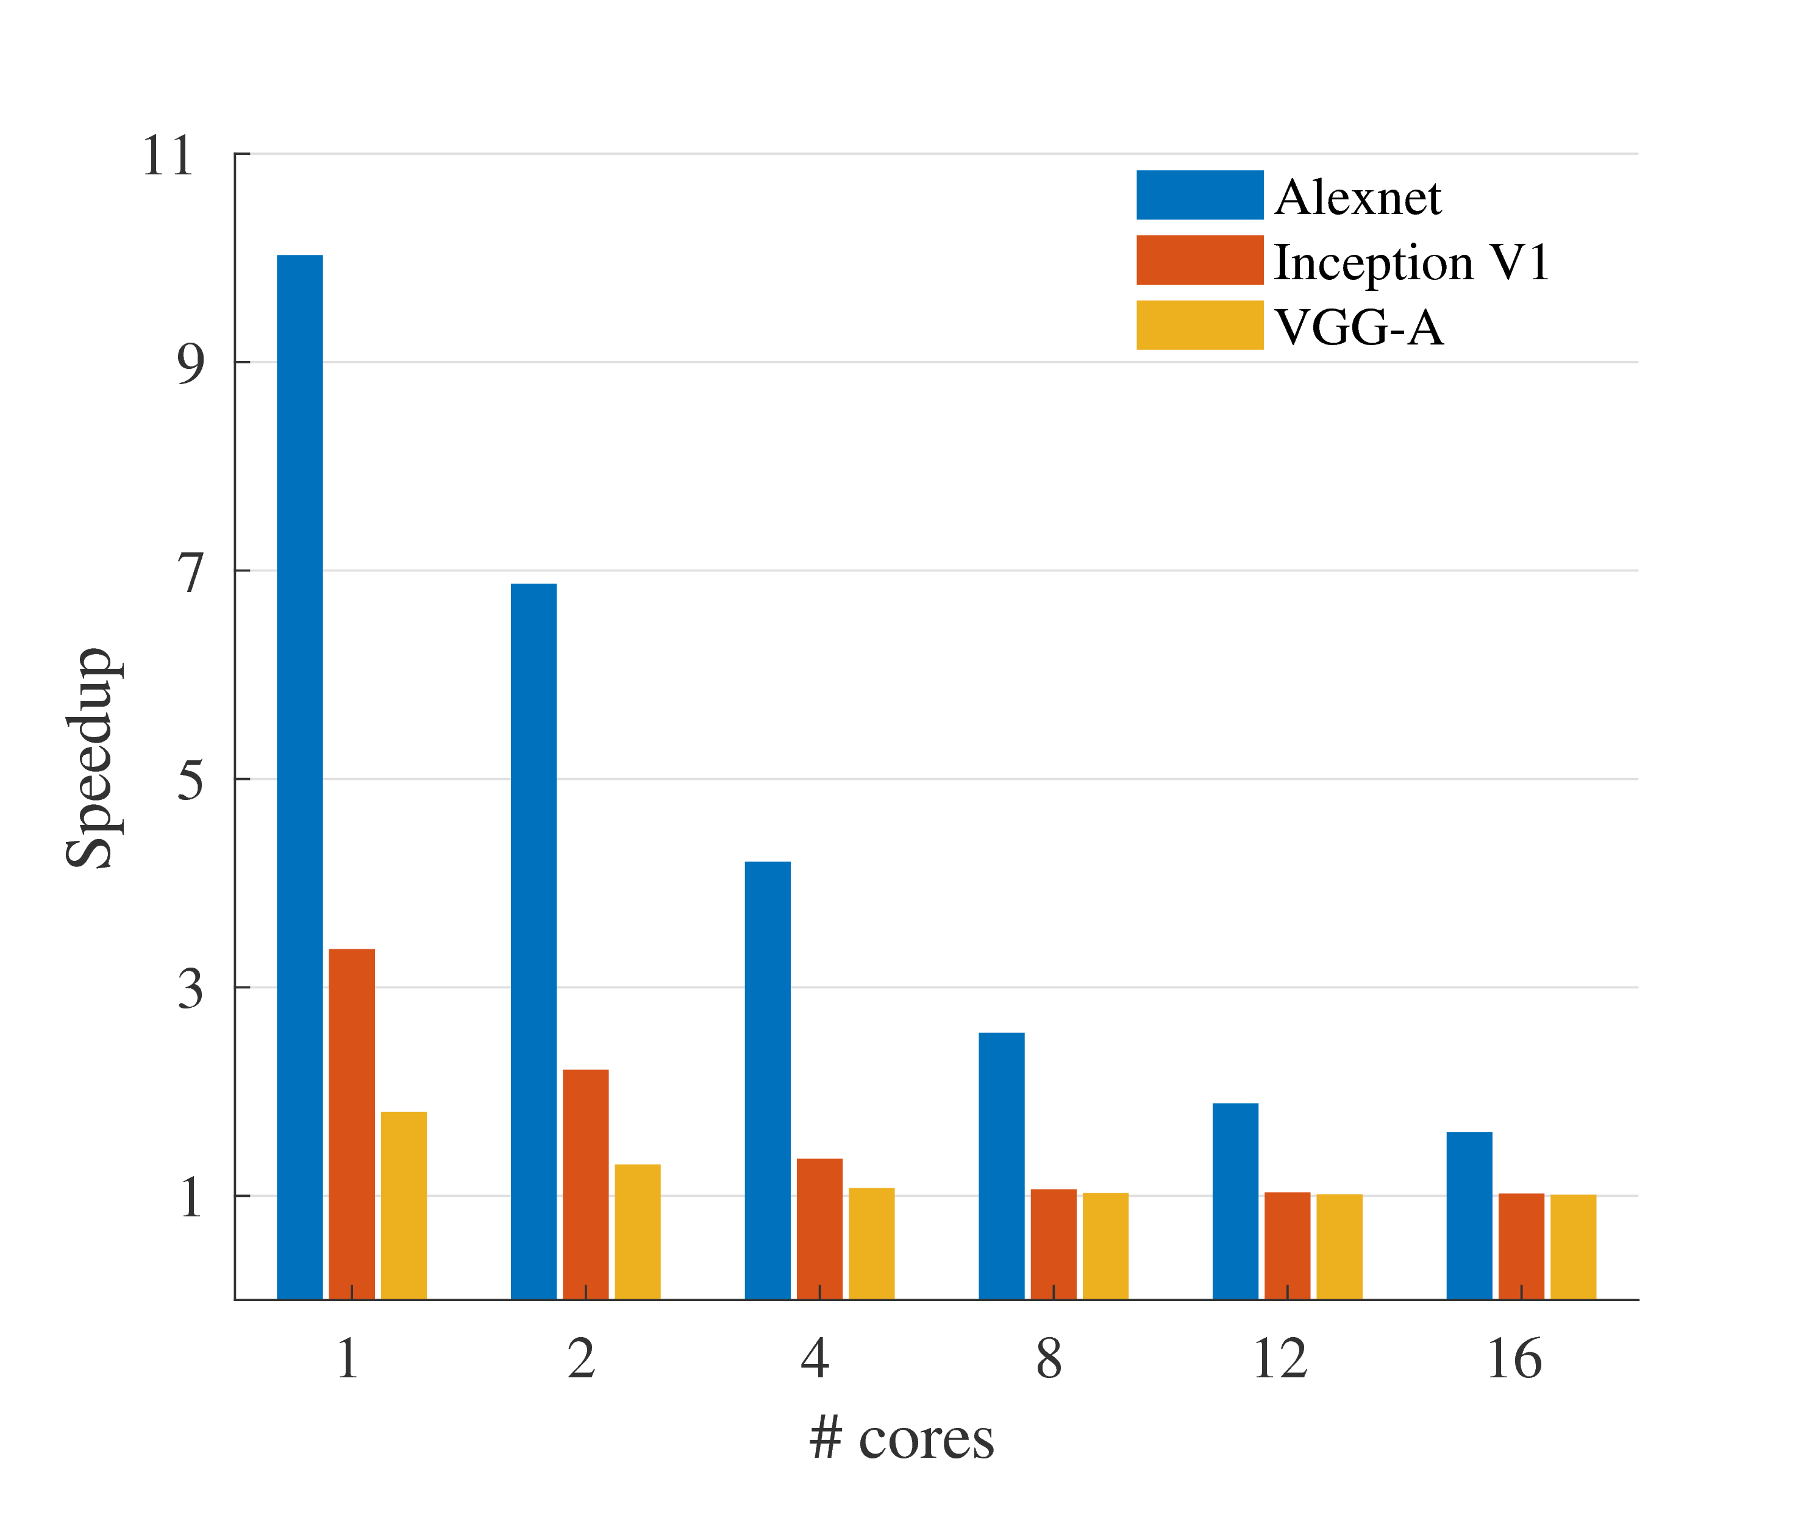
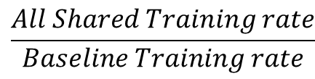
Speedup with Core Limitations
Training Speedup
$$\frac{All Shared Training rate}{Baseline Training rate}$$
# CPU cores

Slide 29
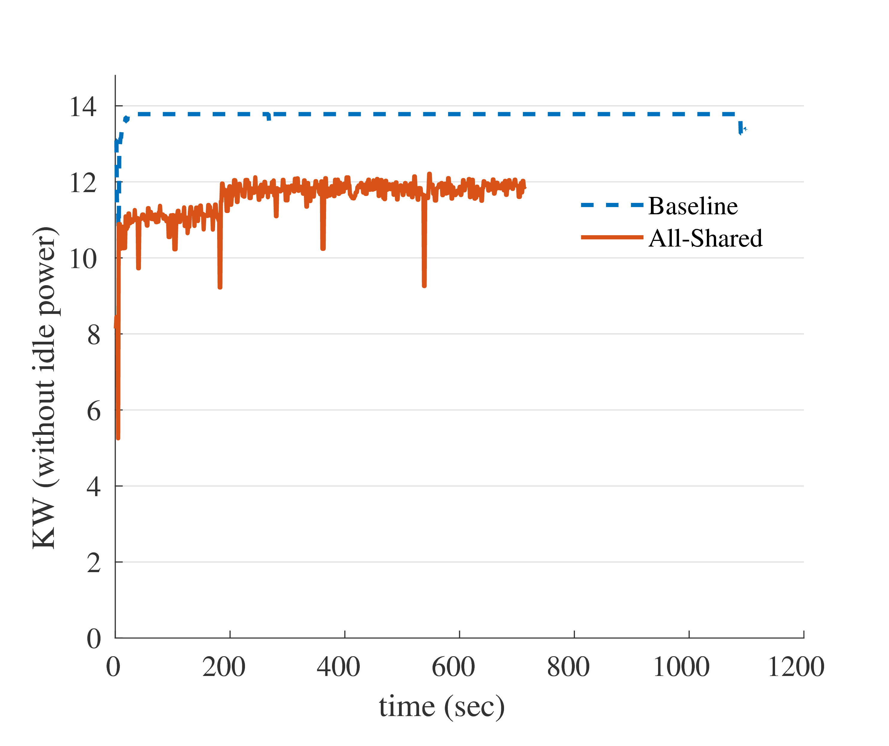
Dynamic Energy Savings
Alexnet
 | Alexnet | Inception | VGG
Baseline (KW) | 13.76 | 12.33 | 12.52
All-Shared (KW) | 11.59 | 11.10 | 11.96
Savings | 15.8% | 10.0% | 4.5%
KW
(w/o idle power)
time (seconds)

Slide 30
Conclusion
Contributions
Identified a preprocessing bottleneck in ensemble training.
Developed efficient communication mechanism for ensemble training.
Provided an efficient data-sharing pipeline for ensemble training.
Demonstrated that flexible pipelines can reduce computation overhead through efficient data-sharing.
Any Questions?

Slide 31
Auxiliary Slides

Slide 32
Future Work
Differences in DNN training performance could cause problems.
Challenges
Enable data-sharing without slowing down faster DNNs.
Allow converged DNNs to exit early.
Reallocate hardware to remaining DNNs whenever a DNN exits.
Goal → Design a flexible pipeline that can adapt to different clusters.
Problem → We lack a programming interface to develop such designs.

Slide 33



Peak Throughput
Each pipeline is primarily ranked by their peak throughput capabilities.
$images/\sec{= }peak\left(n\right)$
$images/\sec{= }peak\left(n\right)$
$images/\sec{= }peak\left(n\right)$
Suppose $peak\left(n\right)$ is the throughput of the preprocessing stage in images/sec when $n$ nodes are in the ensemble.
Suppose $c$ is the rate at which a given DNN consumes input data.
Need $peak\left(n\right)≥c$ in order to train at maximum performance.

Slide 34
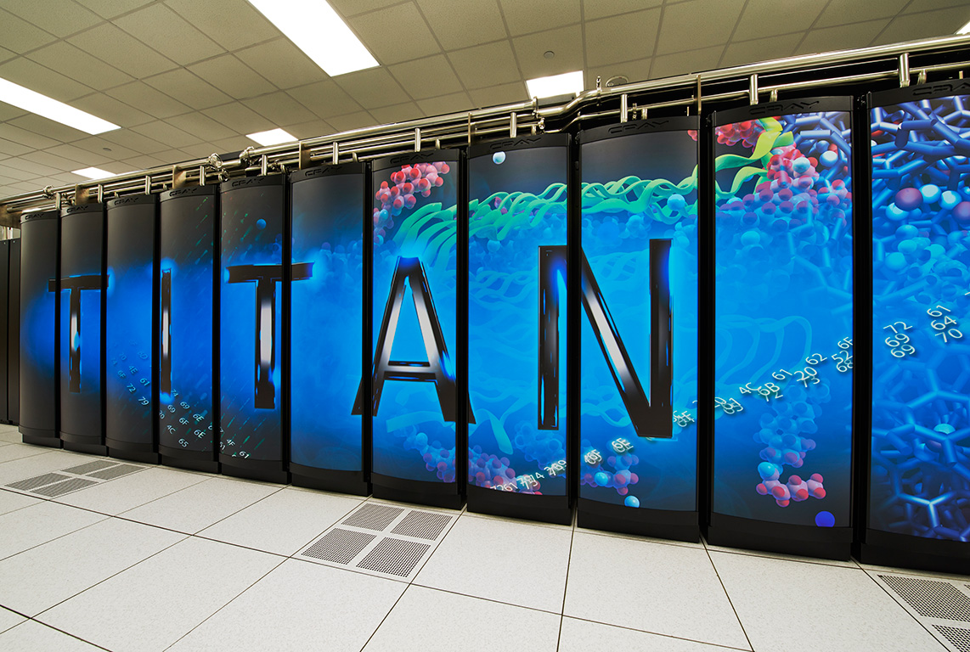
Energy Evaluation
Users must request a reservation on a special metered cabinet.
This provides the power used by the entire cabinet.
Request meter interval time (1 sec)
Make reservation
Record exact start and end times of each job launched during reservation
Wait for wall-time/power data.
Crop data using start and end times

Slide 35
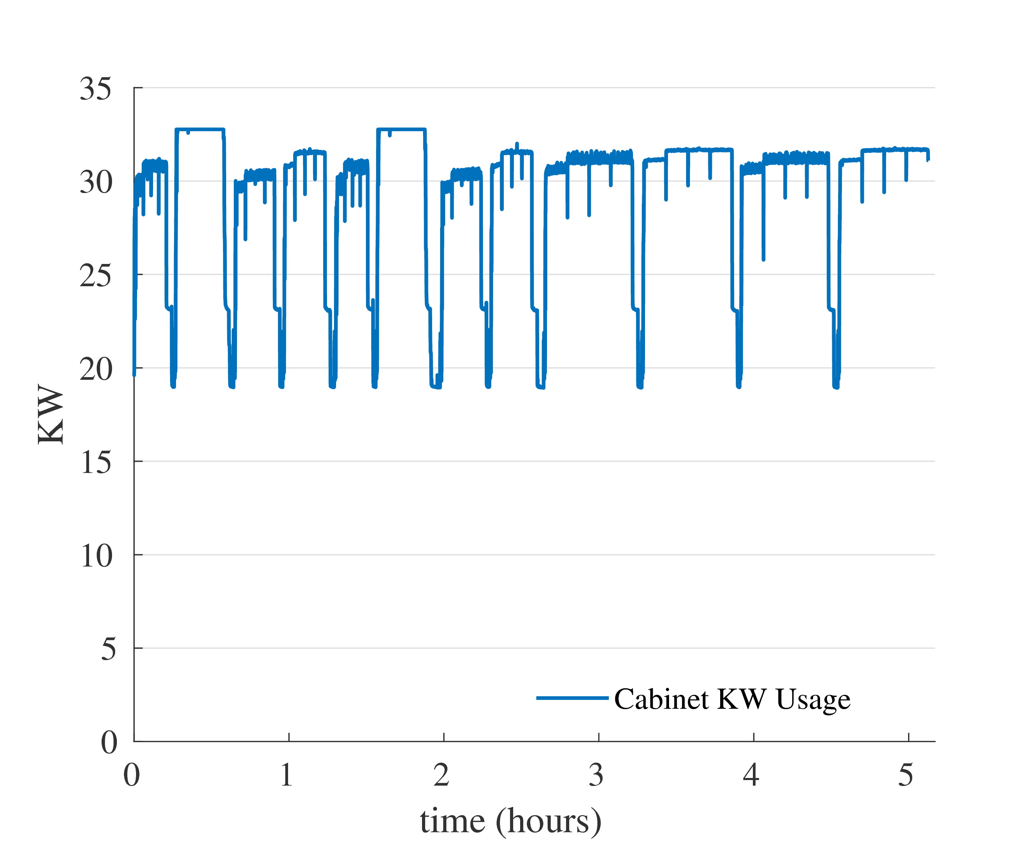
Energy Savings
12 jobs: 3 DNNs, 2 versions (optimized, baseline), 2 run redundancy
All jobs
Alexnet jobs

Slide 36
Limiting Core Usage on Titan
Partial CPU allocation isn’t possible on Titan.
Core ID | Avg % Util | Core ID | Avg % Util
0 | 94.0 | 8 | 0.0
1 | 96.4 | 9 | 0.0
2 | 94.6 | 10 | 0.0
3 | 0.0 | 11 | 0.0
4 | 0.4 | 12 | 0.1
5 | 0.0 | 13 | 0.0
6 | 0.6 | 14 | 0.0
7 | 0.0 | 15 | 0.1
Instead, we set the maximum number of threads per MPI rank.

Slide 37
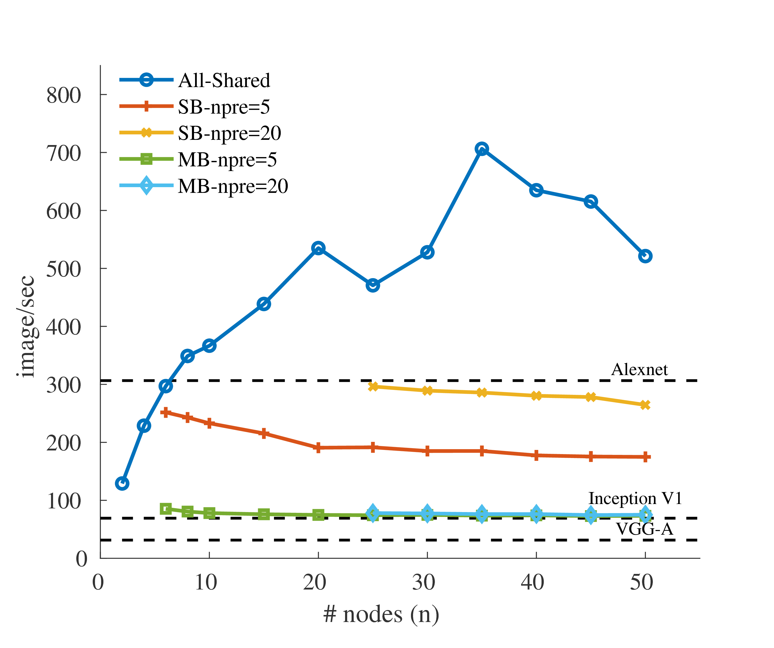
Preprocessing Throughput
16/16 cores
4/16 cores
images/sec
images/sec
Total # ensemble nodes
Total # ensemble nodes
Notes:
Audience will forget which pipeline is which, re-explain them one at a time so things are clear.

Slide 38
Tensorflow to Python-MPI
Initially tried transferring data out of Tensorflow, then across MPI using mpi4py, then back into Tensorflow.
Tensorflow
Python - MPI
Tensor
Numpy Array
session.run
Had latency issues with the data copy!

