Slide 1
Lessons learned from memory errors observed over the lifetime of Cielo
Scott Levy, Kurt B. Ferreira, Nathan DeBardeleben, Taniya Siddiqua, Vilas Sridharan, Elisabeth Baseman

Slide 2
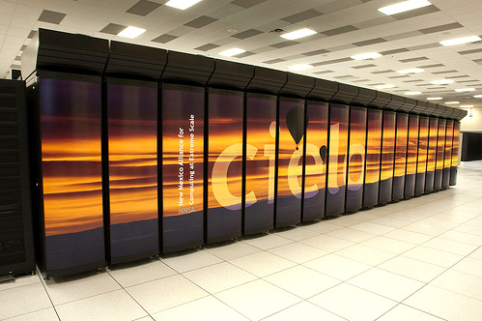
Overview of Cielo (2011-2016)
Operational Life | March 2011 – May 2016
Architecture | Cray XE6
Size | ~8,500 compute nodes
Memory | 32 GB/compute node
Location | Los Alamos, New Mexico, USA
Top500 rank | #6 (June 2011) -- #75 (June 2016)

Slide 3
Cielo’s Node Layout
rack
slot
chassis
compute
node
96 racks = 16 rows of 6

Slide 4
Corpus of System Logs
  Resource Management Logs (2014-16)
    captures the operational state of compute nodes
    does not explicitly record administrative time (e.g., scheduled downtime); we use heuristics to identify changes in administrative state
  Memory Error Logs (2011-16)
    details about correctable errors are written to the system log using the x86 Machine Check Architecture (MCA)
    details about uncorrectable are extracted after the node is rebooted
  Kernel Panic Logs (2014-16)
    when the kernel is unable to continue operation, it writes information about the failure to the system log and forces a reboot
  Hardware Inventory Logs (2011-16)
    captures the hardware configuration of each compute node
    provides enough detail to track per-manufacturer device reliability, but lacks sufficient detail to track the movement of individual DIMMs

Slide 5

Notes About Data Presentation
  All of the data in this presentation is presented in terms of faults rather than errors
    fault represents the underlying cause of the malfunction
    error represents each time the malfunction occurs
    example: a stuck-bit fault results an error each time that a memory location is accessed
  Some of the data in this presentation is (intentionally) obfuscated
    some detailed results would reveal proprietary information
    information
    the identity of DRAM manufacturers are anonymized
    units are omitted from figures that would otherwise
    reveal the uncorrectable memory error rate
      Nomenclature note
        “correctable fault” means a fault that results in
        correctable errors

Slide 6
DRAM Usage by Manufacturer

Slide 7
DRAM Usage by Year
70% of total usage
1.5% of total usage

Slide 8
Detectable, Uncorrectable Errors (DUEs) in Memory

Slide 9
Root Cause Analysis

Slide 10
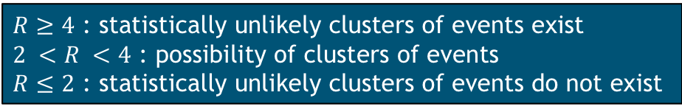
Independence of Uncorrectable Memory Faults
  Based on technique developed by Aupy et al. (IEEE Cluster 2017), we compute the lag plot ratio (R) of the interval between memory faults
    SRAM: 1.31
    DRAM: 1.82
    Combined: 2.13
  Spatial analysis is also possible: compare empirical distribution to expected distribution of faults across nodes
$R≥4$ : statistically unlikely clusters of events exist
$2 <R <4$ : possibility of clusters of events
$R≤2$ : statistically unlikely clusters of events do not exist
Fraction of compute nodes that experienced one or more uncorrectable memory faults
94% of compute nodes that experienced an uncorrectable memory error only experienced one

Slide 11
Distribution Fitting : Q-Q Plots
DRAM
SRAM
All

Slide 12
Distribution Fitting : Cumulative Distribution
Aggregate data
2013-2015 distribution
matches the theoretical distribution closely
2011-12
slightly longer intervals
between DUES
Exponential distribution based on aggregate data
2016
slightly shorter intervals
(recall: much less data in 2016)

Slide 13
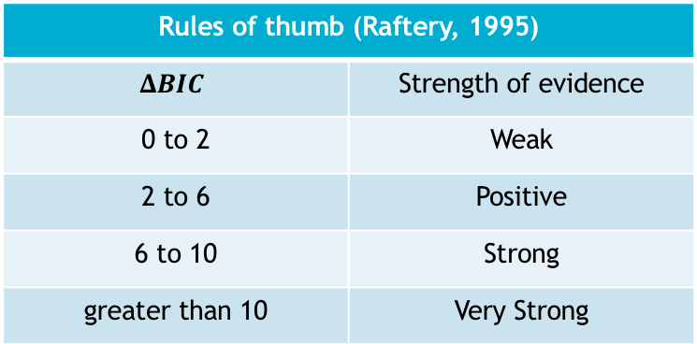
Distribution Fitting : Bayesian Information Criteria (BIC)
  The Bayesian Information Criteria (BIC) provides a statistical method for choosing between competing statistical models
  The model with the lowest BIC is preferred
  Raftery (1995) provides guidance on evaluating the difference between BIC values
Rules of thumb (Raftery, 1995)
$$ΔBIC$$ | Strength of evidence
0 to 2 | Weak
2 to 6 | Positive
6 to 10 | Strong
greater than 10 | Very Strong

Slide 14
Cielo’s Memory Reliability over Time

Slide 15
No Evidence of Decreasing Memory Reliability
maximum
median
minimum
SRAM
DRAM

Slide 16
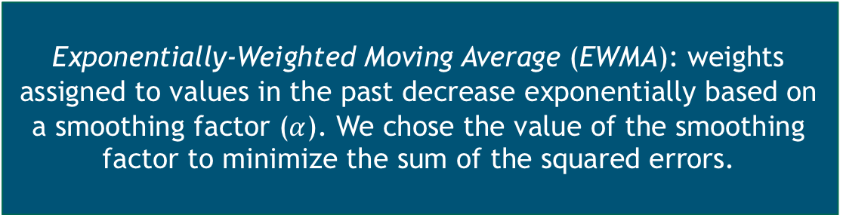
Two Spikes in Uncorrectable DRAM Errors Account for Variation
Exponentially-Weighted Moving Average (EWMA): weights assigned to values in the past decrease exponentially based on a smoothing factor ($α$). We chose the value of the smoothing factor to minimize the sum of the squared errors.

Slide 17

Rate of Correctable DRAM Errors May Have Been Decreasing
Failures in Time (FIT): common metric for hardware device reliability, it is the number of failures per billion (${10}^{9}$) hours of device operation
Correctable
FIT/DRAM
DRAM-hours by
manufacturer

Slide 18
Relationship between Correctable and Uncorrectable Faults

Slide 19
Correctable Faults Do Not Foretell Uncorrectable Faults
Correctable DRAM Faults
All Correctable Faults

Slide 20
Correctable Faults Do Not Foretell Uncorrectable Faults (cont’d)
Pearson’s Correlation Coefficient
r = -0.05

Slide 21
Correctable Faults Do Not Foretell Uncorrectable Faults (cont’d)
2-week interval
Nodes where Correctable Fault
Preceded Uncorrectable Fault

Slide 22
Implications for the Future of Checkpoint/Restart

Slide 23
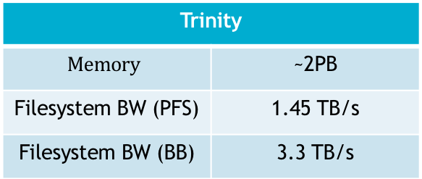
Implications for Future Systems
Same reliabilty as Cielo
Reliability relative to Cielo
Hard targets for application efficiency have not been established, but we believe that checkpoint/restart will be viable if application efficiency is above 80%
Trinity
$$Memory$$ | ~2PB
Filesystem BW (PFS) | 1.45 TB/s
Filesystem BW (BB) | 3.3 TB/s

Slide 24
Implications for Future Systems (cont’d)
green: achievable in the near future
orange: within exascale projections
red: beyond current projections

Slide 25
Conclusion / Lessons Learned
  No discernible aging effects were observed
    reliability of Cielo’s memory showed no noticeable decrease in reliability over its lifetime
  Correctable DRAM faults were not reliable predictors of uncorrectable DRAM faults
    we found no instance in which correctable DRAM faults lead to an uncorrectable DRAM fault
  Failure analysis is challenging
    root cause analysis is challenging
    difficult to reconcile data from multiple, independently-maintained logs
  Efficient failure mitigation through checkpoint/restart will require continued advancement
    achieving reasonable application performance (e.g., > 80% efficiency) will likely require that filesystem bandwidth continues to increase as expected

Slide 26
Acknowledgements
  Kurt Ferreira, sandia national laboratories
  Nathan DeBardeleben, los alamos national laboratory
  Taniya Siddiqua, AMD
  Vilas Sridharan, AMD
  Elisabeth Baseman, los alamos national laboratory

Slide 27
Questions?
sllevy@sandia.gov

