Slide 1
Evaluating and Accelerating High-Fidelity Error Injection for HPC
Chun-Kai Chang, Sangkug Lym, Nicholas Kelly,
Michael B. Sullivan§, Mattan Erez
Department of Electrical and Computer Engineering
The University of Texas at Austin
§NVIDIA Research
Notes:
Add pause (3 sec) for slides with depth
1

Slide 2
1
Problems
High-fidelity error injection is (too) slow
  RTL level only: takes months per application
  Microarchitecture level: takes 1.5 days for an embedded app^{[1]}
Simple bit-flip errors at instruction level
  Usually takes a few hours per application
  May lead to wrong conclusions, especially about SDCs
[1] Kaliorakis et al. "MeRLiN: Exploiting Dynamic Instruction Behavior for Fast and Accurate Microarchitecture Level Reliability Assessment." ISCA 2017.
Notes:
Clarify assumptions: from Logic level to application level
Logic masking only (No timing and electrical masking)
Say “Silent data corruption”

Slide 3
1
Main Goals
We address two concerns:
  When is it important to model hardware faults with high fidelity?
  How to enable fast and high-fidelity error injection given that error detectors are employed?
Application
Instruction (ISA)
Microarchitecture
Gate
Device

Slide 4
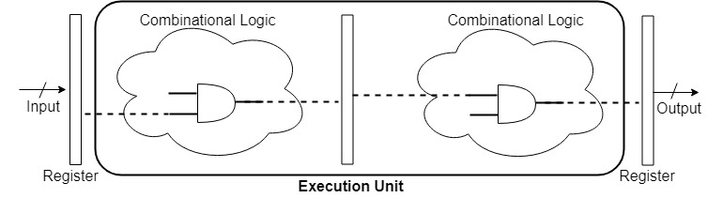
1
Modeling Gaps in Existing Error Models
Single-event upsets that affect execution units
  Directly affect application data → SDC more likely
Not Modeled (Hidden soft errors)
A + B ➝ C
How do hidden soft errors corrupt the output latch if they are not masked?
Notes:
Emphasize single cell, single event upset
Emph. soft error in the pipeline registers
Emphasize instruction level error model
Remember to say fault masking and multi-bit error at output

Slide 5
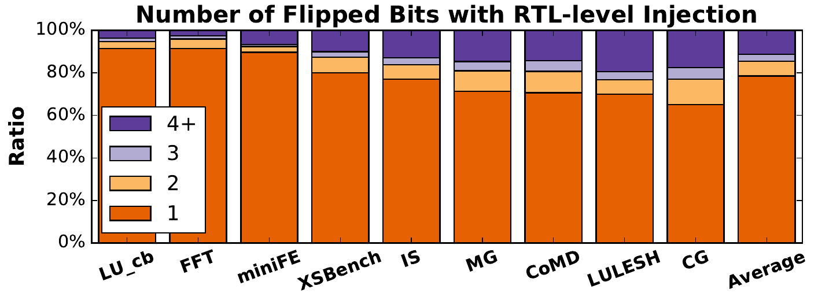
1
Characteristics of Hidden Soft Errors
78% of hidden errors that corrupt the output latch are single-bit errors
Bit-flip count distribution is application-dependent
Notes:
Add previous fig here and highlight the output latch
Don’t use mouse (e.g, use pointer or animation)
Need to emphasize bit-flip count is also app-dependent

Slide 6
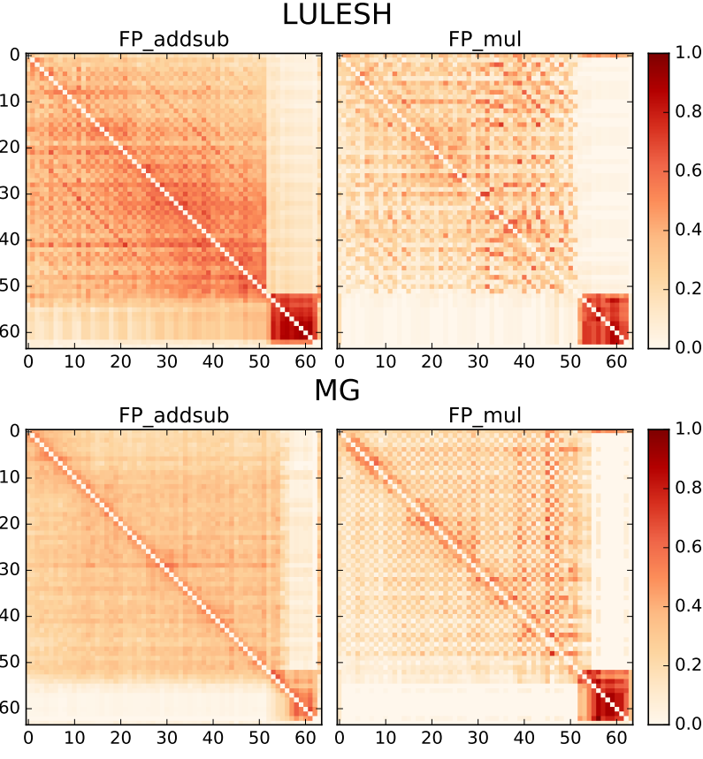
1
Characteristics of Hidden Soft Errors (Contd.)
Correlations between bit-flip positions vary across
  Applications
  Circuits
Conditional probabilities between bit-flip positions
at the output latch (64-bit)
Simple error models do not match realistic error patterns. However, full-system RTL-level injection is too slow.
Notes:
Explain the axes of the plots and circuit
Don’t use mouse (e.g, use pointer or animation)
Say dark color means what vs light?

Slide 7
1
Improving Fidelity with Hierarchical Injection
Hierarchical injection balances fidelity and speed
  Invokes detailed model only at injection site
  Typically includes 2+ levels, including μ-arch and RTL
  (e.g., SWAT-Sim^{[1]})
We integrate instruction level + RTL level
  However, RTL-level fault masking → Fewer SDCs
  Needs lots of Monte Carlo trials (i.e., evaluation time ↑)
Goal: to accelerate injecting instruction-level errors
[1] Li et. al., “Accurate microarchitecture-level fault modeling for studying hardware faults,” HPCA 2009
Notes:
However, HI does not solve the entire problem because Monte Carlo method is usually used to evaluate metric such as SDC rate
Remind that we want to accelerate injection : RTL-level masking→fewer SDC cases
Mention nested monte carlo (for overall evaluation)

Slide 8
1
Inefficiency of Traditional Monte Carlo Method
Pre-injection
Injection
Post-injection
Draw a Random Instr. Instance
RTL Gate-level Fault Injection
Apply Corrupted Instr. Context
Masked
?
Yes
Remove Instrumentation & Continue
No
(30% to 50%)
Count until Reaching
Target Instr.
Detected?
Yes
Log Injection Outcome
(> 90%)
No
High overhead
Observation: >95% of time is spent on pre-injection and post-injection phases
  >99% for long-running applications
Notes:
Intro: so, what’s the problem
Shouldn’t say the loops here
Start from what the problem is, then use the figure to explain it

Slide 9
1
Saving Evaluation Time with Nested Monte Carlo
Pre-injection
Injection
Post-injection
Draw a Random Instr. Instance
RTL Gate-level Fault Injection
Apply Corrupted Instr. Context
Masked
?
Yes
Remove Instrumentation & Continue
No
Count until Reaching
Target Instr.
Detected?
Yes
Log Injection Outcome
No
Benefits increase with masking/detection rate
or the length of the detector chain
High overhead
Notes:
Mention random in both time and space dimensions?

Slide 10
1
Issues of Nested Monte Carlo
Need to observe multiple unmasked faults to have a good statistical bound for the RTL masking rate
  This can be done offline if we log the fault injection context for each Monte Carlo trial
  Same for detector coverage estimation
Need to set a limit on iteration to avoid infinite loop when the masking rate is high
  The limit affects tradeoff between injection speed and accuracy
Notes:
Say practically infinite loop

Slide 11
1
Recap
How to enable fast and high-fidelity error injection given that error detectors are employed?
  Nested Monte Carlo + Hierarchical injection
When is it important to model hardware faults with high fidelity?
  Impact of error model on outcome distribution and output quality
  Impact of detector model

Slide 12
1
Error and Detector Models
RB1
  Randomly flips a single bit
RB2
  Randomly flips two bits
RND
  Replaces with a random value
RTL
  Generates an error pattern with hierarchical injection (i.e., on demand RTL gate-level fault injection)
Model+
  Uses Model on a design with a single-modulus (3) arithmetic residue checker where Model ∊ {RB1, RB2, RND, RTL}
Model++
  Similar to Model+ but with a double-modulus (3,5) residue checker (stronger detection)
Notes:
Need transition to this one (e.g., benefits?)... then transit to evaluation methodology

Slide 13
1
Experimental settings
Output error at random instruction per trial
3000 trials per error/detector combination
Benchmarks: NAS (IS, CG, MG), SPLASH2 (FFT, LU_cb), miniFE, LULESH, CoMD, XSBench
RTL gate-level circuits from Synopsys DesignWare library synthesized with Nangate 45nm cell library
  Circuits are pipelined to match Intel’s Broadwell
Notes:
Say broadwell clearly

Slide 14
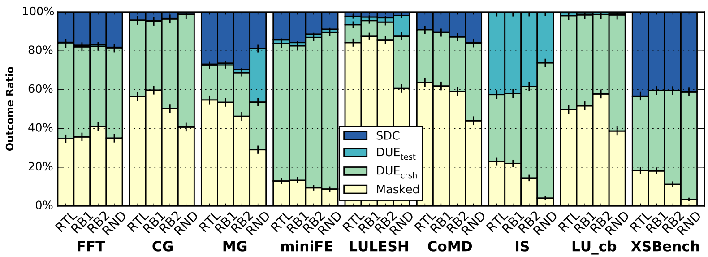
1
Injection Outcome Distribution
Outcome classification
  Masked: application output identical to error-free run
  DUE_{crsh}: crash or hang
  DUE_{test}: obviously erroneous output / assertion violation
    E.g., output is not finite, mismatch in matrix size, etc.
  SDC: output is erroneous in non-obvious way
Notes:
Say mean error is 5% and the err bars are overlap
Say (spell out) DUE…
Remember to contrast RB2 and RND
Also say, though it is statistically different, still seems to be unimportant.. And i will show later in this talk

Slide 15
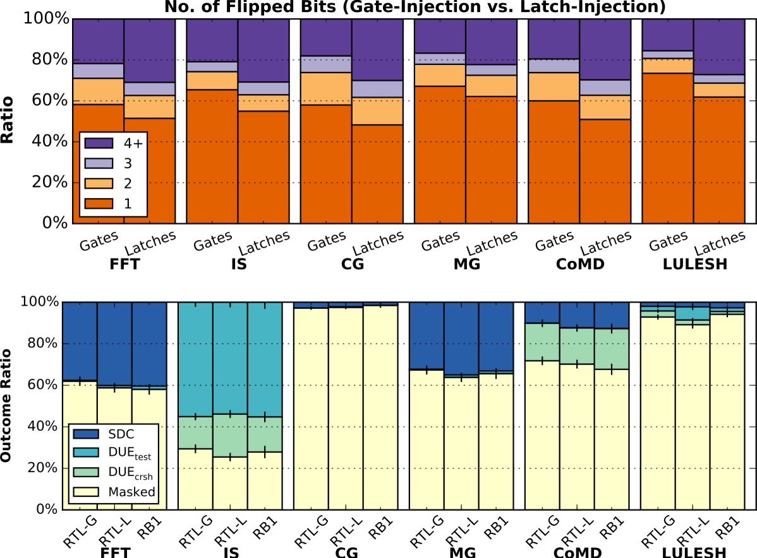
1
Injection Outcome: Gate vs. Latch Faults
Single-bit flip is a good approximation of RTL injection,
whether experiencing gate or latch faults.

Slide 16
1
Impact of Hardware Detectors
Detector Coverage (residue checkers)
  Dependent on error models and applications
  More app-dependent with high-fidelity (RTL) model
Error Model | Detector (min, max) | Stronger Detector (min, max)
RTL | (80%, 93%) | (92%, 100%)
RB1 | 100% | 100%
RB2 | (29%, 31%) | (78%, 90%)
RND | (44%, 46%) | (79%, 81%)
Notes:
Use range notation
Box plot?
RTL+ Coverage: 87%
RTL++ Coverage: 97%

Slide 17
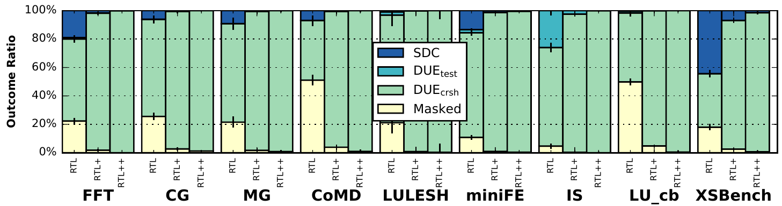
1
Impact of Hardware Detectors
Outcome distribution for integer＋, — and ✕
  Detected errors become DUEs
Notes:
Fewer bars and applications
Didn’t say enough: INT only, compare RTL RB2 RND …
Show fewers applications or use magnifier

Slide 18
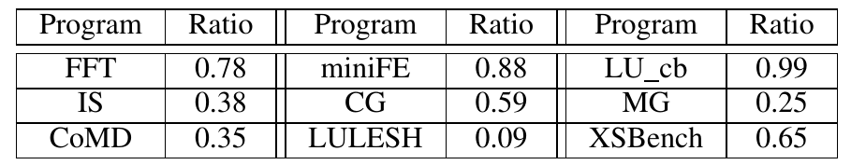
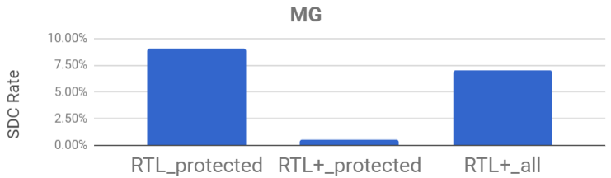
1
Impact of Hardware Detectors
Residue checkers protect subset of instructions
  E.g., The actual SDC rate improvement of MG is only 2% instead of 9% as only 25% of instructions are protected
With detectors, the impact of the error model is large
when the fraction of instructions protected is also large.
2%
9%

Slide 19
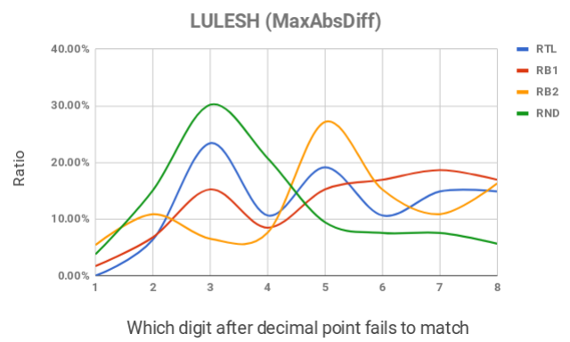
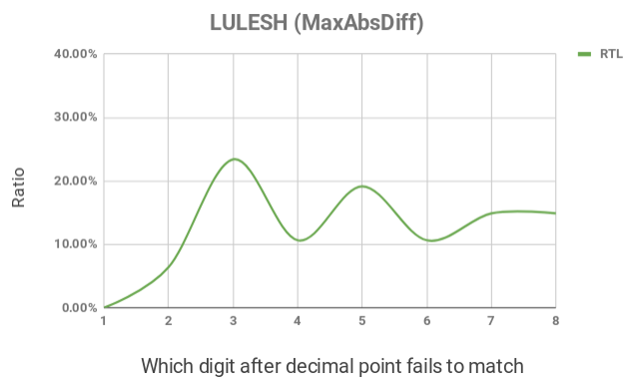
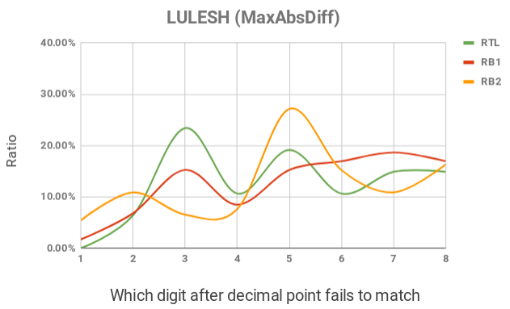
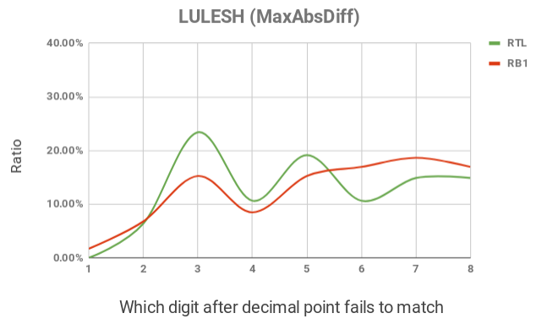
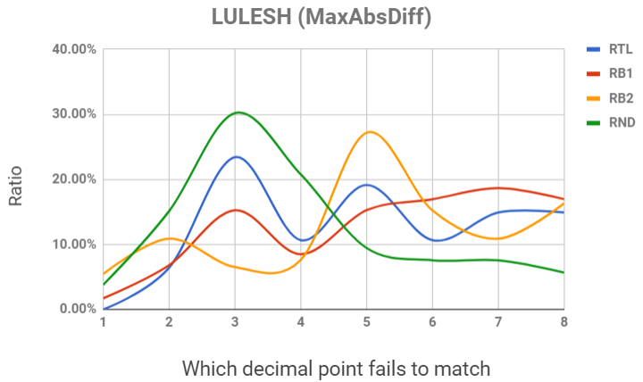
1
Application Output Quality
Output quality distribution of SDC cases
  We use two statistical tests to compare distributions:
    Chi-square test: for binned data
    Kolmogorov-Smirnov test: for continuous data
E.g.,*
Error-free: 0.01
Observed: 0.04
*For illustration only. These are not actual values.
Notes:
Animate the second bullet after showing the distr.
Which digit position
Show each dist. One at a time
Explain the quality metric better
Say RB1 and RTL looks different but not statistically different

Slide 20
1
Application Output Quality
Without detectors,
both tests fail to show RB1 and RTL are different
  For all applications we studied
  RB2 and RND are statistically different from RTL
  for some applications
With residue checking,
RB1 is statistically different from RTL
  Due to app-dependent protection ratio
High-fidelity error model is necessary to evaluate output quality, especially when detectors are used.
Notes:
Since with detector, we might need higher-fidelity,... can say sth for circuits used here
Say the ensemble result in another paper

Slide 21

1
Conclusions
How to enable fast and high-fidelity error injection given that error detectors are employed?
  Nested Monte Carlo + Hierarchical Injection
When is it important to model hardware faults with high fidelity?
  Without detectors, single-bit flip is good enough for outcome distribution
  With detectors, need high-fidelity only when the fraction of protected instructions is large
https://lph.ece.utexas.edu/users/hamartia/
Notes:
Mention the circuits we use might not represent the real products
Take some pause between slides

