Slide 1


A Lightweight Model for Right-Sizing
Master-Worker Applications
Nate Kremer-Herman, Ben Tovar, Douglas Thain

Slide 2
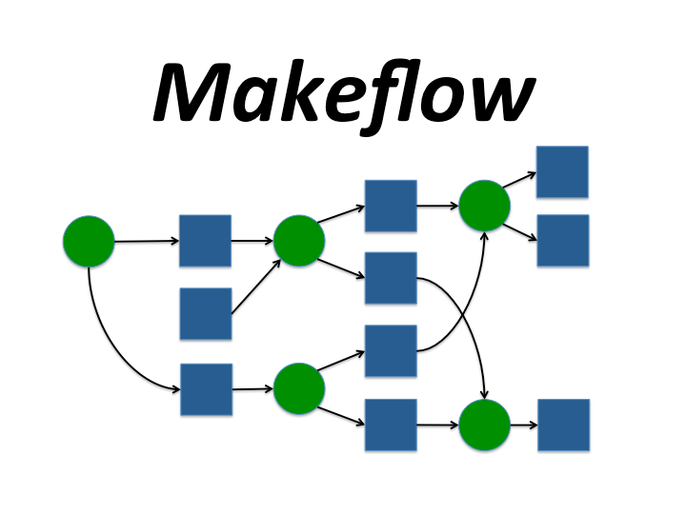
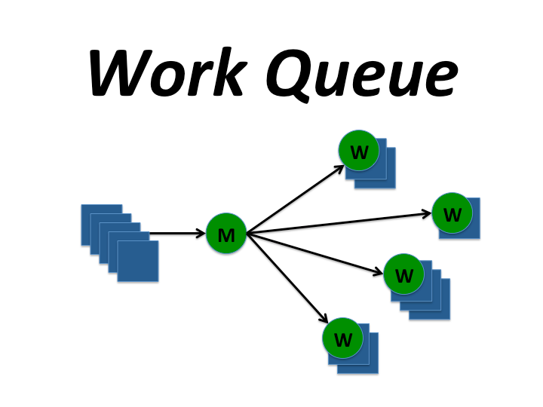
Cooperative Computing Lab

Slide 3

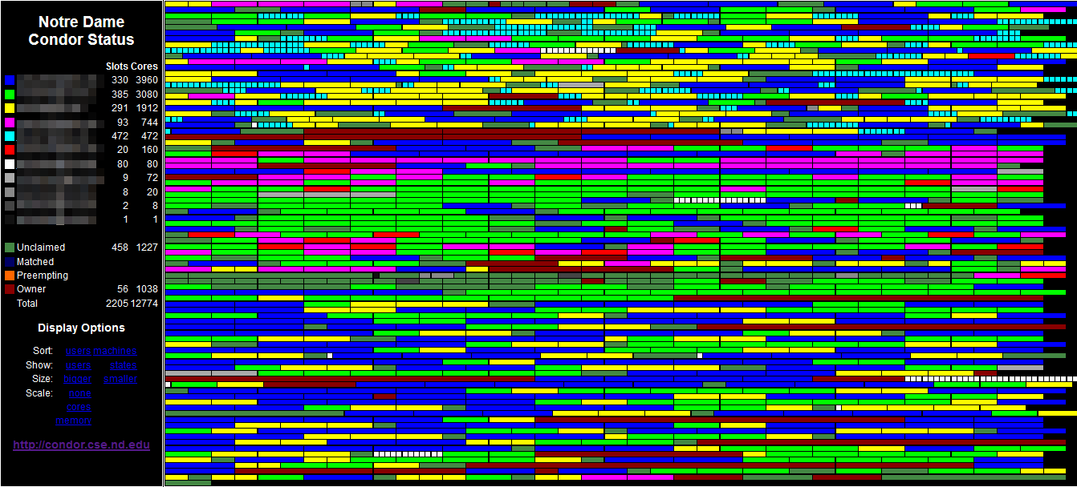
Center for Research Computing

Slide 4
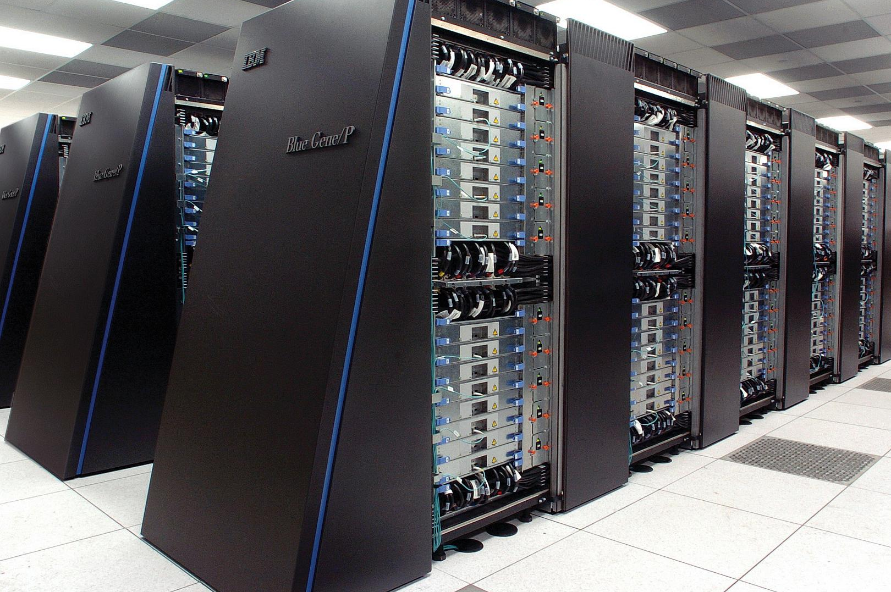


Mad Scientist courtesy of vecteezy.com
Scientist pair courtesy of clipart-library.com
Blue Gene courtesy of flickr.com/photos/argonne/

Slide 5
Give us 10 machines, please.

Slide 6
Give me ALL THE CLUSTER!!!

Slide 7



Slide 8
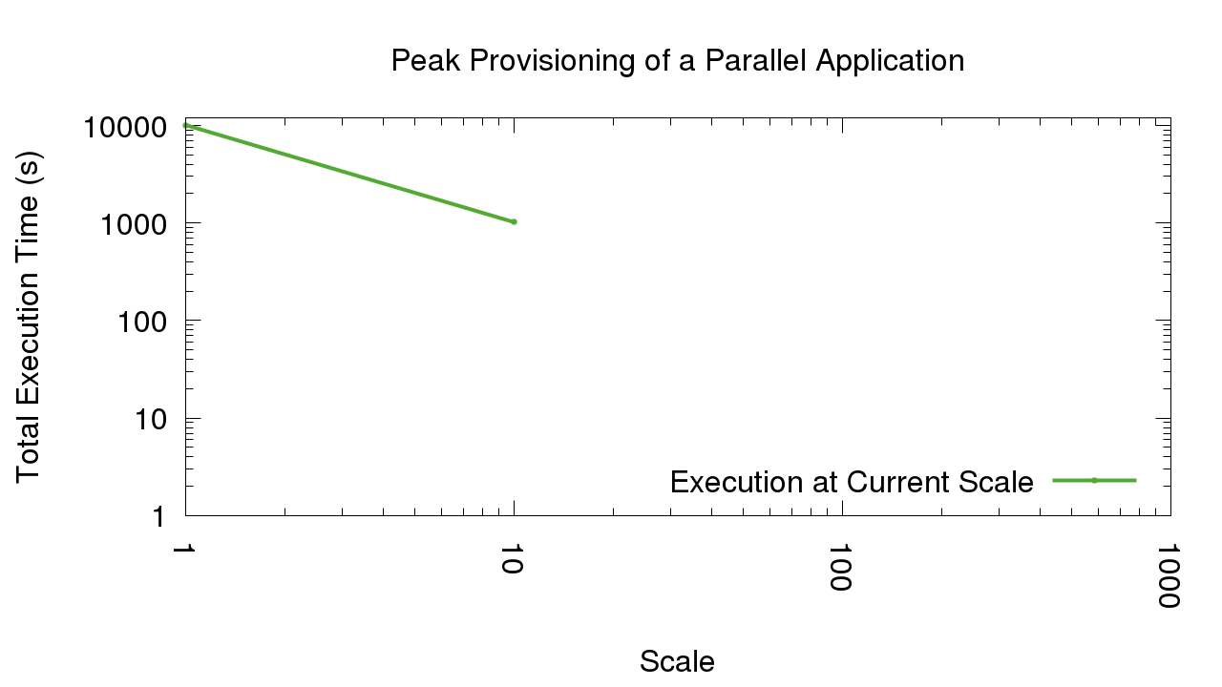
We should increase our scale!

Slide 9
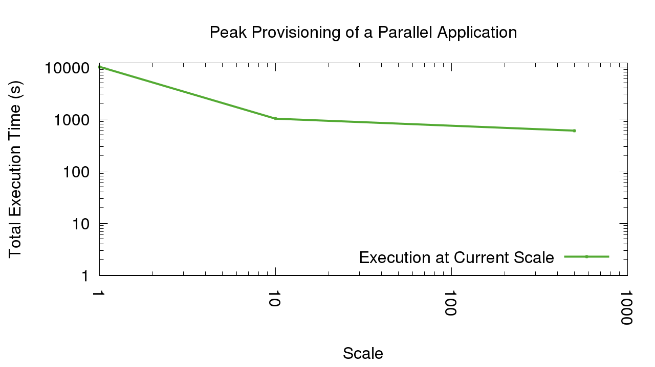
Still getting faster!

Slide 10
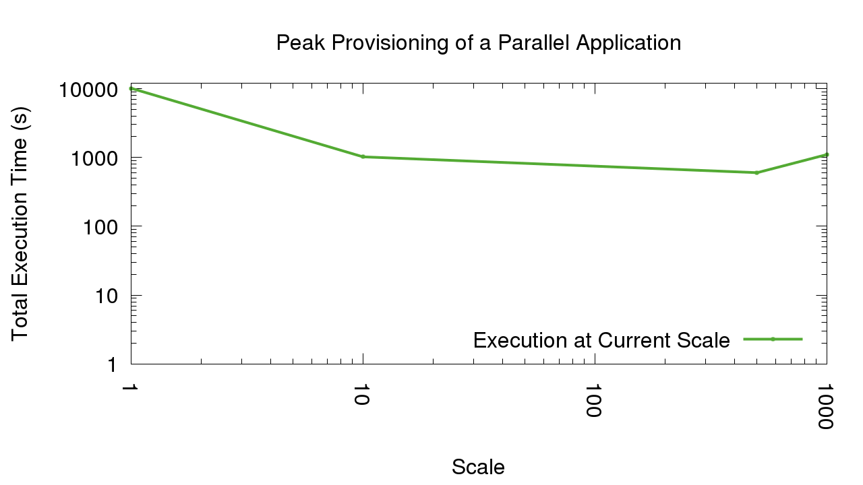
500 machines it is, then!

Slide 11
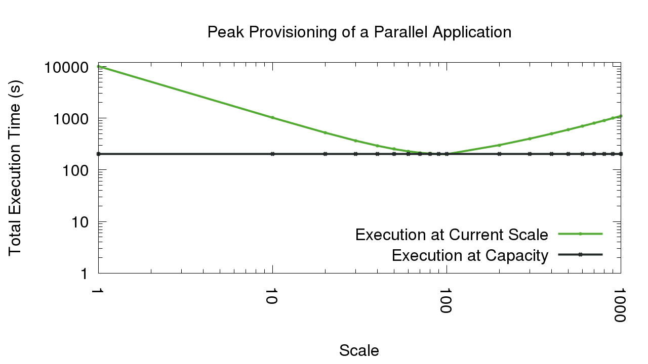

Slide 12
I LOVE running my analyses more than once.
No One Ever

Slide 13
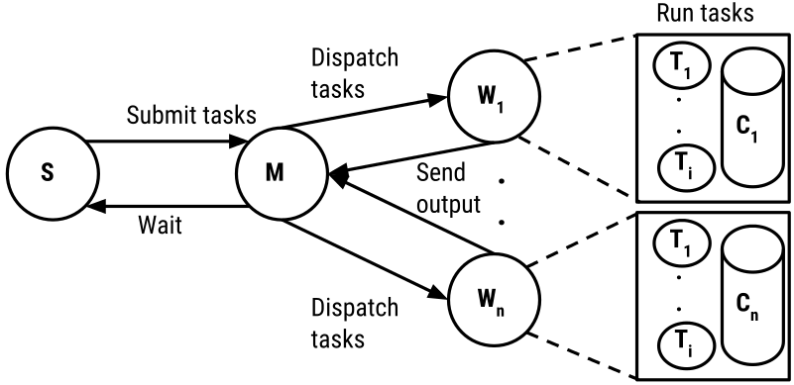
Master-worker framework

Slide 14
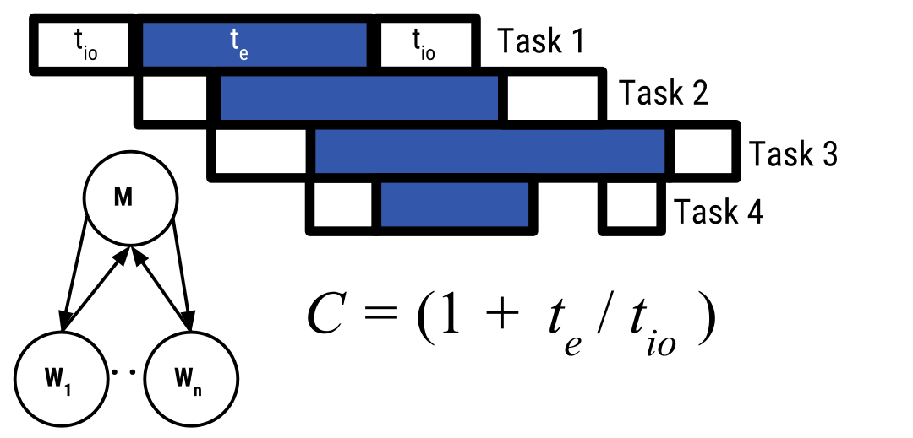
The bottleneck of a master-worker application

Slide 15
A lightweight model for right-provisioning
Capacity is the maximum number of resources a master can keep busy such that it is either sending input data to or retrieving output data from a worker at any given moment.
We estimate this upper bound using an exponentially weighted moving average for each task completed.
For the sake of completeness:

Slide 16
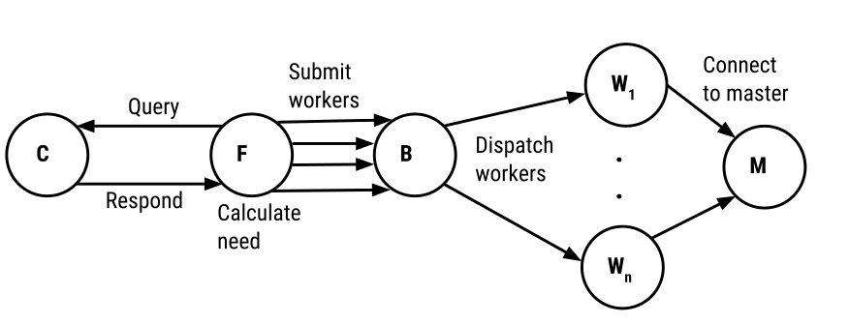
Work Queue Factory resource allocation

Slide 17
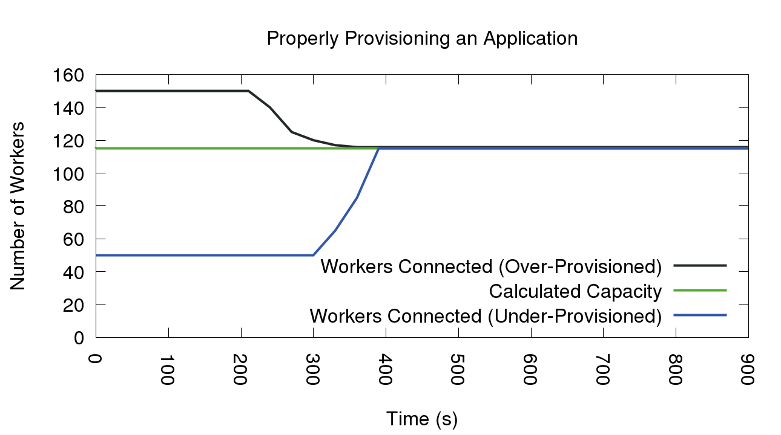
BWA

Slide 18
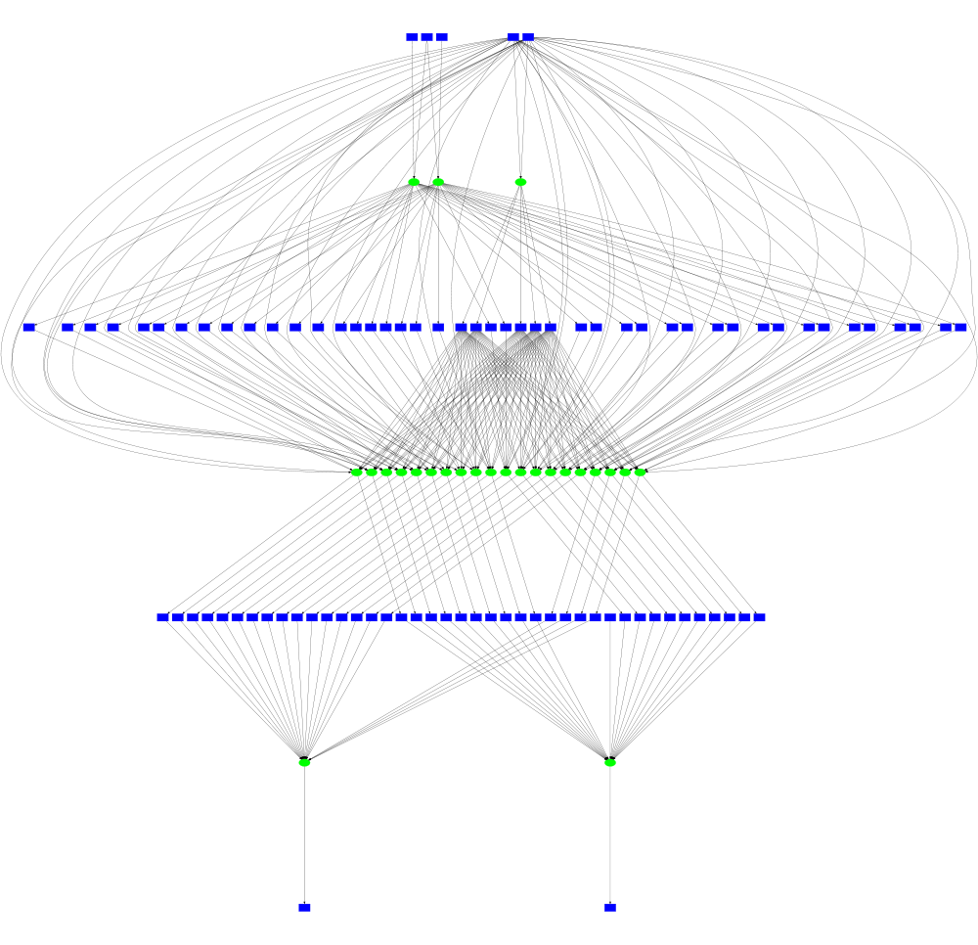

Slide 19
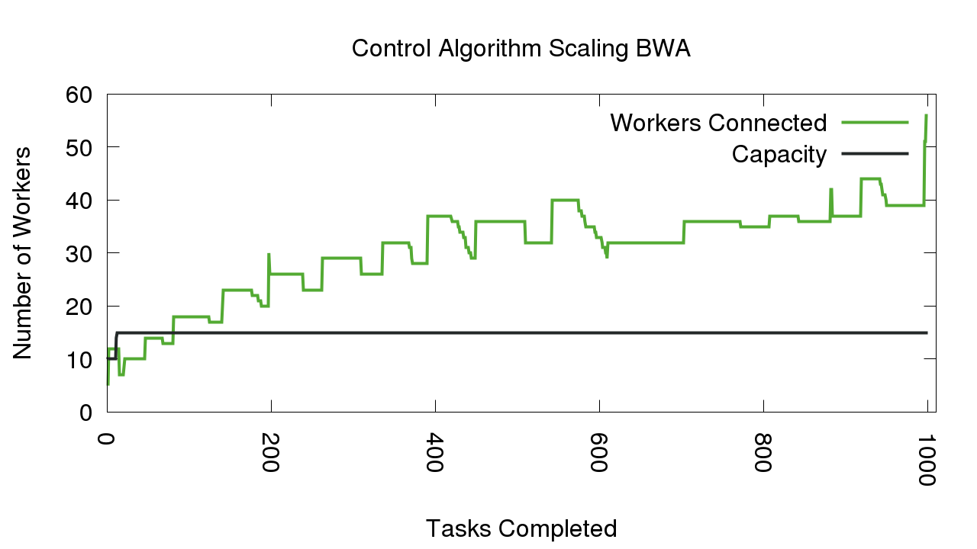
BWA

Slide 20
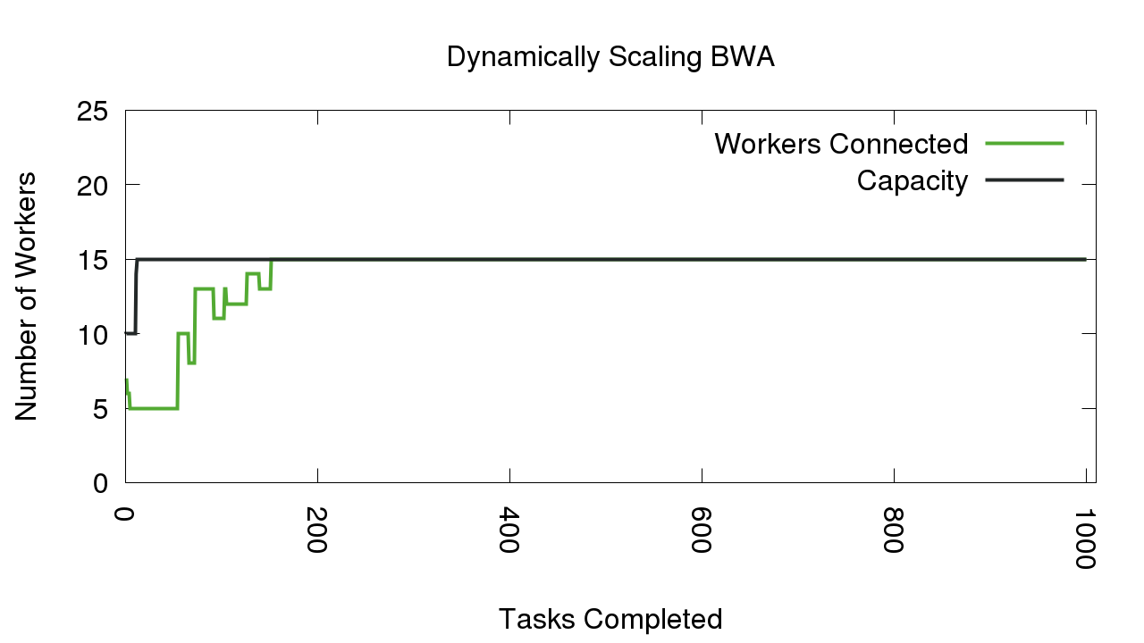
BWA

Slide 21
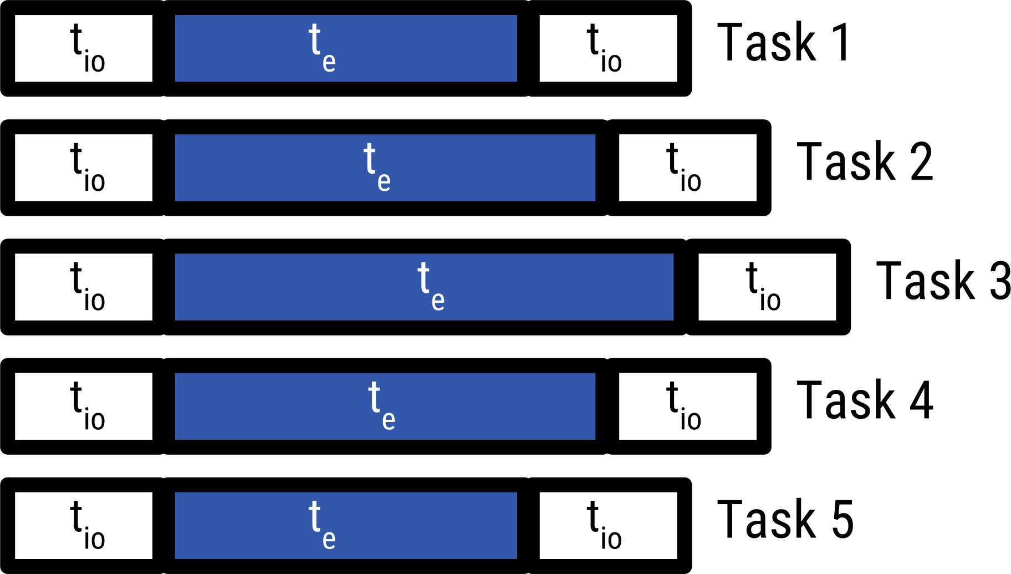
BWA

Slide 22
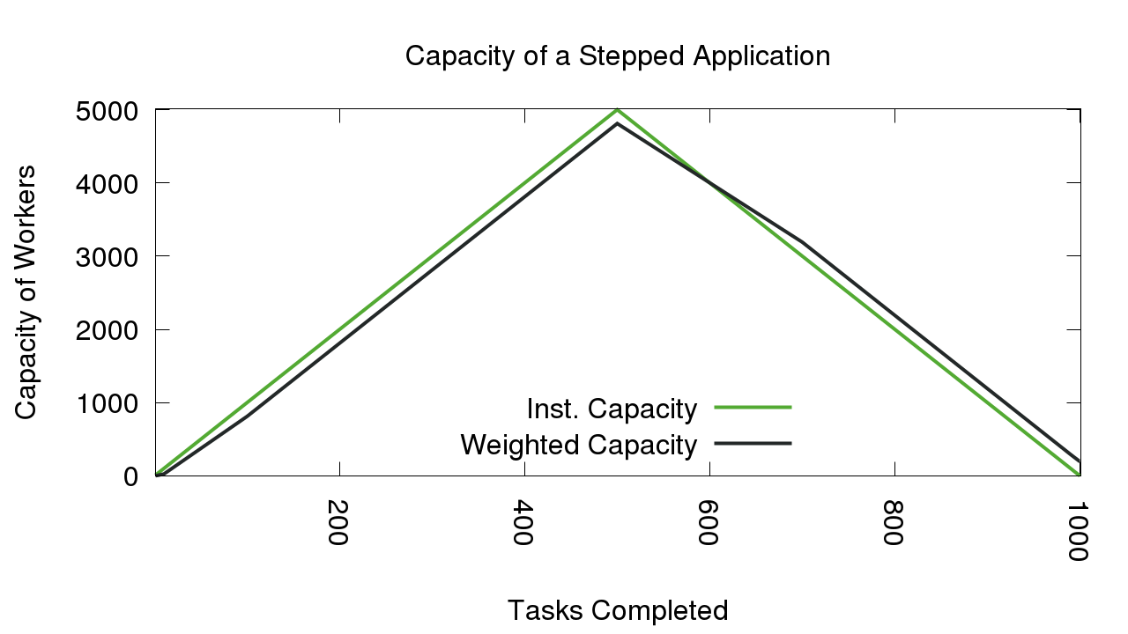
Limitations of the model

Slide 23
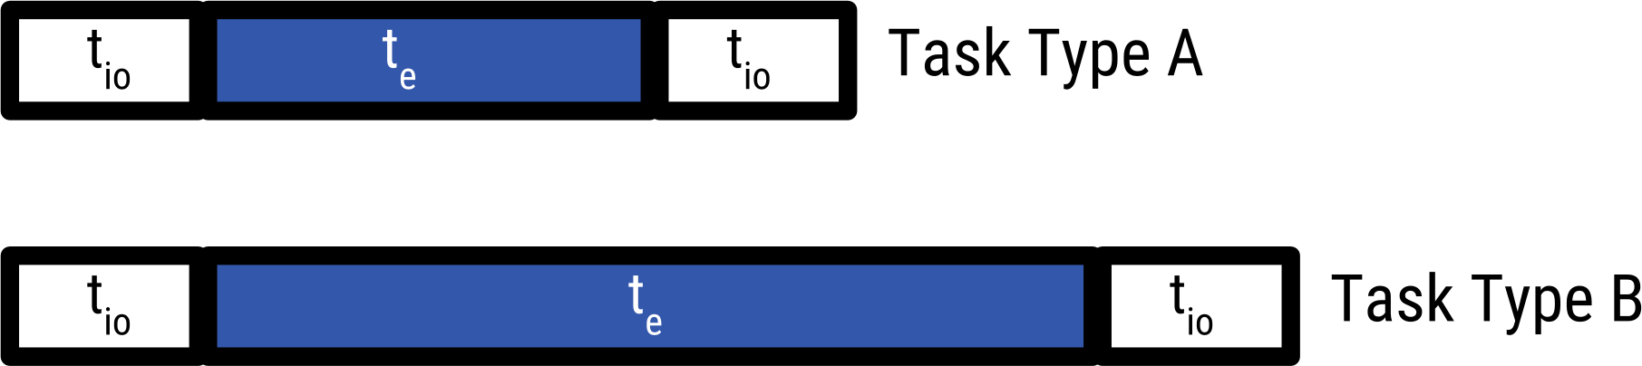
BWA

Slide 24
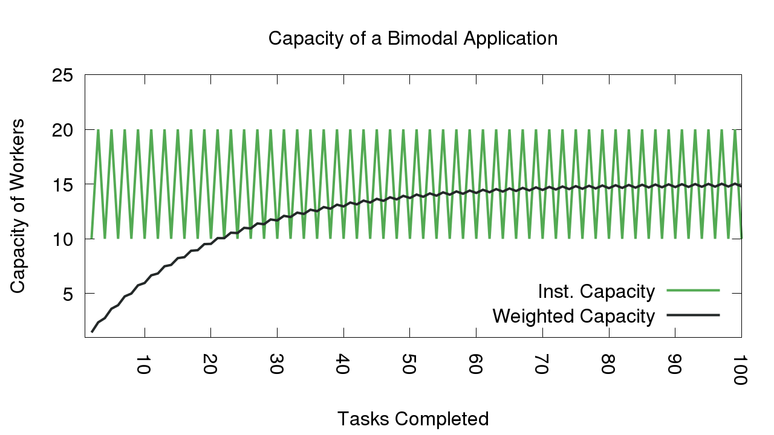
Limitations of the model

Slide 25
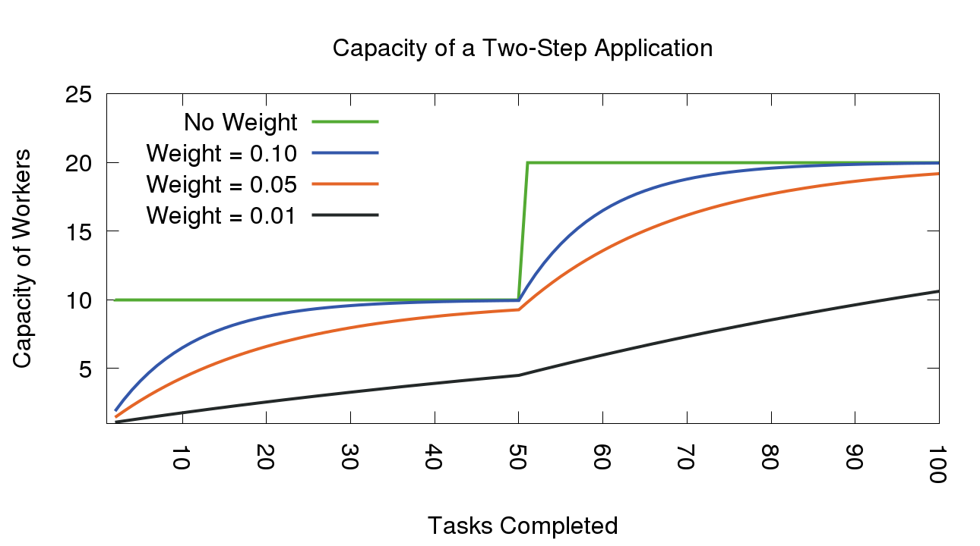
Limitations of the model

Slide 26
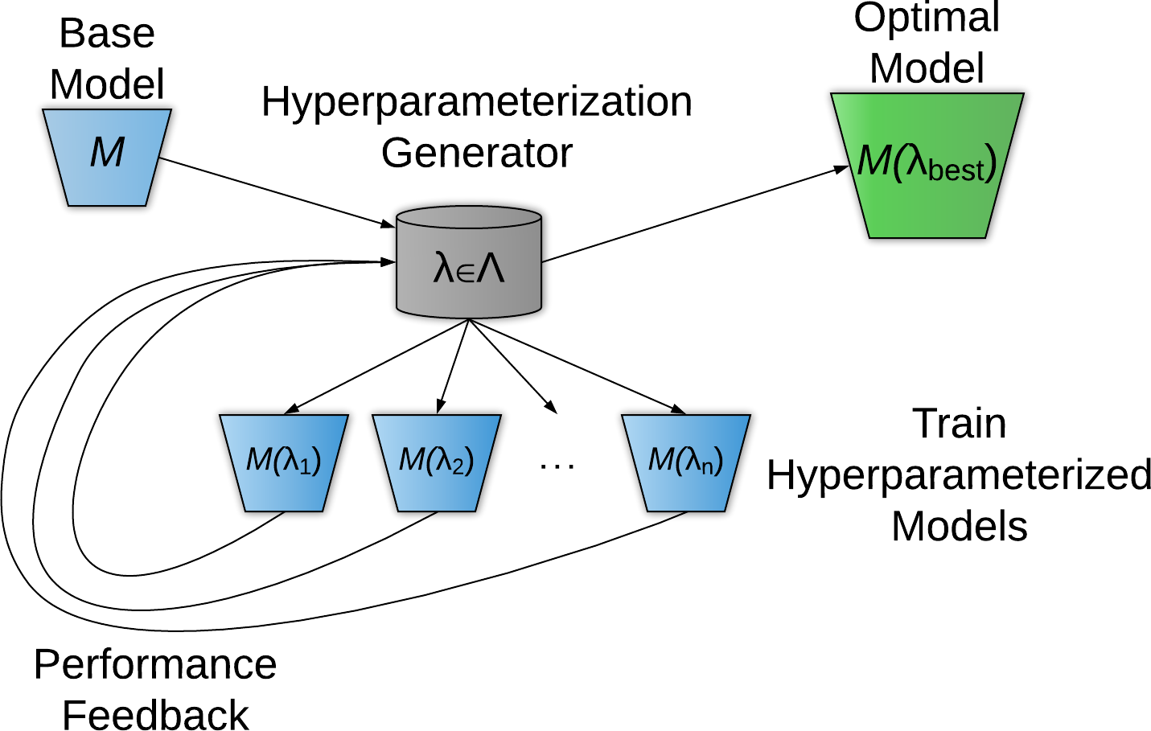

Slide 27
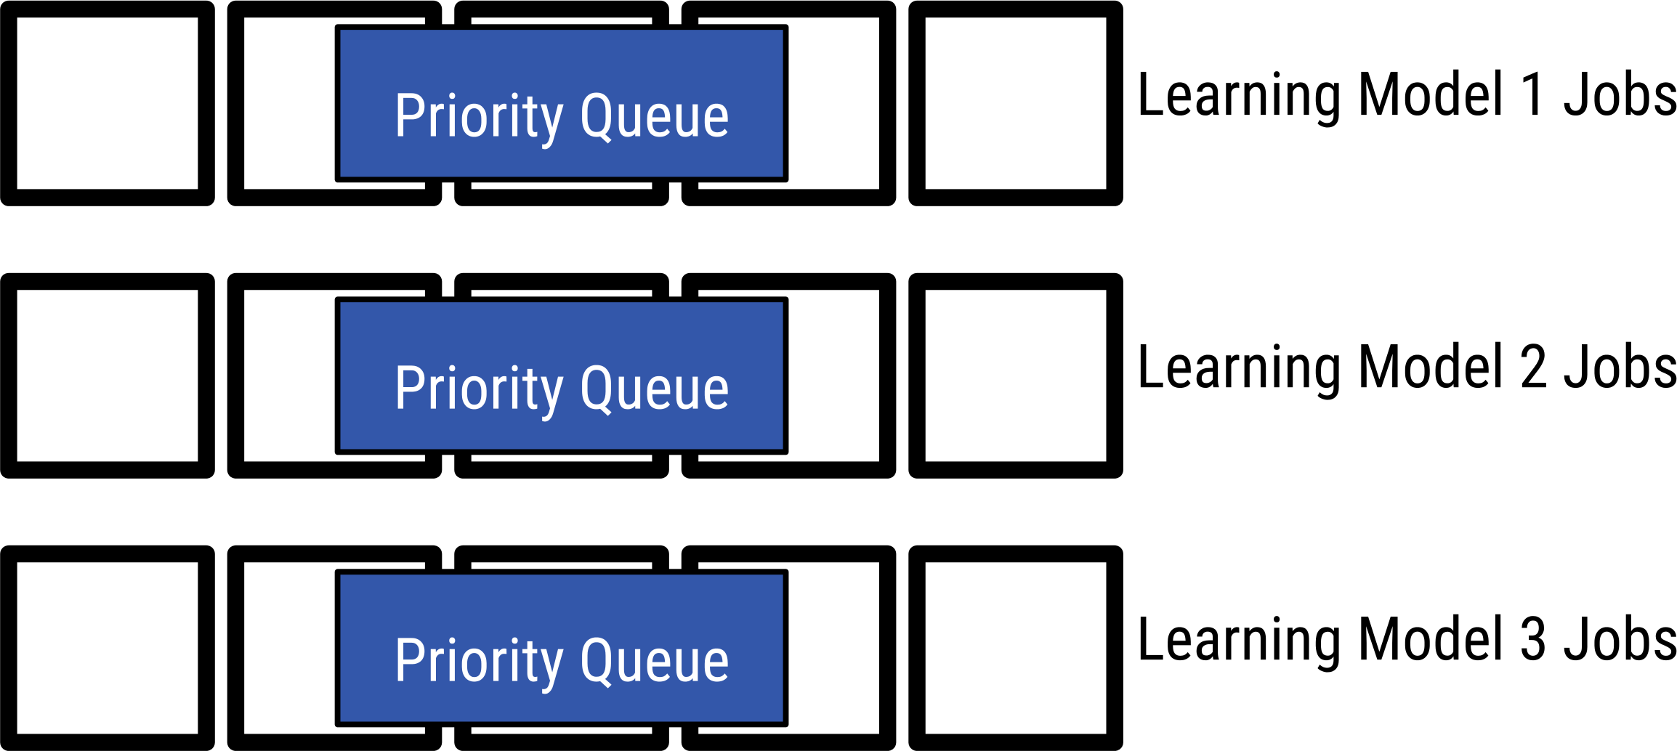
BWA

Slide 28
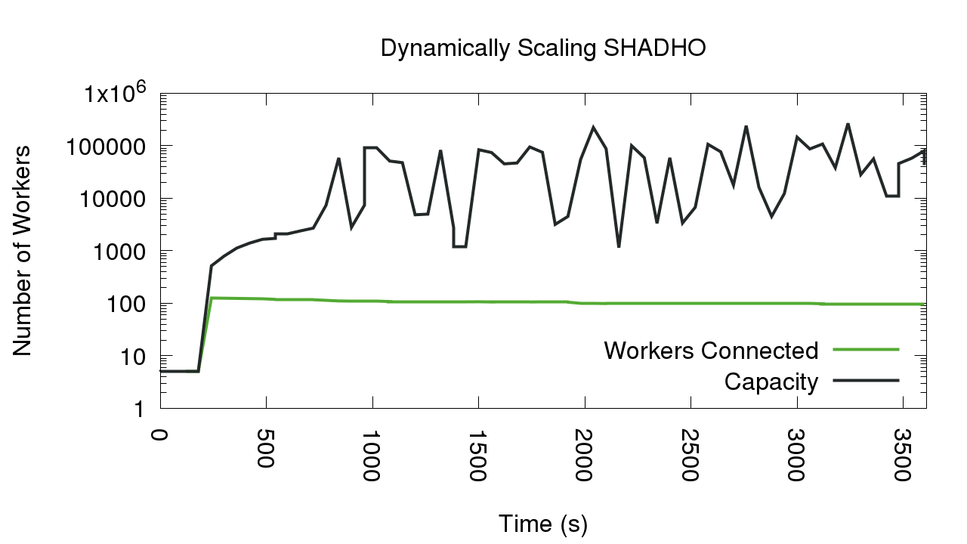
The perfect storm of limiting factors

Slide 29

Why does this matter for other paradigms?
We should consider implementing resource provisioning policies before leaving that choice in a user’s hands.
Not all systems have the same bottlenecks as master-worker applications, but they may be similar and worth investigating.
Lightweight models for resource provisioning add a layer of transparency to how a user’s work is completed.

Slide 30
Please contact me!
Nate Kremer-Herman
nkremerh@nd.edu
Reproduce Our Results!
github.com/cooperative-computing-lab/capacity-paper-data
github.com/cooperative-computing-lab/makeflow-examples
Learn to Use Our Software!
ccl.cse.nd.edu/software/tutorials/makeflow
ccl.cse.nd.edu

