Slide 1
RM-Replay: A High-Fidelity Tuning, Optimization and Exploration Tool for Resource Management
Maxime Martinasso
Swiss National Supercomputing Centre (CSCS)
Supercomputing 2018
Notes:
A new methodology and tool to investigate RM efficiency without relying on simulation

Slide 2
Exploring resource manager parametrization of a production system
HPC center view
  Goal is to improve the usage of the resource: higher utilization, higher throughput
  What-if scenario:
    Changing RM parameters
    Introducing new policies
    Updating RM and using new features
User point of view
  How long will my job wait in the queue?
    If I improve my runtime estimate
    If I use this specific queue
    If I use a special constraint
Current approaches
  Identify a better configuration? How do you test it?
    Apply a change between two maintenances, monitor
  Using a simulator?
    Complexity of a production system: partitions, priorities, node states, reservation, …
    Accuracy of the simulation
    Translate simulation output into decision making

Slide 3
New approach: RM-Replay
Use the exact same software stack for the RM
  No modification of the code (or very minimal)
Use fewer resources than the production system
  Less physical resources: nodes
  Less time: faster-than-real-time clock
“Replay” the exact set of actions for a workload:
  Job submissions
  Node availability
  Reservations
Allow historical studies, gather statistics on events (end of allocation period, GB)
Use a well-known interface (the RM itself) by the system engineers

Slide 4
How does RM-Replay work?
Use a container to recreate the entire resource manager software stack in an isolated environment
Inside the same container recreate the set of users (who submit jobs)
Create an adjustable clock which will replace the system clock and will be used by the software stack
Develop a set of programs to recreate the interaction originating from a workload
Provide configuration data outside the container to enable portability to other HPC systems

Slide 5
Instance of RM-Replay: Slurm-Replay
Slurm is a resource manager used on many large HPC systems
  6 of top 10 in the top500 (November 2017)
  Many features: High scalability and performance, fair-share, reservation, plugins, …
Slurm is a complex software:
  Accurate simulation is very difficult
  Integrated simulator modifies code base and the scheduling behavior
    Event based simulation, capturing all events? Impact on the scheduling?
    Lack of portability
Objective of Slurm-Replay:
  Use the original and not modified Slurm software stack
  Use configuration parameters from a large HPC production system (Piz Daint)
  Replay production workloads
  Evaluate scheduling metrics: throughput, utilization, waiting time, …

Slide 6
How does Slurm-Replay work?

Slide 7
Workload:
Jobs
Job dependencies
Node states
Reservations
Multitenant:
Extract users/groups

Slide 8
Workflow

Slide 9
Technical solutions and limitations
No root privileges inside the container (to use HPC container runtimes)
Wrap functions used to impersonate users to always return true:
  setuid, setgid, chown
Wrap common C time functions to use a faster clock:
  sleep, gettimeofday, …, clock counter is in /dev/shm
Create and bind mount /etc/passwd and /etc/group from users in the worload
Use Slurm Frontend feature to execute only one slurmd daemon for an arbitrary number of nodes
Missing data from Slurm db taken from system logs
  job dependency, topology, reservation submission time

Slide 10
Accuracy: makespan
Data distribution over 50 tests
24 hours, 6025 jobs: 2664 jobs GPU constraint, 2409 jobs MC constraint, 169 jobs in other partitions
10 reservations and 51 state changes of nodes
Peak utilization of 97% of GPU nodes and 54% of MC nodes
Schedule completed in 47.65 hours for GPU and 42.7 hours for MC

Slide 11
Performance vs clock rate
Failure: Slurm-Replay takes too long to process backlog of jobs
Performance dependent on the underlying CPU frequency
A clock rate of 0.06 (16.7x faster) seems to be the best option on a 2.1 GHz CPU
Use only one slurmd daemon

Slide 12
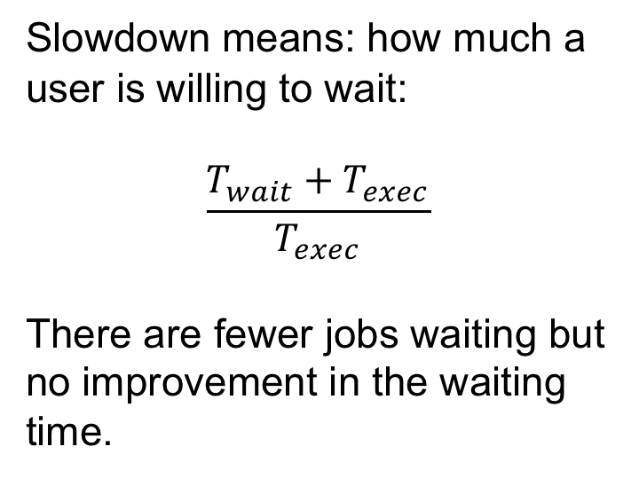
Example of use case
User: “Will my job be scheduled earlier if I provide a better runtime estimation?”
Slowdown means: how much a user is willing to wait:
$$\frac{T_{wait}+T_{exec}}{T_{exec}}$$
There are fewer jobs waiting but no improvement in the waiting time.

Slide 13
Conclusion and future work
RM-Replay: A High-Fidelity Tuning, Optimization and Exploration Tool for Resource Management
Useful for testing what-if scenario: parameter, version, feature, policy, …
Help to take better decision on a production system configuration
Slurm-Replay an instance of RM-Replay for Slurm
Use Slurm-Replay at CSCS
Investigate slurmd performance
https://github.com/eth-cscs/slurm-replay

Slide 14
Thank you for your attention.

