Slide 1



Dynamically Negotiating Capacity Between On-demand and Batch Clusters
Feng (Francis) Liu, Kate Keahey, Pierre Riteau, Jon Weissman
(11/14/2018)

Slide 2
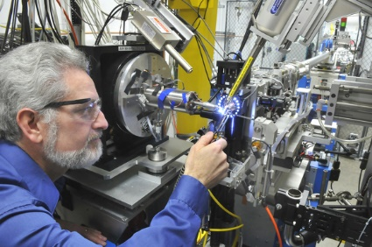


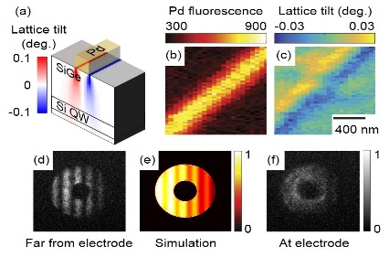
On-Demand Resource Access
A growing need for on-demand resource allocation in scientific computing.
Experiment
Blast of data
Processing
Results
Notes:
Today’s scientific computing world has witnessed a growing need for on-demand resource access.
The new generation of experimental devices and equipment, ranging from light sources for high-energy physics to sensor network, are capable of generating ever larger volumes of data and these data are time-sensitive.
Meaning that they requires fast allocation of many many computational resources, such that the results can be quickly generated and feedback to the users.
In this scenario, on-demand resource allocation is vital for the efficiency of this scientific discovery cycle.

Slide 3
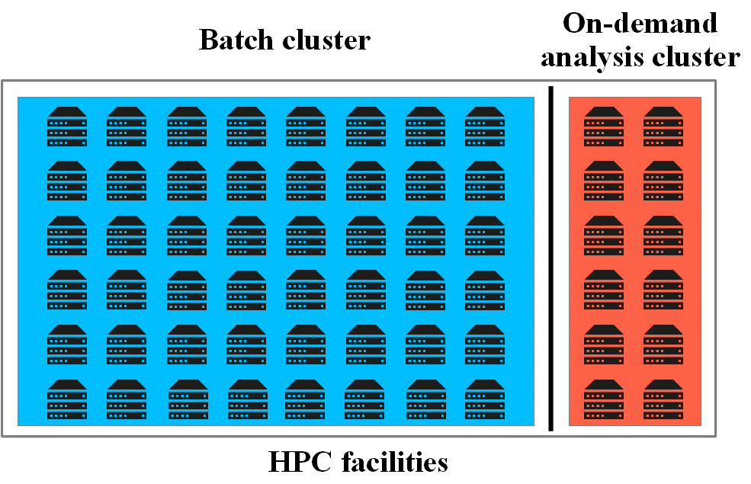
HPC: A Tale of Two Clusters
Over-subscribed
Long wait time
Over-provisioned
Low wait time
Notes:
In order to meet such needs…

Slide 4
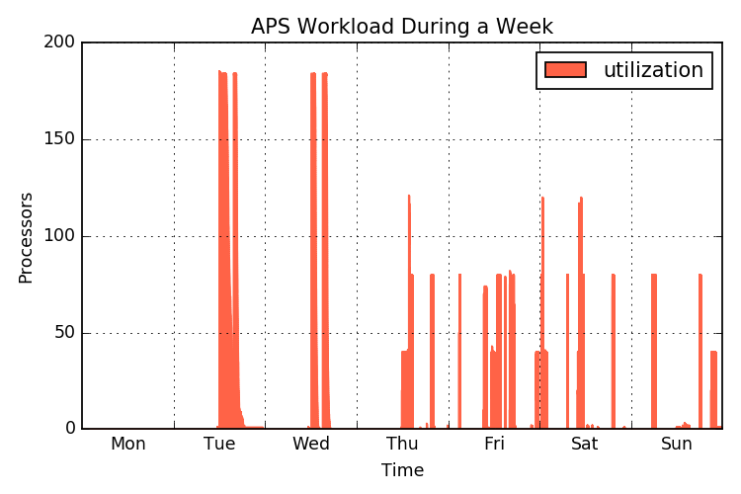
The Problem: Underutilized On-Demand Cluster
Trading utilization for lower resource provisioning time
A real-life example of resource utilization in an on-demand science cluster
The on-demand workloads are bursty and spiky

Slide 5
The Idea: Combine Workloads
Two separate partitions
One combined cluster
Batch workload can use idle on-demand resources
Bursty on-demand workload can also run on batch resources

Slide 6
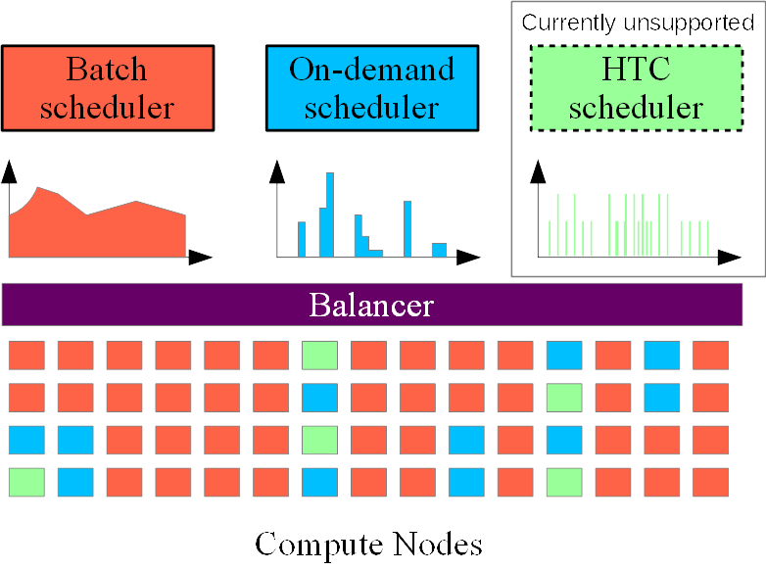
The Balancer Approach
Instead of a single scheduler…
A thin layer between existing schedulers and resources
Dynamically move nodes between scheduling pools
Nonintrusive

Slide 7
Balancer APIs
Resource negotiation
Balancer
request nodes
release nodes
reclaim nodes
restore nodes
On-demand scheduler
Batch scheduler

Slide 8
Balancer Algorithms
A1: Basic algorithm
A2: Hint algorithm
A3: Predictive algorithm

Slide 9
A1: The Basic Algorithm
Initially Balancer reserves minimum # of on-demand nodes
When on-demand cluster runs out of resource, Balancer steals cycles from batch cluster
Input parameters
  R: nodes reserved for OD scheduler
  W: rejection timeout
    OD request rejected if balancer can’t find enough nodes within W

Slide 10
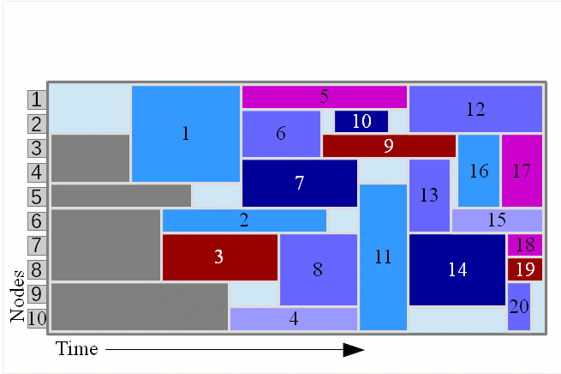
Example: Reclaimable Nodes
How many nodes can be reclaimed between a given time period?
Steal, not kill!
Scheduling sequence w/o on-demand requests

Slide 11
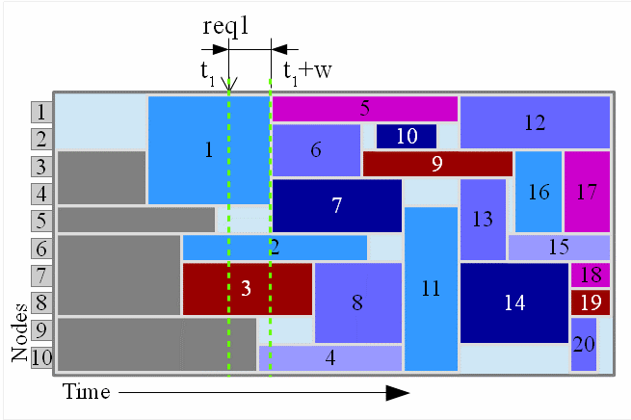
Example: Reclaimable Nodes
Suppose an OD request arrives at time t1
Which nodes can be reclaimed until t1+w?

Slide 12
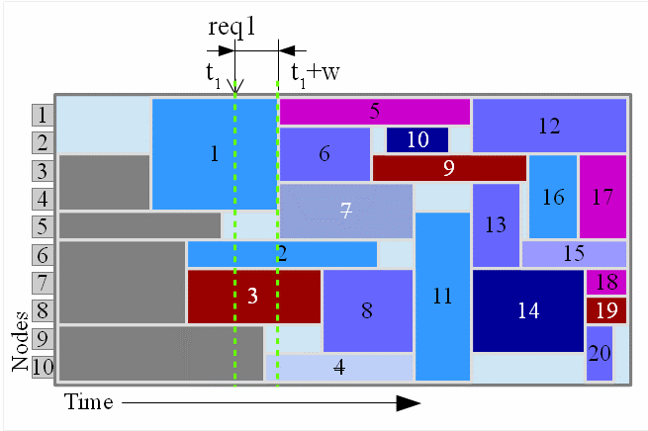
Example: Reclaimable Nodes
Max reclaimed nodes
3 nodes: 5, 9, 10

Slide 13
A2: The Hint Algorithm
A dynamic reserve algorithm, leverage short-term predictability
  According to the OD users, despite wait time is sometimes unacceptable, 15-30 minutes advance notification is possible

Slide 14
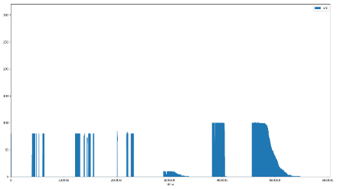
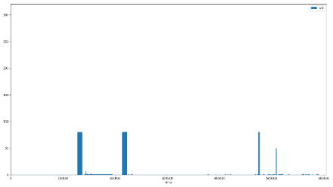
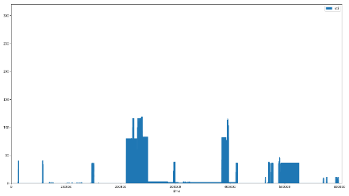
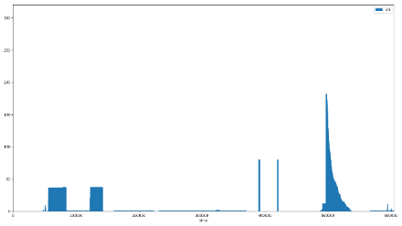
A3: Predictive Algorithm
When hint isn’t available, predict
dynamic R based on historical data
  Divide a day into time slots
  Estimate reserve in each slot by history
Week 1
Week 2
Week 3
Week 4

Slide 15
Implementation
Based on existing technologies
  Torque/Maui as the batch scheduler
  OpenStack as the on-demand scheduler
Balancer is implemented as a stand-alone HTTP endpoint
No code change in Torque/Maui, only add 2 scripts
Modified OpenStack Nova scheduler to send resource request to Balancer

Slide 16
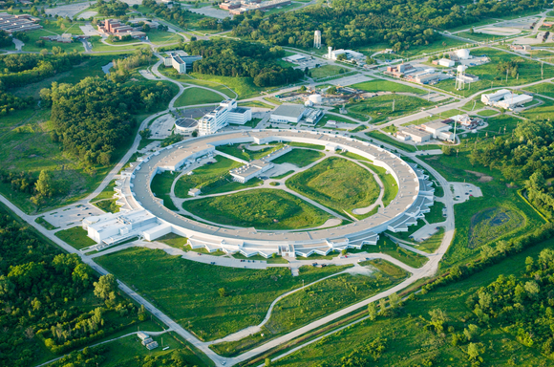

Real-Life Scenario
Combine on-demand/batch workloads and resources
APS/LCRC workloads
  2 years, 10/06/2013~09/25/2015
  APS: Sun Grid Engine job traces
  LCRC: Torque job traces
APS/LCRC combined cluster
  304 (lcrc) + 68 (aps) = 372 16-core nodes
Advanced Photon Source
(ANL)
https://github.com/Francis-Liu/LcrcOnDemand
LCRC Cluster

Slide 17
On-demand VM Requests
Single-core APS jobs
16-core VM deploy requests
How mapping was done:
  At each APS job start/stop event,
    calculate # core usage → # 16-core VMs needed, assuming tightly packed
    If more VMs needed → VM deployment request
    If less VMs needed → VM termination request

Slide 18

Experimental Setup
Scale down in space
  Run 372 worker nodes as 372 Docker containers
  24 containers / physical node (24-core, 128G RAM)
  (16 worker + 1 controller) physical nodes
Scale down in time
  Accelerated 60x (hours to minutes)
  But still, we can’t replay 2-yrs worth of traces
  Instead, we pick the most challenging week
It’s free!
www.chameleoncloud.org

Slide 19
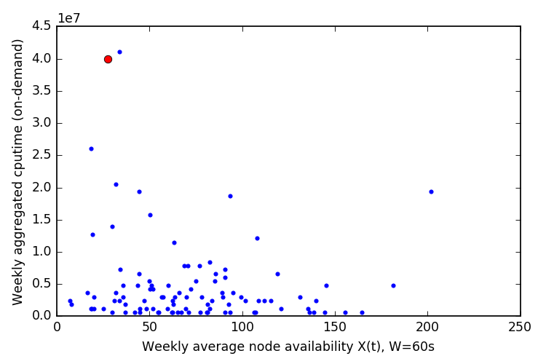
Picking The Most Challenging Week
Definition of ‘challenging’
  High total resource usage in the on-demand trace
  Low average node availability in the batch trace
Plot each week’s X: batch availability and Y: on-demand usage on a 2D graph
Most challenging

Slide 20
Metrics
Number of on-demand rejections, or reject rate
Mean batch wait time
Average utilization
  Batch utilization
  On-demand utilization

Slide 21
Results: Most Challenging Real-Life Scenario
Goal: find the best parameters setting that result in
  0 rejection
  also produce high utilization + low batch wait time
Table 1: Experimental results for the most challenging week

Slide 22
Results: Most Challenging Real-Life Scenario
Baseline: replicate existing configurations, statically partition batch & on-demand clusters
  Combined utilization: 80.1%
  Batch wait time: 16.7 hours
  Rejections: 0

Slide 23
Results: Most Challenging Real-Life Scenario
2 hypothetical cases: assign all nodes to batch, or to on-demand
  (only) Batch utilization: 84.4%
  (only) Batch wait time: 2.0 hours ← lower-bound

Slide 24
Results: Most Challenging Real-Life Scenario
2 hypothetical cases: assign all nodes to batch, or to on-demand
  (only) Batch utilization: 84.4%
  (only) Batch wait time: 2.0 hours ← lower-bound
  (only) On-demand utilization: 1.25%

Slide 25
Results: Most Challenging Real-Life Scenario
Balancer scenarios
  Basic algorithm
  Increase R and W, until rejections=0 or W=10 min

Slide 26
Results: Most Challenging Real-Life Scenario
Achieved best Balancer results when R=12, W=0
  0 rejection
  Compared to baseline, only need 18% (12/68) dedicated on-demand nodes
  batch wait time decrease from 16 hours to 2 hours
  utilization increase from 80.1% to 85.3%
Notes:
Highlight the final result

Slide 27
Synthetic Workload
How does Balancer perform under diverse workloads?
  Synthetically modify the challenging real-life trace

Slide 28
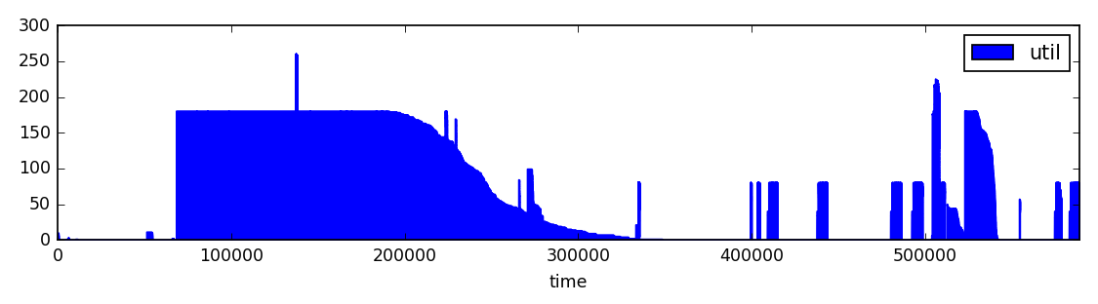


Synthetic Workload
Change on-demand workload intensity
  Multiply each request by 2x, 4x, 8x, 16x, and 32x
  OD utilization rho=2.5%, 5%, 10%, 20%, 30% (peak at 264 req/s in experiment)
$$×2$$
$$×2$$

Slide 29
Synthetic Workload
Change batch workload intensity and shape
  The real-life trace is U66-Mainstream
  Manipulate job shape ==> U66-Wide, U66-Narrow
  Inject more jobs to have U77, U88
Wide
M
N
N

Slide 30
Synthetic Workload Results: Basic Algorithm
Condition: R=0, W=0
Focus: 0 reject
U66-Mainstream&Narrow, up to rho 5%
Harder to accommodate OD requests when batch jobs are wide

Slide 31
Synthetic Workload Results: Hint Algorithm
Basic
Hint (H=30 min)
Hint algorithm significantly reduces reject rate

Slide 32
Synthetic Workload Results: Predictive Algorithm
Hint
Predictive
Predictive algorithm has similar reject rate as Hint algorithm
But at the cost of over-reservation, which lowers overall utilization and increases batch wait time
Notes:
Finish in 23 min

Slide 33
Conclusion
In a real-life situation, Balancer could reduce reserved on-demand infrastructure by 82%, and improve batch wait time by 8x
Notes:
Show results
Show the limits: <10%

Slide 34
Conclusion
In a real-life situation, Balancer could reduce reserved on-demand infrastructure by 82%, and improve batch wait time by 8x
Basic algorithm could support 0 rejection for up to 5% on-demand workload into a batch cluster with 66% utilization
Notes:
Show results
Show the limits: <10%

Slide 35
Conclusion
In a real-life situation, Balancer could reduce reserved on-demand infrastructure by 82%, and improve batch wait time by 8x
Basic algorithm could support 0 rejection for up to 5% on-demand workload into a batch cluster with 66% utilization
For batch cluster with denser workload (up to 88%), Hint/Predictive algorithms are needed to support up to 10% on-demand workload
Notes:
Show results
Show the limits: <10%

Slide 36
Conclusion
In a real-life situation, Balancer could reduce reserved on-demand infrastructure by 82%, and improve batch wait time by 8x
Basic algorithm could support 0 rejection for up to 5% on-demand workload into a batch cluster with 66% utilization
For batch cluster with denser workload (up to 88%), Hint/Predictive algorithms are needed to support up to 10% on-demand workload
Batch job shape affects on-demand rejection rate

Slide 37
Future Work
Explore batch job preemption
Improve prediction accuracy of predictive algorithm
Deploy our system in production

Slide 38
Questions
Thank you!
Trace, reproducibility, temporarily published at
https://github.com/Francis-Liu/LcrcOnDemand

Slide 39
Backup slides

Slide 40
Related Works
Mesos
  not support time-bounded resource allocation
  no performance-aware resource reclamation
Kubernetes
  not treating batch as the main tenant
  multitenancy at node level, vs. node-exclusiveness in HPC

Slide 41
Compared to Priority-Based Batch Scheduling
Why not use a single batch cluster which supports priority-based preemption?
  Can’t reuse the environment management provided by popular cloud solutions
  Lacking of ‘smart’ reservation like hint and predictive
  Lacking of support of time-bounded request & rejection

Slide 42
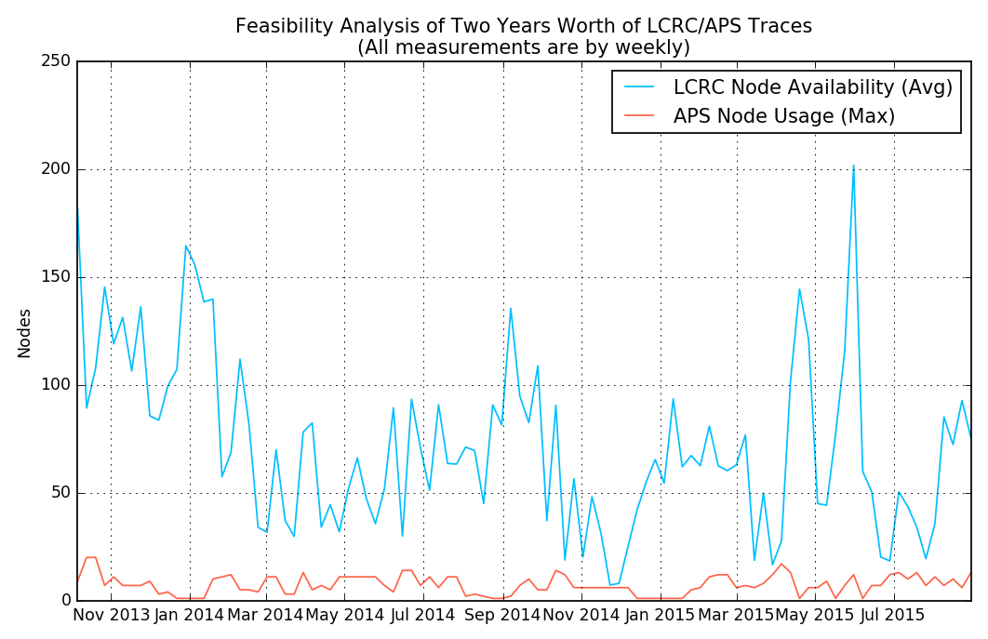

Feasibility Analysis
LCRC average node availability
APS maximum node usage
If availability > usage, then workloads can be combined

