Slide 1



Mitigating Inter-Job Interference Using Adaptive Flow-Aware Routing
Staci A. Smith, Clara E. Cromey, David K. Lowenthal
The University of Arizona
Jens Domke
Tokyo Institute of Technology
Nikhil Jain, Jayaraman J. Thiagarajan, Abhinav Bhatele
Lawrence Livermore National Laboratory

Slide 2
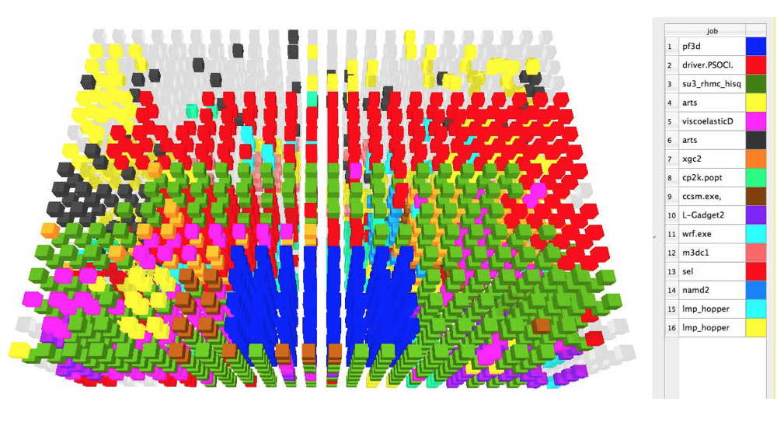


Inter-job network interference on production systems
Dedicated nodes
isolated compute resources
Shared network
inter-job network contention
Credit: Bhatele et al. “There goes the neighborhood” SC’13.
Torus-based systems can have up to 2x performance degradation [Bhatele 13].
Evidence on dragonfly-based systems indicates variability as well [Chunduri 17].

Slide 3
Our contributions
Measured inter-job interference on dragonfly and fat-tree clusters
There is more than 2x performance degradation with both interconnects.

Slide 4
Our contributions
Measured inter-job interference on dragonfly and fat-tree clusters
There is more than 2x performance degradation with both interconnects.
Performed analysis of interference on the fat-tree cluster
Performance degradation is caused by a few network hotspots on fat-tree.

Slide 5
Our contributions
Measured inter-job interference on dragonfly and fat-tree clusters
There is more than 2x performance degradation with both interconnects.
Performed analysis of interference on the fat-tree cluster
Performance degradation is caused by a few network hotspots on fat-tree.
Developed a routing-based mitigation strategy on fat-tree clusters
The strategy, Adaptive Flow-Aware Routing or AFAR, achieves up to 46% runtime improvement on benchmarks run under contention.

Slide 6
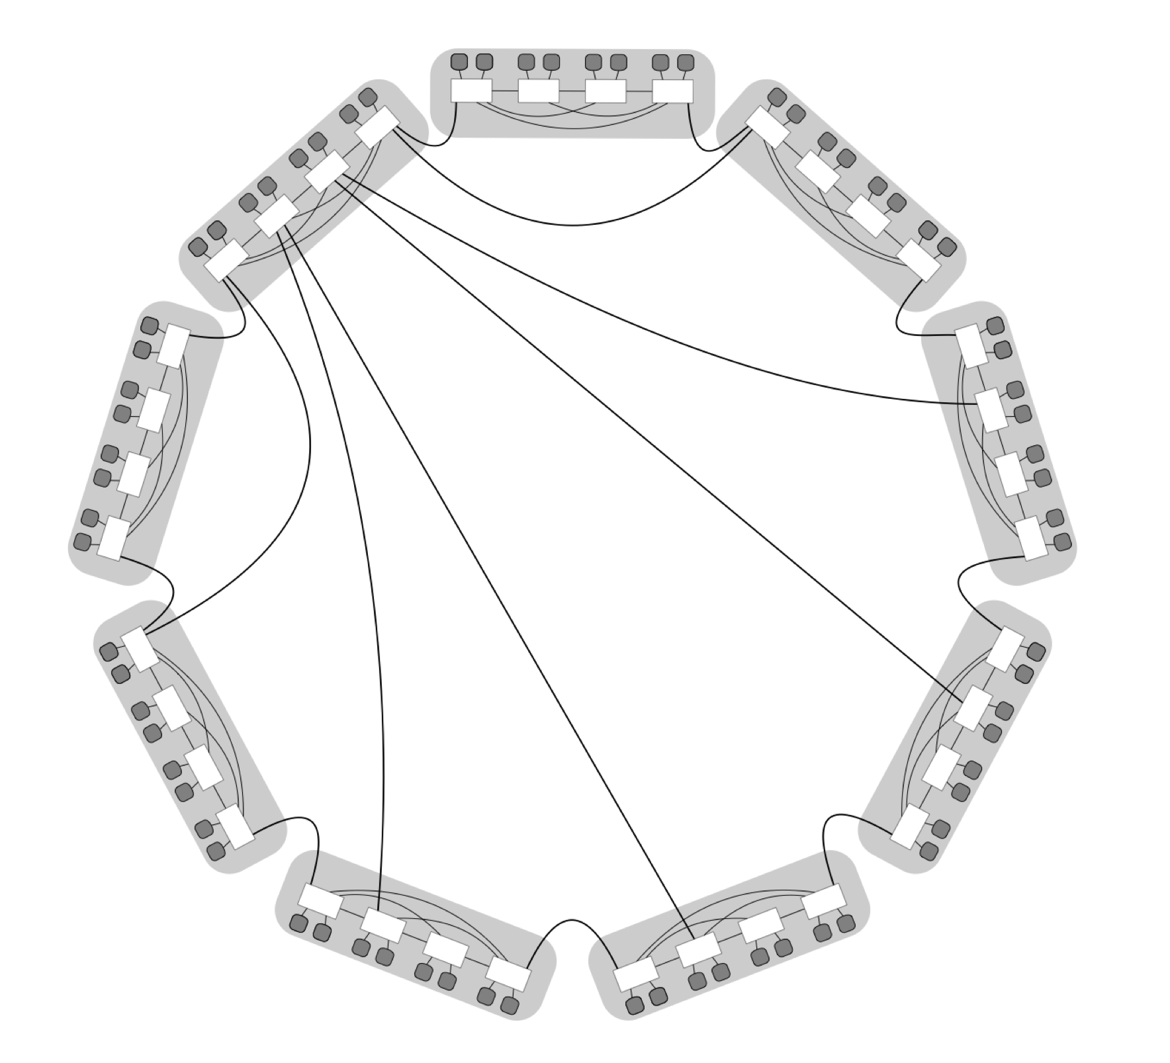
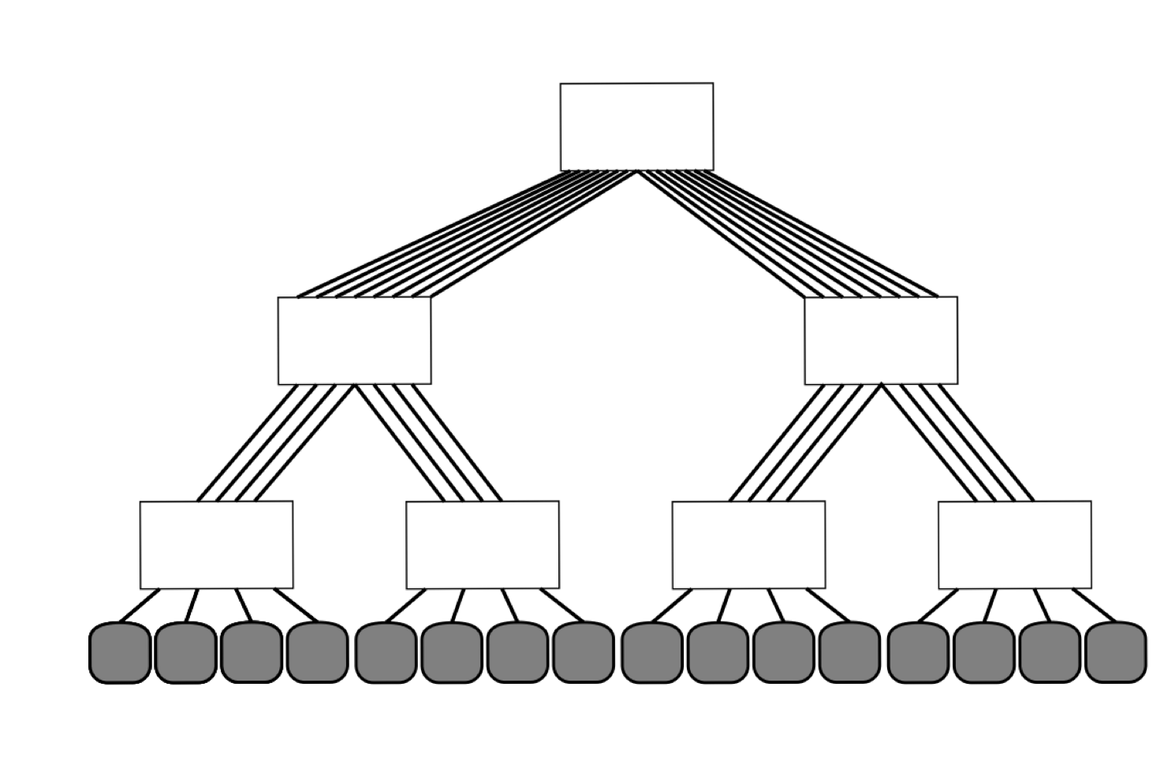
Background: Routing in modern systems
Dragonfly: Routed adaptively
  path between each pair of nodes is non-deterministic
  multipath routing — attempts to avoid congestion
Fat-tree: Typically routed statically
  path between each pair of nodes is deterministic
  single-path routing — oblivious to congestion
  adaptive routing has not been used until very recently (new Sierra and Summit systems [Vazhkudai et al. SC’18])

Slide 7
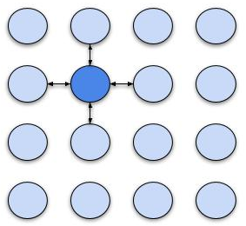
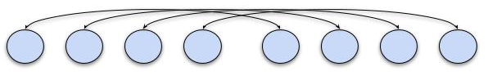
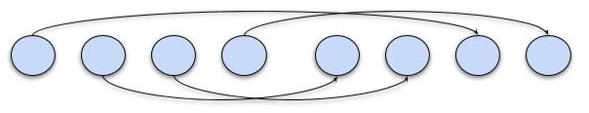
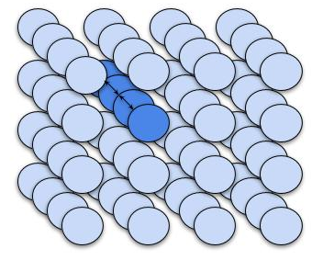
Inter-job interference experiments
System:
Cab, a 1296-node Infiniband-based fat-tree cluster at LLNL
Benchmarks:
bisection bandwidth
nearest neighbors
random pairs
FFT proxy
Methodology:
Benchmarks spend 70-75% time in computation
Each job ran (1) in isolation and (2) with competition
bisection bandwidth
nearest neighbors
random pairs
FFT proxy

Slide 8
Interference results
Performance degrades under competition (with respect to isolated performance).

Slide 9
Interference results
Median degradation is usually 30-50% for applications sensitive to contention.

Slide 10
Interference results
Degradation varies significantly across different placements of a given job. Why?

Slide 11
Varying distribution of traffic across Cab
System link loads I
Minor slowdown

Slide 12
Varying distribution of traffic across Cab
System link loads I
System link loads II
System link loads III
Minor slowdown
Moderate slowdown
Significant slowdown

Slide 13
Varying distribution of traffic across Cab
System link loads I
System link loads II
System link loads III
Minor slowdown
Moderate slowdown
Significant slowdown

Slide 14
Varying distribution of traffic across Cab
System link loads I
System link loads II
System link loads III
Minor slowdown
Moderate slowdown
Significant slowdown

Slide 15
Varying distribution of traffic across Cab
System link loads I
System link loads II
System link loads III
Minor slowdown
Moderate slowdown
Significant slowdown

Slide 16
Correlating performance to traffic
Per-process performance correlates to amount of interfering traffic on links.

Slide 17
Correlating performance to traffic
Per-process performance correlates to amount of interfering traffic on links.
Degradation increases starting at 60 GB traffic on link.
3.9 GB/s on average
78% of advertised maximum

Slide 18
Correlating performance to traffic
Per-process performance correlates to amount of interfering traffic on links.
Since most links are below 60 GB, can we reduce traffic on the others to improve performance?
System link loads III
Only a few links are too heavily loaded

Slide 19
AFAR: Adaptive Flow-Aware Routing
Idea: periodically re-route to alleviate hotspots
Given traffic for each pair of nodes in the system and given current routing
Calculate current load on all links in system
Find link with maximum load
If maximum too high, re-route one flow crossing that link to a less utilized link
Repeat from (1), using new routing

Slide 20
AFAR example
Two jobs (blue and orange) scheduled on the system

Slide 21
AFAR example
Two jobs (blue and orange) scheduled on the system
Node-to-node traffic known

Slide 22
AFAR example
Two jobs (blue and orange) scheduled on the system
Node-to-node traffic known

Slide 23
AFAR example
Two jobs (blue and orange) scheduled on the system
Node-to-node traffic known

Slide 24
AFAR example
Two jobs (blue and orange) scheduled on the system
Node-to-node traffic known
Current routing tables used to calculate links carrying flows

Slide 25
AFAR example
Two jobs (blue and orange) scheduled on the system
Node-to-node traffic known
Current routing tables used to calculate links carrying flows

Slide 26
AFAR example
Two jobs (blue and orange) scheduled on the system
Node-to-node traffic known
Current routing tables used to calculate links carrying flows

Slide 27
AFAR example
Two jobs (blue and orange) scheduled on the system
Node-to-node traffic known
Current routing tables used to calculate links carrying flows
Using all flows, find the link with maximum load (circled)

Slide 28
AFAR example
Choose one of the flows on that link…

Slide 29
AFAR example
Choose one of the flows on that link…

Slide 30
AFAR example
Choose one of the flows on that link… and re-route it to a less utilized link

Slide 31
AFAR example
Calculate new flows and repeat
In this example, all links now have at most one flow.

Slide 32
AFAR prototype in OpenSM
OpenSM is an InfiniBand subnet manager
  Handles computing and distributing routing tables
  Open-source availability
Our prototype:
Uses OpenSM file routing engine*
AFAR provides routing tables to OpenSM using a shared file and a signal
* Since publication, we have implemented the algorithm directly in OpenSM

Slide 33
Tests on Cab
Methodology:
For each workload, run AFAR offline to generate new routing tables (in practice, it achieves threshold in 10-20 iterations)
Run workload with
  Default fat-tree routing (baseline)
  AFAR routing
Evaluate per-job performance with each routing

Slide 34
Results of applying AFAR to our workloads
AFAR achieves significant improvement when degradation is the worst...
Results normalized to isolated performance.

Slide 35
Results of applying AFAR to our workloads
AFAR achieves significant improvement when degradation is the worst...
Maximum improvement: 46%
Results normalized to isolated performance.

Slide 36
Results of applying AFAR to our workloads
AFAR achieves significant improvement when degradation is the worst...
Maximum improvement: 46%
… and good median improvement across all experiments.
Runtime improvement across all experiments
Median for bisection | 25%
Median for nearest-neighbors | 13%
Results normalized to isolated performance.

Slide 37
Related Work
Routing to improve system performance
  Scheduling-Aware Routing [Domke 16]
    System-wide re-routing, but not flow-aware.
  SDN in InfiniBand fat-tree networks [Lee 16]
    Requires extension to current InfiniBand networks, results simulated.
  Positive preliminary results of Mellanox adaptive routing on fat-tree [Vazhkudai 18]
    We have not yet evaluated AFAR in comparison.
Performance variability on dragonfly
Various sources of variability on dragonfly [Chunduri 17]
Variability of communication benchmarks on dragonfly [Groves 17]

Slide 38
Conclusion
Network interference on current systems can cause 2x performance degradation.
AFAR targets network hotspots at runtime to significantly reduce interference.
In tests on a fat-tree system our prototype achieves:
  Up to 46% runtime improvement
  13%-25% median improvement for different job types

Slide 39
Acknowledgements and contact information
Thanks to Livermore Computing at LLNL for making our experiments possible.
Questions?
Contact email: smiths949@cs.arizona.edu
Code repository: https://bitbucket.org/stacismith/sc18-adaptive-flow-aware-routing

Slide 40
This work was performed under the auspices of the U.S. Department of Energy by Lawrence Livermore National Laboratory under Contract DE-AC52-07NA27344 (LLNL-PRES-761428).
This document was prepared as an account of work sponsored by an agency of the United States government. Neither the United States government nor Lawrence Livermore National Security, LLC, nor any of their employees makes any warranty, expressed or implied, or assumes any legal liability or responsibility for the accuracy, completeness, or usefulness of any information, apparatus, product, or process disclosed, or represents that its use would not infringe privately owned rights. Reference herein to any specific commercial product, process, or service by trade name, trademark, manufacturer, or otherwise does not necessarily constitute or imply its endorsement, recommendation, or favoring by the United States government or Lawrence Livermore National Security, LLC. The views and opinions of authors expressed herein do not necessarily state or reflect those of the United States government or Lawrence Livermore National Security, LLC, and shall not be used for advertising or product endorsement purposes.

