Slide 1
GPU Select Scheduling to Improve Job Success Rates on Titan
Christopher Zimmer
Don Maxwell
Stephen McNally
Scott Atchley
Sudharshan S. Vazhkudai

Slide 2
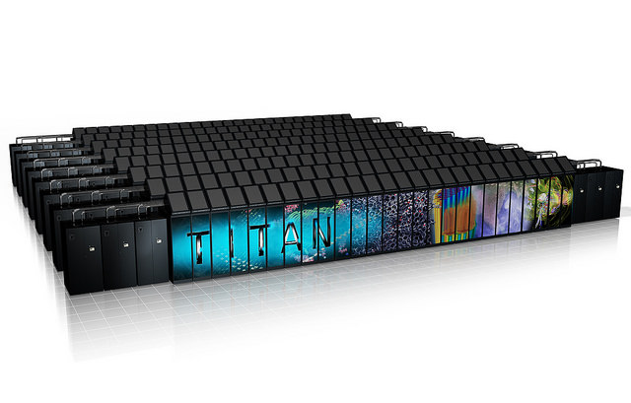
Titan Supercomputer
As of Nov 2018 #9 on Top 500
  Nov 2012 #1
First Major hybrid Supercomputer ( > 10 PF)
  17.57 PF
18688 Nodes
  AMD Interlagos CPUs
  Tesla K20X GPUs (1 Per Node)

Slide 3
GPU Stability
Production Started 2013
  Exceptional GPU Stability
2013 – ~30 GPU Node Failures
2014 - ~50 GPU Node Failures
2015 - ~58 GPU Node Failures
JMTTI – 7 Days

Slide 4
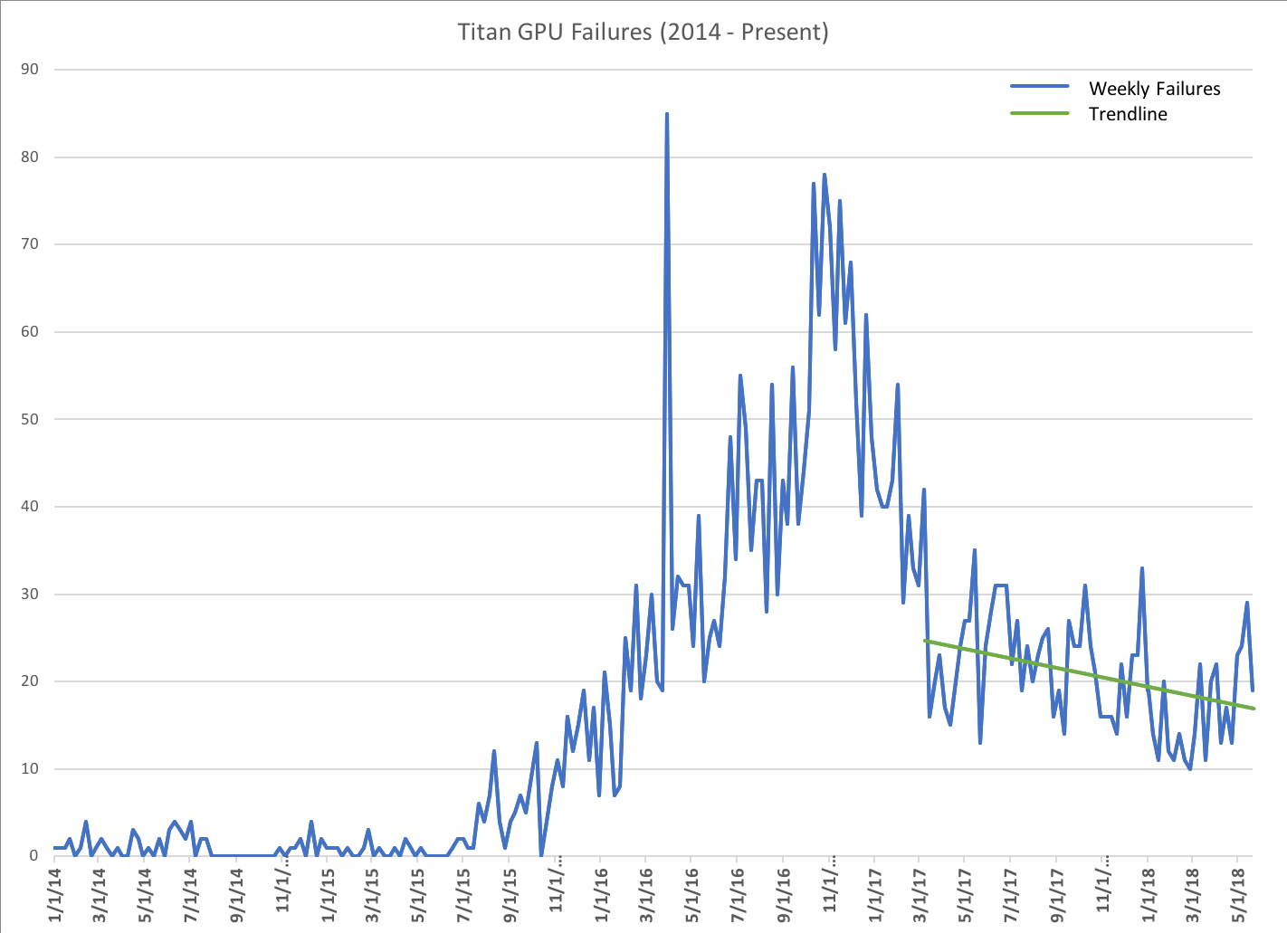
GPU Instability
July 2015
  Failures Start to Increase
April 2016
  85 Failures in 1 week
We have a problem
  Multiple DBE errors: Indicative of a failing device
    Several DBE errors within a given amount of time would lead to the GPU being pulled from production
At Peak, Titan was losing
  12 GPUs/Day

Slide 5
Replacements
Late 2016 cause
  Manufacturing defect in GPU SXM
    Not GPU Chip itself
  Fix meant replacement; no easy repair
Problem:
  Tesla K20X no longer being manufactured
  Integrated form factor
  Not enough replacement parts for the whole machine

Slide 6
Where to replace?
By late 2017 ~8500 Replacement GPUs
NVIDIA developed replacement model
  Age, location, heat …
  90% accurate at high failure rates
We knew which GPUs to replace and where.

Slide 7
Failures Stable but Problems Persist
Early 2017 failures per week stabilized
Leadership jobs continued to experience bulk of failures

Slide 8
Continued Impact to Leadership Computing
10 – 30 Failures per week after stabilization
55-65% of Application failures occurring in Leadership Jobs
  Leadership i.e. Jobs comprising greater than 20% of the machine
Why?
  50% of Titans GPUs are higher failure rate the other are low failure rate
  Leadership jobs get more high failure rate GPUs and only one needs to fail

Slide 9
Impact
Leadership Jobs
  Run longer (24 Hours)
  Run Larger (20% or more of the machine)
  Wait Longer (Days/Weeks of waiting)
Policy Name | Nodes | Runtime
Bin60 | 11250 – 18688 | 24
Bin20 | 3750 – 11249 | 24
Bin0 | 125-3749 | 6
Small | 1-124 | 2

Slide 10
GPU Select Scheduling
Influence Scheduling
  Increase the use of Stable GPUs in Leadership Jobs
  Maintain high utilization
  Avoid user gaming

Slide 11
Alps Reordering
Moab First Fit
  Top down, low index nodes used most
Alps traditionally orders for tight network clustering
  Natural fragmentation occurs in a multiplexed system
Stable GPUs push to low indexes of scheduling list
Best effort to maintain Hilbert Curves

Slide 12
Dual-Ended Scheduling Revisited
Smaller jobs are impacted less by failure
Previous work:
  Schedule certain classes of jobs from the opposite end of the list
  High frequency small jobs reduced fragmentation
Now
  Schedule certain classes of jobs from the opposite end of the list
  Give shorter, less likely to fail jobs less stable GPUs
What demarcation points?

Slide 13
Benefit Analysis
Two factor strategy to increase stable GPU hours in leadership jobs
Determine use
  Simulation to understand
    Overall impact
    Study different demarcation strategies

Slide 14
Base Simulation
  DE16 Base was production comparison
  Reorganized Strategies added GPUs on average to each job
40% Jobs
20% Jobs
60% Jobs

Slide 15
CPU Only Jobs
CPU-Only jobs added
Boost new gpu hours
  ~100K Additional Hours

Slide 16
Network Congestion
Simulation and Testshot
Additional Fragmentation is considerable
Network measurement show impact to runtime over quiet system
  Production results
Simulation
4096 Jobs Measured

Slide 17
Production Measurement
Added to Production July 2017
Several consistent months
  Leadership job failures accounted for less than 50% of failures

Slide 18
Conclusion
Significant increase in failure rate on Titan
  Even after fixes, continued impact to leadership computing
Scheduling and system ordering was modified
  Maintain high utilization
  Subtly shift stable GPUs to leadership jobs
Simulation added 33% more stable gpu hours to leadership jobs
Production results show consistent trends of failures in leadership jobs dropping from 55-60% to 40-45%

Slide 19
Questions?

