Slide 1
ParSy: Inspection and Transformation of Sparse Matrix Computations for Parallelism
Kazem Cheshmi¹, Shoaib Kamil²,
Michelle Strout³, Maryam Mehri Dehnavi¹
University of Toronto¹, Adobe Research^{2,} University of Arizona³

Slide 2
Outline
Overview
ParSy: Inspection and transformation for parallelism
  ParSy internals: input, inspection, transformation, and code generation
  The Cholesky factorization example
Results
Conclusion
Notes:
The outline of the talk is:
I first give you a brief overview and motivate what sympiler does and showing a sneak peek of the results.
Then we will get into sympiler internals and walk you throught two examples which are triangular solver and Cholesky.

Slide 3
Outline
Overview
ParSy: Inspection and transformation for parallelism
  ParSy internals: input, inspection, transformation, and code generation
  The Cholesky factorization example
Results
Conclusion

Slide 4
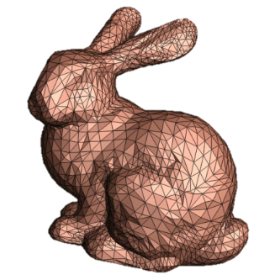



Applications of Sparse Matrix Kernels
  Matrix factorizations, e.g. Cholesky, LU, QR
    Linear system solvers
    Optimization problems, nonlinear optimizers
  Matrix multiplications
    Iterative methods, deep neural network
Computer graphics
Robotics
Medical imaging
Self-driving cars
Notes:
In this slide three different classes of sparse matrix kernels are shown that are matrix factorization, sparse matrix-vector, and Triangular solve. some of the many important application of these kernels are shown. In this work, we use a factorization example to elaborate our methodology.

Slide 5
Compiler Loop Parallelism in Sparse Kernels
  Loop-carried dependences widely exist in sparse kernels e.g., matrix factorization.
  Dependency analysis is difficult in sparse kernels because of Indirect memory access e.g., A[B[i]].
Two existing compiler techniques for loop parallelism:
  Sparse polyhedral frameworks* that typically use wavefront parallelism.
  Domain-specific code generators leverage domain knowledge.
* Strout, Michelle Mills, Mary Hall, and Catherine Olschanowsky. "The Sparse Polyhedral Framework: Composing Compiler-Generated Inspector-Executor Code." Proceedings of the IEEE 99 (2018): 1-15.
Notes:
Loop carried dependences are widely existed in sparse kernels such as matrix factorization. In a loop-carried dependence, dependence exists across iterations. Though there are several compiler techniques to tackle this problem in dense matrices, it is not trivial in sparse kernels. The main reason is the indirect memory access. As we know indirect memory access is where the array index points to somewhere in the memory that is not know in compile-time such as A[B[i]]. Sparse Polyhedral approaches generate an inspector to find the dependencies in run-time. Howvere, these methods rely on wavefront techniques that are not efficient. Let's look at how wavefront techniqe works assuming the inspector is generated.

Slide 6
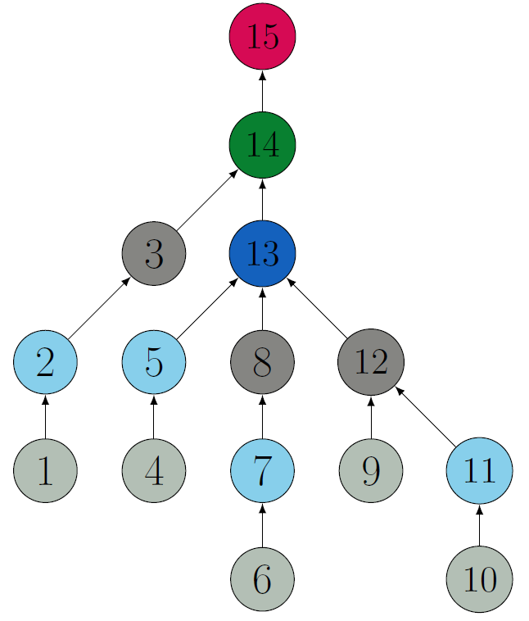
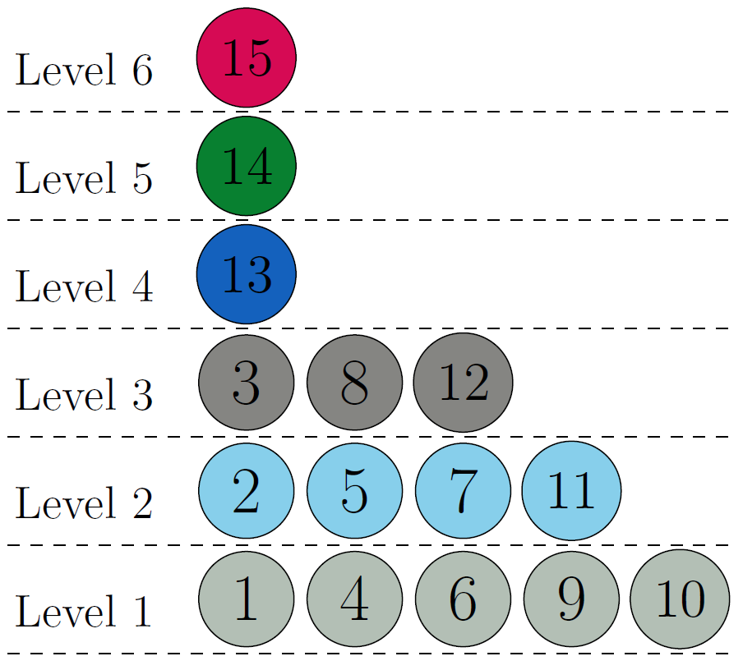
Loop Parallelism in Wavefront Methods
The iteration space traversal graph of a loop in sparse Cholesky factorization.
Problems with wavefront parallelism:
  Lack of locality
  Load-imbalanced implementation.
Notes:
Let’s look at wavefront parallelism that is typically used in SPF.
The dependence graph
Each node shows the amount of computation and edge represents dependencies.
This graph is computed by an inspector that is generated using code analysis and some domain information in run-time.

Slide 7
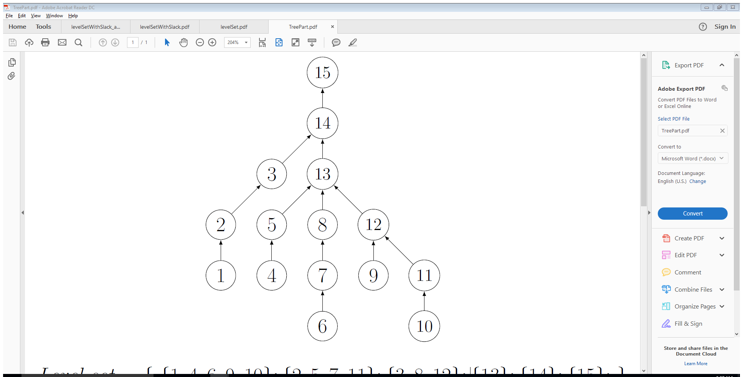
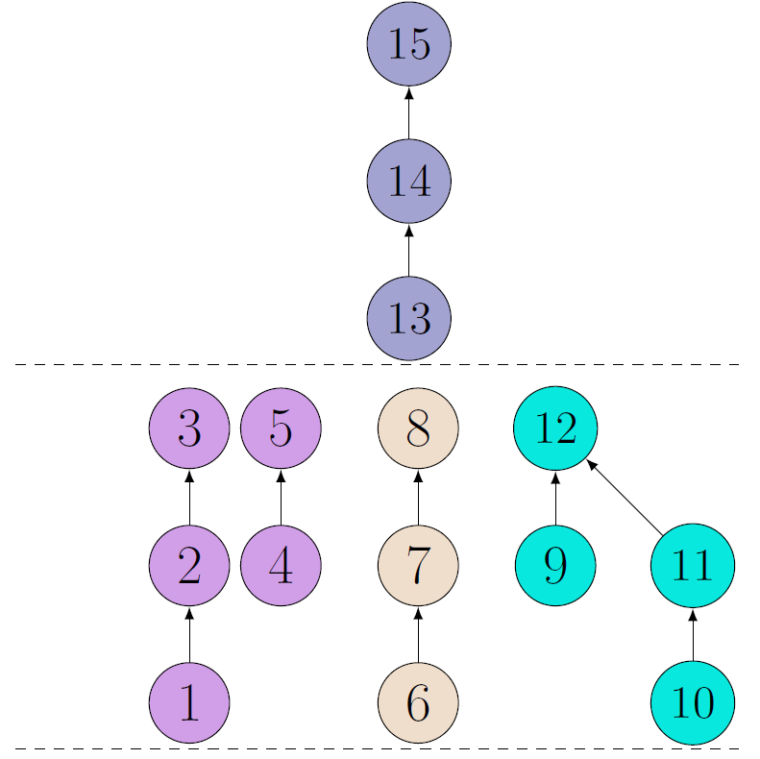
Loop Parallelism in ParSy
ParSy is a domain-specific code generator that builds a coarsened level set.
The coarsened level set preserves locality while providing a balanced enough parallelism.
Notes:
ParSy
ParSy knows the dependence graph due to domain information.

Slide 8
Cholesky Numeric Performance: Wavefront
The blue bar shows the performance of wavefront parallelism for selected benchmarks.
Notes:
Before digging into the talk I give you a brief overview of the kind of the performance ParSy provides. The x axis is some matrices from Suitesparse matrix collection and the y axis is performance of Cholesky factorization in terms GFLOP per sec. The blue bar shows the performance of wavefront library.

Slide 9
Cholesky Numeric Performance: ParSy
The red bar shows ParSy’s added performance by using a coarsened level set along with a loop transformation.
Notes:
Before digging into the talk I give you a brief overview of the kind of the performance sympiler provides. The x axis is some matrices from Suitesparse matrix collection and the y axis is performance of Cholesky factorization in terms GFLOP per sec. The blue bar shows the performance of Eigen library.

Slide 10
Outline
Overview
ParSy: Inspection and transformation for parallelism
  ParSy internals: input, inspection, transformation, and code generation
  The Cholesky factorization example
Results
Conclusion
Notes:
The outline of the talk is:
I first give you a brief overview and motivate what sympiler does and showing a sneak peek of the results.
Then we will get into sympiler internals and walk you throught two examples which are triangular solver and Cholesky.

Slide 11
ParSy is Parallel Sympiler
Sympiler* is a domain-specific compiler for generating high-performance code for sparse solvers
  It decouples symbolic information (information about the sparsity) and uses it to transform the sparse code
  Sympiler did not support multicore architectures.
* Cheshmi, Kazem, et al. "Sympiler: transforming sparse matrix codes by decoupling symbolic analysis." Proceedings of the International Conference for High Performance Computing, Networking, Storage and Analysis. ACM, 2017.

Slide 12
ParSy is Parallel Sympiler
Sympiler* is a domain-specific compiler for generating high-performance code for sparse solvers
  It decouples symbolic information (information about the sparsity) and uses it to transform the sparse code
  Sympiler did not support multicore architectures.
ParSy is parallel Sympiler!
  ParSy generates parallel code for sparse matrix computations.
* Cheshmi, Kazem, et al. "Sympiler: transforming sparse matrix codes by decoupling symbolic analysis." Proceedings of the International Conference for High Performance Computing, Networking, Storage and Analysis. ACM, 2017.
Notes:
Before explaining the ParSy internals let me introduce Sympiler.

Slide 13
ParSy Internals
Sparsity Pattern
Symbolic Inspector
Numerical Method
Inspector-Guided Transformations
Code Generation
Notes:
Let’s look at the sympiler internals. Sympiler uses sparsity pattern as well as the numerical method as input and then generates the symbolic information in the symbolic inspector. The generated symbolic information are used in the transformatipn phases.

Slide 14
ParSy Inputs
Sparsity Pattern
Symbolic Inspector
Numerical Method
Inspector-Guided Transformations
Code Generation
Notes:
Let’s see how ParSy inputs look like.

Slide 15
An Example Input Representation for Cholesky
int main() {
Sparse A(Float(64),“L.mtx”);
Cholesky chol(A);
chol.sympile_to_c(“chol”,k);
}
Input sparsity pattern
Numerical method
Sparsity Pattern
Symbolic Inspector
Numerical Method
Inspector-Guided Transformations
Code Generation
Notes:
This is the kind of code that the user inputs to Sympiler. This slide shows a sample input to Sympiler. As shown, the input sparsity of both matrix A and k are given as input as well as the numerical method.

Slide 16
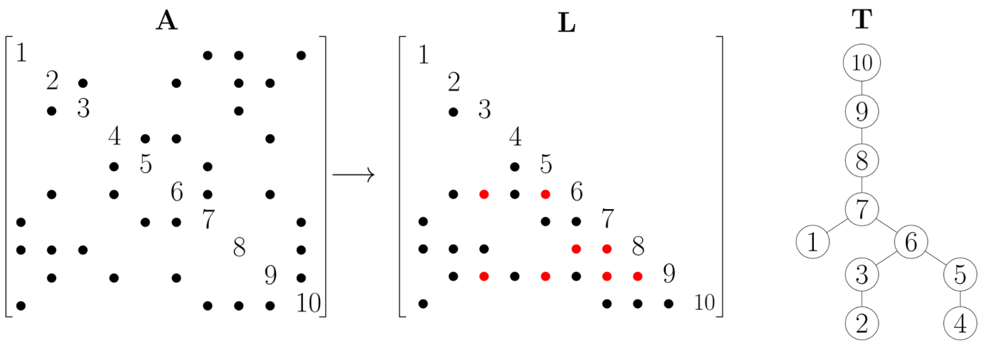
Cholesky Factorization
Cholesky factorization is commonly used in direct solvers and is used to precondition iterative solvers.
The elimination tree (T) is one of the most important graph structures used in the symbolic analysis of sparse factorization algorithms.

Slide 17
Symbolic Inspection
Sparsity Pattern
Symbolic Inspector
Numerical Method
Inspector-Guided Transformations
Code Generation
Notes:
Given the inputs, let’s see how the symbolic inspector performs symbolic analysis.

Slide 18
The Symbolic Inspector: H-Level
Symbolic inspector creates an inspection graph from the given sparsity pattern and traverses it during inspection using a specific inspection strategy. The result of the inspection is the inspection set.
H-Level Set = {{{ 1, 2, 3, 4, 5 }, { 6, 7, 8 } , { 10, 11, 9, 12 }} ; {{ 13, 14, 15 }} ; }
Inspection Graph: Elimination Tree
Inspection Strategy:
Load-Balanced Level Coarsening
Inspection Set:
H-level set
Sparsity Pattern
Symbolic Inspector
Numerical Method
Inspector-Guided Transformations
Code Generation
Notes:
The symbolic inspector builds a graph based on the input kernel and also the input sparsity. And then applies a method specific inspection on the inspection graph which is called inspection strategy and generates an inspection set. To clearly shows how these components are defined in Sympiler, let’s look attriangular solve example.

Slide 19
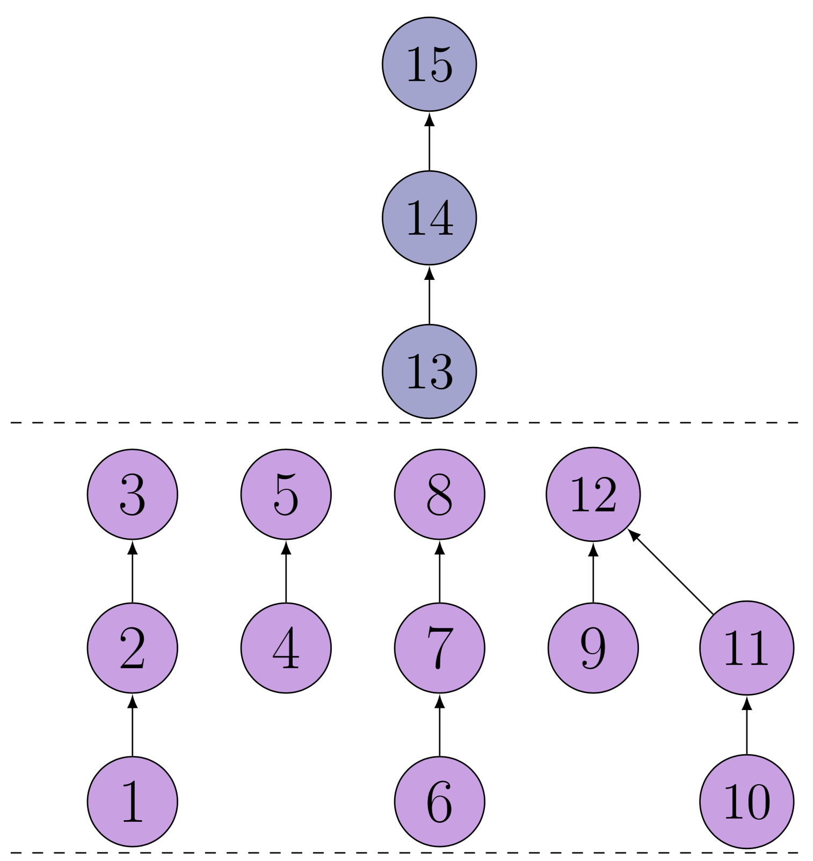
The Load-Balanced Level Coarsening (LBC) Algorithm
Step 1: L-partitioning
  Find the initial cut for the first l-partition
  Build the rest of l-partitions
LBC
Notes:
I discussed the components of the symbolic inspector in VI-Prune transformation, lets look at the components of the symbolic inspector for VS-Block in triangular solve. Again, for the inspection graph, the dependence graph is used and the node equivalence algorithm is applied on dependence graph as for the inspection method and finally blockset is generated. The block-set is the same as supernode in the context of factorizartion algorithm.

Slide 20
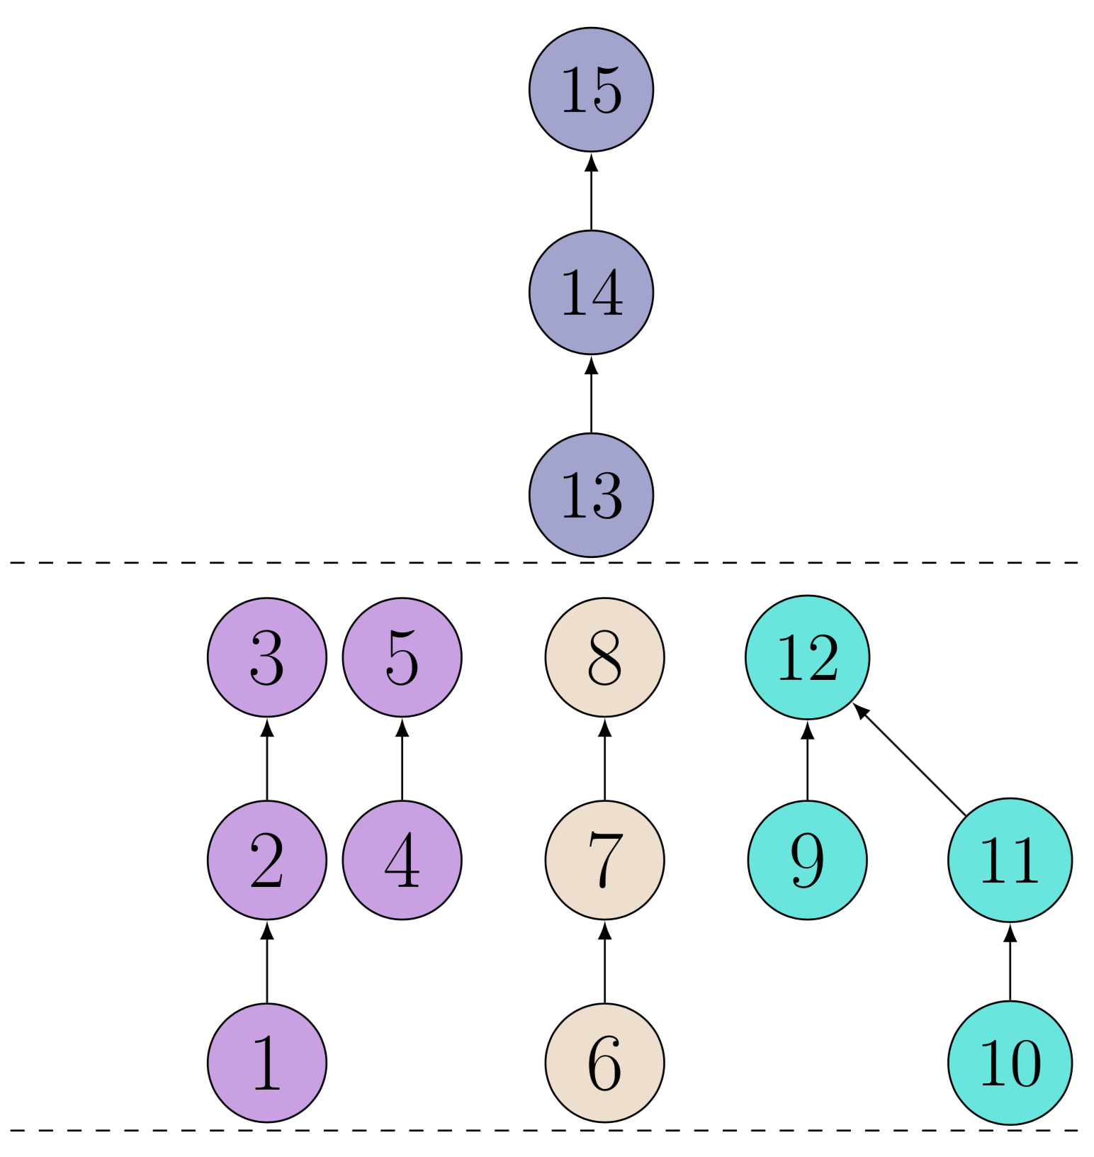
The Load-Balanced Level Coarsening (LBC) Algorithm
Step 1: L-partitioning
  Find the initial cut for the first l-partition
  Build the rest of l-partition
LBC
Step 2: W-partitioning
  A cost model for load-balance
Notes:
I discussed the components of the symbolic inspector in VI-Prune transformation, lets look at the components of the symbolic inspector for VS-Block in triangular solve. Again, for the inspection graph, the dependence graph is used and the node equivalence algorithm is applied on dependence graph as for the inspection method and finally blockset is generated. The block-set is the same as supernode in the context of factorizartion algorithm.

Slide 21
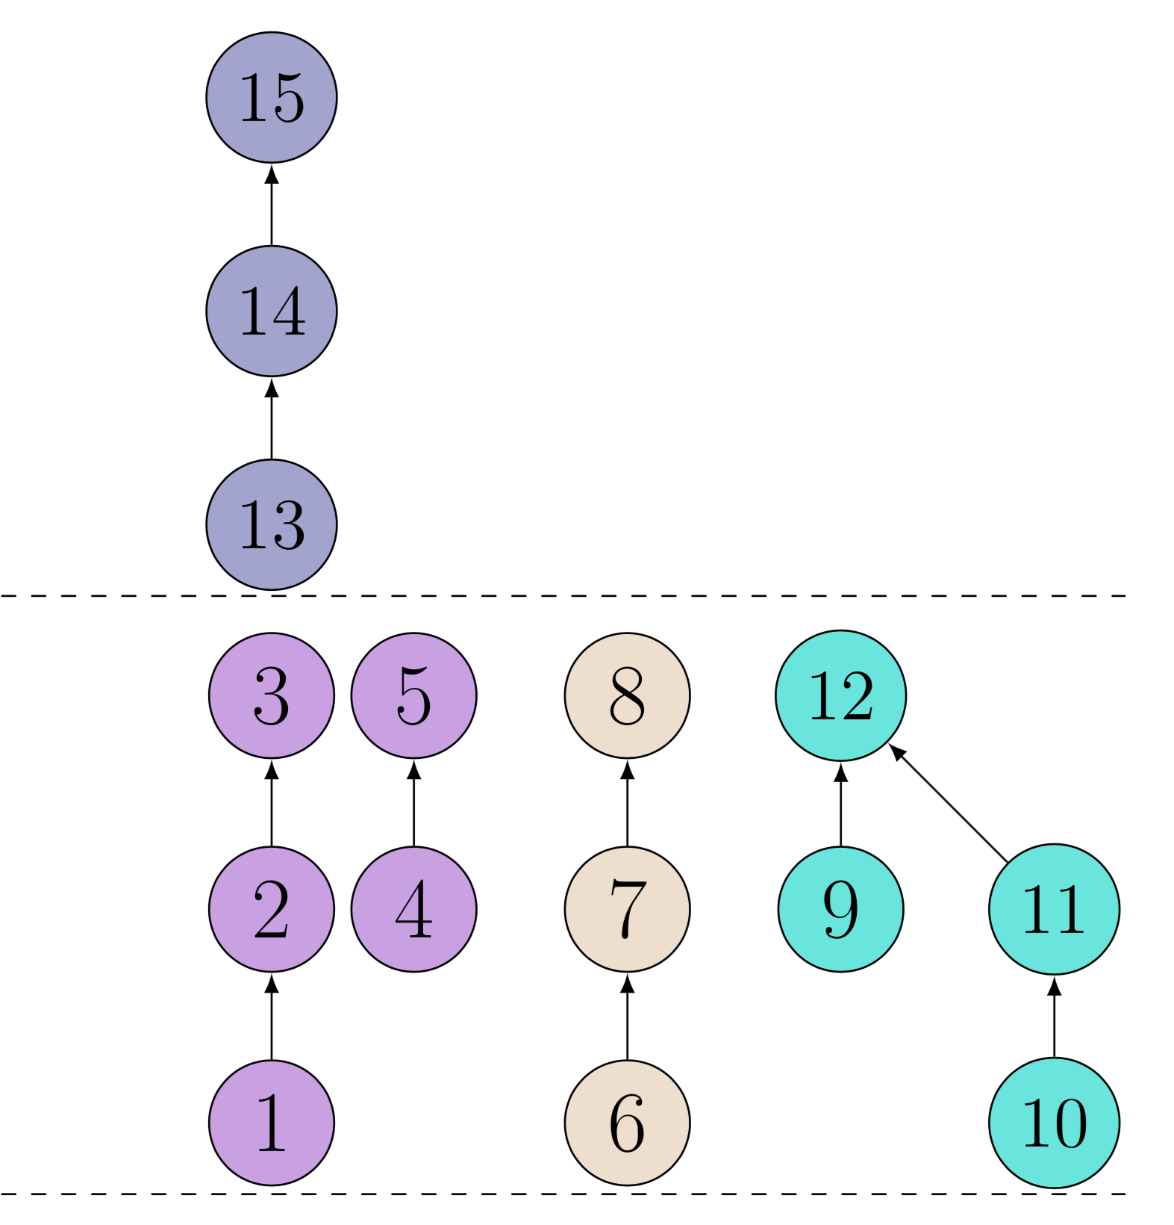
The Load-Balanced Level Coarsening (LBC) Algorithm
Step 1: L-partitioning
  Find the initial cut for the first l-partition
  Build the rest of l-partition
LBC
Step 2: W-partitioning
  A cost model for load-balance
Step 3: Reordering
  Reduce intra-partition cost.
H-Level Set = { {{ 1, 2, 3, 4, 5 } , { 6, 7, 8 } , { 10, 11, 9, 12 }} ; {{ 13, 14, 15 }} ; }
Notes:
I discussed the components of the symbolic inspector in VI-Prune transformation, lets look at the components of the symbolic inspector for VS-Block in triangular solve. Again, for the inspection graph, the dependence graph is used and the node equivalence algorithm is applied on dependence graph as for the inspection method and finally blockset is generated. The block-set is the same as supernode in the context of factorizartion algorithm.

Slide 22
Inspector-Guided Transformations
Sparsity Pattern
Symbolic Inspector
Numerical Method
Inspector-Guided Transformations
Code Generation
H-Level
Notes:
Now the question is how sympiler uses these sets to transform the code. Sympiler supports two types of transformations. VI-Prune and VS-Block. I will frist explain VI-PRune

Slide 23
Inspector-Guided Transformations: H-Level
Hierarchical Level (H-Level) creates partitions with coarser tasks while ensuring good balance between execution threads.
H-Level:
for(I₁) {
…
for(I_{n}(I₁)) {
Atomic:
c /= a[idx(I₁,...,I_{n})];
}
}
for ( every l−partition i) {
#pragma omp parallel for private(pVars)
for ( every w−partition j ) {
for ( every v ∈ HLevelSet[i][j] ) {
I₁ = v
…
for(I_{n}(I₁)) {
#pragma omp atomic
c /= a[idx(I₁,...,I_{n})];
}
}}}
Internally annotated code
Transformed with H-Level
Sparsity Pattern
Symbolic Inspector
Numerical Method
Inspector-Guided Transformations
Code Generation

Slide 24
The ParSy Generated code for Cholesky
H-Level:
for (int i=0; i<blockNo; ++i){
b1 = block2col[i]; b2 = block2col[i+1];
f = A(:,b1:b2);
// Update phase
for(block r=0 to i-1 L(i,r)!=0){
f-=GEMM(L(b1:n,r),transpose(L(i,r)));
}
// Diagonal operation
L(b1:b2,b1:b2)=POTRF(f(b1:b2));
// Off-diagonal operations
for(off-diagonal elements in f){
L(b2+1:n,b1:b1) =
TRSM(f(b1+1:n,b1:b2),L(b1:b2,b1:b2));
}}
for(every l-partition i){
#pragma omp parallel for private(f){
for(every w-partition j){
for(every v ∈ HLevelSet[i][j]){
int i = v;
b1 = block2col[i];b2 = block2col[i+1];
f = A(:,b1:b2);
for(block r=0 to i-1 L(i,r)!=0){
f-=GEMM(L(b1:n,r),transpose(L(i,r)));
}
L(b1:b2,b1:b2)=POTRF(f(b1:b2));
for(off-diagonal elements in f){
L(b2+1:n,b1:b1) =
TRSM(f(b1+1:n,b1:b2),L(b1:b2,b1:b2));
} }}} }
//Specialized code for the last l-partition.
Cholesky_Specialized(HLevelSet[n − 1][0]);
H-Level
Sparsity Pattern
Symbolic Inspector
Numerical Method
Inspector-Guided Transformations
Code Generation
Notes:
This slide shows how block transformation is applied in the cholesky code. As you can see ll operation after VS-Block are blocks. And the diagonal parts are also changed from a sqr root to a dense cholesky.

Slide 25
Outline
Overview
ParSy: Inspection and transformation for parallelism
  ParSy internals: input, inspection, transformation, and code generation
  The Cholesky factorization example
Results
Conclusion
Notes:
The outline of the talk is:
I first give you a brief overview and motivate what sympiler does and showing a sneak peek of the results.
Then we will get into sympiler internals and walk you throught two examples which are triangular solver and Cholesky.

Slide 26
Experimental Setup
Numeric and symbolic times are compared separately where applicable; Target processor: Intel® Xeon® Platinum 8160 (Skylake); Benchmarks: University of Florida repository
Name | Application | Order (10³) | Non-zeros (10⁶)
StocF_1465 | Computational fluid dynamics problem | 1465.1 | 1245
Hook_1498 | 3D mechanical problem | 1498 | 1783.8
audikw_1 | Structural problem | 943.7 | 1473.1
bone010 | Model reduction problem | 986.8 | 1210.1
thermomech_dM | Thermal problem | 204.3 | 9.7
Emilia_923 | Geomechanical model | 923.1 | 1992
Fault_639 | Contact mechanics | 638.8 | 1275.4
nd24k | 2D/3D problem | 72 | 435.9
Notes:
Wehave selected a set of matrices from university of flodora repository to compare the sympiler performance with the state o the art libraries.

Slide 27
ParSy vs Libraries: Cholesky
Notes:
In this slide the the performance of the Sympiler gented code is compared with both eigen and Cho,mod. The bla bar show the Cholmod performance, The blus bar shows the Eigen performance and the stacked bar belonged to Sympiler. Sympiler outperforms both libraries in almost all matrices,

Slide 28
Symbolic Analysis Cost: Cholesky
Notes:
We have the same observation for Cholesky. The accumulated time of all three tools are normalized with eigen time. Are shown in the graph As you can see, the accumulated time of sympiler is better thanthe other two tools in almo aall matrices.

Slide 29
Outline
Overview
ParSy: Inspection and transformation for parallelism
  ParSy internals: input, inspection, transformation, and code generation
  The Cholesky factorization example
Results
Conclusion
Notes:
The outline of the talk is:
I first give you a brief overview and motivate what sympiler does and showing a sneak peek of the results.
Then we will get into sympiler internals and walk you throught two examples which are triangular solver and Cholesky.

Slide 30
Conclusion
ParSy is a domain-specific code generator for transforming sparse matrix codes for parallel multi-core processors.
ParSy uses H-Level inspection and transformations to create coarse-level parallelism.
The ParSy-generated code outperforms state-of-the-art sparse libraries Intel MKL Pardiso and PaStiX.
ParSy’s source code is publicly available from:
  https://www.Sympiler.com/

