Slide 1
Fully-dynamic aimGraph
Efficient Memory Management and Algorithmic Validation
of a Dynamic Graph Framework on GPUs
Martin Winter

Slide 2
Outline
Motivation & Goals
faimGraph
  Memory Layout
  Updates
    Edge Updates (Insertion & Deletion)
      Sequential & Concurrent
    Vertex Updates (Insertion & Deletion)
  Algorithms
    STC (Static Triangle Counting)
    PageRank
Comparison to cuSTINGER, Hornet & GPMA
Performance

Slide 3
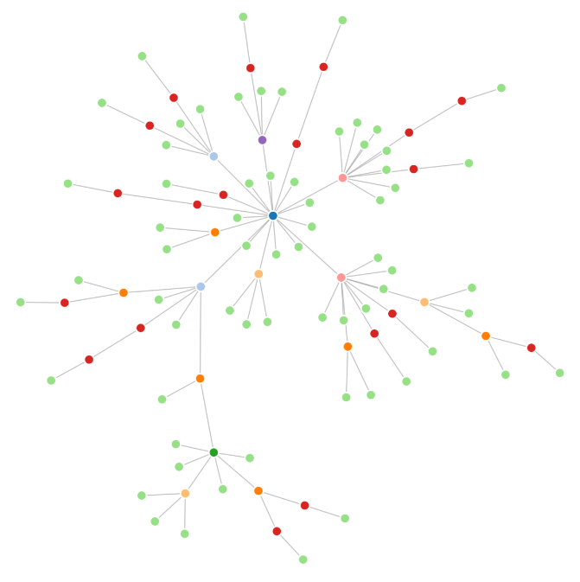
Motivation
Dynamic graphs can represent various
problem domains including
  Communication networks
  Social media networks
  Biological networks
  …
Massively parallel architectures are beneficial when dealing with large dynamic graphs, but
  Difficult to handle on the GPU
    Dynamic memory handling & memory locality
    Thread divergence

Slide 4
Goal 1
Focus on dynamic properties
Large number of updates
  Different update implementations targeting graph properties, updating graph structure should be fast
Structure grows/shrinks dynamically
  Memory layout should be malleable enough to accommodate such changes
Framework fully dynamic
  Support both vertex and edge updates

Slide 5
Goal 2
Focus on efficient memory management
Comparatively small amount of memory
  Even compute cards don’t offer storage capabilities close to host-based systems
  Using less memory allows for bigger graphs in memory
Return unused memory to memory manager
  Both pages and vertex indices can be reused

Slide 6
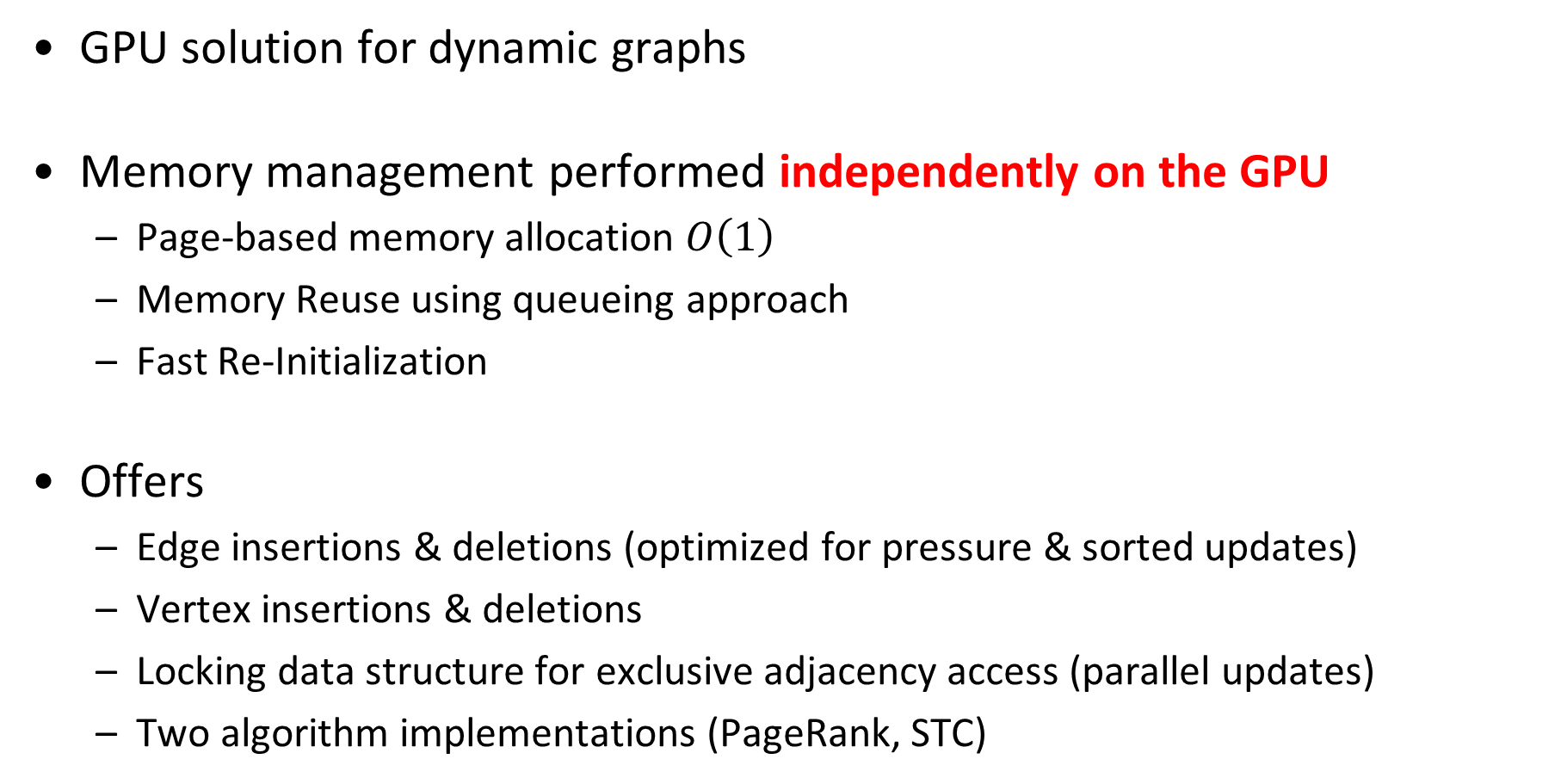
faimGraph
GPU solution for dynamic graphs
Memory management performed independently on the GPU
  Page-based memory allocation $O\left(1\right)$
  Memory Reuse using queueing approach
  Fast Re-Initialization
Offers
  Edge insertions & deletions (optimized for pressure & sorted updates)
  Vertex insertions & deletions
  Locking data structure for exclusive adjacency access (parallel updates)
  Two algorithm implementations (PageRank, STC)

Slide 7
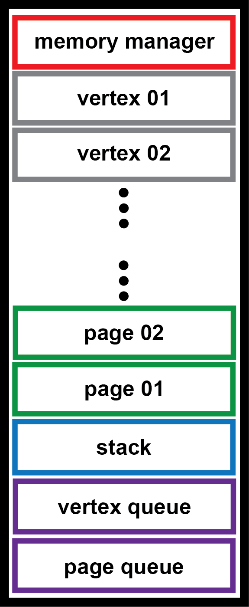
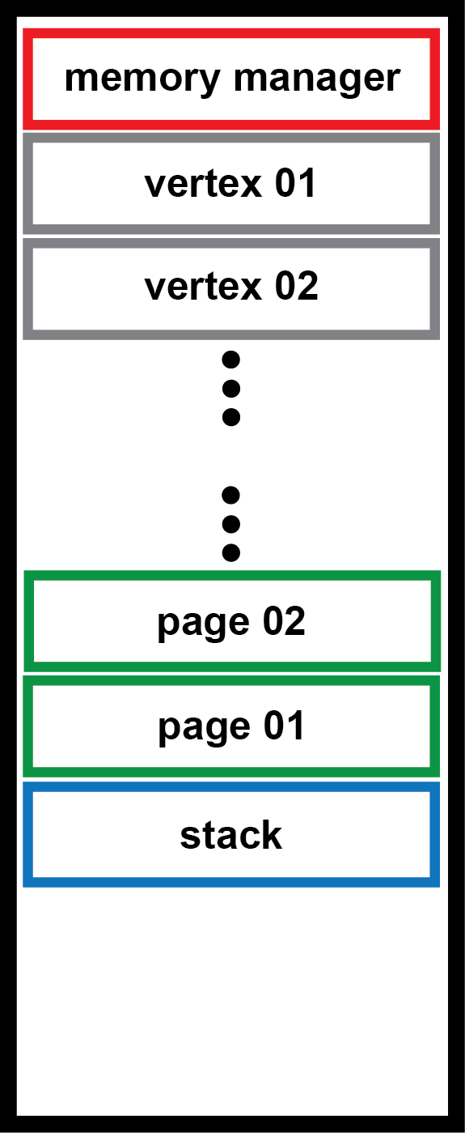
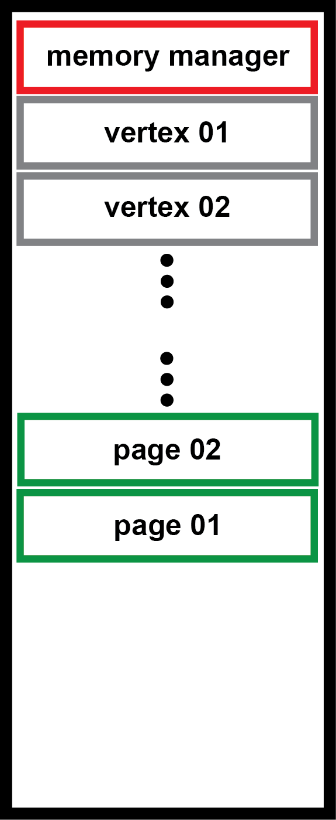
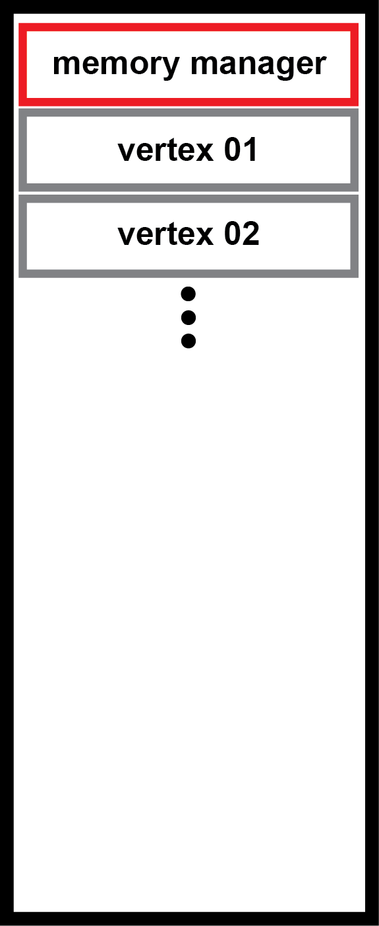

Memory Layout & Setup
Memory Manager
  Holds pointers to memory areas
  Contains graph information (number vertices, …)
Vertex Management Data
  AOS approach
Edge Data
  AOS/SOA approach, stored on pages, linked with indices
Temporary Data
  Stack (optional)
  After vertex data (if vertex data static in call)
Index Queues
  Hold free page/vertex indices

Slide 8
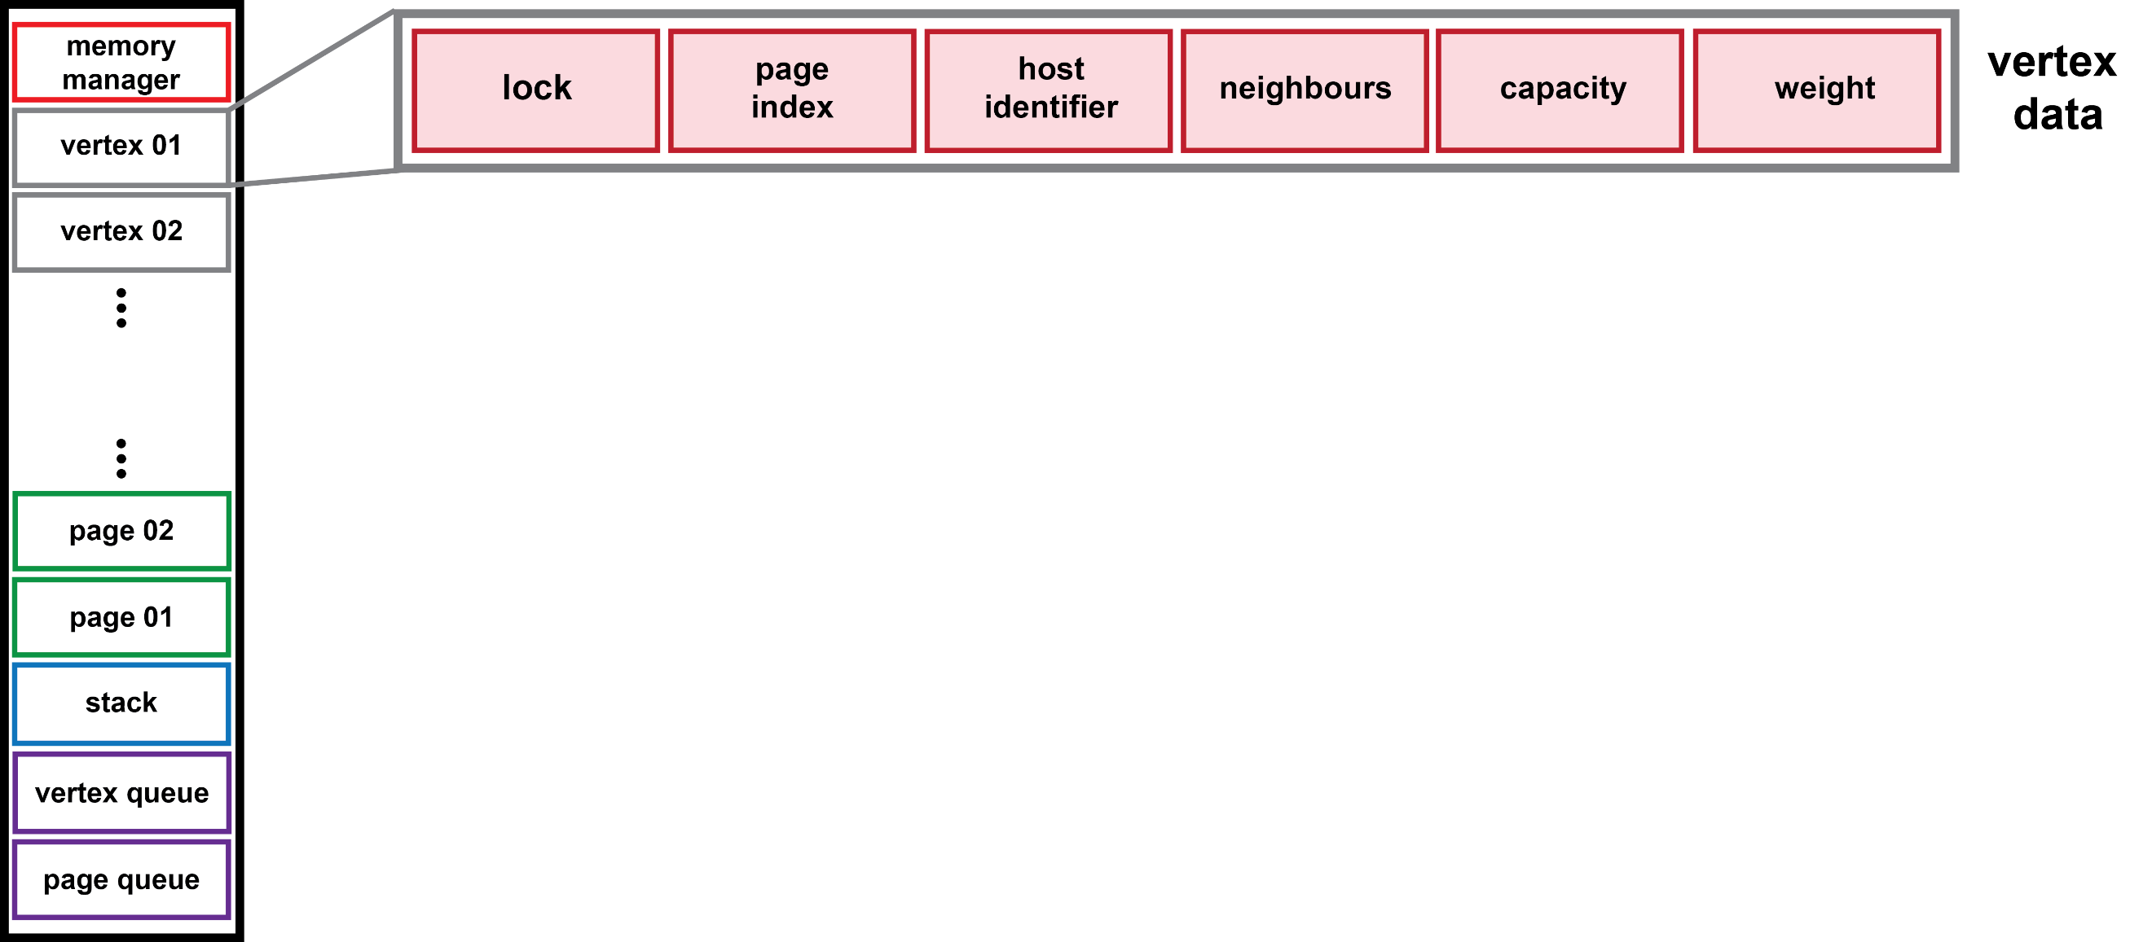
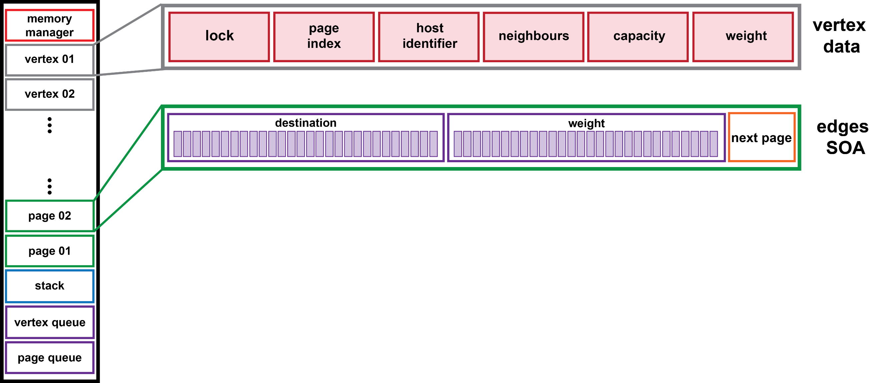
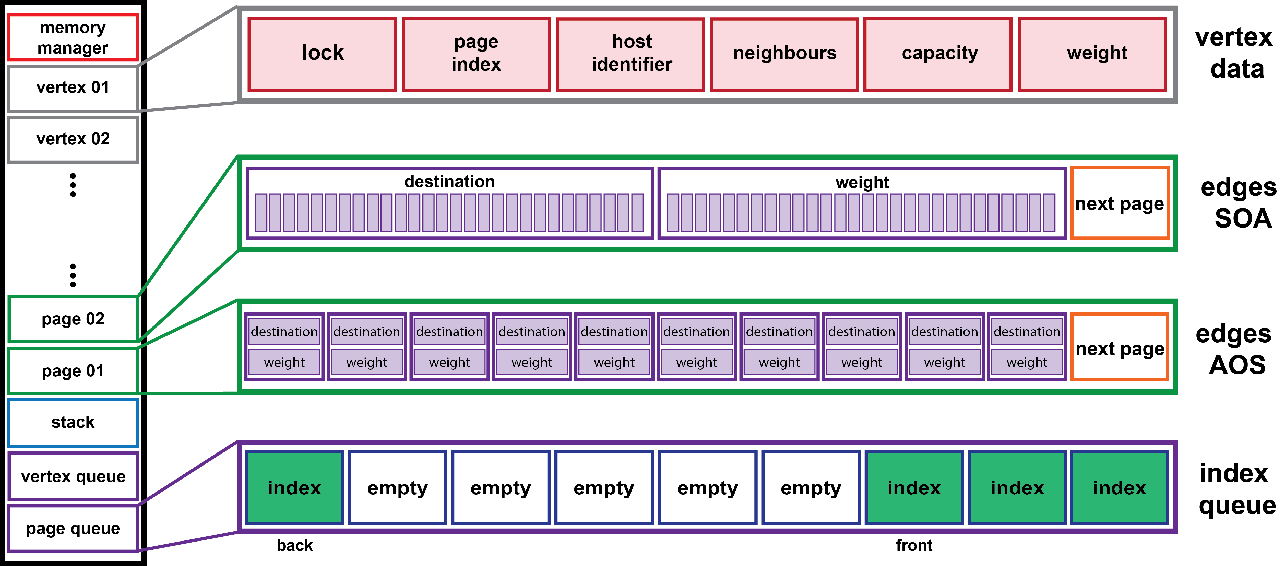
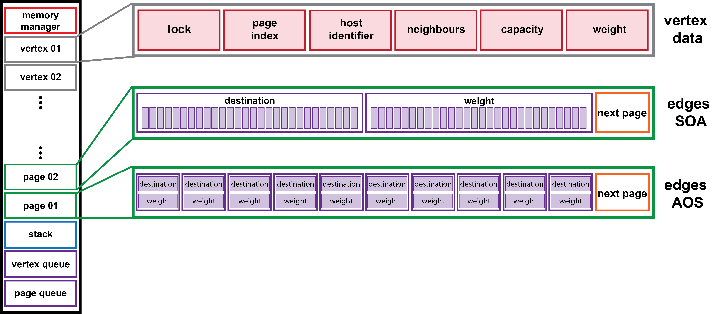
Memory Layout

Slide 9
Edge Updates | Three modes
Update Centric
  Thread-/Warp-/Block-based | Locking possible
  Works best with close to uniformly distributed updates / sparse graphs
Vertex Centric
  Thread-based
  Ideal for all scenarios
Sorted Vertex Centric
  Thread-based
  Ideal for all scenarios (except very dense graphs)

Slide 10
Sorted Vertex Centric Edge Updates
Sort Updates according to source/destination
Construct offset scheme
…
src
dst
08
17
12
06
08
101
08
153
52
53
08
17
36
178
52
68
…
Updates
src
offset
08
0
12
04
36
05
52
06
Offset scheme

Slide 11
Sorted Vertex Centric Edge Updates
…
src
dst
08
17
08
17
08
101
08
153
12
06
36
178
52
53
52
68
…
Sorted Update batch
17
17
101
153
Updates for vertex 08
06
22
106
next page
Adjacency of vertex 08

Slide 12
Sorted Vertex Centric Edge Updates
Remove duplicates
Inserted new updates, keeping sort-order
x
17
101
153
17
Updates for vertex 08
06
22
106
next page
Adjacency of vertex 08

Slide 13
Vertex Updates
Vertex updates require initial mapping step
  Host Identifier Device identifier
    SIM Identifier Memory Location on Device
Mapping reported to host after insertion
Insertion
Insertion trivial
  Get new vertex index
  Get new page for edges
Duplicate checking complex
  Reverse duplicate checking
Deletion
Modifies both vertex and edge data
Deletion trivial
  Return vertex index and pages to memory manager
Delete references to vertices
  Reverse deletion

Slide 14
Algorithm implementation
PageRank and STC (Static Triangle Counting)
  Straight-forward implementations
Framework offers Work Balancing
  Compute offset scheme based on pages in memory
  Start operation per page instead of per adjacency
Framework performs well even for memory-intensive algorithms
  Page-based balancing beneficial for imbalanced or denser graphs
  Random adjacency access is slower compared to array-based approach

Slide 15
cuSTINGER[1] – HPEC’16
First dynamic graph data structure on GPU
GPU implementation of STINGER [2]
Partially dynamic (only edge updates)
Aligned edge data arrays (similar to CSR)
Enables high update rates
Memory allocation flags set on GPU, but actual allocation & management done on the CPU
  Overallocation is used to minimize this effect
  Reallocation is a major factor for performance

Slide 16
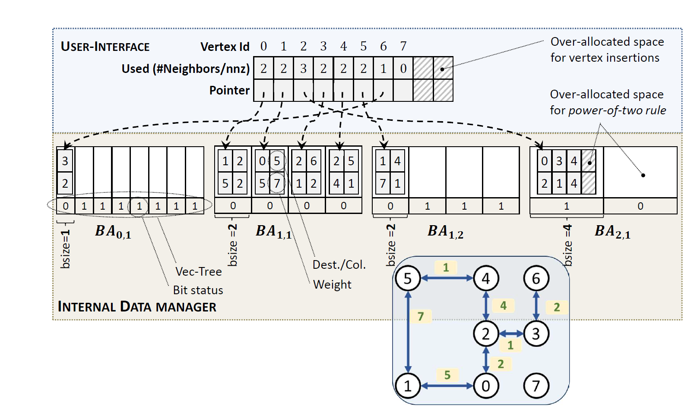
Hornet[3] – HPEC’18
Update on cuSTINGER
Faster & more stable in all regards
Partially dynamic
(over-allocated for vertex insertion)
Efficient block-array structure
CSR-like adjacency
Memory Management done on CPU
  Elaborate management structure
  introduces overhead
  Smaller impact compared to cuSTINGER
F. Busato et. al. „Hornet: An Efficient Data Structure for Dynamic Sparse Graphs and Matrices on GPUs“. In: Conference Paper, HPEC‘18, Georgia Institute of Technology, 2018

Slide 17
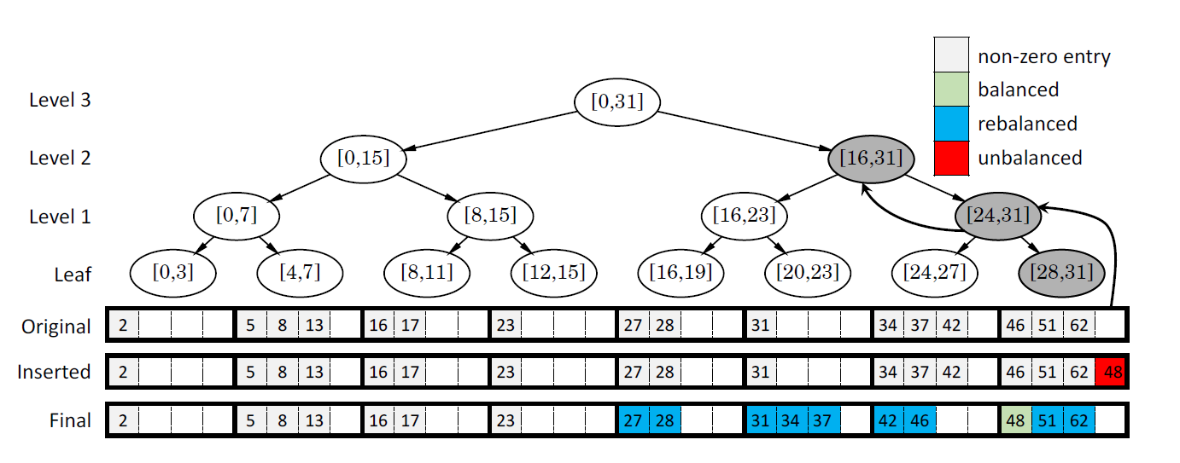
GPMA [4] – VLDB’18
Modified Packed-Memory-Array (PMA) storage structure
  Implicitly sorted adjacency
  Adapted for concurrent updating per tree-level
Fully dynamic (in theory)
Efficient memory management
for very sparse graphs
  Less efficient for denser graphs
Traversal prone to divergence
due to empty space
  Also memory overhead
M. Sha et. al. „Accelerating dynamic graph analytics on GPUs“. In: Proceedings of the VLDB Endowment 2018, National University of Singapore, 2018

Slide 18
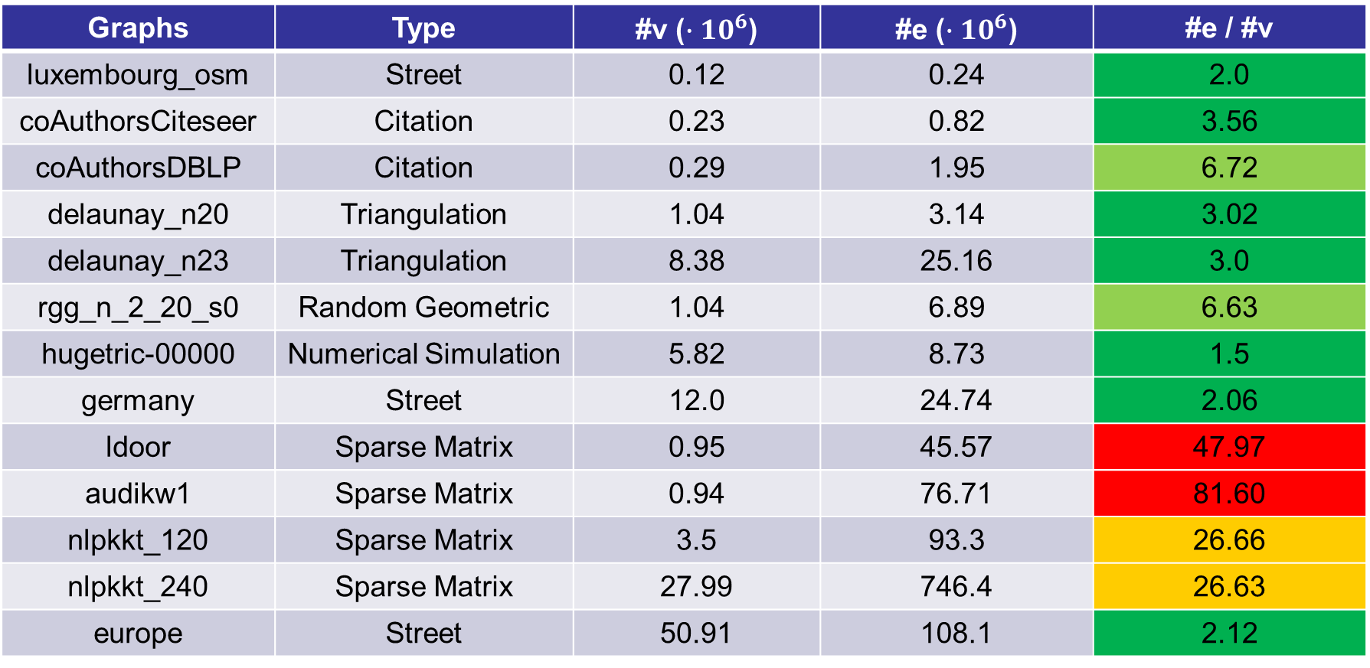
Graphs used for Performance
Graphs | Type | #v (${∙10}^{6}$) | #e (${∙10}^{6}$) | #e / #v
luxembourg_osm | Street | 0.12 | 0.24 | 2.0
coAuthorsCiteseer | Citation | 0.23 | 0.82 | 3.56
coAuthorsDBLP | Citation | 0.29 | 1.95 | 6.72
delaunay_n20 | Triangulation | 1.04 | 3.14 | 3.02
delaunay_n23 | Triangulation | 8.38 | 25.16 | 3.0
rgg_n_2_20_s0 | Random Geometric | 1.04 | 6.89 | 6.63
hugetric-00000 | Numerical Simulation | 5.82 | 8.73 | 1.5
germany | Street | 12.0 | 24.74 | 2.06
ldoor | Sparse Matrix | 0.95 | 45.57 | 47.97
audikw1 | Sparse Matrix | 0.94 | 76.71 | 81.60
nlpkkt_120 | Sparse Matrix | 3.5 | 93.3 | 26.66
nlpkkt_240 | Sparse Matrix | 27.99 | 746.4 | 26.63
europe | Street | 50.91 | 108.1 | 2.12

Slide 19
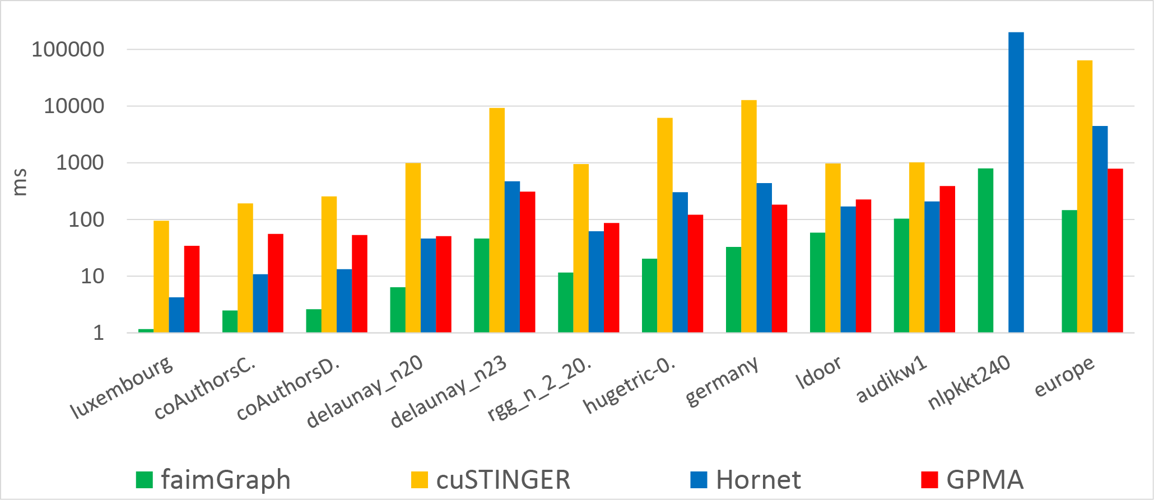
Performance | Initialization (ms)

Slide 20
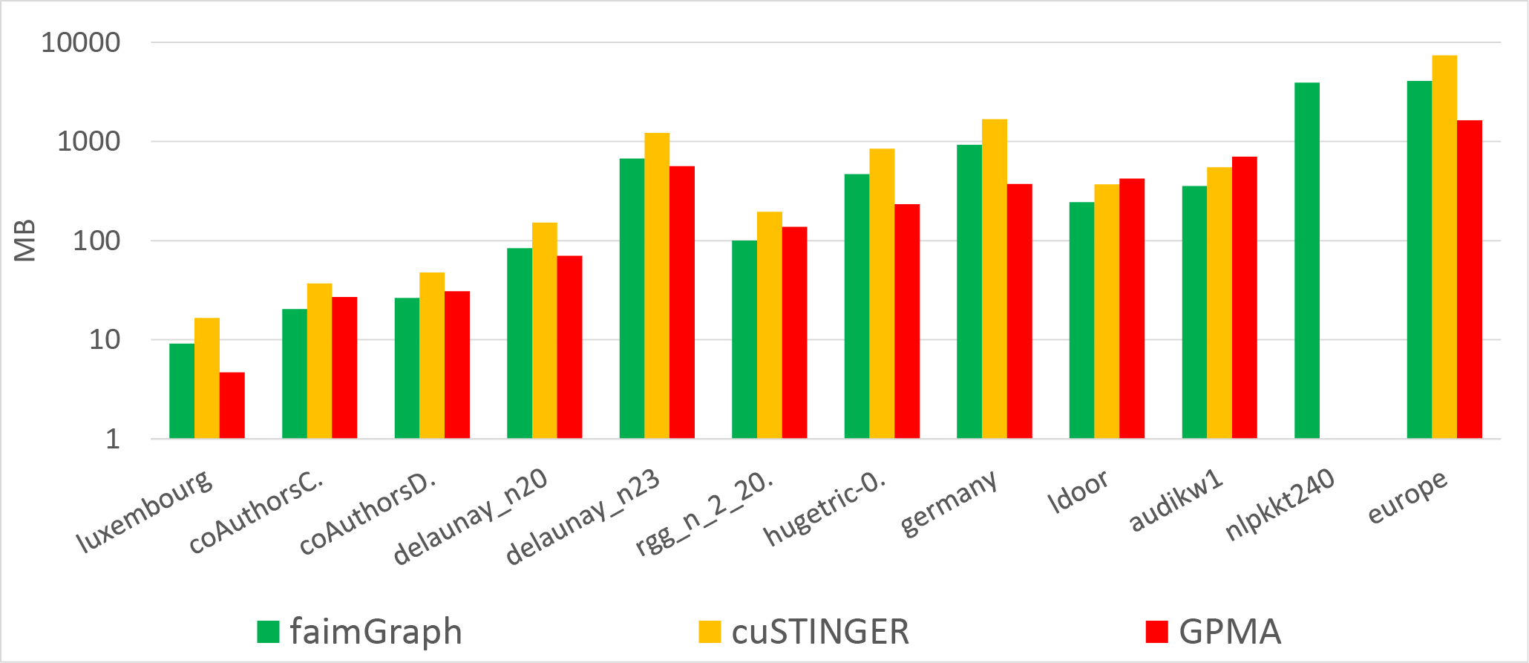
Performance | Initialization (MB)

Slide 21
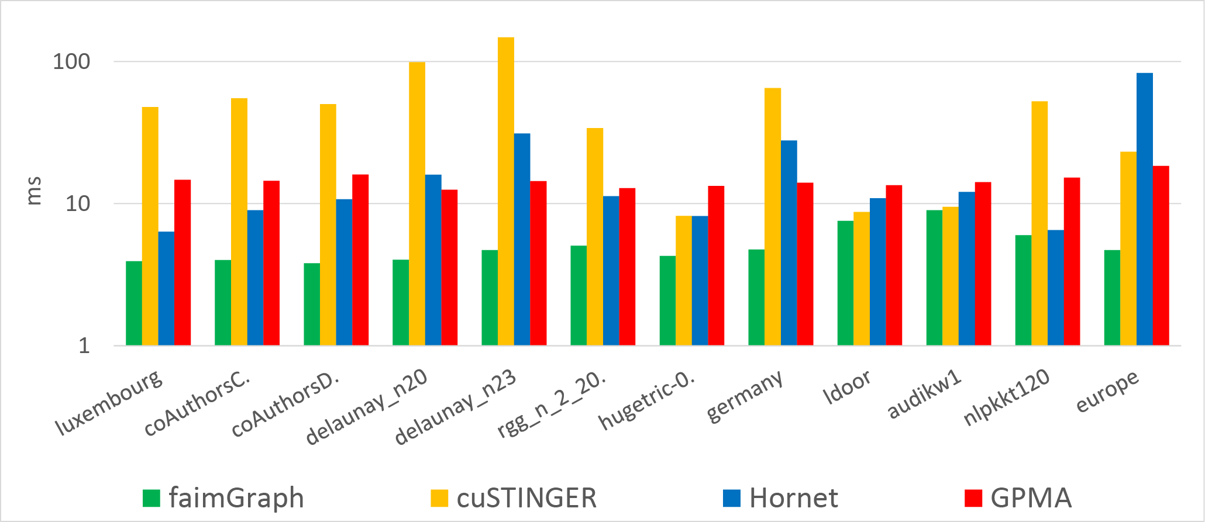
Performance | Edge Insertion | Uniform

Slide 22
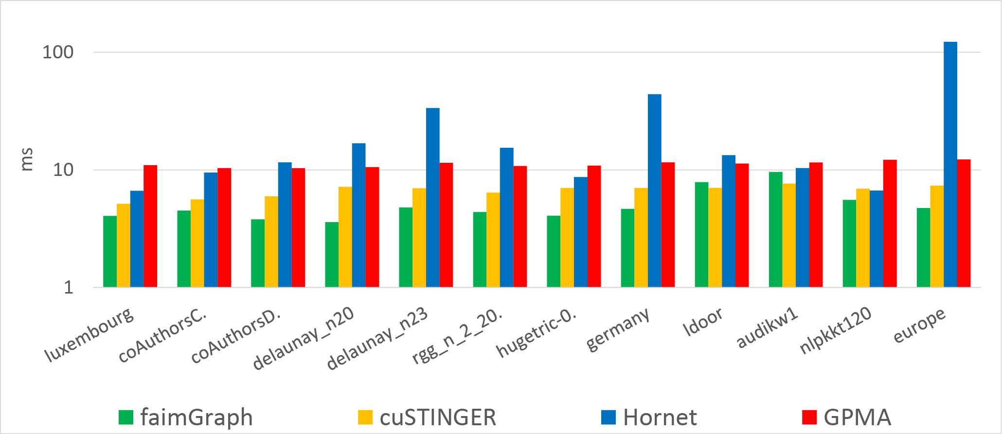
Performance | Edge Deletion | Uniform

Slide 23
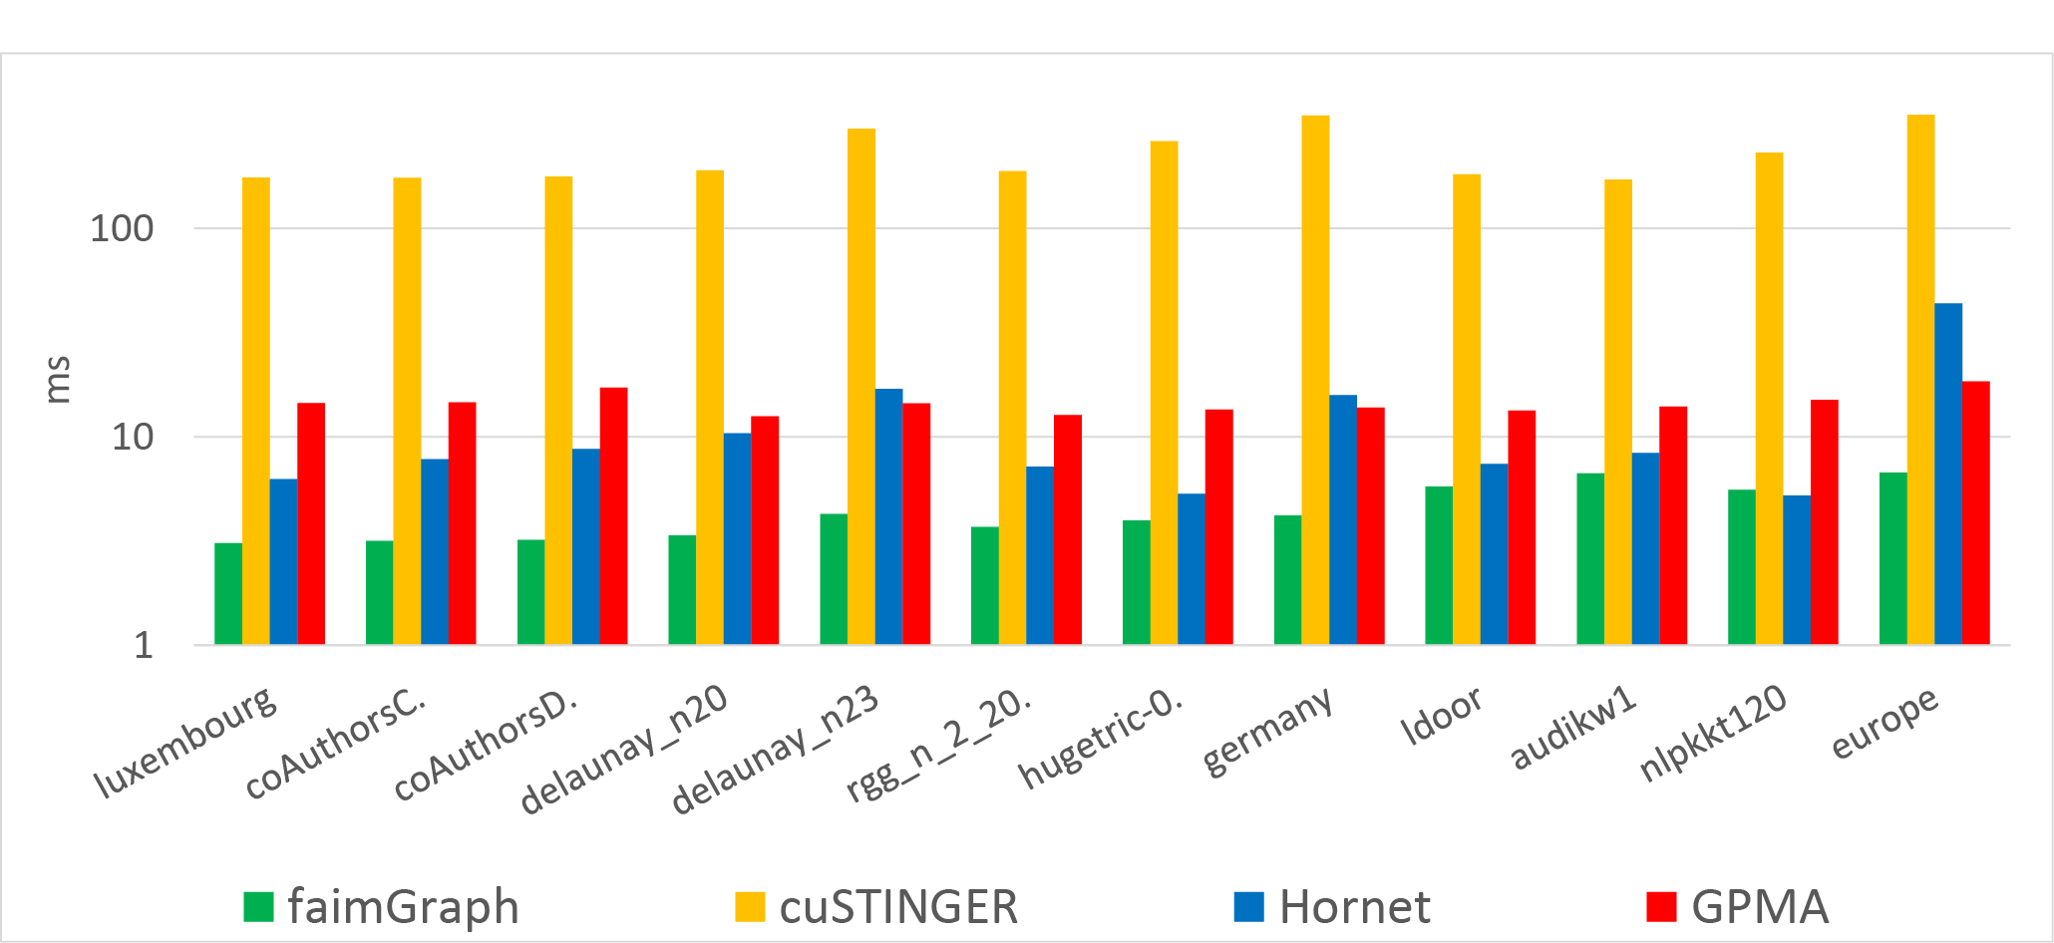
Performance | Edge Insertion | Pressure

Slide 24
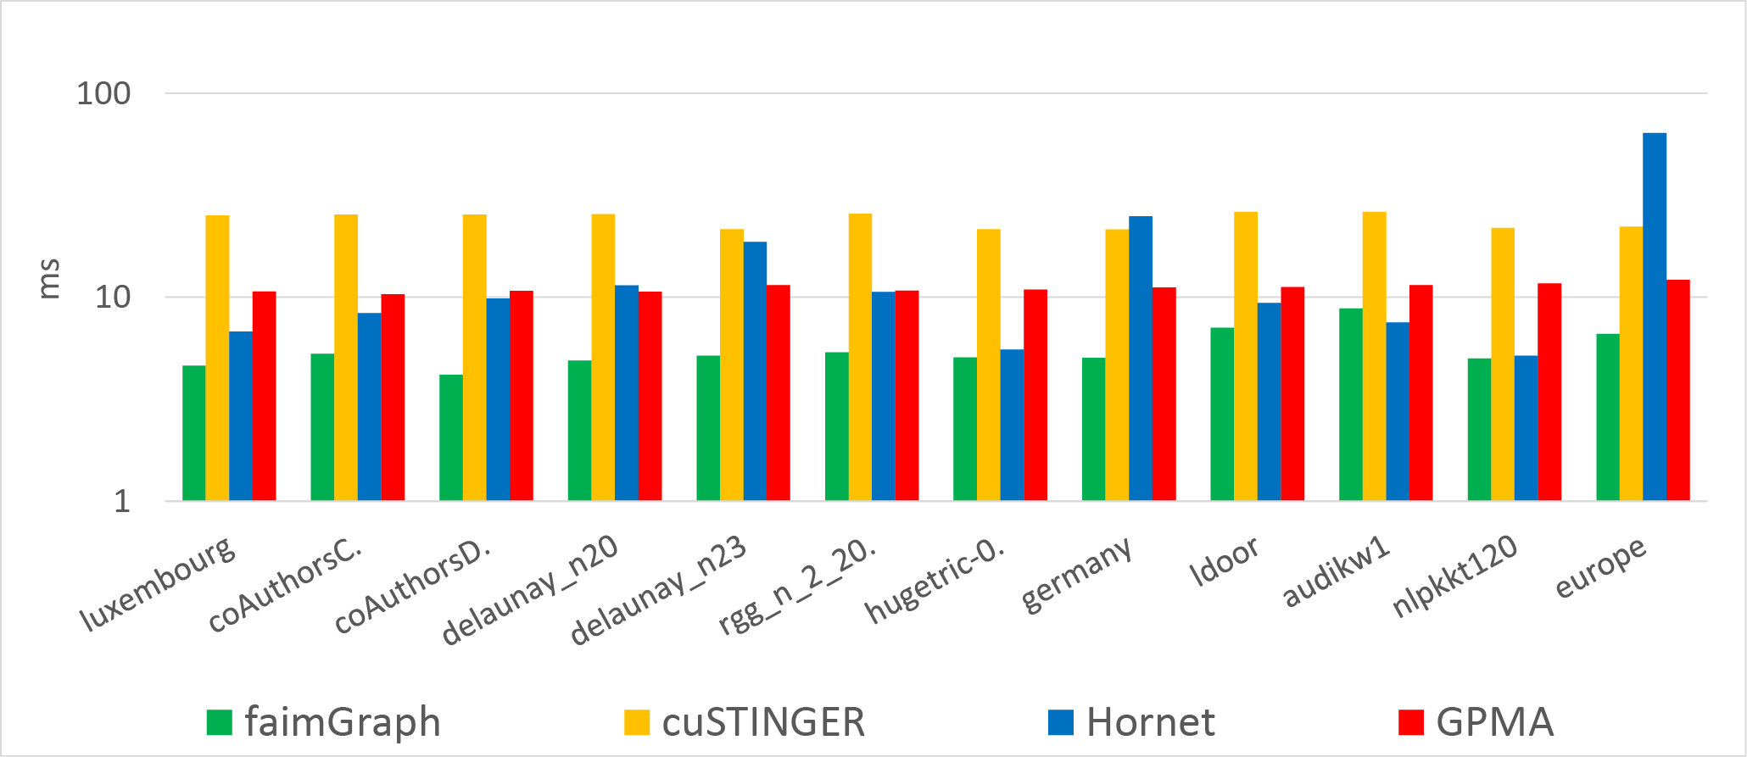
Performance | Edge Deletion | Pressure

Slide 25
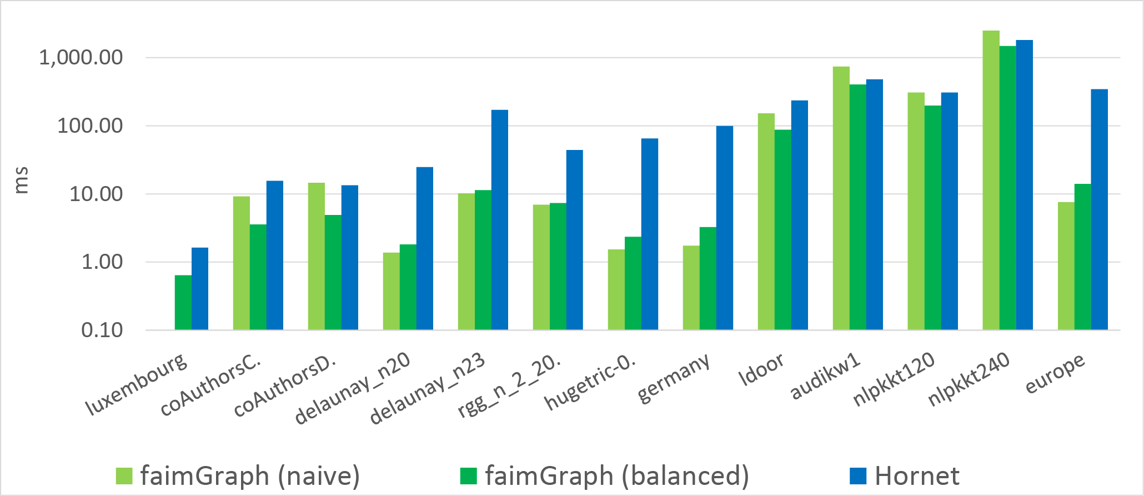
Performance | STC

Slide 26
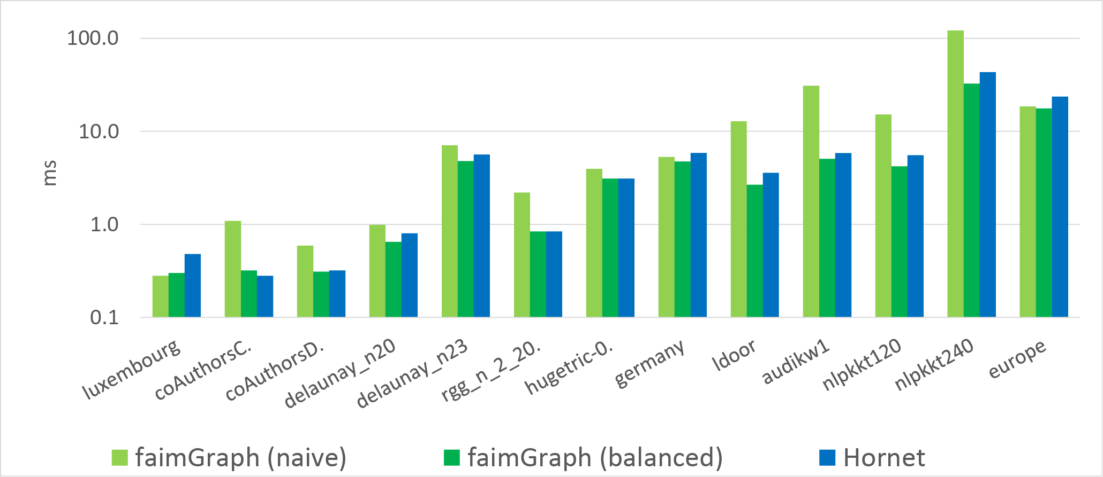
Performance | Pagerank

Slide 27
Conclusion & Future Work
Offers a dynamic graph framework with
  Low memory footprint & flexible memory layout
  Efficient memory management using queuing
  Fully dynamic (Edge & Vertex updates)
  PageRank & STC implementations
Ongoing research
  Multi-GPU approach
  Out-of-Core Graphs
  Task scheduling
    MegaKernel / Dynamic Parallelism

Slide 28
Thank you for your attention!
Questions?
[1] O. Green and D. Bader. „cuSTINGER: Supporting dynamic graph algorithms for GPUs“. In: Conference Paper, HPEC‘16, Georgia Institute of Technology, 2016
[2] D. Bader et. al. „STINGER: Spatio-Temporal Interaction Networks and Graphs (STING) Extensible Representation“. In: Technical Report, Georgia Institute of Technology, 2009
[3] F. Busato et. al. „Hornet: An Efficient Data Structure for Dynamic Sparse Graphs and Matrices on GPUs“. In: Conference Paper, HPEC‘18, Georgia Institute of Technology, 2018
[4] M. Sha et. al. „Accelerating dynamic graph analytics on GPUs“. In: Proceedings of the VLDB Endowment 2018, National University of Singapore, 2018

