Slide 1

SP-Cache: Load-balanced, Redundancy-free cluster caching with Selective Partition
Yinghao Yu, Renfei Huang, Wei Wang, Jun Zhang, Khaled Ben Letaief
HKUST

Slide 2









The rise of cluster caches
PUT
GET
Caching layer
Big data apps
Spark
TensorFlow
Hadoop
Cluster storage
HDFS, Azure Storage, S3
10-100x faster than on-disk solutions

Slide 3
However, load imbalances are prevalent in cluster caches
Cold
Hot

Slide 4
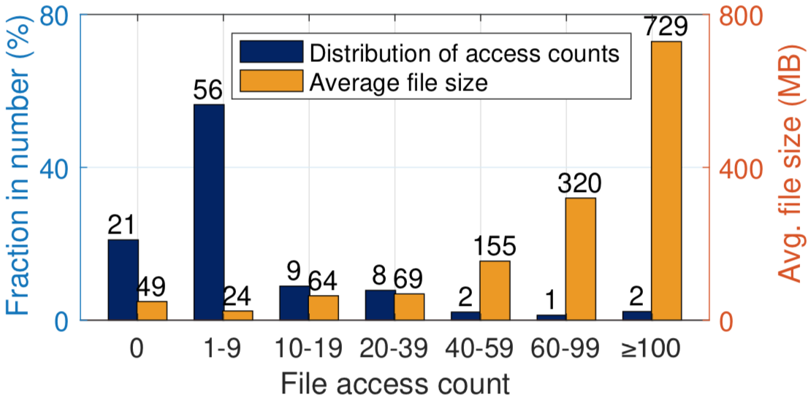
Skew in data popularity
Trace study in a Yahoo! cluster
A small number of files highly popular (Zipf-like distribution)
Hot files much larger than cold ones

Slide 5
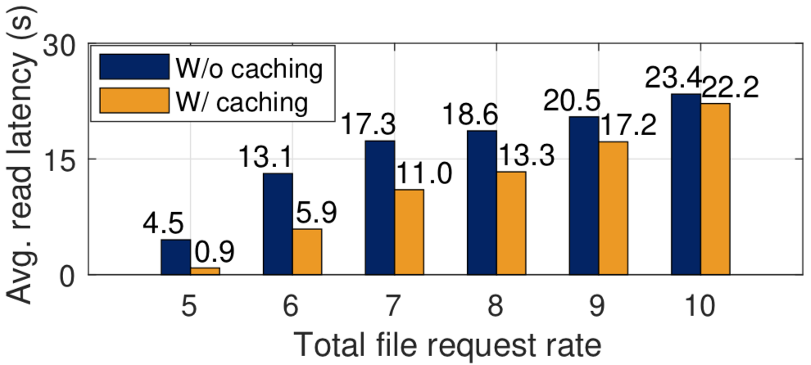
Load imbalance harms
Stress test in a 30-node Alluxio cluster in Amazon EC2
File popularity follows Zipfian distribution (highly skewed)
Benefits of caching diminishes!

Slide 6
How do we load-balance caching servers?

Slide 7
Outline of this talk
Prior arts
SP-Cache
Performance evaluation
Summary

Slide 8
Selective replication
Scarlett [Eurosys’11]
[Hong et al. SoCC’13]
State-of-the-art
Erasure coding
EC-Cache [OSDI’16]

Slide 9
Selective replication
Cache replicas of files based on their popularity
  more replicas for more popular files
GET A
GET B
2x
1x
A
B

Slide 10
Selective replication
Cache replicas of files based on their popularity
  more replicas for more popular files
GET A
GET B
GET A
1x
1x
1x
A
B
A

Slide 11
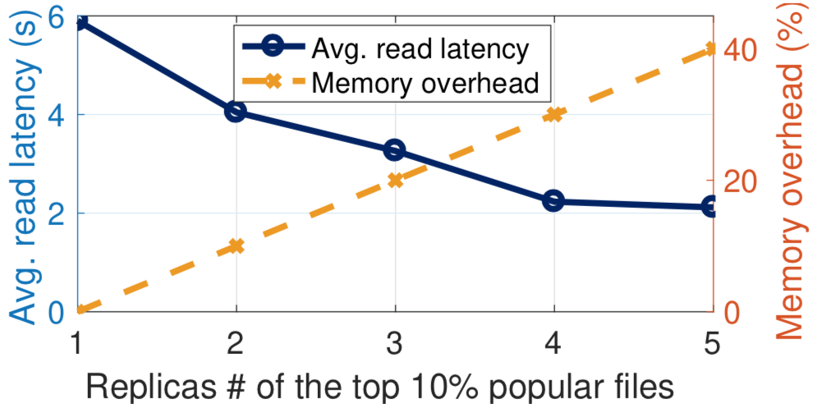
Drawback of selective replication
Replication is too costly in memory
  1x memory overhead per replica
  hot files large in size

Slide 12

Read performance
& load balance
Selective replication
Single copy
in memory
Memory overhead

Slide 13
Erasure coding
(k, n) code: split a file into k chunks and compute n-k parity chunks
Any k of the n chunks are able to decode the original file
  less memory overhead: (n-k)/k
State-of-the-art goes to EC-Cache [Rashmi et al. OSDI’16]

Slide 14
(4, 6) code
Data chunk
Split/Encode
Parity chunk
d1
d2
d3
d4
p1
p2

Slide 15
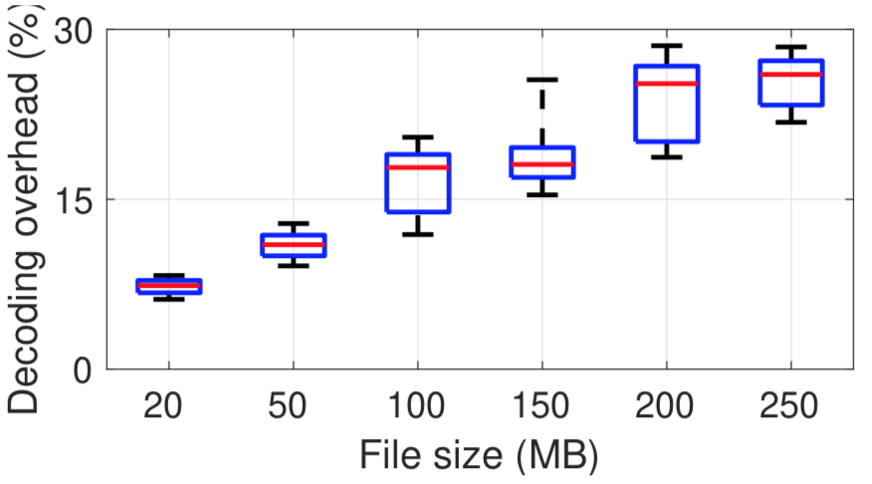
Problem of EC-Cache
High computational overhead due to encoding/decoding
  May delay read requests by up to 30%

Slide 16


Read performance
& load balance
no memory redundancy or encoding/decoding overhead?
Erasure coding
Selective replication
Single copy
in memory
Memory overhead

Slide 17
Outline of this talk
Prior arts
SP-Cache
Performance evaluation
Summary

Slide 18
Mitigating hot spot w/ partition
Split files into multiple partitions, cached by servers uniformly at random
400 Mbps
50 Mbps
A
B
Split A into 4 partitions

Slide 19
Mitigating hot spot w/ partition
Split files into multiple partitions, cached by servers uniformly at random
100 Mbps
100+50
100
100
1/4
1/4
B
1/4
1/4
Split A into 4 partitions

Slide 20
Potential benefits of partition
Spread the load of hot files to multiple servers
No encoding/decoding overhead
No redundancy w/ highest memory efficiency
Increased read parallelism speeds up I/O

Slide 21
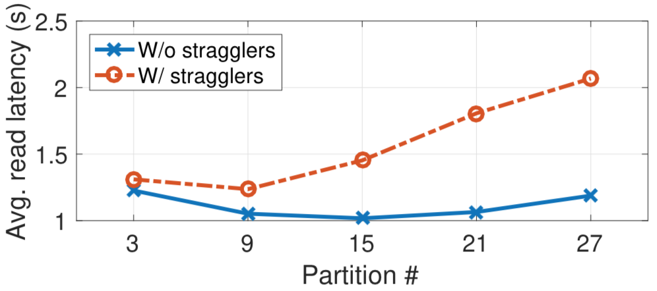
However, reading partitions from multiple servers is susceptible to stragglers
30-node Alluxio cluster, w/ and w/o stragglers

Slide 22
How many partitions should a file be split into?
  Too few are unable to mitigate the load of hot spots
  Too many are susceptible to stragglers
Intuition: selectively split hot files

Slide 23


Selective partition
Split files into partitions based on their (expected) loads
popularity
# partitions
size
scale factor
load
Equalized per-partition load:

Slide 24
Selective partition
Split files into partitions based on their (expected) loads
Uniformly distribute partitions to cache servers at random
  placements of partitions irrelevant given equalized loads

Slide 25
400 Mbps
200 Mbps
100 Mbps
Selective partition
d1
d2
d3
d4
d1
d2

Slide 26
Scale factor controls # of partitions
popularity
# partitions
size
scale factor
load
How to judiciously determine scale factor?

Slide 27

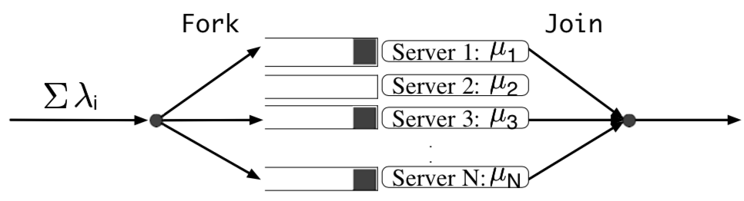
Determining scale factor
Model selective partition as a fork-join queue
Upper-bound analysis for the mean read latency

Slide 28
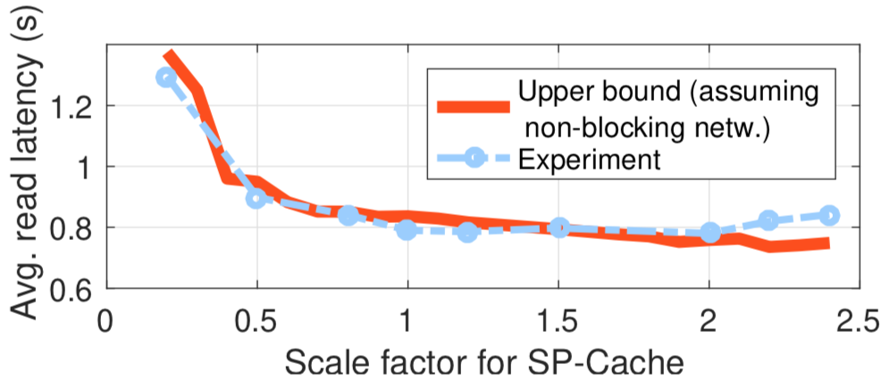
Determining scale factor
Model selective partition as a fork-join queue
Upper-bound analysis for the mean read latency
Sweet spot
(knee)
Just-enough # of partitions to achieve load balancing

Slide 29
Outline of this talk
Prior arts
SP-Cache
Performance evaluation
Summary

Slide 30
EC2 deployment
51 r3.2xlarge instances: 1 master, 30 servers, and 20 clients
File popularity follows Zipf distribution w/ exponent parameter 1.05 (high skewness)
Two baselines w/ the same memory overhead
  EC-Cache: (10, 14) coding scheme [Rashmi et al. OSDI’16]
  Selective replication: copy top 10% popular files to 4 replicas

Slide 31
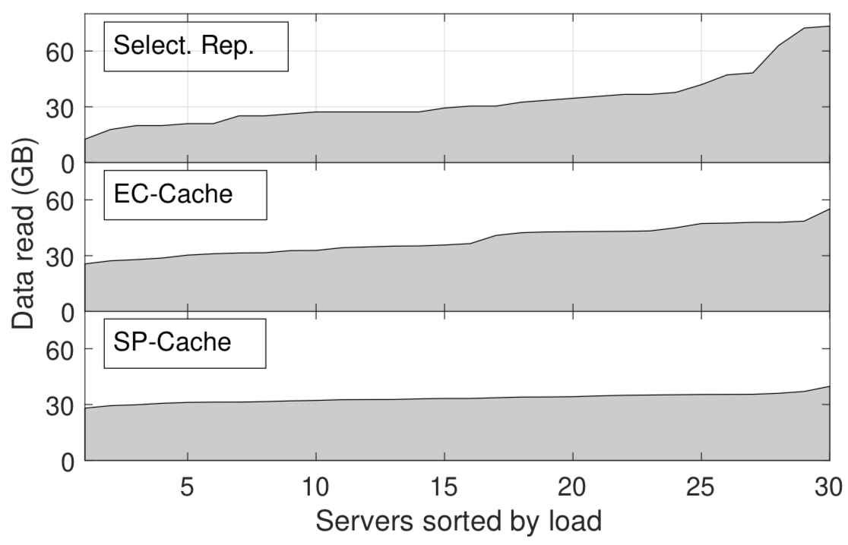
Load balancing

Slide 32
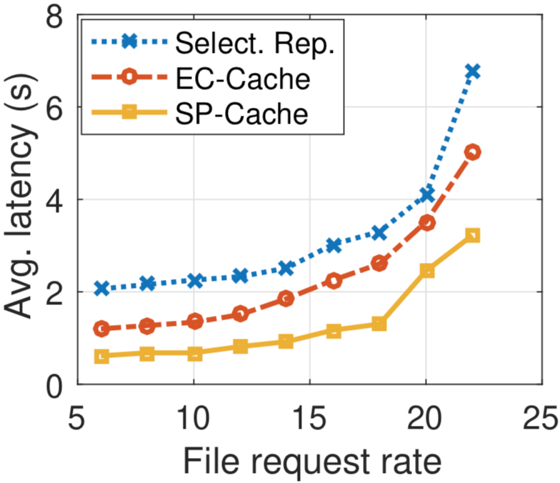
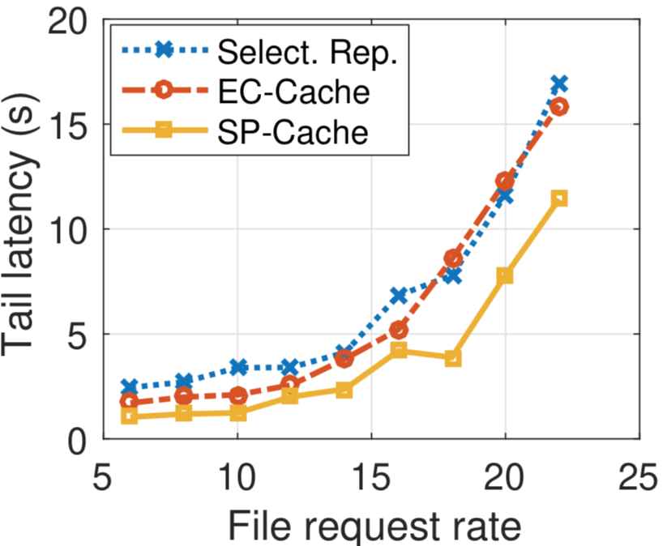
Read latency
29-50% improvement over EC-Cache
22-55% improvement over EC-Cache

Slide 33
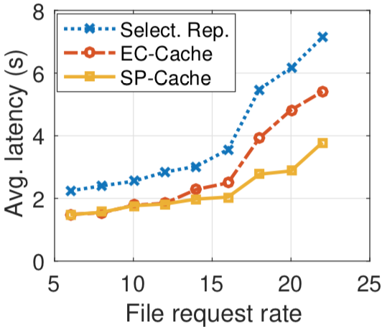
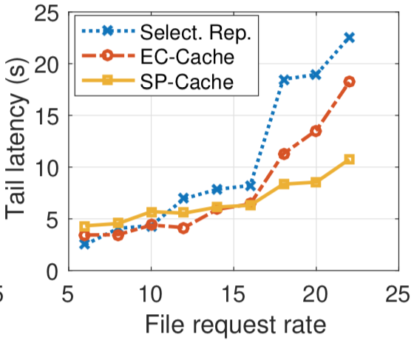
Read latency w/ straggler
Manually inject stragglers
  Bing cluster trace
Resilient to stragglers
  up to 40% improvement in latency

Slide 34
Outline of this talk
Prior arts
SP-Cache
Performance evaluation
Summary

Slide 35
Summary
Load-balancing cluster caches with selective partition
  split files into partitions based on their popularity
  redundancy-free
  no encoding/decoding overhead
Split files into just enough # of partitions for load balancing

Slide 36
Read performance
& load balance
Selective partition
Erasure coding
Selective replication
Single copy
in memory
Memory overhead

Slide 37
Questions?

