Slide 1
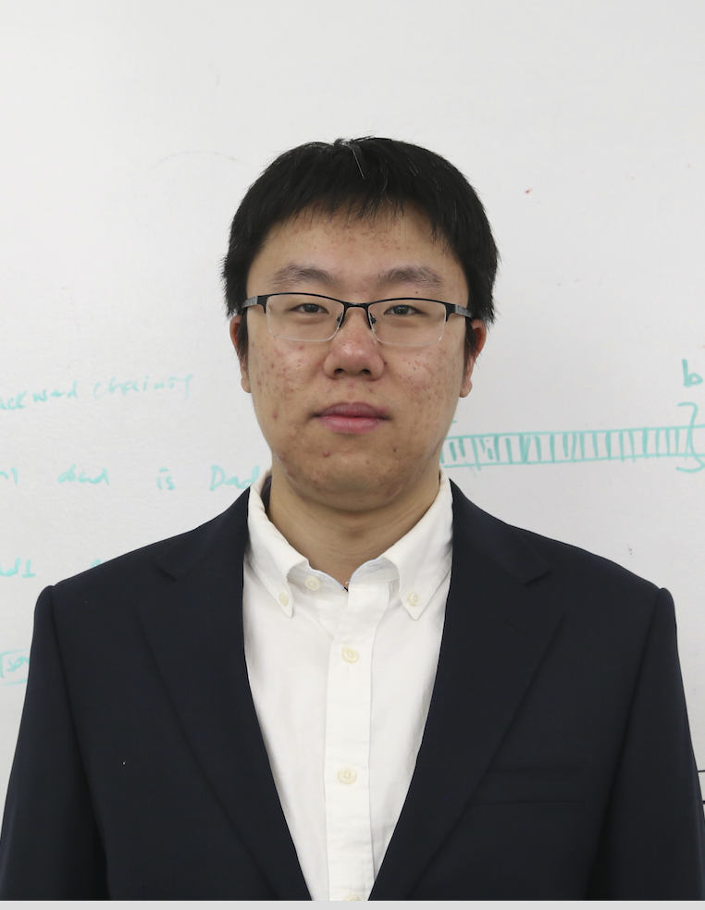



iSpan: Parallel Identification of Strongly Connected Components with Spanning Trees
Yuede Ji Hang Liu H. Howie Huang
The George Washington University
University of Massachusetts Lowell
Notes:
Thank you for the introduction. Good morning, everyone! Today I'm going to talk about our work “iSpan: parallel identification of strongly connected components with spanning trees”. This is a joint work with my former lab mate and now Professor Hang Liu from University of Massachusetts Lowell, and my advisor Professor Howie Huang.

Slide 2

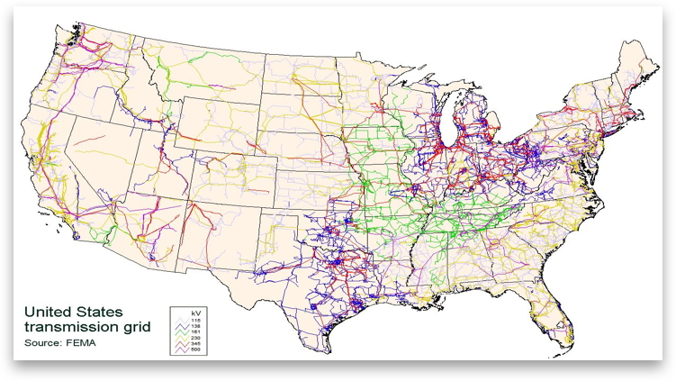
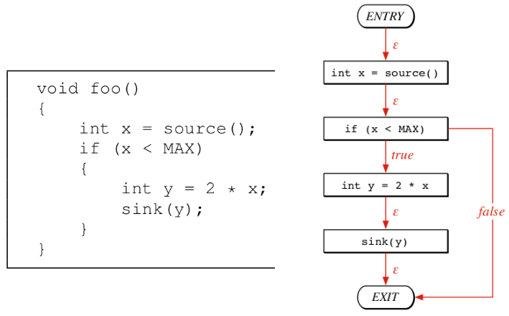
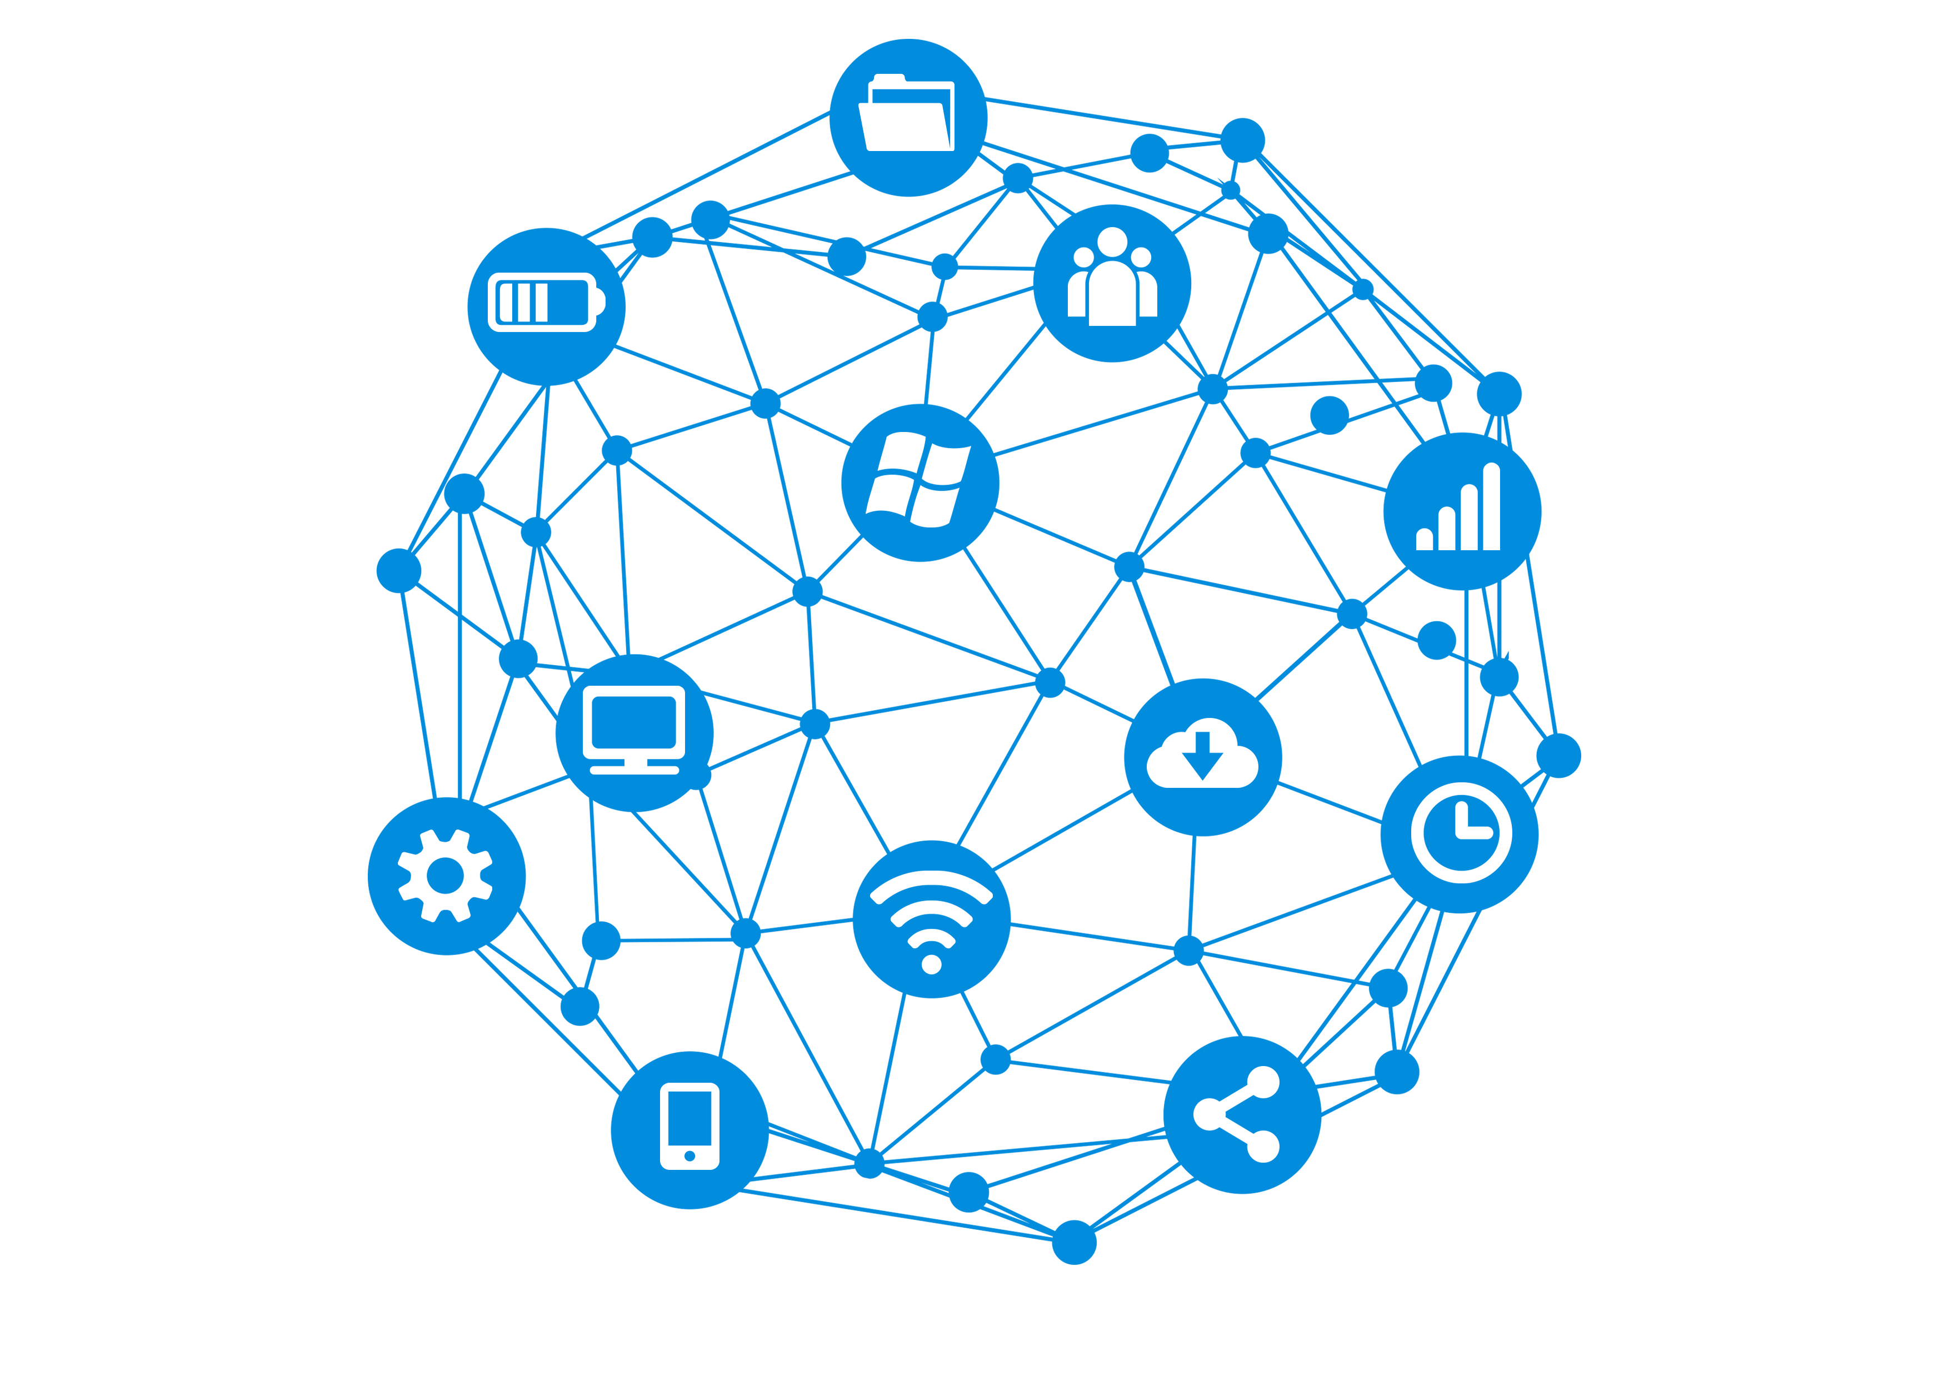
Graph is Everywhere
2
Notes:
Graph is made up of vertex and edge. It is a natural representation for many real world applications.
For example, in the social network, every person is a vertex, the connection between two persons is an edge. Together, they form a social network graph. In code analysis, taking every statement as a vertex, the control flows between them as an edge, you can get a control flow graph.
Graphs can also be found in many other applications, such as map and internet communication networks.
Another example is the Internet communication network, every IP address is a vertex, the network connection between two IP addresses is an edge. Together, they form the network communication graph.

Slide 3
Strongly Connected Component (SCC)
In a directed graph, an SCC is a maximal subset of the vertices that every vertex has a directed path to all the others
SCC detection will find all the SCCs in the directed graph
23
10
14
9
0
7
22
17
11
8
1
2
19
16
15
6
4
5
20
21
18
13
12
3
3
Notes:
Strongly connected component or SCC is an important graph algorithm. In a directed graph, a SCC is a maximal subset of the vertices that every vertex has at least one directed path to all the other vertices. In the right graph, each shaded area is an SCC. Vertex 23 itself is an SCC because it cannot reach any other vertices. Vertex 22 is also an SCC because it cannot reach and be reached by the same vertex. These two are size-2 SCCs. Vertex 19 and 20 is an SCC because they can reach each.
SCC detection will find all the SCCs in a directed graph. It serves as a fundamental algorithm for many applications. For example, in topological sort, the vertices are ranked in a partial order decided by the edge. If there are cycles in the graph, all the vertices in that cycle are considered as equal rank. SCC is used to find all the cycles.
Reachability query is a widely used query. Basically it asks whether a vertex can reach another one through a directed path. Because all the vertices in an SCC are reachable from each other, they will first convert the general directed graph into a directed acyclic graph (DAG) by contracting an SCC into a single vertex.

Slide 4
SCC Applications
Topological sort
  Rank the vertices in a partial order
  Vertices in one cycle are ranked equally
  SCC is used to find all the cycles
Reachability query
  Whether a vertex can reach another one through a directed path
  Convert a general directed graph into a directed acyclic graph (DAG) by contracting an SCC as a vertex
4
Notes:
SCC detection serves as a fundamental algorithm for many applications. For example, in topological sort, the vertices are ranked in a partial order decided by the edge. If there are cycles in the graph, all the vertices in that cycle are considered as equal rank. SCC is used to find all the cycles.
Reachability query is a widely used query. Basically it asks whether a vertex can reach another one through a directed path. Because all the vertices in an SCC are reachable from each other, they will first convert the general directed graph into a directed acyclic graph (DAG) by contracting an SCC into a single vertex.

Slide 5
Outline
Background and Observations
iSpan
Experiment
Conclusion
5
Notes:
This is the outline of my following presentation.
Firstly, I will discuss the motivation.
Then, I will explain iSpan.
Later, I will present the experiment.
Finally, I will conclude this paper.
Change the form

Slide 6
Background: SCC Property
  Power-law property
    A single large SCC takes the majority of the vertices
    The rest are a large number of small SCCs, especially size-1 SCC
426,926 size-1 SCCs (88% of SCCs)
    Flickr graph,
    |V| = 2,302,926
    |SCC| = 485,572
58,635 (12%) other small SCCs,
size < 150
One large SCC, 70% vertices
6
Notes:
In the real-world graphs, the SCC follows the power-law property. That is, A single large SCC takes majority of the vertices. And the rest are a large number of small SCCs. Also, the number of size-1 SCCs takes majority of the SCCs.
Let’s take a look at an example graph flickr. It’s a social network graph. There are about 2.3million vertices and about 486 thousand SCCs in the graph. In the right figure, the x-axis shows the SCC size, which is the number of vertices, the y-axis shows the number of SCCs. Basically, you can see that the single large SCC takes about ~70% of the vertices. The number of size-1 SCCs takes about 88% of all the SCCs. And the rest are all small SCCs with size smaller than 150.

Slide 7
Prior Work
  Large SCC
    Forward-Backward (FW-BW) algorithm
  Small SCC
    Applies Trim-1/2 to quickly remove the size-1/2 SCCs
    Applies FW-BW algorithm again for the rest
BFS FW-BW [SC’13]; Multistep [IPDPS’14]
7
Notes:
Observing this, one state-of-the-art work from SC’13 applies different techniques to different SCCs.
For the large SCC, it applies the forward-backward (FW-BW) algorithm.
For the small SCCs, they uses the trim-1 and their newly designed trim-2 to quickly remove the size-1 and size-2 SCCs. For the rest small SCCs, they use forward-backward algorithm as well, but with the help of weakly connected component.

Slide 8
FW-BW Algorithm
  Forward-Backward (FW-BW) algorithm takes ~80% of total runtime
10
14
9
0
7
Forward BFS
17
11
8
1
2
10
14
9
0
7
10
14
9
0
7
16
15
6
4
5
17
11
8
1
2
17
11
8
1
2
8
21
18
13
12
3
16
15
6
4
5
16
15
6
4
5
10
14
9
0
7
21
18
13
12
3
21
18
13
12
3
Backward
BFS
17
11
8
1
2
Detected SCC
16
15
6
4
5
8
21
18
13
12
3
Notes:
In total, the forward-backward algorithm takes ~80% of the total runtime. Therefore, if we can optimize this part, the performance will be greatly improved.
Now, let’s take a look at the forward-backward algorithm with an example.
Given this example graph, the forward-backward algorithm first selects a pivot vertex, for example, 8.
Then, it runs forward breadth-first search (BFS) using the out edges and gets the forward reachable vertex set from the pivot vertex. Later, it runs the backward BFS with the in edges and gets the backward reachable vertex set that can reach the pivot vertex. Finally, the intersection of the two vertex set is the detected SCC containing the pivot vertex.

Slide 9
Observation
  The FW-BW can be done by any spanning tree construction algorithm.
    BFS produces the correct levels, which is not only unnecessary for SCC, but also requires synchronization and thus limits the performance
Forward
spanning tree
10
14
9
0
7
10
14
9
0
7
17
11
8
1
2
17
11
8
1
2
8
16
15
6
4
5
16
15
6
4
5
21
18
13
12
3
Backward
spanning tree
21
18
13
12
3
Detected SCC
9
Notes:
Our motivation is mainly gained from the following two observations.
First, the reachable vertex set can be obtained by any spanning tree construction algorithm, not necessarily the breadth-first search (BFS).
The second observation is BFS gets the correct levels which is not necessary for the reachable vertex set. To get the correct levels, BFS has to synchronize during traversal which limits the performance.

Slide 10
iSpan Techniques
    Relaxed synchronization (Rsync)
    Fast spanning tree construction method
    Scale to multiple machines
10
Notes:
In iSpan, we design a new synchronization strategy, relaxed synchronization (Rsync). Later, we introduce a fast spanning tree construction method.
Further, we scale iSpan to multiple machines.

Slide 11
Relaxed Synchronization (Rsync)
Current Sync BFS (bottom-up)
1 foreach unvisited vertex v in parallel do
2 foreach vertex w in InNeighbor(v) do
3 if visit[w] == level then
4 visit[v] = level + 1;
5 break;
6 barrier();
…
Rsync
1 foreach unvisited vertex v in parallel do
2 foreach vertex w in InNeighbor(v) do
3 if visit[w] is visited then
4 visit[v] = visited;
5 break;
6 barrier();
…
8
8
10
14
9
0
7
1
4
1
2
4
17
11
8
1
2
synchronization
7
5
6
16
15
6
4
5
0
2
5
6
0
3
12
13
9
19
18
13
12
3
9
7
3
12
13
11
Sync BFS Tree
Rsync Spanning Tree
Notes:
Before we talk about our relaxed synchronization, let me first explain what is the current synchronization for BFS. This is the typical pseudo code of the synchronous (Sync) BFS. Basically, for an unvisited vertex v, one thread will check its neighbors, if one of them has been visited in the previous level, the current vertex will be changed to be visited. Given this example graph, starting from vertex 8, you will get a BFS Tree like this. There are 4 synchronizations in total.
And this is the pseudo code of Rsync. The difference lies in line 3 and 4. When a thread checks whether the current vertex should be visited, it will not only use the visited vertices in the previous level, but also the vertices visited in any other level. Rsync will get a spanning tree like this. There are 3 synchronizations in total.
Case #1: A vertex can be early terminated by newly visited vertices.
Case #2: The vertex that should be visited at later level can be visited earlier.

Slide 12
Rsync Benefits
The vertex that should be visited at later level can be visited earlier
Benefit #1: Reduce the number of synchronizations required
  18% for forward traversal
  25% for backward traversal
12
Notes:
In total, Rsync brings two benefits,
First, it reduces the number of synchronizations. The following figure shows the number of synchonizations of Sync over Rsync. On average of 14 tested graphs, for forward traversal, Rsync is able to reduce 18%.
For backward traversal, Rsync is able to reduce 25%.

Slide 13
Rsync Benefits
A vertex can be early terminated by newly visited vertices
Benefit #2: Reduce the number of traversed edges
  2.7x for forward traversal
  3.3x for backward traversal
13
Notes:
The second benefit is that Rsync reduces the traversed edge number. The following figure shows the traversed edge number of Sync over Rsync. On average of 14 tested graphs, for forward traversal, Sync traverses 2.7 times more edges than Rsync. For backward traversal, Sync traverses 3.3 times more edges than Rsync.

Slide 14
Fast Spanning Tree Construction
Direction-optimizing BFS [SC’12]
  Top-down - visited vertex find unvisited
  Bottom-up - unvisited vertex find visited
Switch based on the workload
  Starts from top-down
  Switches to bottom-up in the middle (majority of the time)
  Switches back to top-down
0
8
8
8
1
2
1
4
1
4
6
4
Top-down
Bottom-up
Sync Top-down
Sync Top-down
Sync Bottom-up
Rsync Bottom-up
Sync Top-down
Async Top-down
(a) Direction-optimizing BFS
(b) iSpan spanning tree construction
14
Notes:
Next, I will present our fast spanning tree construction method.
Direction-optimizing BFS is used by the state-of-the-art SCC works. Basically, the top-down way is the traditional way. Starting from the visited vertex, a thread will mark its neighbors as visited. For this toy graph, a thread works on vertex 8, and marks its neighbors 1 and 4 as visited.
Reversely, bottom-up starts from the unvisited vertex, a thread will check its neighbors to see if one of them has been visited before. Note that, top-down and bottom-up will generate the same BFS tree, but their workload is different.
Direction-optimizing BFS follows the right workflow. Basically, it starts from the Top-down BFS, switches to Bottom-up BFS in the middle, and switches back to the top-down BFS in the end. The switching is decided by the workload. When the workload of the other one becomes less the current one, it will switch. Often times, bottom-up takes majority of the time.
While, iSpan follows this workflow, starting form the sync top-down, switches to our new Rsync bottom-up, and finishes with the Async top-down.
We start from the same sync top-down because the workload of top-down is much smaller than bottom-up. Sync top-down provides the best performance in the beginning. And we have showed Rsync performs better than Sync for bottom-up. Now let’s look at the Async top-down.

Slide 15
Async Top-down
Asynchronous traversal (Async)
  Each thread takes equal partition at the beginning
  Each thread works on its own partition till the end
    does not incur any synchronization
Long tail frontier distribution
  Frontier is the number of visited vertices in one level
Comparison (switch at 35-th level)
  Sync top-down requires 1,326 levels (thus synchronizations) vs Async top-down 1 level
35
425
1,361
15
Notes:
We select Async in the end because some graphs have long tail frontier distribution. Frontier is the number of visited vertices in one level.
Taking this Wikipedia graph as an example. There are 1,361 levels in total. Assume we switch to the final sync top-down at the 35-th level. The sync top-down will synchronize another 1,326 levels. While, the Async top-down only needs to synchronize one 1 more level.
At 30-th level, the frontier size becomes smaller than 10, and reduces to 1 at the 425-th level till its end at 1, 361 level.
Also, for the normal graphs, the performance of Async is comparable to Sync Top-down in the end.

Slide 16
Benefits of Fast Spanning Tree Construction
Large SCC (FW-BW)
  Speedup over our optimized direction-optimizing BFS
  1.1x with Async top-down,
  1.6x with Rsync bottom-up
  1.8x with Async + Rsync
16
Notes:
So, the benefits of our fast spanning tree construction method is summarized below.
For the large SCC, Async top-down brings 1.1X, Rsync bottom-up brings 1.6X speedup.
Together, the fast spanning tree construction is able to achieve 1.8X speedup.
Questions, why?
Here, the baseline is our optimized directing-optimizing BFS, which has several small optimizations, such as better frontier queue usage, status array management, and direction switching.

Slide 17
Distribute iSpan to Multiple Machines
Challenge:
  High communication cost
Vertex-centric 1-D partition
Large SCC
  Bitwise status compression
    Visited, unvisited, newly visited
    2 bits for one status, thus |V|/8 bytes
  Frontier queue (FQ)
    Only the newly visited vertices
  Hybrid queue - min(|V|/8, |FQ|)
Small SCCs
  Compact the graph for the remaining vertices and edges
    Average 2.1% vertices and 0.5% edges left
  Replicate this graph on every machine
    No communication is required
17
Notes:
We also extend iSpan to distributed. We use the vertex-centric 1-D partition. The challenge is the high communication cost. To reduce that, for the large SCC, we devise a new bitwise status compression technique and use the hybrid with frontier queue communication method. For the small SCCs, we compact the remaining subgraph to replica in each computing node. BY doing this, the communication cost is greatly reduced.
Why contract the graph?
We observe that the remaining subgraph only contains, on average, 2.1% vertices and 0.5% edges of the original graphs for the fourteen tested graphs. The largest percentages are 11.8% and 3.2% for the vertex and edge, respectively. Such a small subgraph can be easily generated and stored across all workers. Second, we can reorder the vertices during graph compaction which can potentially bring better cache locality [4], [64], [31].

Slide 18
Outline
Background and Observations
iSpan
Experiment
Conclusion
18
Notes:
Next, I will present the experiment.

Slide 19
Experiments
Hardware
  A single server with two Intel Xeon E5-2683 (2.00 GHz) CPUs with 56 hardware threads
  32 nodes on university clusters
Software
  GCC 4.8.5
  OpenMP 3.1
  OpenMPI 1.8
Report average of 10 runs
Use the same configuration for comparison
19
Notes:
We run the experiments on a server with two Intel Xeon E5 CPUs, there are 56 hardware threads. We also use the GWU ColonialOne Cluster and The Massachusetts Green High Performance Computing Cluster (MGHPCC). We use GCC 4.8.5, OpenMP 3.1, and OpenMPI 1.8

Slide 20
Graph Benchmarks
17 graphs
  14 real-world graphs
    Konect, University of Koblenz-Landau
    SNAP, Stanford
  3 synthetic graphs
    R-MAT
    Kron
Graph (Abbr.) | |Vertex| | |Edge| | # of SCC | Large SCC Size
Baidu (BD) | 2,141,301 | 17,794,839 | 1,503,004 | 609,905
Dbpedia (DB) | 3,966,925 | 13,820,853 | 3,636,316 | 178,593
Flickr (FL) | 2,302,926 | 33,140,017 | 485,572 | 1,605,184
Hudong (HD) | 2,452,716 | 18,854,882 | 2,189,120 | 185,668
Livejournal (LJ) | 4,847,572 | 68,475,391 | 971,233 | 3,828,682
Pokec (PK) | 1,632,804 | 30,622,564 | 325,893 | 1,304,537
Wiki_comm (WC) | 2,394,386 | 5,021,410 | 2,281,880 | 111,881
Wikipedia_en (WE) | 18,268,993 | 172,183,984 | 14,459,547 | 3,796,073
Wikipedia_link (WL) | 11,196,008 | 340,309,824 | 4,266,559 | 6,916,926
Wiki_talk_en (WT) | 2,987,536 | 24,981,161 | 2,736,716 | 249,610
Twitter_www (TW) | 41,652,231 | 1,468,365,182 | 8,044,729 | 33,479,734
Facebook (FB) | 96,079,682 | 679,728,426 | 93,892,292 | 2,186,877
Twitter_mpi (TM) | 52,579,683 | 1,963,263,821 | 12,407,622 | 40,012,384
Friendster (FR) | 68,349,466 | 2,586,147,869 | 18,697,703 | 48,928,140
Random (RD) | 4,000,001 | 256,000,000 | 2 | 4,000,000
R-MAT (RM) | 3,999,984 | 256,000,000 | 2,105,950 | 1,894,035
Kron_30 (KR) | 1,073,741,824 | 17,179,869,184 | 708,654,254 | 364,818,982
20
Notes:
We tested 14 graph benchmarks.
There are 12 real-world graphs and 2 synthetic graphs. The details of the graphs are shown in the Table.
The real-world graphs are collected from the Konect project and SNAP project. The synthetic graphs are generated from R-MAT and Kron generators.

Slide 21
Speedup of iSpan over Related Work
Higher is better
DFS style work: 67x over Tarjan [SICOMP’72]; 21x over UFSCC [PPoPP’16];
BFS style work: 4.1x over BFS FW-BW [SC’13]; 3.6x over Multistep [IPDPS’14]
21
Notes:
We compare the performance of ISPAN with related works. We compared with four related works. Specifically, Tarjan stands for the classical serial Tarjan’s algorithm. UFSCC is a DFS-based on-the-fly parallel SCC detection method. BFS FW-BW stands for a FW-BW SCC detection method [29], and Multistep [57] is another FW-BW based solution. We run their source codes on our server with the same configurations. We run them with 56 threads and report the number as the average of 10 runs. For some of the graphs, like DB, HD, Multistep fails to run due to segmentation fault.
The speedup is calculated by the run time of others over the time of ours. In the right figure, the y-axis shows the speedup, which is the higher the better.
On the average, iSpan achieves 67X speedup over Tarjan,

Slide 22
Scale to Multiple Threads
iSpan achieves average 11x speedup over baseline, Multistep 9.6x, BFS FW-BW 5.5x
For billion vertex graph, iSpan gets 19x, Multistep 10x
22
Notes:
Now, we show the scalability of iSpan. iSpan is able to scale
Time unit (second)

Slide 23
Scale to Multiple Machines
  Use four representative graphs, LJ, FL (social graph), WE (web graph), RD (synthetic graph)
Compare with HPCGraph [IPDPS’16]
  Better scalability for WE, FL, and RD
  Worse scalability for LJ - faster single node runtime, 8x
23
Notes:
Why these four graphs.
Add average in the end.

Slide 24
Conclusion
  New insight: spanning tree is sufficient for SCC
  New relaxed synchronization approach
  New spanning tree construction method
  Results:
    Outperform current state-of-the-art DFS and BFS- based methods by average 18x and 4x
    Scale to billion vertex graph on tens of machines
24
Notes:
Finally, I will conclude this paper and summarize our future works.
In conclusion, we design Rsync, a relaxed synchronization strategy.
We design a Fast spanning tree construction.
Combining them together, iSpan is able to achieve 4X speedup over the state-of-the-art on the average of 14 graphs.
Further, iSpan is able to scale to billion vertex graph and achieve 1.3X speedup over the state-of-the-art.

Slide 25

Thank You
Check out our graph code repository at github.com/iHeartGraph/
25
Notes:
Thank you. Thanks NSF for supporting our research.
You an find me through this email. iSpan is open source on github.

