Slide 1




FlipTracker: Understanding Natural
Error Resilience in HPC Applications
Luanzheng Guo, Dong Li
University of California Merced
Ignacio Laguna
LLNL
Martin Schulz
TUM
SC’18, November 13, Dallas, TX
Notes:
In collaboration with UCM, LLNL, and TUM.

Slide 2
Soft errors
The danger of soft errors grows dramatically as HPC systems scale
Soft errors are transient and difficult to handle
We cannot tell when and where the next soft error will occur
Application natural resilience can tolerate soft errors
Electrical noise or external high-energy
particle strikes
Bitflip: from 0 to 1
or from 1 to 0.
Storage cells
A soft error
Notes:
Soft errors are caused by …, which lead to bitflips in storage cells.
The error can bypass the hardware detection mechanism and affect the application state.
(no we think) Application natural resilience can help handle soft errors

Slide 3
What’s application natural resilience?
Capability of the application to tolerate soft errors
This capability is natural or inherent
No modifications are required to the code
Notes:
Which means that the application handle soft errors all by the application itself without add-on mechanisms such as ABFT or checkpoint-restart or redundancy.

Slide 4
Motivation of our work
Previous studies have shown many applications that have natural resilience
Why does the application have natural resilience?
We don’t have a framework to identify the reason.
Examples of such applications are algebraic multi-grid solvers (AMG), Conjugate Gradient (CG) solvers, Monte Carlo simulations, and machine learning algorithms, such as clustering and deep-learning neural networks
Notes:
People have show that a few applications have natural error resilience that can help tolerate soft errors.
* Previous work attribute the natural resilience to statistical and iterative structures of applications,
We don’t have a framework to figure the reason out!

Slide 5
The goal of FlipTracker
To design a code structure model that enables to separate an application into code regions
To have a framework that allows us to do fine-grained analysis of error propagation and resilience properties
To propose a methodology that helps reason the natural resilience of code segments
Notes:
Remember this!

Slide 6
Fault model
We use random fault injection to mimic the effect of real soft errors in the application
When an error is injected, we define three possible error manifestations
Success
SDC (Silent Data Corruption)
Interruption
Notes:
Success means that the execution output passed the verification of the application
SDC means that the execution terminates but the execution output didn’t pass the verification of the application
Interruption means that the execution breaks out in the middle of the execution and crashes

Slide 7
Application Code Region Model
We characterize HPC applications as sets of iterative structures or loops where the program spends most of its time
HPC Application
Non-resilience Code Region
y = ...
for (...) {
x = y * ...
double tmp = x + ...
result = ...
}
Resilience Code Region
z = result * ...
Non-resilience Code Region
while (...) {. ...
Resilience Code Region
Notes:
Our loop-based model also enables a divide-and-conquer approach, where we can identify application subcomponents that may or may not have resilience patterns.

Slide 8
An overview of FlipTracker
Clean Dynamic Instruction Trace
Code Regions
Application
Doing Fault
Injection
Faulty Dynamic Instruction Trace
…
7

Slide 9
An overview of FlipTracker
DOWN
Dynamic
Data
Dependence
Graph
(DDDG)
If the output of the two DDDGs are the same
Alive Corrupted Locations (ACL) Table
Resilience Code Regions
TOP
Resilience Computation Patterns
7
Notes:
We will explain each phase in detail in next slides.
Output variables are those that are written in the code region and read after the code region.

Slide 10
Dynamic Data Dependence Graph
For each code region, we generate a DDDG from an instruction trace
function
operand
conj_grad p156
140731587809888
conj_grad beta
140731587809884
value
LOAD
LOAD
operation
conj_grad 2
0.328
conj_grad 3
1.261
MUL
MUL
conj_grad 4
0.413
Input variables
STORE
Internal variables
conj_grad p156
140731587809888
Output variables
Notes:
As we mentioned, we generate a DDDG for each code region. Here is what a DDDG looks like. In this example, the operand is a register.
DDDG has multi-fold usages, such as identifying inputs of the code region.

Slide 11
How to identify resilience code regions?
We find a resilience code region in the following two cases
(1)
The value of an input location is corrupted.
Code region
locations can be the memory locations or registers.
The values of all output locations are correct.
Notes:
locations can be the memory locations or registers.

Slide 12
How to identify resilience code regions?
We find a resilience code region in the following two cases
(2)
The value of an input location is corrupted.
Code region
The value of output locations is corrupted.

Slide 13
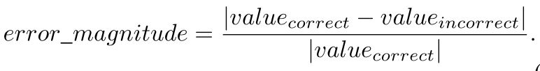
How to identify resilience code regions?
We find a resilience code region in the following two cases
(2)
However, the error magnitude in at least one corrupted location becomes smaller.
Code region

Slide 14
Alive Corrupted Locations table
For any resilience code region, we use DDDG to build a table of Alive Corrupted Locations (ACL)
The ACL table stores the number of alive, corrupted locations at each dynamic instruction
Location A:
Alive Corrupted
Location B:
Alive Corrupted
Location C:
Alive Corrupted
Location D:
Alive Corrupted
Runtime
Instr. 1
#ACLs: 0
Instr. k
#ACLs: 3
Instr. n
#ACLs: 2
Notes:
Here is the idea of the ACL table
We call a location “alive” if the value in that location will be referenced again in the remainder of the computation.
For location A, the region marked by the green window represents the time when location A is alive corrupted, before the green window,
A is clean; after the green window, A is either never used anymore or overwritten by a clean value. So the corruption at A doesn’t take effect and affect the execution anymore.
The long arrow ends with runtime is the timeline of the execution and shows the sequence of the execution. The execution starts from left to right. The first scale represents the first instruction, the second …. At instruction 1, there are 0 ACLs because there are no ACLs at the instruction 1.

Slide 15
Alive Corrupted Locations
The period of alive corrupted Location A
Location A
Instr 1
Instr 2
Instr 3
Instr k
Instr k+1
A
A
A
A
A
Clean
Alive Corrupted:
A starts being affected by errors
Alive Corrupted:
A is used in this
or later instructions
Alive Corrupted:
A is used in this
or later instruction
Clean:
A is not used
anymore. Or
A is written by
a clean value.
Notes:
We explain what does alive corrupted means in detail.
White color of A means clean; red color of A means corruption.
The corruption in Location A is alive until A is not used anymore or is written by a clean value.

Slide 16

LagrangeElements()
A real example
of the ACL table.
We map and visualize the ACL table in this figure.
It shows the number of ACL-s in LULESH after an error is injected.
Number of Alive Corrupted Location
LagrangeNodal()
Iteration
Iteration
Iteration
0
0 1.00 1.02 1.04 1.06 1.08 1.10 1.12 1.14
Dynamic Instruction number (${×10}^{7}$)
Notes:
The ACL table is mapped and visualized in the figure.
After the error is triggered, the error is tolerated in three iterations.
We want to understand the reason of the four decreases of the number of Alive corrupted locations, in which error masking happens, which can guide us to find resilience computation patterns.

Slide 17
Resilience computation pattern
  We define a resilience computation pattern as a combination of series of computations (or instructions) that contribute to error masking events
  We find six resilience computation patterns after examining the error masking events from 10 representative applications

Slide 18
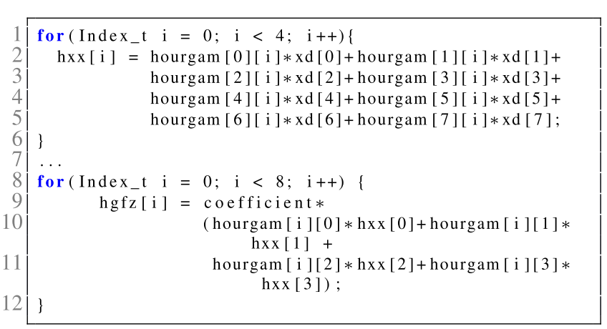
Resilience pattern---Dead Corrupted Locations
  Pattern 1: Dead Corrupted Locations (DCL)
  - In this pattern, corrupted locations are not used anymore
The array hourgram[][] is a temporal corrupted array that is dead after the current code snippet.
Example of the Dead Corrupted Locations in LULESH

Slide 19
Resilience pattern---Repeated Addition
  Pattern 2: Repeated Additions (RA)
    In this pattern, the value of a corrupted location is repeatedly added by other correct values

Slide 20
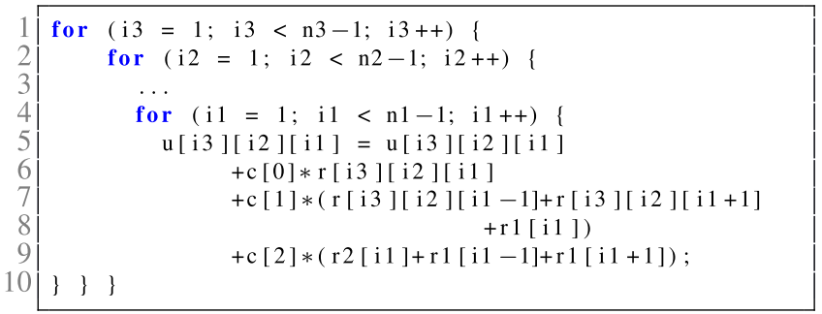
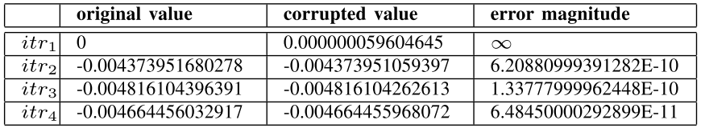
Resilience pattern---Repeated Addition
Example of the Repeated Additions pattern in MG.
We examine the value of the array element (u[10][10][10]). This code region is iteratively called four times.
Notes:
When u[] is corrupted, …

Slide 21
Resilience pattern---Conditional Statement, Shifting, Truncation, and Overwriting
Pattern 3: Conditional Statements
  A conditional statement helps tolerate errors
Pattern 4: Shifting
  Corrupted bits are lost due to shifting operations
Pattern 5: Data Truncation
  Corrupted data is truncated or not presented to users
Pattern 6: Data Overwriting
  Corrupted data is overwritten by a correct value

Slide 22
Case studies
Use case 1: Resilience-Aware Application Design
Use case 2: Predicting Application Resilience
We apply resilience patterns to the CG benchmark, aiming to improve its resilience
We build a regression model to predict the success of the error manifestation using resilience patterns
Notes:
Resilience computation patterns have many potential uses.
We give two preliminary case studies.

Slide 23
Use case 1: Resilience-Aware Application Design
The goal of this use case is to show that resilience computation patterns can guide application designs towards natural resilience
We successfully apply three patterns, dead corrupted locations (DCL), data overwriting, and truncation, to the CG benchmark
Notes:
To apply dead corrupted location and data overwriting, we replace two global arrays referenced in sprnvc() with two temporal arrays
We then copy the updated values of the temporal arrays back to the global arrays after computation
We replace 64-bit floating-point multiplications with 32-bit integer multiplications for some computations.

Slide 24
Use case 1: Applying resilience patterns to CG
Applying truncation to CG
Applying dead corrupted locations (DCL) and data overwriting to CG
static void conj_grad (int colidx[], ..., double p[], double q[])
{ ...
d = 0.0;
for (j = 0; j < lastcol - firstcol + 1; j++) {
d = d + p[j]*q[j];
}
...
} Original Code
static void conj_grad (int colidx[], ..., double p[], double q[])
{ ...
d = 0.0;
for (j = 0; j < lastcol - firstcol + 1; j++) {
if(j<=350&&j>=340){
int tmp = p[j]; // truncation
int tmp1 = q[j]; // truncation
d = d + tmp*tmp1;
}else{
d = d + p[j]*q[j];
}
}
...
} Applying truncation
void sprnvc(){
while (…){
…
v [ nzv ] = vecelt;
}
}
} Original Code
void sprnvc(){
double v_tmp [] ; // define a temp array
for (i =0; i <=NONZER; i ++){
v_tmp [ i ] = v [ i ] ; // initialization
}
while (…){
…
v_tmp [ nzv ] = vecelt; // replace v with v_tmp
}
for (i =0; i <=NONZER; i ++) {
v[ i ] = v_tmp [ i ] ; // copy back
}
} Applying DCL and overwriting
Notes:
Don’t say simply, easy and too difficult.

Slide 25
Use case 1: Results
The number of fault injections is decided by 99% confidence level and 1% margin of error
Comparison of application resilience after applying resilience patterns to CG
Resilience patterns applied | Application resilience (Success rate) | Execution time in average (s)
None | 0.590 (the baseline) | 159.010
DCL and overwriting | 0.780 | 159.167
Truncation | 0.614 | 158.835
All together | 0.782 | 158.859
32.2% improvement in application resilience with less than 0.1% performance loss
4.1% improvement in application resilience with no performance loss
32.5% improvement in application resilience with less than 0.1% performance loss
Notes:
Don’t explain why the result of all together is not the combination of the results of the first two cases? DCL and overwriting and Truncation.

Slide 26
Conclusions
We design a framework that enables fine-grained and comprehensive analysis of error propagation to capture application resilience
We give an analysis and formal definition of six resilience computation patterns that we discover in these representative programs
We think, resilience computation patterns can not only enable a deeper understanding of application resilience, but can guide future application designs towards patterns with resilience
Notes:
Remember this.

Slide 27


Slide 28
Backup slide 1
How many more patterns you didn’t find?
Using FlipTracker, we find six resilience computation patterns from 10 benchmarks. But it doesn’t mean that there are not other patterns that you can find from more applications.

Slide 29
Backup slide 2
How do you verify the resilience patterns?
We verify the effectiveness of the six resilience patterns in the two use cases. Especially in the use case 2, we count the number of resilience patterns as features to predict the success rate of new applications. We achieve a good prediction accuracy. We also do an importance study of features (resilience patterns) in the use case 2.

